Slide 1
TABE Math-E PAXEN Unit-4 Fractions Lesson 25 Fractions on a Number Line
Revised: October 16, 2023
Nolan Tomboulian
Some graphics may not have copied well during the scan process.

Slide 2
Math-E - Lesson 25 – Fractions of a Line

Slide 3
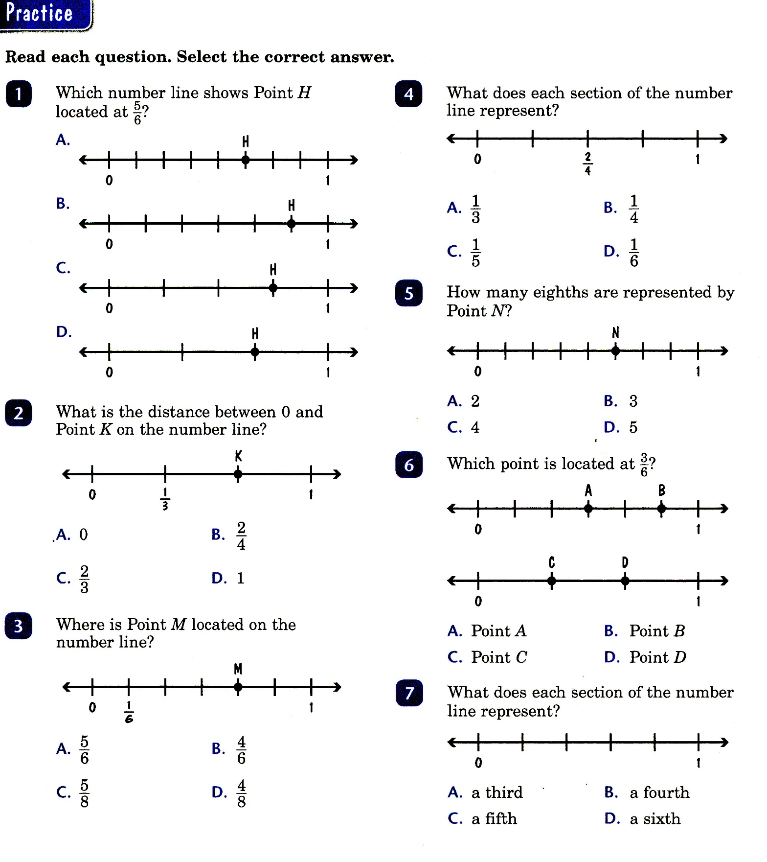
Math-E - Lesson 25 – Fractions of a Line

Slide 4
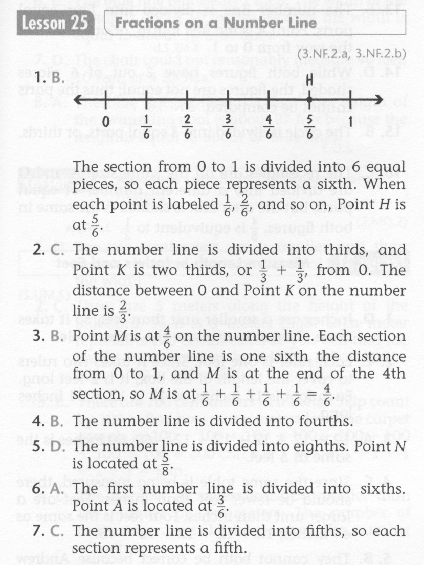
Math-E - Lesson 25 – Fractions of a Line

Slide 5
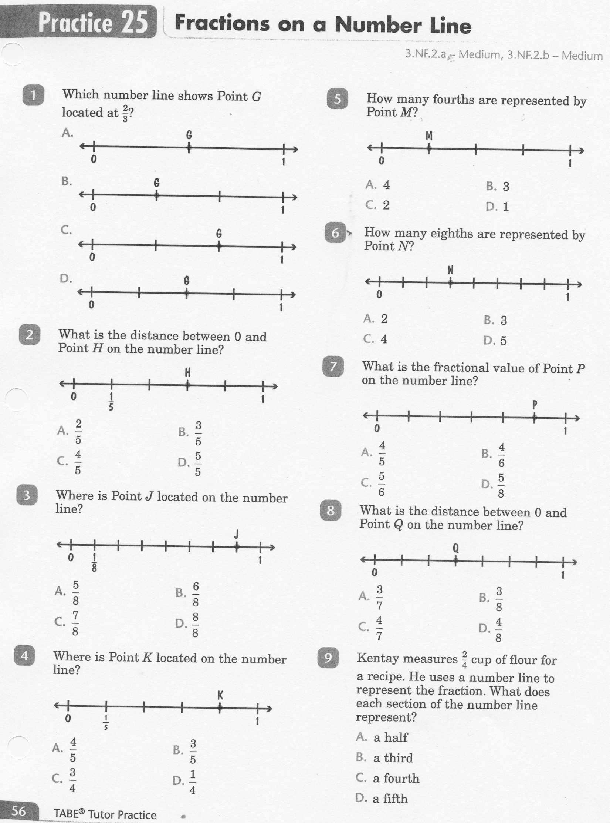
Math-E - Lesson 25 – Fractions of a Line

Slide 6
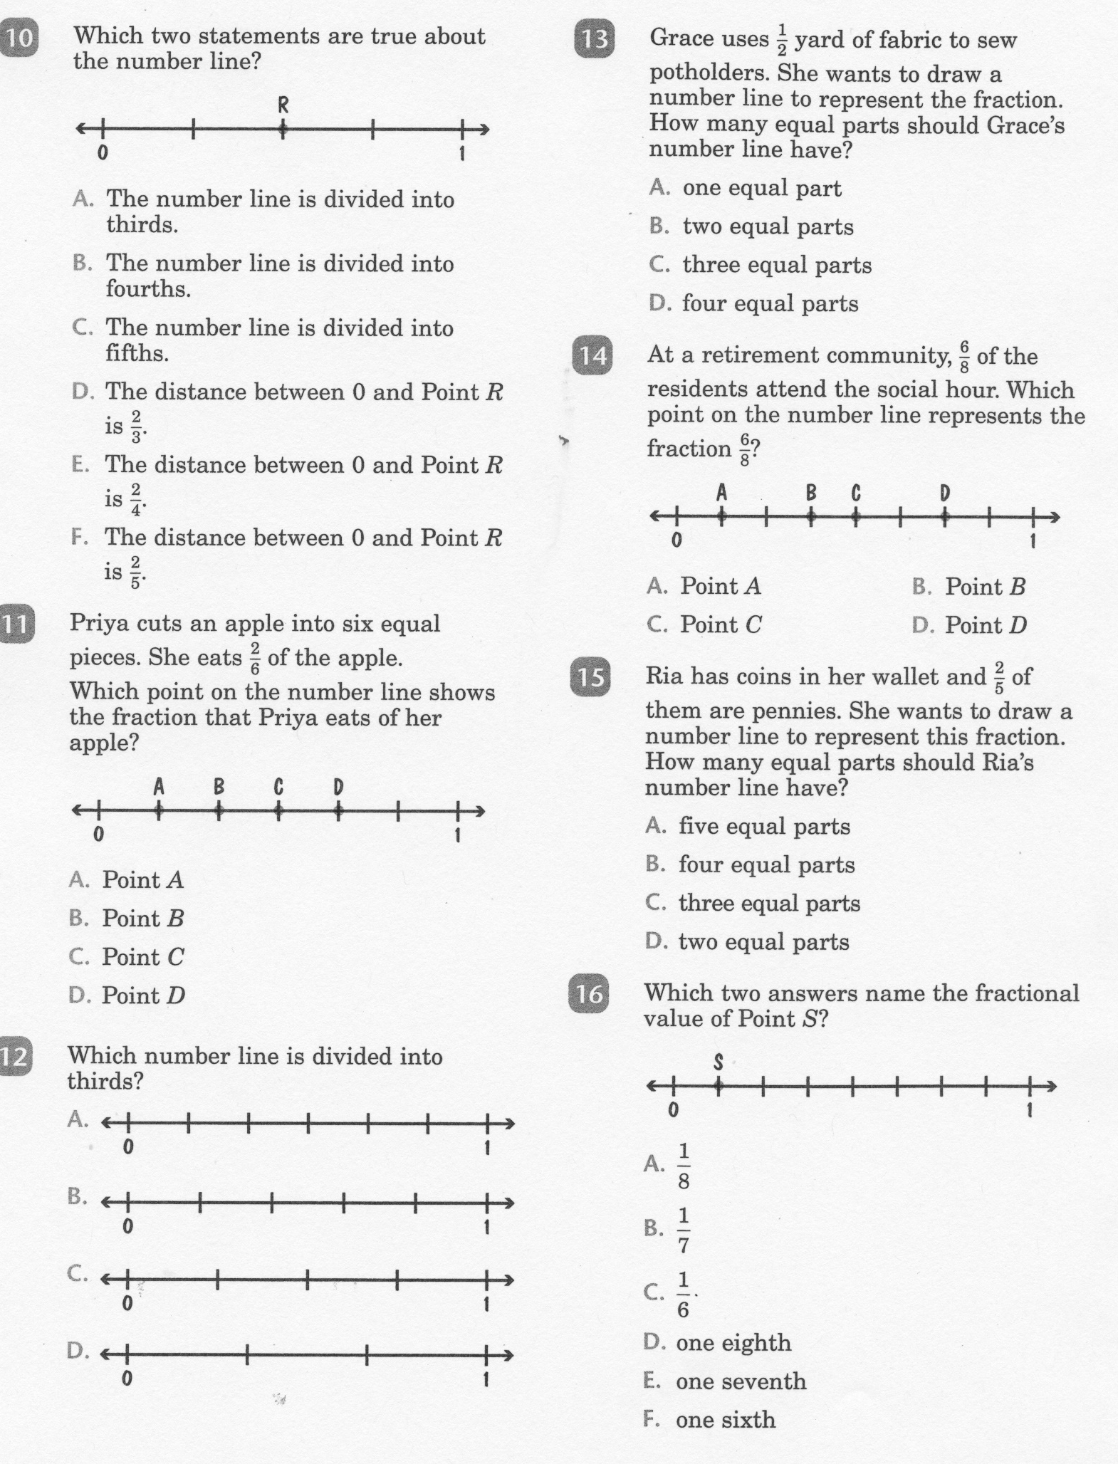
Math-E - Lesson 25 – Fractions of a Line

Slide 7
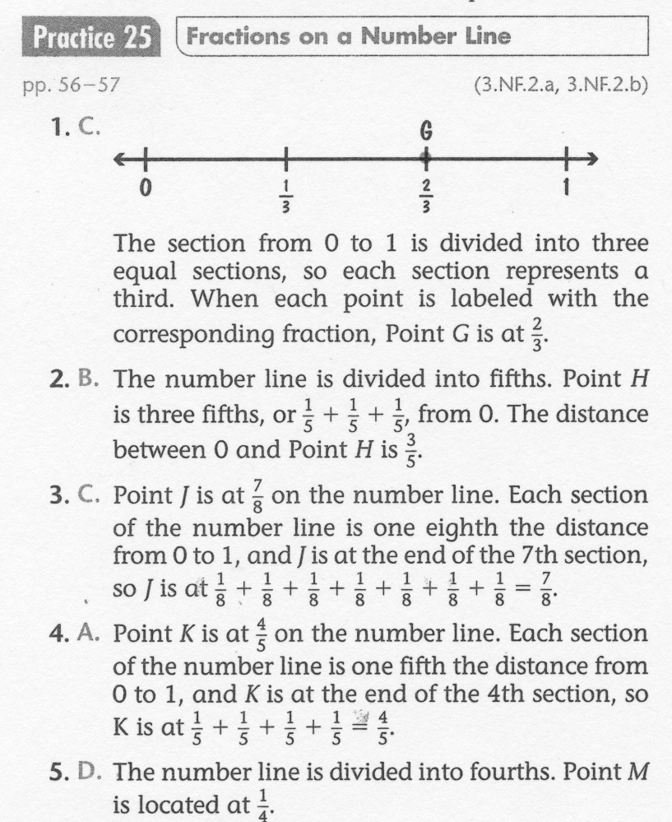
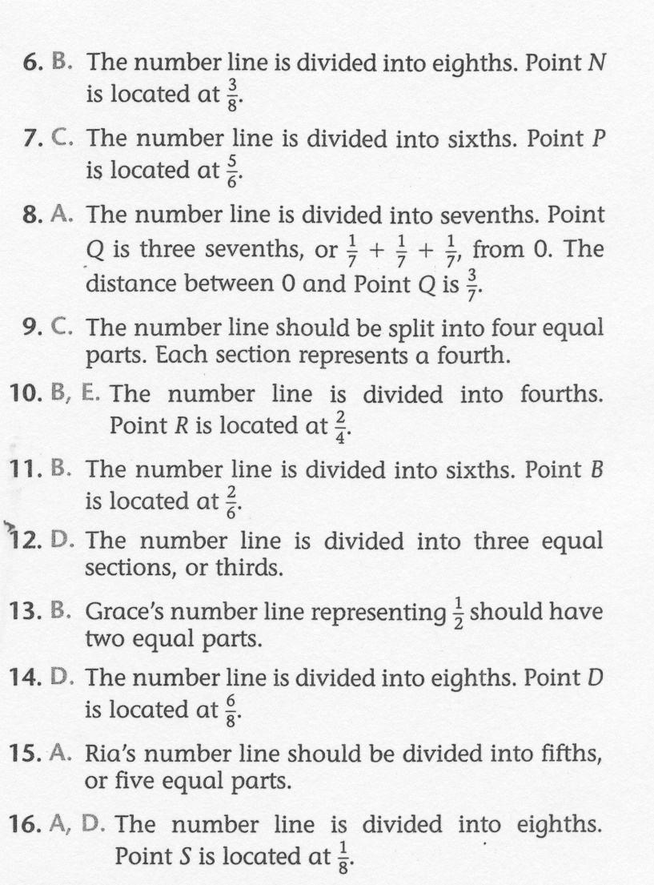
Math-E - Lesson 25 – Fractions of a Line

