Slide 1
TABE Math-E PRAXEN Unit-2 Add and Subtract Whole Numbers Lesson 12 2-Step Equations
Revised: October 16, 2023
Nolan Tomboulian
Some graphics may not have copied well during the scan process.

Slide 2
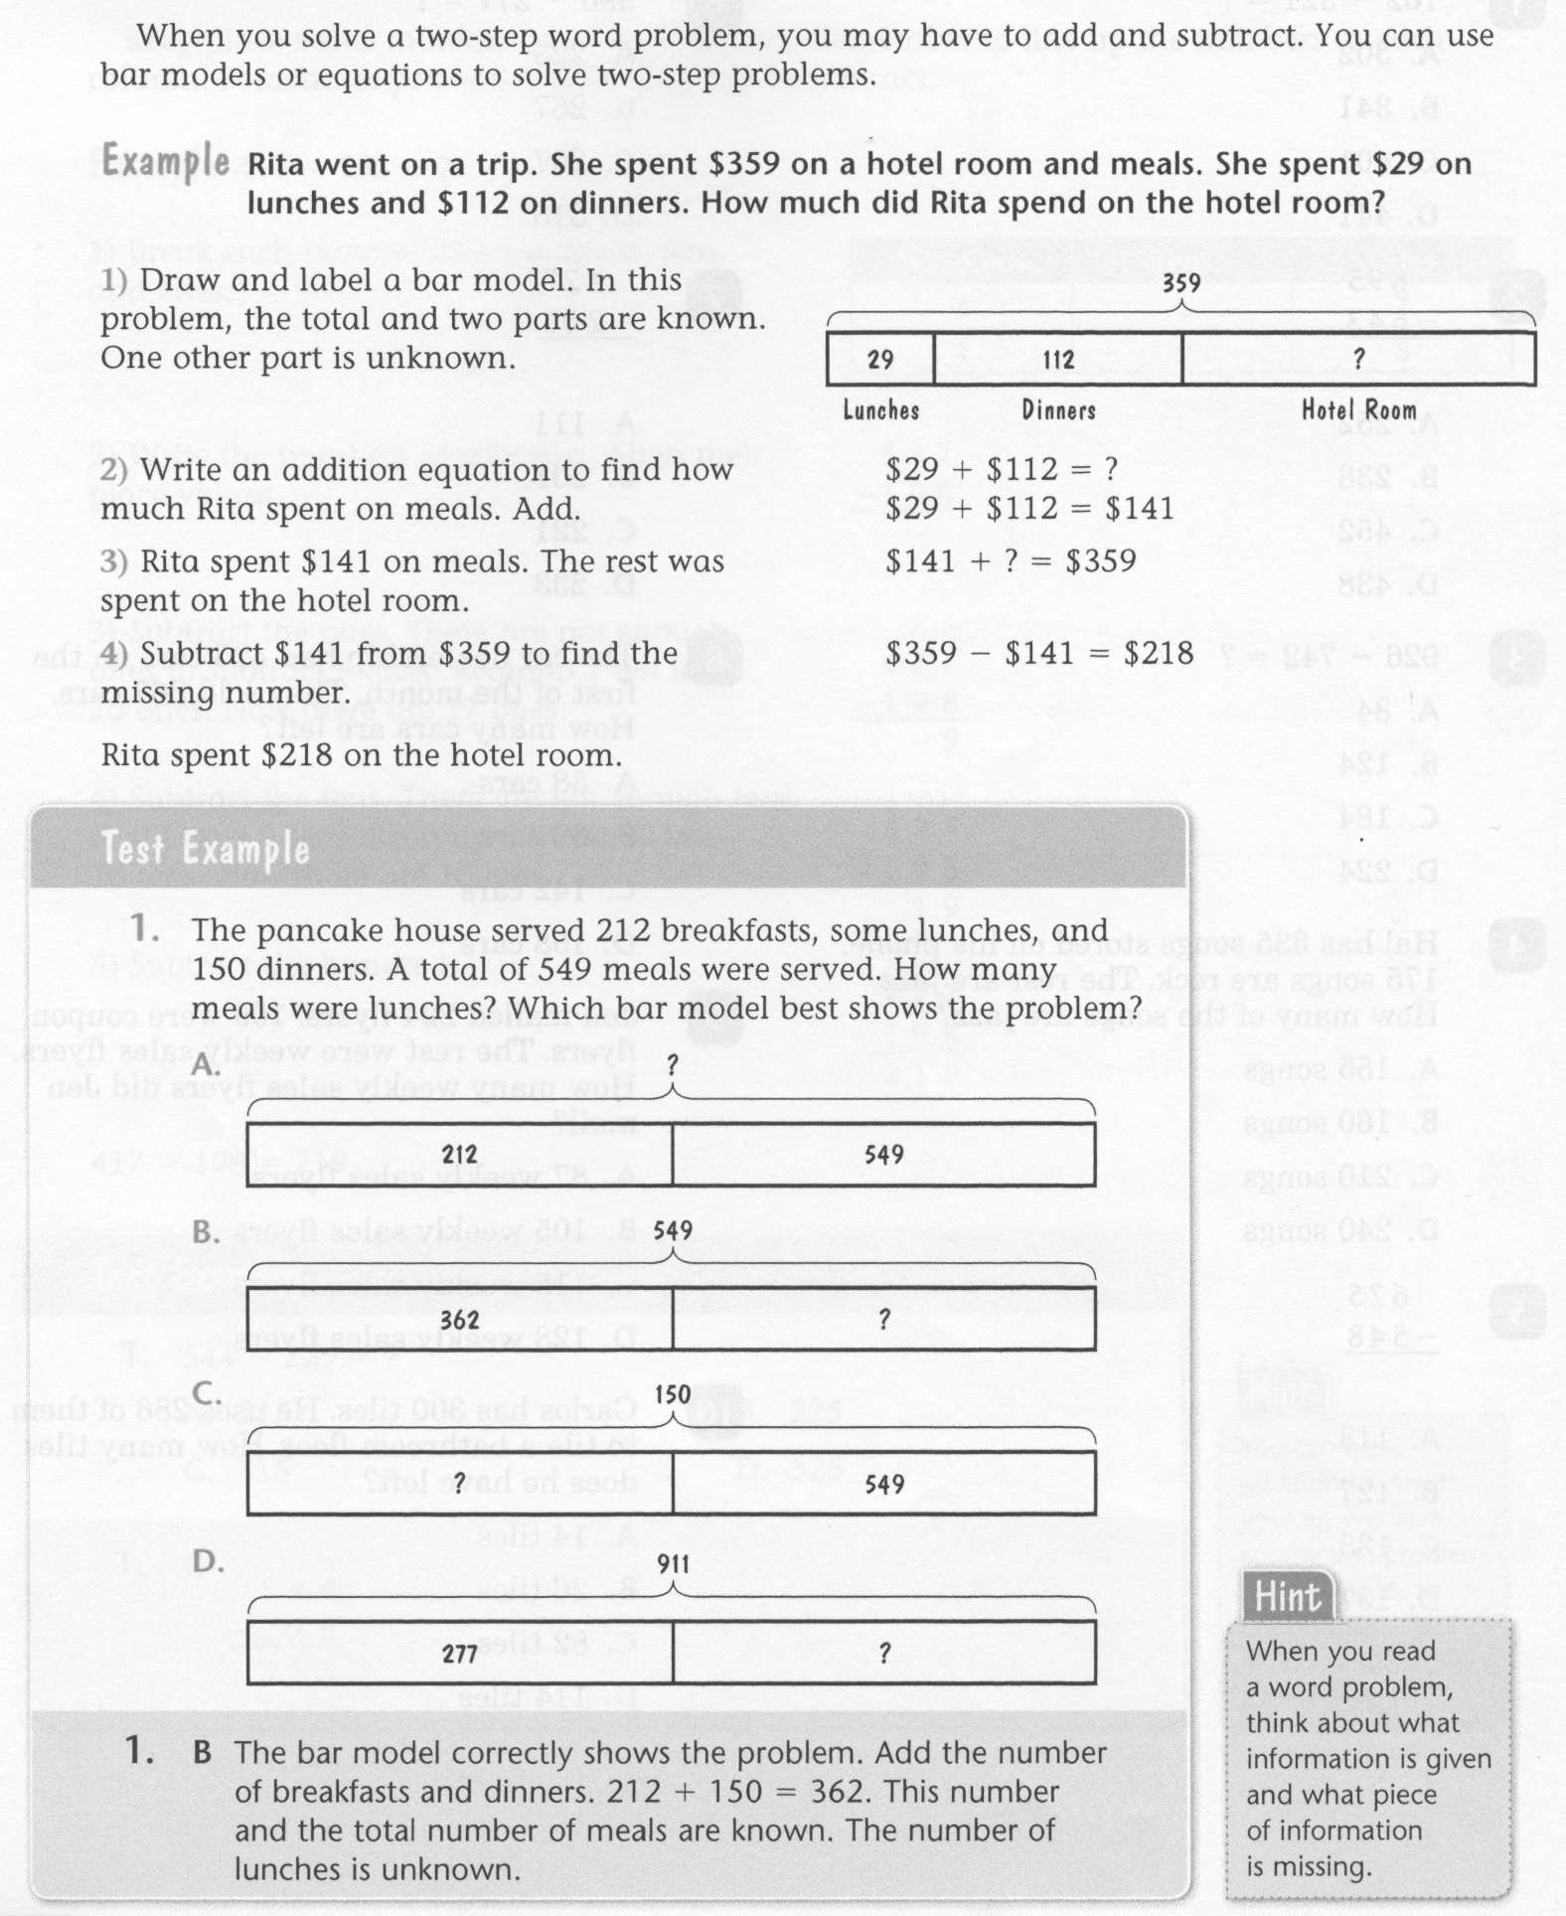
Math-E - Lesson-12 – 2-Step Equations

Slide 3
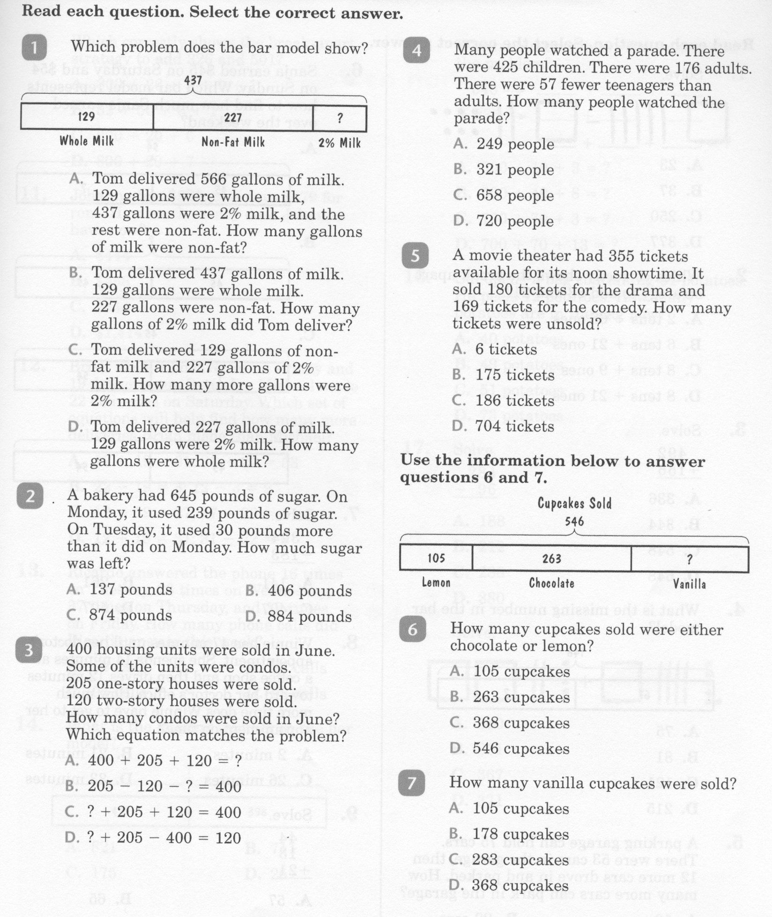
Math-E - Lesson-12 – 2-Step Equations

Slide 4
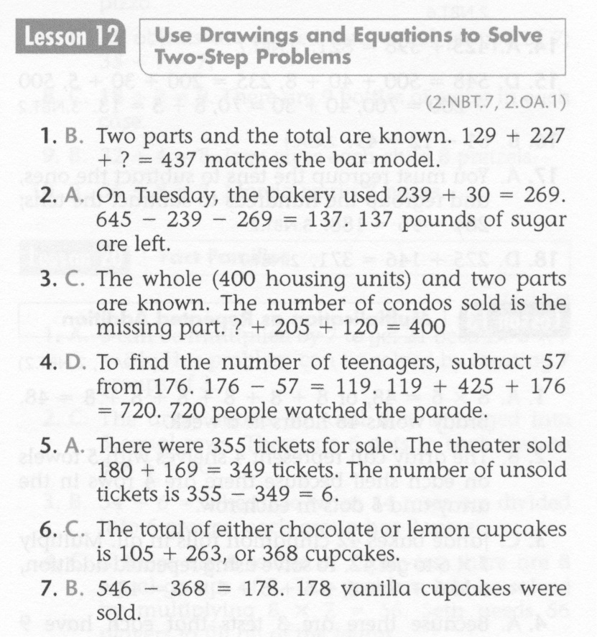
Math-E - Lesson-12 – 2-Step Equations

Slide 5
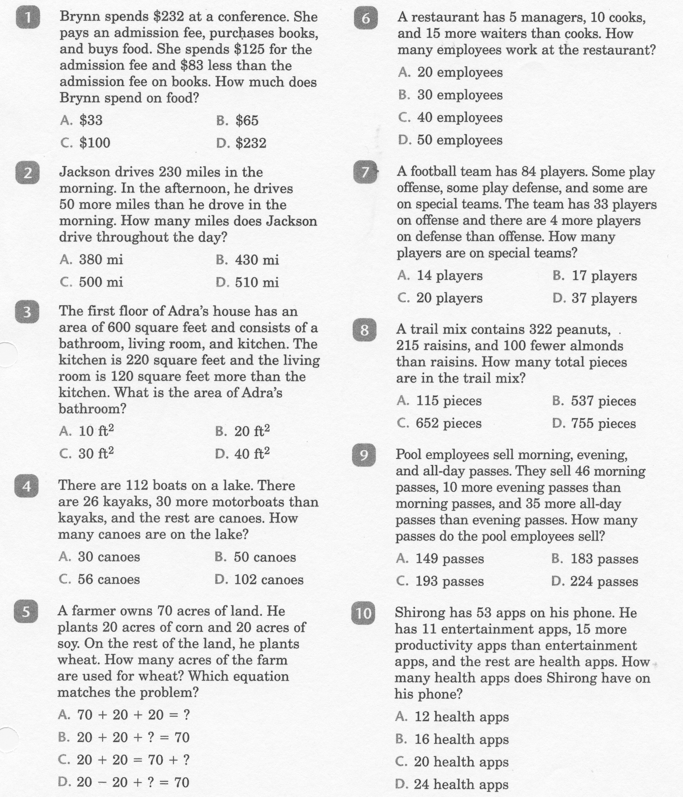
Math-E - Practice-12 – 2-Step Equations

Slide 6
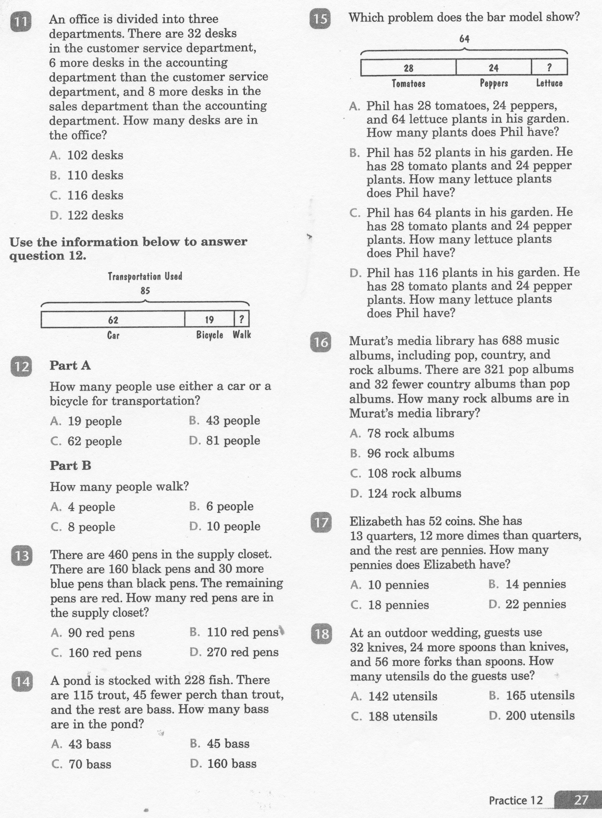
Math-E - Practice-12 – 2-Step Equations

Slide 7
Math-E - Practice-12 – 2-Step Equations

