Slide 1





Microsoft Office
Introduction
EXCEL
2010
Nolan Tomboulian
252-675-0176
Tomboulian@Yahoo.com
Tomboulian.Wikispaces.com

Slide 2
Table Of Contents
Page | TOPIC
5 | Classroom Administration
9 | Introduction and Objectives
17 | Workbook Terms and Navigation
33 | Entering Data
45 | Formatting Cells and Data
69 | Formulas
85 | Absolute and Relative Cell Address
105 | Rows, Columns, Sheet (Move/Copy Insert/Delete)
121 | AutoFill
129 | Paste Special
141 | Charting
161 | Printing
173 | Backstage View
197 | Resources

Slide 5


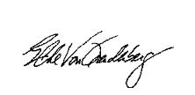


Class Administration
Please Sign In
Please make sure you sign the attendance sheet at this time if you have not already done so.
MAKE SURE WE CAN READ IT!

Slide 6


ADMINISTRATION
Turn off cell phones or switch to vibrate.
Respect each other in the classroom. One person talking at a time.
If you have a question, ask it. You might not be the only one who wants to know!
Because this is a computer lab – Be careful with your drinks!
There will be a 10 minute break each hour.
The class is scheduled from 5:30 PM -8:30 PM

Slide 7
ADMINISTRATION
Turn off cell phones or switch to vibrate.
Respect each other in the classroom.
  One person talking at a time.
If you have a question, ask it.
  You might not be the only one who wants to know!
Because this is a computer lab
  Be careful with your drinks!
There will be a 10 minute break each hour.
Lunch will be 1 hour.
The class is scheduled from 7:30 AM -3:30 PM
Please remember to turn in the Evaluation (WITH COMMENTS)

Slide 8







Restrooms .
Soda machines and vending machines are located in the student lounge across from the entrance.
The designated smoking area is on the Northeast side of the Redd building across the student parking lot against the fence line. There are red cones designating the smoking area. Please, clean-up after yourself.
In the event of a fire please exit the building using the nearest exit away from the fire.
Code Red drill.
Let’s have fun. You have a day away from the bump and grind of your daily routine.
Ask Questions – The class is for you!

Slide 9
Microsoft Office
Introduction
EXCEL
2010
Nolan Tomboulian
252-675-0176
Tomboulian@Yahoo.com
Tomboulian.Wikispaces.com

Slide 10
INTRODUCTION - EXCEL 2010
7 Hour instructor led class for Microsoft Office Excel 2010 will expose participates to a few of the options such as:
Understanding of spreadsheets, environment, terminology and navigation
Entering and Editing Data: Text, Numbers, Dates, and Formulas
Working with Columns and Rows: (Insert, Delete, Hide/Unhide, Resize, Freeze)
Working with Cells and Ranges (blocks of cells)
Understand the mathematical Order of Operations (PEMDAS) used in Formulas
Basic Functions: Sum, Average, Count, Min, Max (and others)
Formatting of Cells and the DATA within the cell. How to use the Format Painter
  Alignment, Format, Wrapping, Merging, Fill, Borders, Outline, Color, Font
Copying Formulas with Relative and Absolute cell addresses.
Using Copy / Paste and AUTOFILL
Introduction to Charts (Graphing)
Worksheets, Workbooks and Backstage View (FILE Tab)
Customization of the Quick Access Toolbar (and Ribbon)
Sorting and Filtering
Introduction to Tables
Demonstrate Intermediate and Advanced Topics for potential applications
Other Tips and Tricks requested by participants
Students should have prior knowledge and experience with
Computer operations and file management.

Slide 11
POINT OF CLARIFICATION
The purpose of this class is to assist you to become a “smarter” worker and more productive and comfortable using the MS Office Excel application.
“Introduction”, “Intermediate” and “Advanced” classifications for topics covered in the different classes is relative!
My task is to help empower you to leave with something useful and meaningful to allow you to do a better job!
Please contact me if you need help!

Slide 12
This class will not be…
Not many people know the word “LECTURE” is actually an acronym. It stands for:
Lengthy
Endless
Continuous
Torture with
Unending
Repetition of
Explanations.
A
LECTURE
Class participation is welcomed and beneficial to you (and others)

Slide 13


How do you eat an elephant?
There are many options you may never use!
There are many tutorials and resources available

Slide 14
POINT OF CLARIFICATION
You know what you know!
You know what you don't know!
But you don't know
what you don't know!

Slide 15
Left Blank for Duplex Printing

Slide 16
Left Blank for Duplex Printing

Slide 17


Excel Worksheet Basics
Terminology
Navigation
The Ribbon
Nolan Tomboulian
Tomboulian@yahoo.com
Tomboulian.wikispaces.com

Slide 18

Introducing Excel
Microsoft Office Excel 2010 (Excel) is a computer application used primarily to enter, analyze, and present quantitative data (but has many other uses: ie: Database for Mail Merge)
It is best for historic data that won’t be changing or need “real-time” updates.
  Desktop Icon
  or
  Start / All Programs / Microsoft Office
    (Right Click and copy the program to the desktop for quick access if it is not there!)
A spreadsheet is usually a collection of text and numbers laid out in a rectangular grid. (Columns and Rows)
  Often used for budgeting, inventory management, and decision making
  Think of Excel as a big table or chart to fill in with data
  Today, every cell is customizable and you are not restricted to set Rows or Columns for Formatting.
  There are 1,048,578 Rows and 16,384 Columns = 17,179,869,184 cells
Other objects such as: pictures, WordArt, SmartArt, drawings/shapes and even other OBJECTS (files) can be inserted into the workbook.

Slide 19
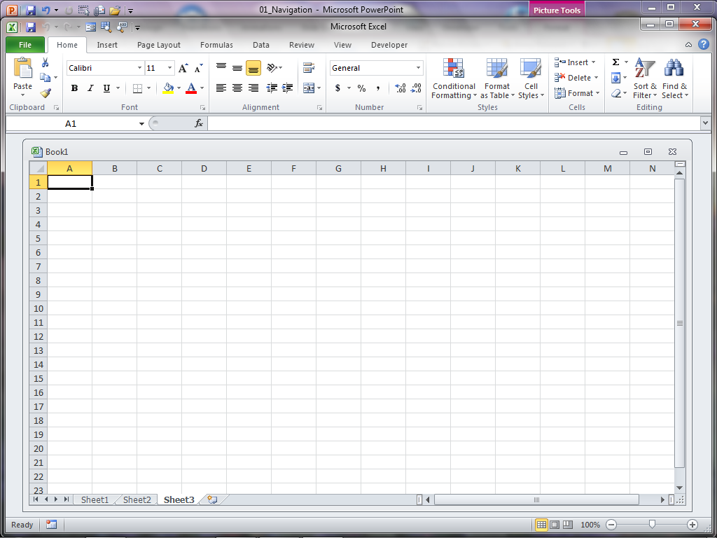
Does your screen look something like this?
You may need to change the SCREEN Resolution
START
  Control Panel
Display
Or the size of the Excel Window?
Program and Workbook View
Your Ribbon and QAT may have been modified by prior users or the options changed (IE: the [DEVELOPER] tab or other add-ins

Slide 20
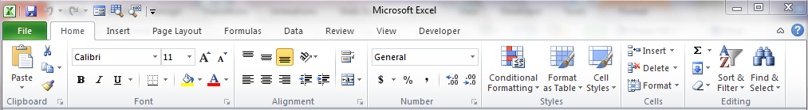
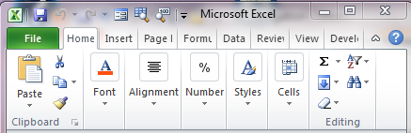
The Ribbon
Depending on the resolution of your screen monitor
and the size of the Excel Window, the Ribbon will change appearance
You CAN change the design or layout of the Ribbon
You CAN minimize the Ribbon (<Ctrl F1>, Ribbon, Button)
You CAN move and modify the Quick Access Toolbar

Slide 21
Basic Workspace Vocabulary
Workbook
Worksheet
Title Bar
Ribbon
Tabs
Groups
Commands
Dialog Boxes
Quick Access Toolbar
Status Bar
Name Box
Range (uses the colon :)
Formula Function (insert)
Formula Bar
Select ALL
Column Headings
Row Headings
Cell
Vertical Scroll Bar
Horizontal Scroll Bar
Zoom Control
View Modes
Screen Splitter
Sheet Tabs
Sheet Tabs Scrolling Bar

Slide 22
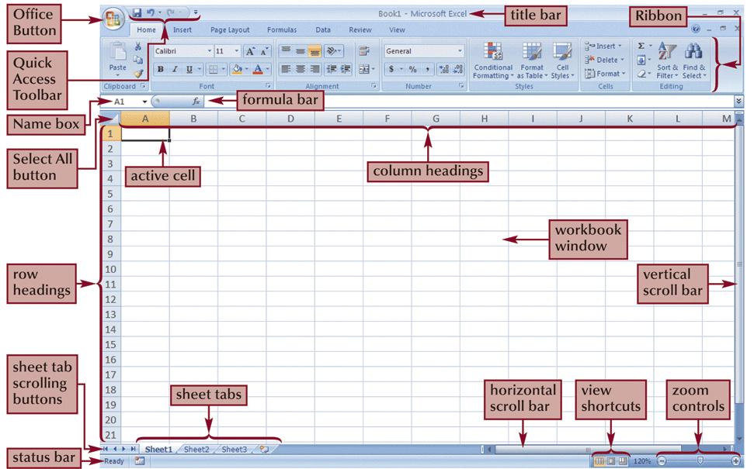
Excel Workspace 2007

Slide 23
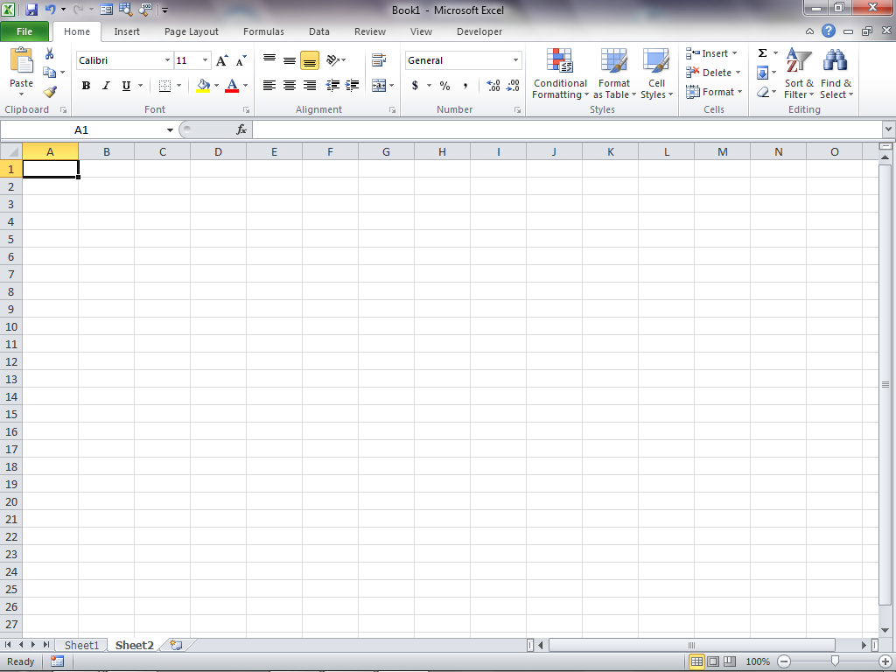

Slide 24
Basic Parts of Excel
Ribbon - Area above workbook window where [Tabs], groups, and Commands are located. (Menu Functions)
  [Home] [Insert] [Page Layout] [Formulas] [Data] [Review] [View] [Developer]
  Each Ribbon Tab has a sub-menu Group of tasks, commands and options
  There are other [TABS] that are Context Based and appear when the selected object is active: Tables, SmartArt, WordArt, Drawings, Pictures, Charts
Workbook – collection of one or more worksheets (An Excel file is a workbook)
Worksheet – collection of cells that hold data or other objects.
Range – Multiple cells (adjacent or non-contiguous) for action to be applied
  (Formatting, Moving, Copying, Sort, Filter, Apply Formula)
Cell – formed at the intersection of a column and row (the cell reference or address: ColumnLetterRowNumber) Cell Address, Cell Reference. Cell Name

Slide 25
Navigating Excel
Worksheet Tabs – click to move between worksheets (can move, rename, and color code)
Columns Headings – Letters above each column that identify the column (cannot change)
Row Headings – Number next to each row that identify each row
Cell Reference – unique combination of column letter and row number intersection point (cell address or Cell Name)

Slide 26
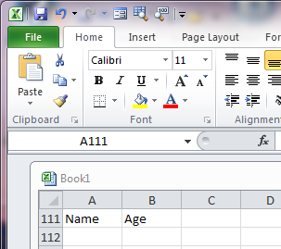
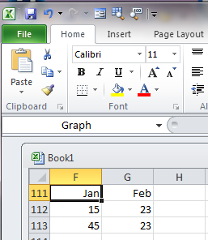
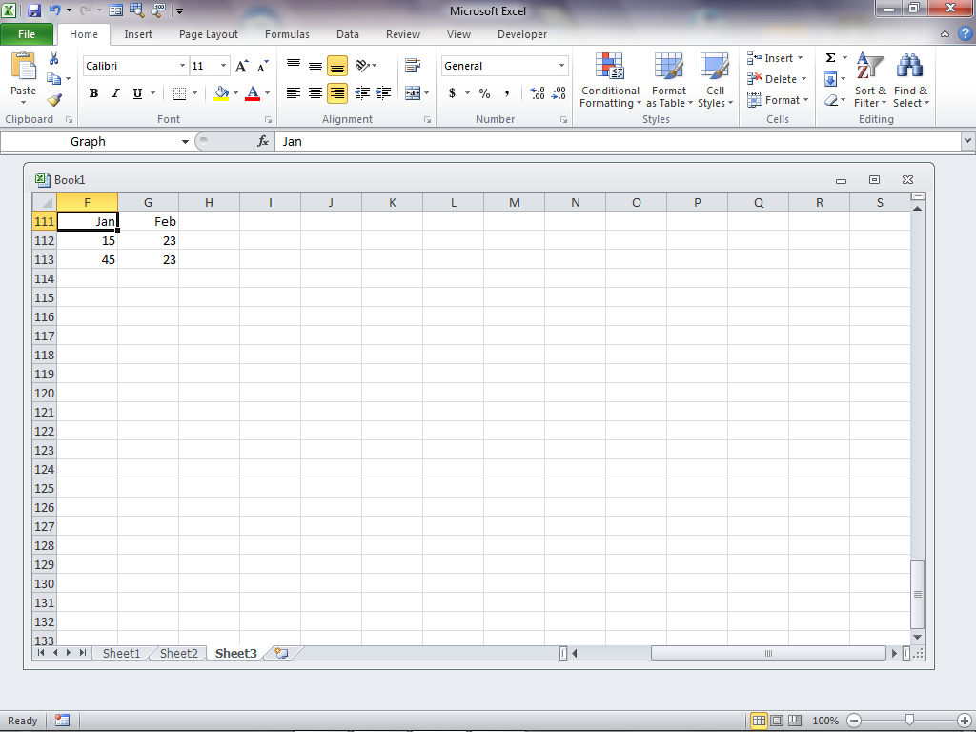
Other Parts of Excel
Formula Bar – Toolbar (usually between the Ribbon and Workbook window) where cell contents are displayed and functions can be inserted in a cell (may be turned off or expanded to view long formulas )
Name Box – Displays the cell reference of the active cell or (Range Name or object). May also be used as a GOTO <F5> address.
View Options – Displays the spreadsheet in the Normal, Page Layout, Page Break and ZOOM mode.
F_{x} Insert Function Dialog Help

Slide 27
Basic Navigating in a Worksheet
<Right Click> Possible Options to do on the item (Dialog Box)
↑ ↓ → ← Up, Down, Left, Right
<Shift> {Arrows} Used to select a “Range” of data
{enter} Down one Row <Shift> {enter} Up one Row
<Tab> Right one Column <Shift><Tab> Left one Column
{Home} Column A of the current Row
<Ctrl> {Home} Cell A1
<Shift>{Home} Highlight cells from current cell to Column A
<Ctrl> {End} Last cell of data in spreadsheet
{PageUp}, {PageDown} move up or down 1 screen of data
<Ctrl> {PageUp} <Ctrl> {PageDown} change SHEETS
<Ctrl>{~} Toggle between Formula View and Calculated View
<F2> Edit
<F3> Name Manger
<F4> Absolute Cell Reference
<F5> Go to Dialog Box
<F8> allows you to select the Lower Right corner of a range
<F1> Help
<F10> Turn on/off <ALT> Ribbon Short-cut Key Tips (HotKeys)
<F11> Chart
<Ctrl> A Select a Range <Ctrl> Z Undo

Slide 28
Links to more shortcut tips
http://office.microsoft.com/en-us/excel-help/excel-shortcut-and-function-keys-HP010073848.aspx
http://www.ddmcomputing.com/excel/keys/excel_fkeys.htm
http://www.ddmcomputing.com/excel/

Slide 29
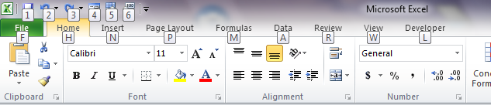
Key Tips
Key Tips are shortcuts to [Tab] and other options on the Ribbon.
Press the <Alt> key to show the Key Tips, then press the corresponding letter (or number) on the keyboard to activate the option.
KeyTips go off when you finish the command.
Pressing <F10> also turns on KeyTips

Slide 30
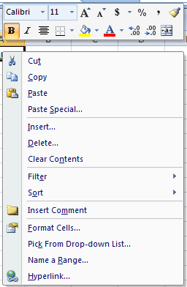
<Ctrl> Commands and <Right Click>
(You don’t always have to use the Ribbon!)
<Right Click> Options
What about the old keyboard shortcuts?
Shortcuts that begin with <CTRL> are still intact, and you can use them like you always have.
Ctrl C Copy
Ctrl V Paste
Ctrl B Bold
Ctrl U Underline
Ctrl I Italic
Ctrl X Cut
Ctrl Z Undo
others…..

Slide 31
Planning a Workbook
Before you begin to enter data into a workbook, you should develop a plan!
Failing to plan is a plan to fail!
  What problem do you want to solve?
    Define the workbook’s purpose
  What data is needed?
    Define the types of data to collect and source
    What calculations are required?
    Define what formulas or functions to use
  What form will the solution take?
    Define appearance of the workbook content. Formatting
  Who is the User?
    Define Edits, Controls, Data Validation, Color Codes
    Passwords and Security?

Slide 32


EXCEL
WORKBOOK Terminology
& NAVIGATION

Slide 33
Nolan Tomboulian
Tomboulian@yahoo.com
Tomboulian.wikispaces.com
Entering Data

Slide 34
Entering Data in Cells
Excel data usually takes one of four basic TYPES:
  Text : combination of letters, numbers, and symbols (Left Align) (sometimes called Labels)
  Numbers : general, integer, decimals, currency, accounting, fractions, percent, others (Right Align)
  Date/Time : dates, parts of dates, times, parts of times (multiple standard and Custom Formats)
  Formulas or Functions:
    All start with =
    Math order of operations: ( ), ^, *, /,+, -, Sum, Average, Count, Min, Max, and many others (under the [FORMULAS] Tabor with the f_{x}Caculatioo perform. Always start with an = Equal sign.

Slide 35
Entering Numbers in Cells
Just like text. Put your cursor in a desired cell and begin typing.
Cells containing numeric data should not include any other data, except for related symbols (currency, percentage, negative)
  Sometimes it is better to Format the cell rather than enter the symbols for $ or %
Depending on the cell format, the number may seem to display incorrectly or in an undesired way!

Slide 36
Entering Dates
Dates can be entered in any standard format
  mm/dd/yyyy, MON-DD-YYYY
Excel calculates dates mathematically. This allows for date and time calculations to be made quickly (January 1st 1900 is DAY 1)
Excel uses default date formats when it detects a date, but other formats can be applied.

Slide 37
Working with Cells and Ranges

Slide 38
Working with Cells and Cell Ranges
A group of cells is called a cell range or range
An adjacent range is a single rectangular block of cells
A nonadjacent range consists of two or more distinct cell or range references
A range reference indicates the location and size of a cell range
The colon (:) between two cells identifies a RANGE
Range references indicate the top-left and bottom-right corners of the cell range
  Adjacent: A1:G5 A15:A30 C15:G15
The Semicolon (;) links multiple ranges in NonAdjacent Ranges
  Nonadjacent: A1:A5;F1:G5
<Ctrl><A> may be used to select a contiguous Range of cells

Slide 39
Selecting Adjacent Cell Ranges
  Left Click the cell in the upper-left corner of the adjacent range to be selected
  Drag the mouse to the lower-right corner
  Release the mouse button
Or
  Left Click the cell in the upper-left corner of the adjacent range
  Press and hold the Shift key and click the cell in the lower-right corner of the adjacent range, and then release the Shift key
Or
  Left Click on the 1st Cell, press and hold the <Shift> key and use the arrows (↑ ← → ↓) to select a range
Or
  Select a cell within the desired contiguous range and press <Ctrl><A>

Slide 40
Selecting Nonadjacent Cell Ranges
  Select the first Range
  Press the <Ctrl> key as you select additional ranges
  Release the <Ctrl> key
  (It is easier with a mouse than with the Keyboard)
To select ALL the cells in a worksheet:
  Click the Select All button located at the intersection of the row and column selectors
    But why would you need to do that?!
(This can be difficult to do with a laptop Mouse Pad)

Slide 41
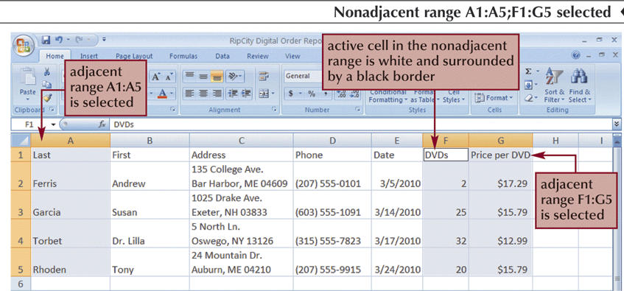
Nonadjacent Range

Slide 42
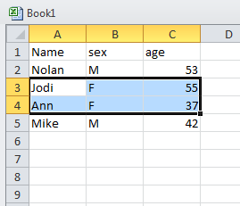
Moving or Copying a Cell or Range
(with the Mouse)
Select the cell (or range) to move or copy
Move the mouse pointer over the border of the selection until the pointer changes shape (Cross-Hair)
  To move the range, <left click> the border and drag the selection to a new location
  To copy the range, press and hold down the <Ctrl> key and then press the <left click> and drag the selection to a new location
(This can be hard to do using a laptop Mouse Pad)

Slide 43

Moving or Copying a Cell or Range
(With Ribbon Cut and Paste Icons)
Select the cell or range you want to move or copy
Go to the [Home] tab - Clipboard group and click the Cut button or the Copy button
  Or <right-click> the selection, and then press
  Cut <Ctrl X> or Copy <Ctrl C> on the shortcut menu
Select the cell or upper-left cell of the range where you want to move or copy the content
In the Clipboard group, click the Paste button (or <right-click> the selection, and then click Paste on the shortcut menu <Ctrl V>)
PASTE can overwrite existing Cell Data without warning! - BE CARFUL!

Slide 44
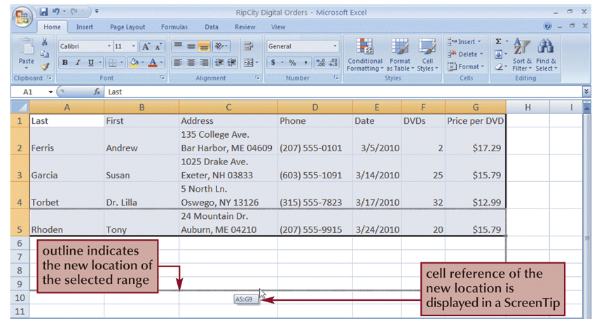
Dragging a Range

Slide 45
Workbook Formatting
Nolan Tomboulian
Tomboulian@yahoo.com
Tomboulian.wikispaces.com
How Things Look
Cell Color Font Color
Cell Borders Font Size
Cell Size Font Style
Numeric or Date Display (Edit Masks)
Direction of Text in the Cell (alignment)

Slide 46
Formatting Workbooks
Formatting is the process of changing a workbook’s appearance by defining the Cell and Data ATTRIBUTES:
Fonts, Styles, Colors, Alignment and decorative features like Borders and Fill
Can change the formatting of a text selection, a cell, a worksheet, or an entire workbook
You can modify the Cells, Rows, Columns and the contents within a cell

Slide 47
Formatting Workbooks
Easier to read
Draw attention to important data
Professional appearance
Provide continuity between worksheets
Only add enough formatting to achieve these goals
Too much formatting detracts from the workbook
If it is going to be printed, Be mindful that some colors won’t look good!

Slide 48
Formatting Text
The appearance of text is determined by its typeface, which is the specific design used for the characters:
  Font: Times New Roman, Ariel,
  Font Effects: bold, underline, italics
  Font Color: Red, BLUE, GREEN
  Font Size: Measured in Points
      72 Points = 1 inch

Slide 49

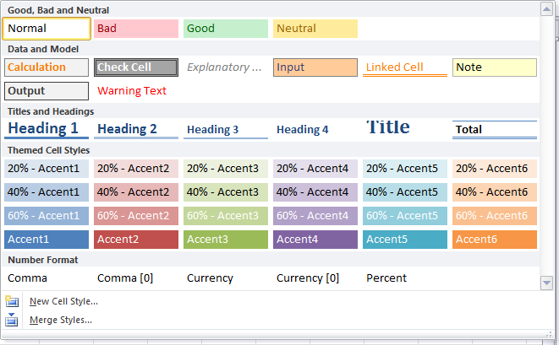
CELL STYLES
(Pre-Defined or Customizable)

Slide 50
Working with Color
Color is usually applied in one of two ways:
  Font Color
  Fill Color
Theme colors are the 12 colors that belong to the workbook’s theme
Standard colors are also available
Can create custom colors
Apply a color by selecting a cell or range of cells, clicking the Font Color or Fill Color button arrow, and then selecting a desired color
Some color combinations look good on the screen but are bad when the spreadsheet is printed!
(and it uses more ink!)

Slide 51
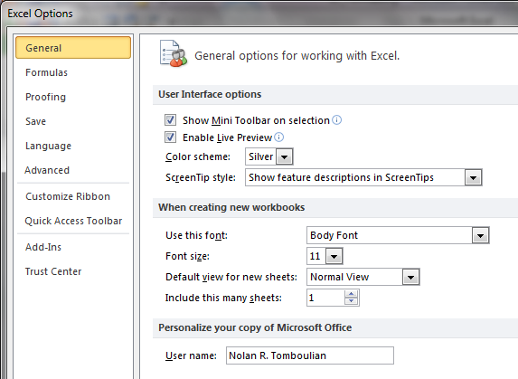
Formatting Text Selections
The Mini Toolbar appears when you select text and contains buttons for commonly used formats
The Mini Toolbar option may be turned off with the [FILE] {Options}

Slide 52

Formatting Data
By default, numeric values appear in the General Number Format, which, for the most part, displays numbers exactly as you enter them.
The {Number group} on the [Home] tab has buttons for applying common numeric formats.
  Dollar Style Button
    Notice the sub-menu options dialog
  Percent Style button
  Comma Style button
  Decrease Decimal button
  Increase Decimal button
  Number Format button

Slide 53
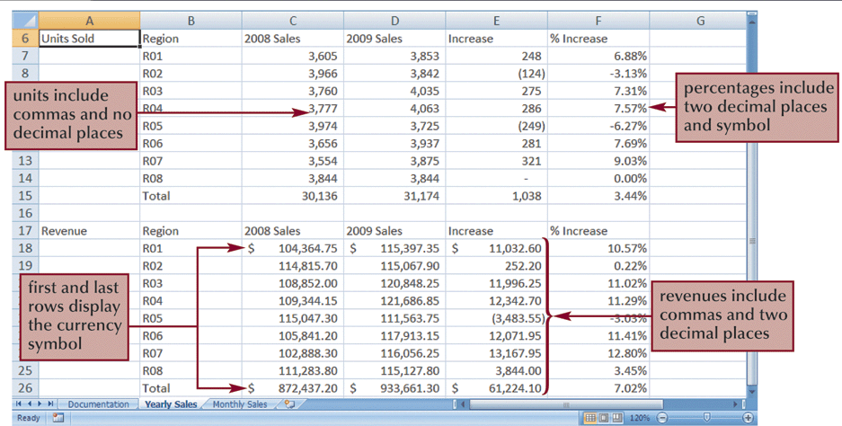
Formatting Data

Slide 54
Formatting Dates and Times
Although DATES and TIMES in Excel appear in “normal” formats, they are actually numbers
Measure the interval between the specified date and time and January 1, 1900 at 12:00 a.m.
Excel uses this system to make date and time calculations easy to perform
Can create Custom Formatting to make Edit Masks to display data in various formats:
  Leading Zeros, Phone-Numers, SSN,

Slide 55

Aligning Cell Content
Alignment refers to the position of values within a cell.
  (It used to be called Justify)
In addition to Left, Right, and Center, you can change the vertical and horizontal attributes:
  (Top, Middle, Bottom)
Data may be also be rotated to an angle within the cell
Alignment buttons are located on the [Home] tab
May also Indent, Wrap or Merge Cells
  (Merged Cells Cannot be sorted)

Slide 56

Indenting Cell Content
You increase or decrease the indentation each time you click a button in the Alignment group on the [Home] tab

Slide 57
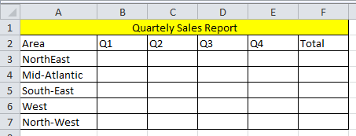
Merging Cells
One way to align text over several columns or rows is to merge, or combine, several cells into one cell.
Useful for a “Heading” over a range of cells
There must not be any data in the adjacent cells being merged!

Slide 58
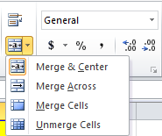
Merging Cells
Select the range of cells you want merged.
  Click the Merge & Center button in the Alignment group
  or
  Click the Merge & Center dialog Box and select Merge Across. This creates the same effect as Merge & Center without centering the text
You can also Merge a range of cell Rows and Columns to make a “Block”
Remember the cells being merged must be empty or it will Erase the contents.

Slide 59
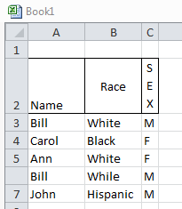
Rotating Cell Content
To save space or to provide visual interest to a worksheet, you can rotate the cell contents so they appear at any angle or orientation
  Select the range
  In the Alignment group, click the Orientation button and choose the desired rotation

Slide 60
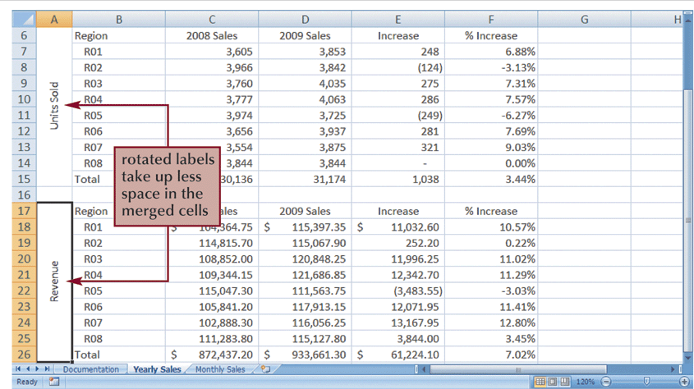
Rotating Cell Content

Slide 61
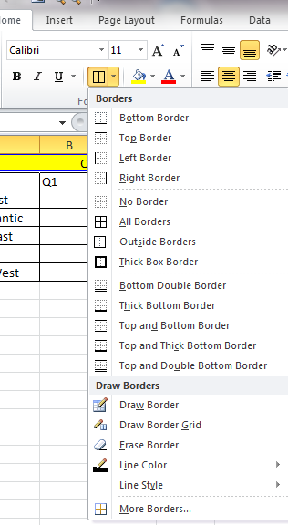
Adding Cell Borders
You can add Borders to the left, top, right, or bottom of a cell or range, around an entire cell, or around the outside edges of a range using the Border Dialog

Slide 62
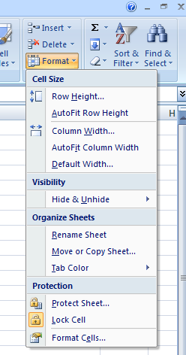
Format Cells
Dialog Box
The Format Cells dialog box provides access to all formatting options related to cells
The Format Cells dialog box has six tabs, each focusing on a different set of formatting options
Can also access with a <Right Click>

Slide 63
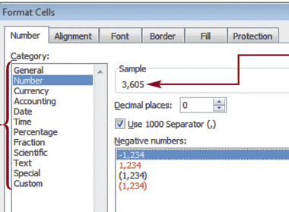
Format Cells Dialog Box

Slide 64
Changing Column Width and Row Height
Column Widths and Row Heights can be adjusted to fit data, create visual space, etc
  The default column width is 8.38 standard-sized characters
  Row heights are expressed in “Points” {72=1 inch}
Autofit eliminates any empty space by matching
  the column to the width of the longest cell entry
  the row to the height of the tallest cell entry

Slide 65
Changing Column Width and Row Height
Position the cursor on the border between column or row headers
When the cursor changes to a resize cursor, left click and drag to resize the column or row
or
<Double Left Click> to Auto Size the Cell to fit the contents
or
Select one or more columns or rows
Go to the [Home] Tab – Cells group and click on the Format button, and then click Column Width or Row Height
  Type the desired column width or row height and then click the OK button

Slide 66
Changing Column Width and Row Height
Autofit a column or row automatically resizes the row or column to fit the largest cell value
Autofit by placing the cursor in the same position as manual resizing, then
<double-left-click> (rather than dragging)

Slide 67
Entering Multiple Lines of Text
Within a Cell
Type the first line of text
For each additional line of text, press the <Alt><Enter> keys and then continue typing
Pressing <enter> in Excel terminates data input and moves <Down> a row. (default setting)
Pressing <Tab> in Excel terminates data input and moves <Right> a Column. (default setting)
<Alt><Enter> puts a “hard coded” <return> (Line Feed)
You can also format a cell to have the text “WRAP” in the cell – But WRAP will “break” the line when the cell is full, not where you want it.

Slide 68
FORMATTING CELLS

Slide 69

Introduction to Formulas and Functions
Nolan Tomboulian
Tomboulian@yahoo.com
Tomboulian.wikispaces.com

Slide 70
Formulas
A formula is an expression that returns a value (Calculation)
A formula is written using operators that combine different values (or cells), returning a single value to be displayed in the cell
  The most commonly used math operators are:
+ - * / ^ and ( )
Add, subtract, Multiply, Divide, Exponent and Parentheses
  Formulas start with an: = (equal) sign

Slide 71
Formulas
The Order of Precedence (or Order of Operations) is a set of predefined mathematical rules used to determine the sequence in which operators are applied in a calculation
Formulas can use: constants, cell references, or even other formulas and functions (NESTED)
Formulas can contain up to 64 nested functions and be 8,000 characters long

Slide 72
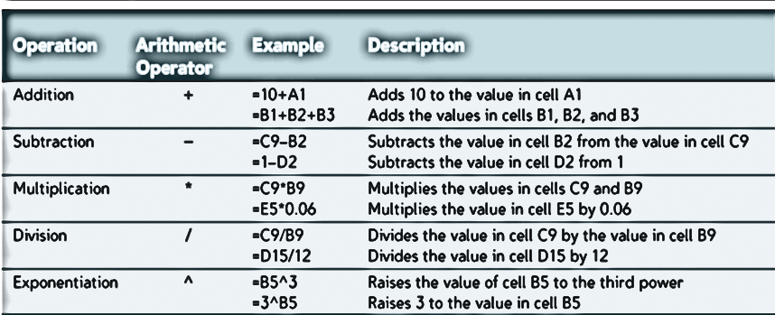
Entering a Formula
Please Excuse My Dear Aunt Sally
Parenthesis Exponent (Multiply or Divide) (Add or Subtract)

Slide 73
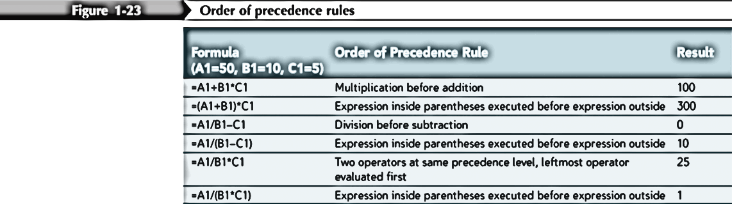
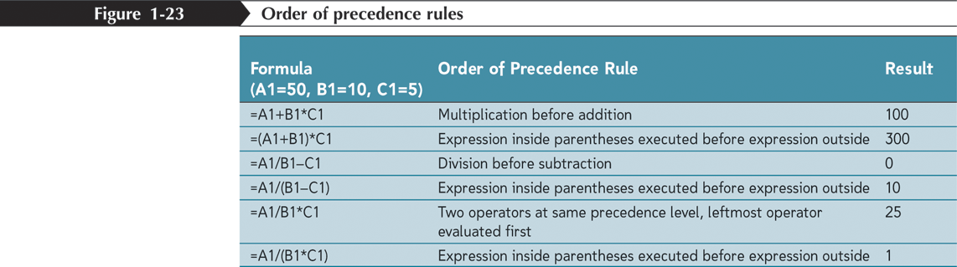
Order of Operations
A1= 50 B1=10 C1=5
Please Excuse My Dear Aunt Sally
Parenthesis Exponent (Multiply or Divide) (Add or Subtract)

Slide 74
Entering a Formula
Click the cell where the formula result will go
Type = and an expression that calculates a value using cell references and arithmetic operators:
  All formulas and functions begin with an equal (=) sign
  Without the =, you are just typing “TEXT”
Press Enter or Tab to complete the formula
  <enter> moves down <Tab> moves right
  <Shift><enter> moves up <Shift Tab> moves left

Slide 75
Entering a Formula
Excel provides tools to help you keep track of how formulas are built
Color coded cell references
  Outlines of the cell are color coded to match the color of the cell reference in a formula
Color coded parentheses
  Helpful when using multiple parenthesis
  Must have a closing ) parenthesis for each open (
  NESTED Formulas:
  =4*((A1*2) + (B6 + Sum(Q7:Q45)/ 4))

Slide 76
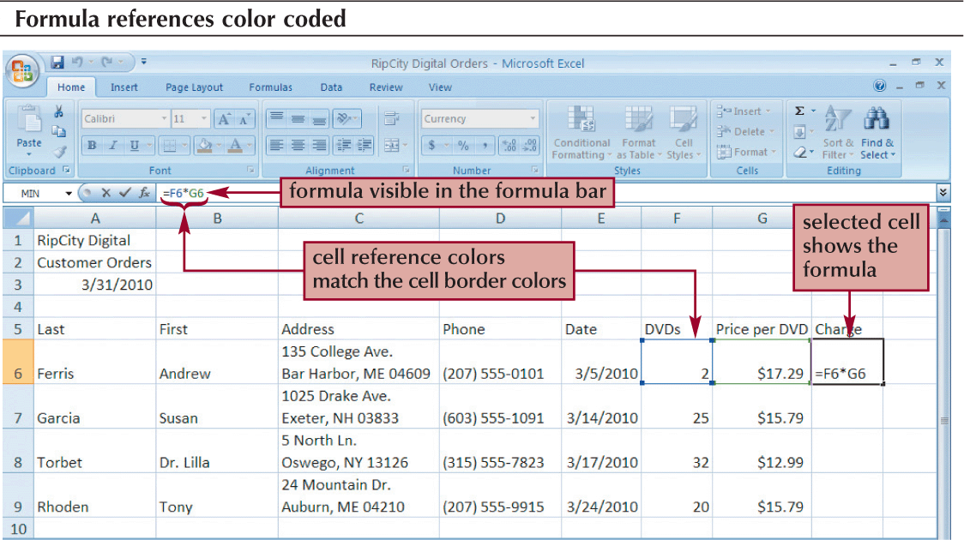
Entering a Formula

Slide 77
Functions
A function is an “operation” that returns a value.
For example, to add the values in the range: A1:A10, you could enter the following long formula:
    =A1+A2+A3+A4+A5+A6+A7+A8+A9+A10
    (But what if you had hundreds of rows of data?)
Or, you could use the SUM function to accomplish the same thing:
    =SUM(A1:A10)
    Functions also have an Open ( and close )

Slide 78
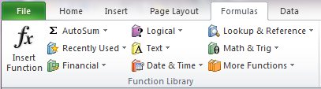
Functions
  Mathematical and Trig
  Financial
  Logical
  Date and Time
  TEXT Manipulation
  Lookup and Reference
  More Functions
    Informational
    Statistical
    Engineering
    Cube

Slide 79

Entering Functions
Functions are entered into a cell by:
  Typing the function directly into the cell (preceded by an =)
  Use the Insert Function button on the Formula Bar, which opens an Insert Function dialog box tailored to the specific function
  Use the [Formulas] Tab – Function Library group, then select a category

Slide 80
Entering Functions with AutoSum
The AutoSum button quickly inserts Excel functions that summarize all the adjacent values in a column or row using a single statistic
  Sum
  Average
  Count
  Minimum value (Min)
  Maximum value (Max)

Slide 81
Entering Functions with AutoSum
BE CAREFUL WITH AUTO Functions
Excel tries to determine the most likely cell range for the function by examining the data around the cell
If there is a BLANK cell in the range, the range Excel puts in the Formula will not be correct!
You can change the chosen range by typing a different range reference or using the mouse to select a different range

Slide 82
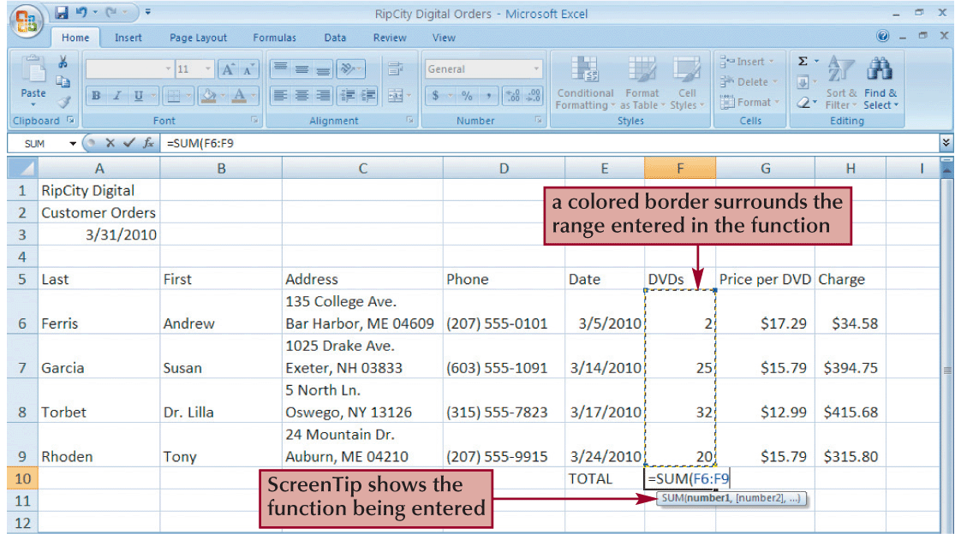
Entering a Function

Slide 83
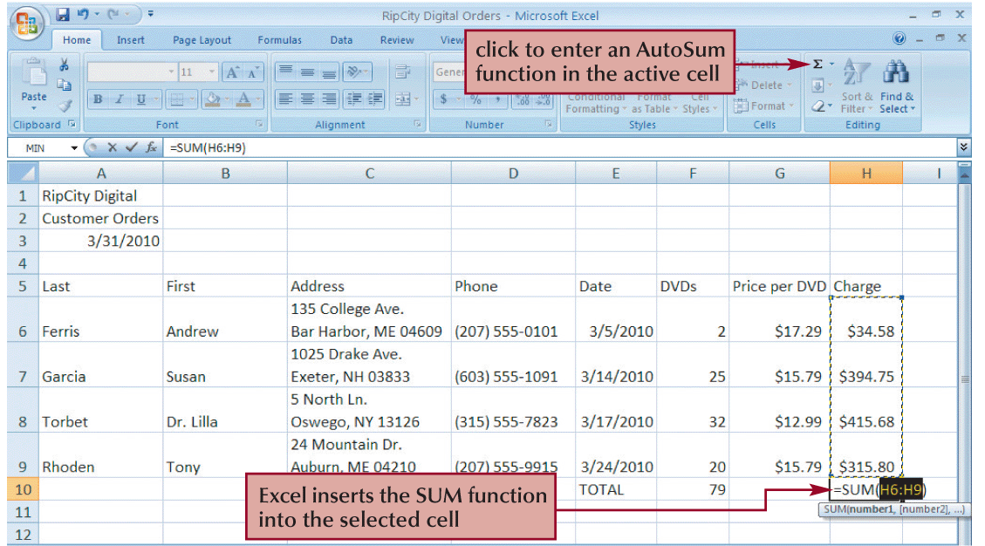
Entering Functions with AutoSum

Slide 84
NOTES for Functions and Formulas

Slide 85
Nolan Tomboulian
Tomboulian@yahoo.com
Tomboulian.Wikispaces.com
Relative
and
Absolute
Cell Reference
And More
FUNCTION SYNTAX

Slide 86
References
Linking back to a cell from another is called a cell reference
Knowing how to use Relative and Absolute references is an critical skill for using functions and formulas
Excel adjusts references when functions and formulas are Moved and/or Copied

Slide 87
References
Absolute references can be identified by dollar signs in front of the column and row designation
  Ex. $A$1
Relative references have just the column and row designations (NO $)
  Ex. A1
Can also use Mixed References
  $A1 : Column A stays fixed but the row will change
  A$1 : Column will change but the row will stay as 1
Use the <F4> key to toggle between the: $x$#, $x#, x$# and x#

Slide 88
Relative References
Usually Excel interprets cell references in a formula in relation to the cell’s location
  Ex. Entering =A1 in cell A3
  Excel interprets that as using the cell two rows above and zero columns over
Copying the formula in another cell would result in a different reference
  Ex. Copying the formula in cell A3 to cell A10 would result in the formula being changed to: =A8.
    ( ie: copy the cell that is two rows above)

Slide 89
Absolute References
Makes the reference to the specified cell
  Ex. Entering =$A$1 in cell A3
  Excel does not interpret the relative difference in cell location
Copying the formula in another cell would not change the cell reference
  Ex. Copying the formula into cell A10 would result in the formula remaining =$A$1

Slide 90
Mixed References
Mixed references are cell references where only one portion is fixed
When a formula using mixed references is copied, one portion shifts and one portion stays fixed
This is useful when you are copying a formula down the rows or across the columns and you want part of the address to remain constant

Slide 91
Entering
Relative, Absolute, and Mixed References
Relative reference – No dollar signs (C12)
Absolute reference – Dollar signs in front of each portion ($C$12)
Mixed reference – Dollar sign in front of the portion you want “locked”
  $C12 - The Column C does not change
  or C$12 - The Row does not change
Or
Press the <F4> key to cycle the reference from relative to absolute to mixed and then back to relative

Slide 92
Understanding Function Syntax
All functions have Arguments or Parameters, which are the data (values, cell references, other functions) that are needed by the function to calculate the value
Some functions have [optional] arguments
Optional arguments are not necessary for the function to calculate a value, but can provide more control over the value or format being returned.

Slide 93
Understanding Function Syntax
Standard function syntax
  =Function name(argument 1 [, argument 2])
    Argument 1: required argument
    Argument 2: optional argument and its default value
    Arguments are separated by a Comma
    All optional arguments have a default value
    Good programming style should require a value for all arguments so it is “Clear” what the intended operation should be

Slide 94
Understanding Function Syntax
Excel provides help with understanding function syntax
  Optional arguments are enclosed in brackets [ ] when typing in a function
  Required arguments are listed in bold text on the Insert Function Dialog Box
When typing a function, Excel also highlights where you are in the function using a Screen Tip

Slide 95
Common Functions
Function | Category | Description
SUM(number1 [, number2,…]) | Math & Trig | Adds a collection of numbers, where number1, number2, etc are either numbers or cell references
ROUND(number, num_digits) | Math & Trig | Rounds a number to a specified number of digits where number is the number to be rounded and num_digits specifies how many digits to round the number to.
AVERAGE(number1, [number2,…]) | Statistical | Calculates the average of a collection of numbers, where number1, number2, etc are either numbers or cell references.
COUNT(value1 [, value2…]) | Statistical | Counts how many cells in a range contain data, where value1, value2, etc are text, numbers, or cell references.
MAX(number1 [, number2,…]) | Statistical | Calculates the maximum value of a collection of numbers, where number1, number2, etc are either numbers or cell references.
MEDIAN(number1 [, number2,…]) | Statistical | Calculates the median, or middle, value of a collection of numbers where number1, number2, etc are either numbers or cell values.
MIN(number1 [, number2,…]) | Statistical | Calculates the minimum value of a collection of numbers, where number1, number2, etc are either numbers or cell references.

Slide 96
Date Functions
Function | Category | Description
DATE(year, month, day) | Date & Time | Creates a date value for the date represented by the year, month, and day arguments.
DAY(date) | Date & Time | Extracts the day of the month from the date value.
MONTH(date) | Date & Time | Extracts the month number from the date value.
YEAR(date) | Date & Time | Extracts the year number from the date value.
WEEKDAY(date, [return_type]) | Date & Time | Calculates the day of the week number from the date value. Return_type changes how Excel numbers the days.
NOW() | Date & Time | Displays the current date and time.
TODAY() | Date & Time | Displays the current date.

Slide 97
Inserting a Function
There are two ways to insert a function into a worksheet
  Use the Insert Function button
  Type the function directly into a cell
If you are new to using functions, or are working with an unfamiliar function, it is usually best to use the Insert Function button
  Excel provides the Function Arguments dialog box, tailored to the specific function you are using

Slide 98
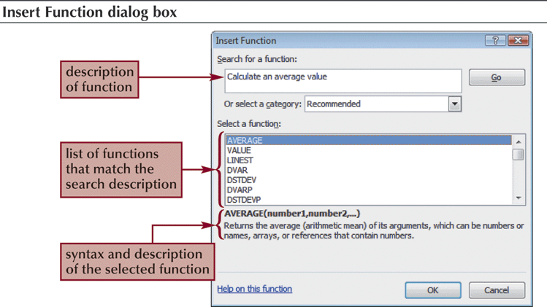
Inserting a Function

Slide 99
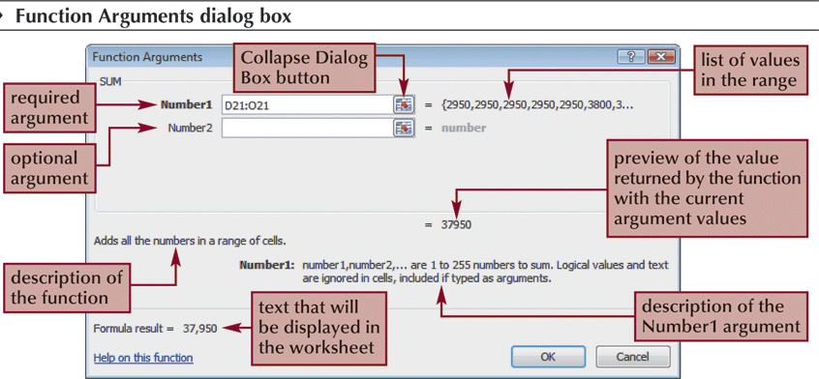
Inserting a Function

Slide 100
Inserting a Function
Typing in functions is another way to insert them
To start entering a function, type =
As you begin to type a function name within a formula, a list of functions that begin with the letters you typed appears

Slide 101
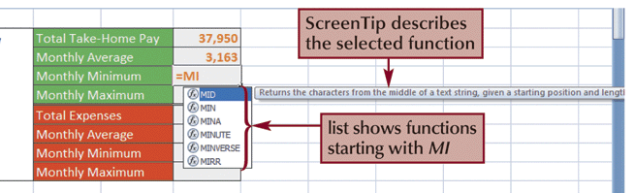
Inserting a Function

Slide 102
END OF SECTION
Absolute and Relative Cells and
FUNCTIONS

Slide 103
Blank for Duplex Printing

Slide 104
Blank for Duplex Printing

Slide 105
Nolan Tomboulian
Tomboulian@yahoo.com
Tomboulian.Wikispaces.com
ROWS
Columns
SHEETS

Slide 106
The real “power” of EXCEL is in its ability to automatically adjust cell references in formulas when you:
MOVE
COPY
INSERT
or DELETE
CELLS
ROWS
Or COLUMNS

Slide 107
Inserting
Columns or Rows
A new column or row can be inserted anywhere in a worksheet
  Inserting a column moves the existing columns to the right
  Inserting a row moves the existing rows down
New Columns inherit the width and formatting attributes of the column to the left (not the formulas)
New Rows inherit the height and formatting attributes of the row above (not the formulas)

Slide 108

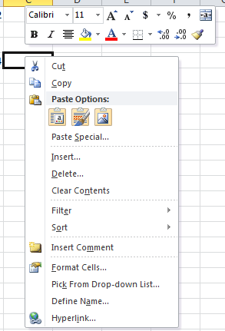
Inserting
Column(s) or Row(s)
Select the column(s) or row(s) where you want to insert the new column(s) or row(s);
Excel will insert the same number of columns or rows as you select (highlight)
  [Home] tab - Cells group, click the Insert button drop down dialog and press
or
  <Right-Click> the column or row heading and then click Insert on the Dialog Menu

Slide 109
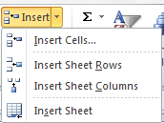
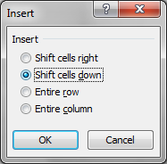
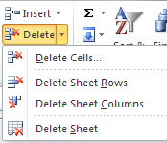
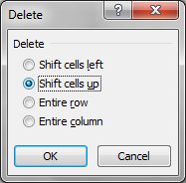
Be careful when using the buttons to select the Drop Down Dialog option.
Clicking the {button} will use the CELL default and may not be what you intended! (Ctrl+Z) to undo

Slide 110
Inserting or Deleting
Cell Range
Select the range that matches the size of the range you want to insert or delete
Go to the [Home] Tab - Cells group
To Insert Cells
  Click the Insert button arrow and then click the Insert Cells command
To Delete Cells
  Click the Delete button Options nd then click the Delete Cells command
Can also <right-click> the selected range, and then select Insert or Delete on the dialog menu

Slide 111
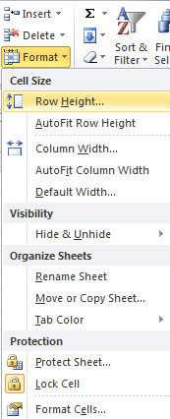
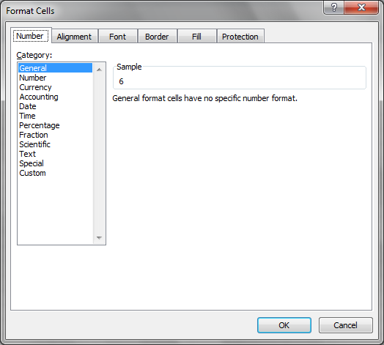

Slide 112
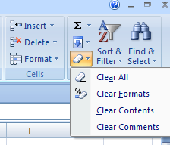
Deleting and Clearing a Row or Column
Deleting data from the worksheet removes both the data and the cells
Clearing data from a worksheet removes the data but leaves the blank cells
Remember <ctrl>+Z to Edit Undo most undesired changes using the keyboard

Slide 113
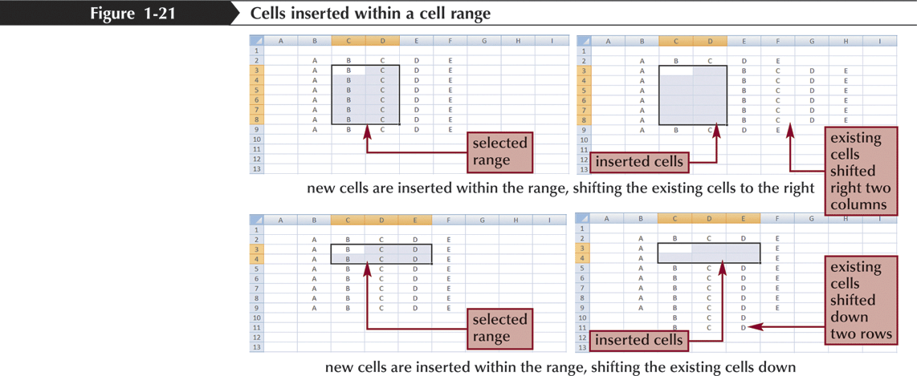
Inserting and Deleting a Cell Range

Slide 114
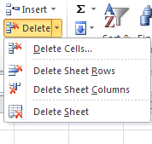
Inserting and Deleting a Worksheet
To insert a new worksheet into the workbook,
  right-click a sheet tab,
  click Insert on the shortcut menu,
  select a sheet type, and then click the OK button
Or Press the Insert Sheet Icon
You can delete a worksheet from a workbook in two ways:
  You can right-click the sheet tab of the worksheet you want to delete, and then click Delete on the shortcut menu
  Go to the Home tab – Cells group, click the Delete button arrow and then click Delete Sheet

Slide 115
Renaming a Worksheet
To rename a worksheet, you Double-Left-Click the sheet tab (or Right-Click) to select the sheet name, type a new name for the sheet, and then press the <Enter> key
  Sheet names cannot exceed 31 characters in length, including blank spaces
  The width of the sheet tab adjusts to the length of what you enter (keep it short!)
  It is a good practice Not to have <Spaces> in the Sheet Name. (Use the underscore _ {Raw_Data}

Slide 116
Moving and Copying a Worksheet
You can change the placement of the worksheets in a workbook
To reposition a worksheet, <Left Click> and drag the sheet tab to a new location relative to other worksheets in the workbook
To copy a worksheet, just press the Ctrl key and <Left Click> and drag and drop the sheet tab
You can also <Right Click> the Sheet Tab and select a desired option from the Dialog Box

Slide 117
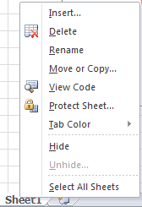
<Right Click> Sheet Tabs

Slide 118
Notes
END OF SECTION
    ROWS – COLUMNS – SHEETS

Slide 119
Blank for Duplex Printing

Slide 120
Blank for Duplex Printing

Slide 121
AutoFill
Nolan Tomboulian
Tomboulian@yahoo.com
Tomboulian.Wikispaces.com

Slide 122
Working with AutoFill
AutoFill copies content and formats from a cell or range into an adjacent cell or range
  Select the cell or range that contains the Data, Formula (s) you want to copy
  Drag the fill handle in the direction you want to copy and then release the mouse button
  To copy only the formats or only the formulas, click the AutoFill Options button (that appears after dragging the fill handle) and select the appropriate option

Slide 123
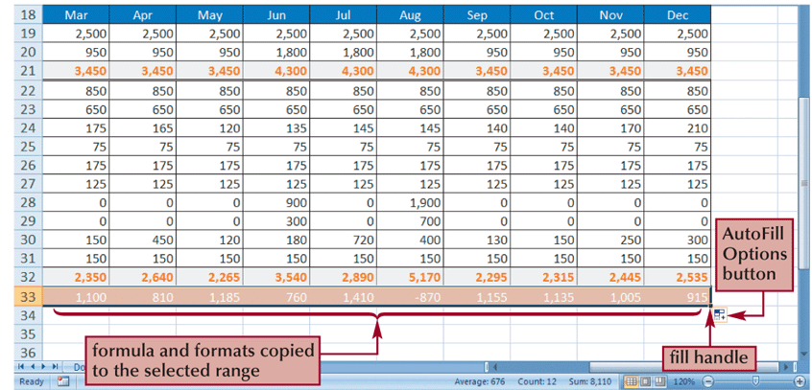
Working with AutoFill

Slide 124
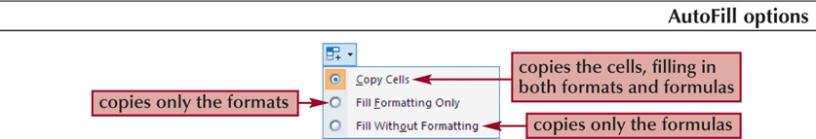
Using the AutoFill Options Button
By default, AutoFill copies both the formulas and the formats of the original range to the selected range
You can specify what is copied by using the AutoFill Options button that appears after you release the mouse button

Slide 125
Working with AutoFill
or
Select the cell or range that contains the formula(s) you want to copy
Go to the [Home] tab - Editing group and click the Fill button
Select the appropriate fill direction and fill type (or click Series, enter the desired fill series options, and then click the OK button)

Slide 126
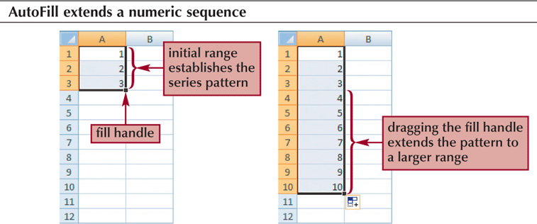
Filling a Series
AutoFill can also be used to create a series of numbers, dates, or text based on a pattern

Slide 127
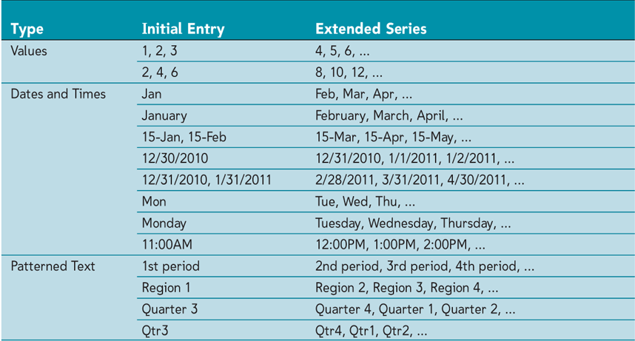
Filling a Series

Slide 128
Creating a Series with AutoFill
Enter the first few values of the series into a range
Select the range, and then drag the fill handle of the selected range over the cells you want to fill
or
Enter the first few values of the series into a range
Select the entire range into which you want to extend the series
Go to the [Home] tab - Editing group, click the Fill button, and then click Down, Right, Up, Left, Series, or Justify to set the direction you want to extend the series

Slide 129
Applying Formats
STYLES &
Paste Special
Nolan Tomboulian
Tomboulian@yahoo.com
Tomboulian.Wikispaces.com

Slide 130
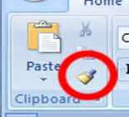
Copying Formats with the Format Painter
The Format Painter copies the formatting from one cell or range to another cell or range, without duplicating any of the data
  Select the range containing the format you wish to copy
  Click the Format Painter Button on the [Home] tab
      <Left Click> 1 time to use 1 time
      <Double Left Click> to use until you press <esc>
  Click the cell to which you want to apply the format

Slide 131
Copying Formats with the
Paste Options Button
The Paste Options button allows you to choose from several options when pasting.
You can choose:
  just values
  values and formatting
  function values

Slide 132

Copying Formats with the
Paste Options Button

Slide 133
Paste Special
Paste Special is another way you can control what is pasted from the Clipboard
Provides many of the same options as the Paste Option button, but includes ability to quickly add summary functions to data and transpose data from rows to columns

Slide 134

Paste Special

Slide 135
Applying Styles
A style is a collection of formatting that can be quickly applied to a cell or a range of cells
Can use the styles supplied with Excel or create your own
Some styles are connected to the workbook’s theme

Slide 136
Applying Styles
Select the cell or range to which you want to apply a style
Go to the [Home tab] – {Styles group} and click the Cell Styles Button
To see a <Live Preview> of a style on the selected cell or range, point to a style in the Cell Styles gallery
Click the style you want to apply to the selected cell or range

Slide 137

Applying Styles

Slide 138
End of Section
STYLES
and
Paste Special

Slide 139
Blank for Duplex Printing

Slide 140
Blank for Duplex Printing

Slide 141
Charts and Graphs <F11>
Nolan Tomboulian
Tomboulian@yahoo.com
Tomboulian.Wikispaces.com

Slide 142
Charts and Graphs
Charts and Graphs are a simple way to help make information easier to analyze
Often helps people make better sense of numerical data
  Show the relationship between a part and a whole
  Show how numbers change over time
  Show how values are distributed across a data set

Slide 143
Selecting a Data Source
The data source is the range that contains the data you want to display in the chart
Series name
Series values
Category values

Slide 144

Selecting a Data Source
Series Name
Category Values
Series Values

Slide 145

Selecting a Chart Type

Slide 146

Selecting a Chart Type
Click the [Insert]tab on the Ribbon
In the Charts group, click on the button of the type of chart you want to create

Slide 147
Moving and Resizing Charts
By default, a chart is inserted as an embedded chart, which means the chart is placed in a worksheet next to the data source
You can also place a chart in a “chart sheet”
To move a chart, go to the
  Chart Tools
    Design tab
      Location group and click the Move Chart button

Slide 148
Chart Elements
Chart Area – contains the chart and all of the different chart elements
Plot Area – the are where the chart is drawn
Data Marker – represents each data value of a data series
Legend – area that labels the marker or symbols used in the chart

Slide 149

Chart Elements

Slide 150
Formatting Chart Elements
Click the Chart Tools Layout tab
Groups and buttons to access the different chart elements
  Labels: Legend, Chart Title, etc
  Axis: depends on the chart type
  Background

Slide 151
Formatting the Chart Axis
Along with modifying axis text and labels, also control the scale of the axes
Modifying the chart axis usually changes the way data is displayed in the chart
Axis are not used in charts such as pie or doughnut

Slide 152

Formatting the Chart Axis

Slide 153
Editing Axis Range
Go to the Chart Tools Layout tab - Axis group then click the Axis button
Select the axis you want to edit
Click More… Options
Make the changes to the axis range are needed

Slide 154
Setting Label Units
Go to the [Chart Tools Layout] tab –
  {Axes group} then click the Axis button
Select the axis you want to edit
Click More… Options
Click the Display units arrow and then make your selection

Slide 155

Setting Label Units

Slide 156
Formatting Data Series
Click on one of the markers for the series you want to modify
Go to the Chart Tools Layout tab - Current Selection group and then click Format Selection
Can also right-click on any data series and select Format Data Series from the Shortcut Menu

Slide 157
Modifying the Legend
Go to the [Chart Tools Layout] tab
  {Labels group}, then click the Legend button, and then click the option you want.
To overlay the legend over the chart, click on the More Legend Options and then click the Show the legend without overlapping the chart check box to remove the check mark

Slide 158
End of Section
CHARTING
And
Graphs

Slide 159
Blank for Duplex Printing

Slide 160
Blank for Duplex Printing

Slide 161
Printing
&
Page Breaks
Nolan Tomboulian
Tomboulian@yahoo.com
Tomboulian.Wikispaces.com

Slide 162
Defining the Print Area
By default, all parts of the active worksheet containing text, formulas, or values are printed
You can select the cells you want to print, and then define them as a Print Area
  Select the range
  Go to the Page Layout tab - Page Setup group
  Click the Print Area button, and then click Set Print Area

Slide 163
Inserting Page Breaks
Excel prints as much as fits on a page and then inserts a page break to continue printing the remaining worksheet content on the next page
Manual Page Breaks specify exactly where you want the page breaks occur
You Can see where page breaks are currently set in the Page Layout or Page Break Preview View

Slide 164
Setting and Removing Page Breaks
To set a page break:
  Select the first cell below the row where you want to insert a page break
  Go to the [Page Layout] Tab –
    {Page Setup group}
  Click the Breaks button,
  and then click Insert Page Break

Slide 165
Setting and Removing Page Breaks
To remove a page break:
  Select any cell below or to the right of the page break you want to remove
  Go to the [Page Layout] tab –
    {Page Setup group}
  Click the Breaks button, and then click Remove Page Break (or click Reset All Page Breaks to remove all the page breaks from the worksheet)

Slide 166

Setting and Removing Page Breaks

Slide 167
Adding Print Titles
You can repeat information, such as the company name, by specifying which rows or columns in the worksheet act as Print titles, information that prints on each page
Go to the [Page Layout] tab – {Page Setup group} and click the Print Titles button
Click in the appropriate “repeat” box, move your pointer over the worksheet, and then select the rows and/or columns you want repeated
Click the OK button

Slide 168
Adding Headers and Footers
A header is the text printed in the top margin of each page
A footer is the text printed in the bottom margin of each page
Useful for adding information to printed worksheets such as page number, date printed, file owner, etc

Slide 169
Adding Headers and Footers
Scroll to the top of the worksheet
Click the left section of the header directly above cell A1 to display the Header & Footer Tools contextual tab
OR
Go to the Insert tab – Text group, and then click on the Headers & Footers button

Slide 170
NOTES

Slide 172
End of Section
PRINTING

Slide 173
Excel 2010
Backstage View
Nolan Tomboulian
252-675-0176
Tomboulian@Yahoo.com
Tomboulian.Info

Slide 174
Excel 2010
Backstage View
Nolan Tomboulian
252-675-0176
Tomboulian@Yahoo.com
Tomboulian.Info

Slide 175

Backstage View
Clicking the [FILE] Tab
brings up the Options for
Workbook File Management.
This was under the Microsoft
Office Button in 2007
The <default> option selected is {RECENT}

Slide 176

Backstage View
Samples from EXCEL 2010
Quick Access Toolbar
File Name
Ribbon Tabs {minimized}
Expand Ribbon
Pinned files.
Keep files active!
Most recently used files
Recover “unsaved” workbooks

Slide 177

Backstage View SAVE
The 1st time you {SAVE} a Workbook, it will give you the SAVE AS screen
File
Type
Optional File Tag Information and Icon View

Slide 178

Backstage View
SAVE AS (Changed the File Type)
Because of the expanded number of File formats, the ICON based Save-as from MS-2007 has been replaced with the drop-down dialog box.
If a workbook contains a MACRO, the new security requires the file to be saved as a Macro-Enabled Workbook

Slide 179

Backstage View
INFO - Versions
Versions are valid until you Close the file.
(Administrator may have disabled option)

Slide 180


Backstage View INFO
Permissions (Protect)
This is just a “Toggle” that can be turned on or off
You must remember the password..
It is CasE sENSItive.
Needs a “SERVICE”
Any changes to the workbook erases the Signature.

Slide 181

Backstage View INFO
Permissions Restrict
(Requires an outside service)

Slide 182

Prepare for Sharing

Slide 183

INFO - Prepare for Sharing / Inspect

Slide 184

Backstage View OPEN
The DEFAULT TYPE for EXCEL is a XLSX but you can select the Type to filter and display other file formats.

Slide 185

Backstage View NEW
Like an OPEN and SAVE AS
Many Template categories
Must <click> here

Slide 186

BackstageView PRINT
Press to Print
Print Preview
Quick Page Setup Options
Specific Printer Options
Page Selection
Zoom Slider

Slide 187

BackstageView SAVE and SEND
Requires
A
WINDOWS LIVE
SKY-DRIVE
ACCOUNT
You can be in the document when you use this.
Requires OUTLOOK to be installed.

Slide 188

BackstageView
HELP

Slide 189

Backstage View Options General
Suggest to leave Mini Tool Bar, Live Preview and Screen Tips on (Checked)
Silver – Blue - Black
The normal
default is 3 Sheets!
User Name change is made to ALL MS Office products

Slide 190

Backstage Options Formulas

Slide 191
Backstage Options Formulas

Slide 192

Backstage View Proofing

Slide 193



Backstage View Advanced

Slide 194


Backstage View Customize Ribbon and QAT
You cannot change the [FILE] Tab
Commands must be added at a {GROUP} level.
You define an Icon for the Group

Slide 195
Notes

Slide 196
Blank Page for duplex printing

Slide 197
Excel on-line
Help
&
Resources
Nolan Tomboulian
Tomboulian@yahoo.com
Tomboulian.Wikispaces.com

Slide 198
Online Resources
Microsoft Office: office.microsoft.com
Microsoft Training: microsoft.com/learning
CustomGuide: www.customguide.com
Mr. Excel: www.mrexcel.com
The Spreadsheet Page: spreadsheetpage.com
ExcelTip.com: www.exceltip.com
Excel for Dummies: www.dummies.com

Slide 199
Templates, Training and Examples
2003 to 2007 Commands (Interactive)
http://office.microsoft.com/en-us/excel-help/interactive-excel-2003-to-excel-2007-command-reference-guide-HA010149151.aspx
Templates
  http://office.microsoft.com/en-us/excel/
2003 to 2007 Menu to Ribbon
http://office.microsoft.com/asstvid.aspx?&type=flash&assetid=XT010149329&vwidth=1044&vheight=788

Slide 200
Microsoft Training Tutorials
http://office.microsoft.com/en-us/training/excel-2007-training-courses-HA010218987.aspx
2003 vs 2007
http://ezinearticles.com/?Excel-2003-Vs-Excel-2007---Whats-New-in-Excel-2007&id=1695056
Tutorials
http://spreadsheets.about.com/od/excel101/a/tutorial_hub.htm
http://www.gcflearnfree.org/excel2007

Slide 201
Excel Functions
http://www.excelfunctions.net/
Cheat Sheet
http://www.computerworld.com/s/article/9028218/Excel_2007_Cheat_Sheet_Quick_reference_charts
PDF Migration Information
http://www.liv.ac.uk/csd/acuk_html/473.dir/473.pdf

Slide 202
Microsoft Excel Interactive Menu Commands
http://office.microsoft.com/en-us/excel-help/interactive-excel-2003-to-excel-2007-command-reference-guide-HA010149151.aspx
2003 vs 2007 Key Differences
http://www.add-ins.com/Excel%202003%20versus%202007.htm
Keyboard Shortcuts
http://office.microsoft.com/en-us/excel-help/excel-shortcut-and-function-keys-HP010073848.aspx?pid=CH100947761033

Slide 203
Excel Functions
http://office.microsoft.com/en-us/excel-help/excel-functions-by-category-HP010079186.aspx
Odd Excel Commands
http://spreadsheetpage.com/index.php/oddity/bahttext/
Tricks and Tips
http://www.teachexcel.com/excel-help/excel-how-to.php?i=70019

Slide 204
Tutorial of Functions
http://www.teacherclick.com/excel2003/a_4_4_2.htm
Another page of “Hints”
http://www.bettersolutions.com/excel/EDH113/QE813022021.htm
Code to Covert a Number to Words Words
http://support.microsoft.com/default.aspx?scid=kb;en-us;213360
http://www.xldynamic.com/source/xld.xlFAQ0004.html
http://www.pcreview.co.uk/forums/convert-numeric-text-t1770367.html

