Slide 1
TABE ELA-E PAXEN Unit-4 Vocabulary and Word Use Lesson-30 Glossaries and Dictionaries
Some graphics may not have copied well during the Scan Process

Slide 2
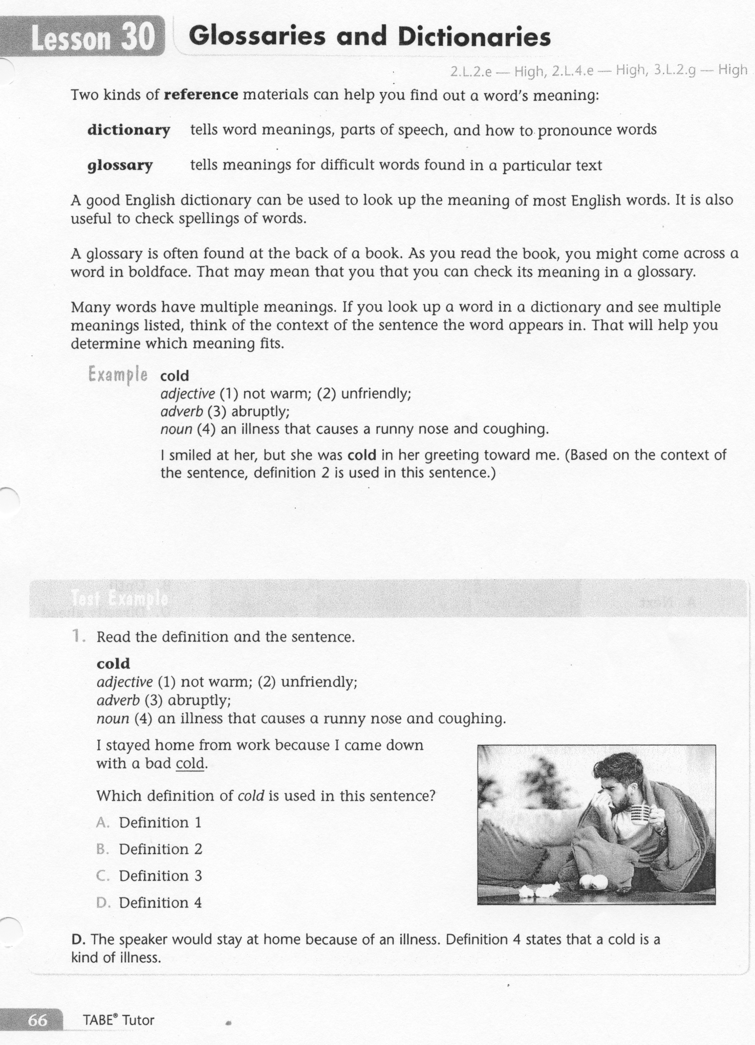
ELA-E-30 Glossaries and Dictionaries

Slide 3
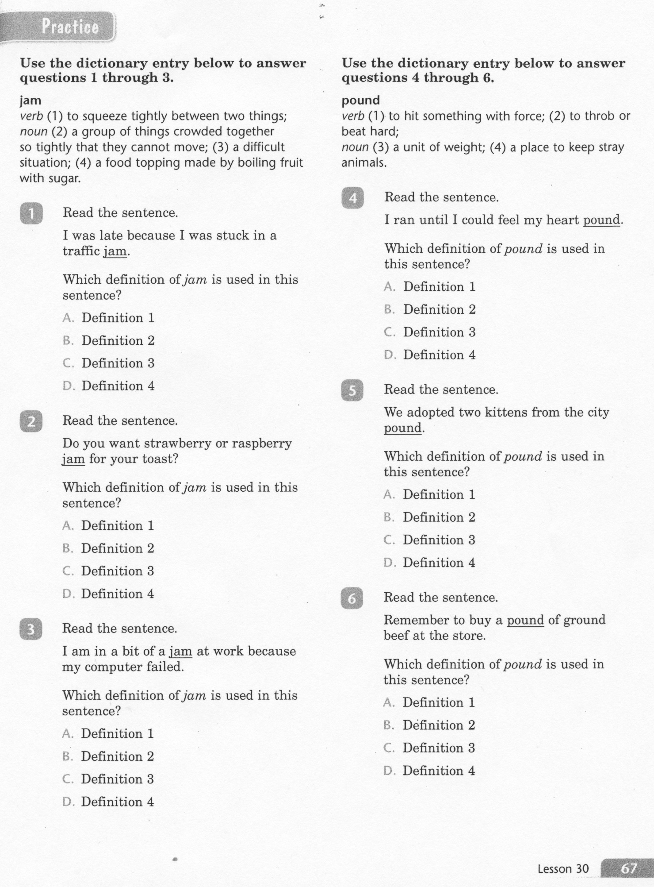
ELA-E-30 Glossaries and Dictionaries

Slide 4
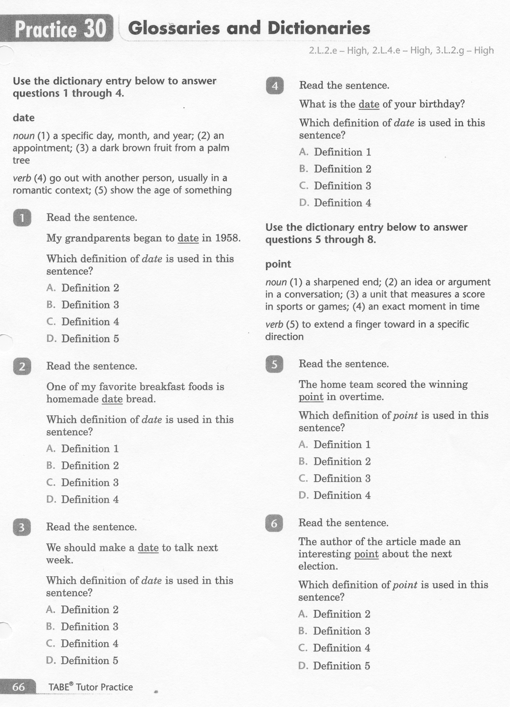
ELA-E-30 Glossaries and Dictionaries

Slide 5
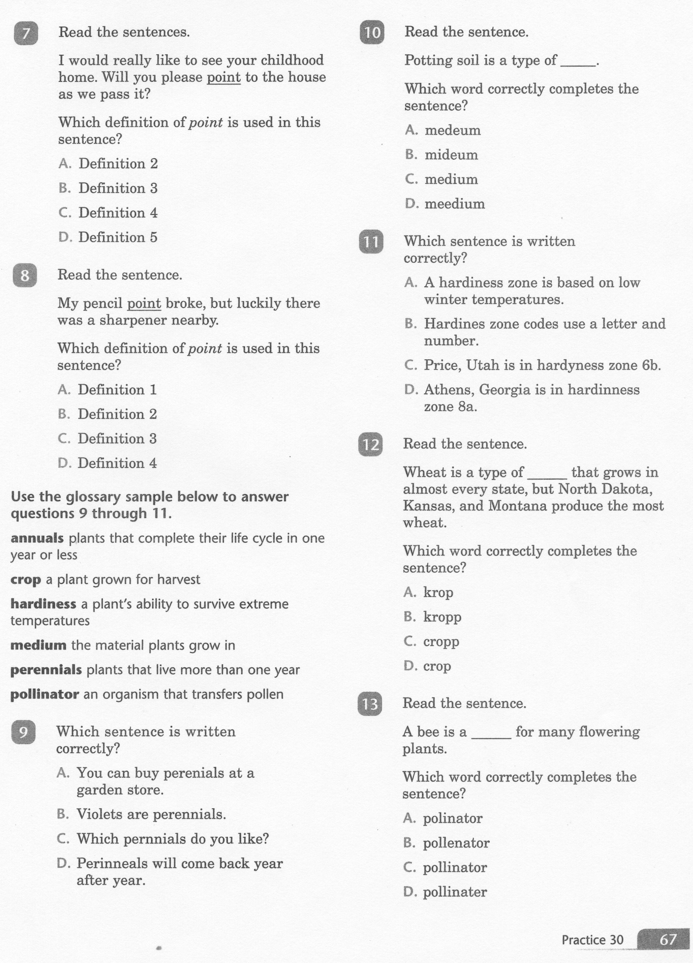
ELA-E-30 Glossaries and Dictionaries

Slide 6
ELA-E-30 Glossaries and Dictionaries

Slide 7
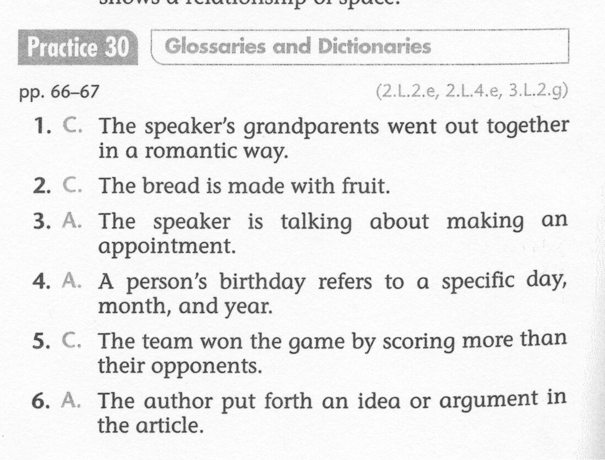
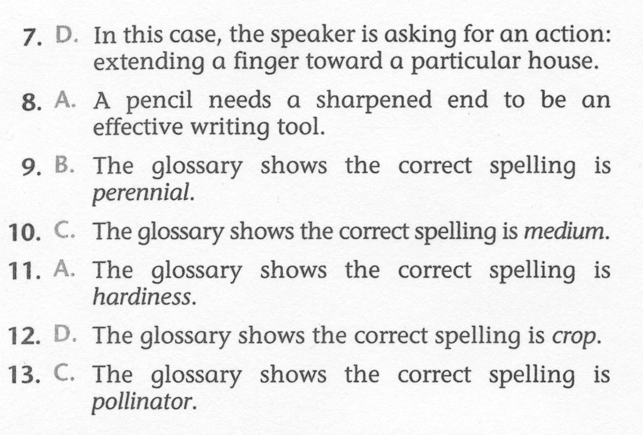
ELA-E-30 Glossaries and Dictionaries

