Slide 1
TABE ELA-E PAXEN Unit-4 Vocabulary and Word Use Lesson-26 Literal and Non-Literal
Some graphics may not have copied well during the Scan Process

Slide 2
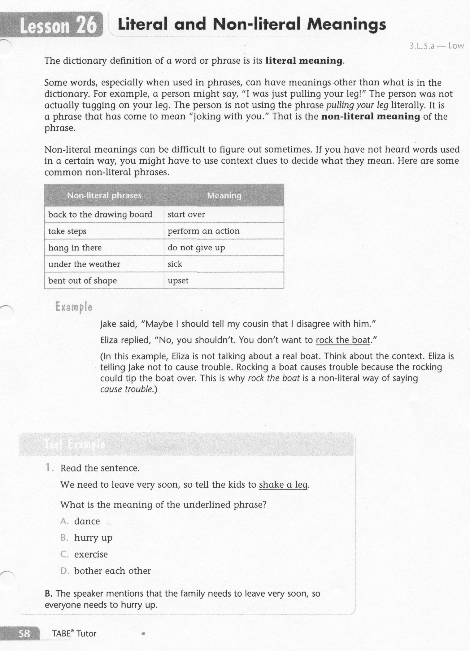
ELA-E-26 Literal and Non-literal

Slide 3
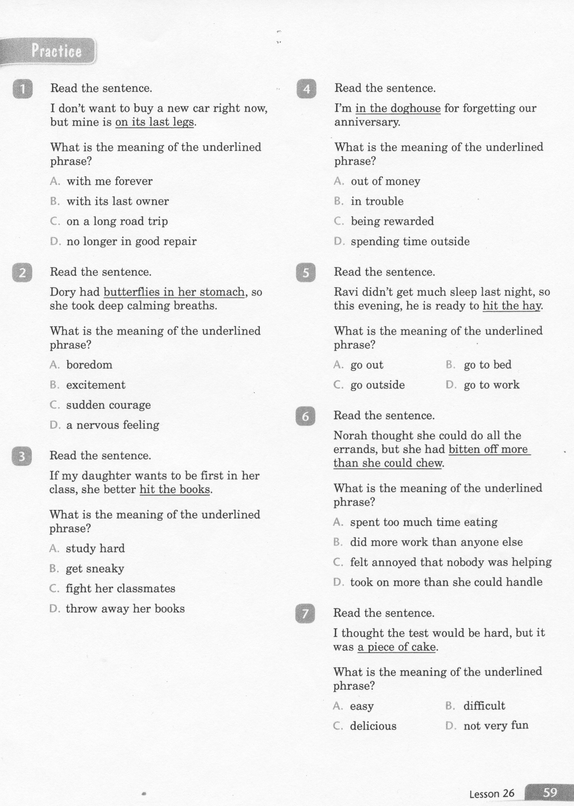
ELA-E-26 Literal and Non-literal

Slide 4
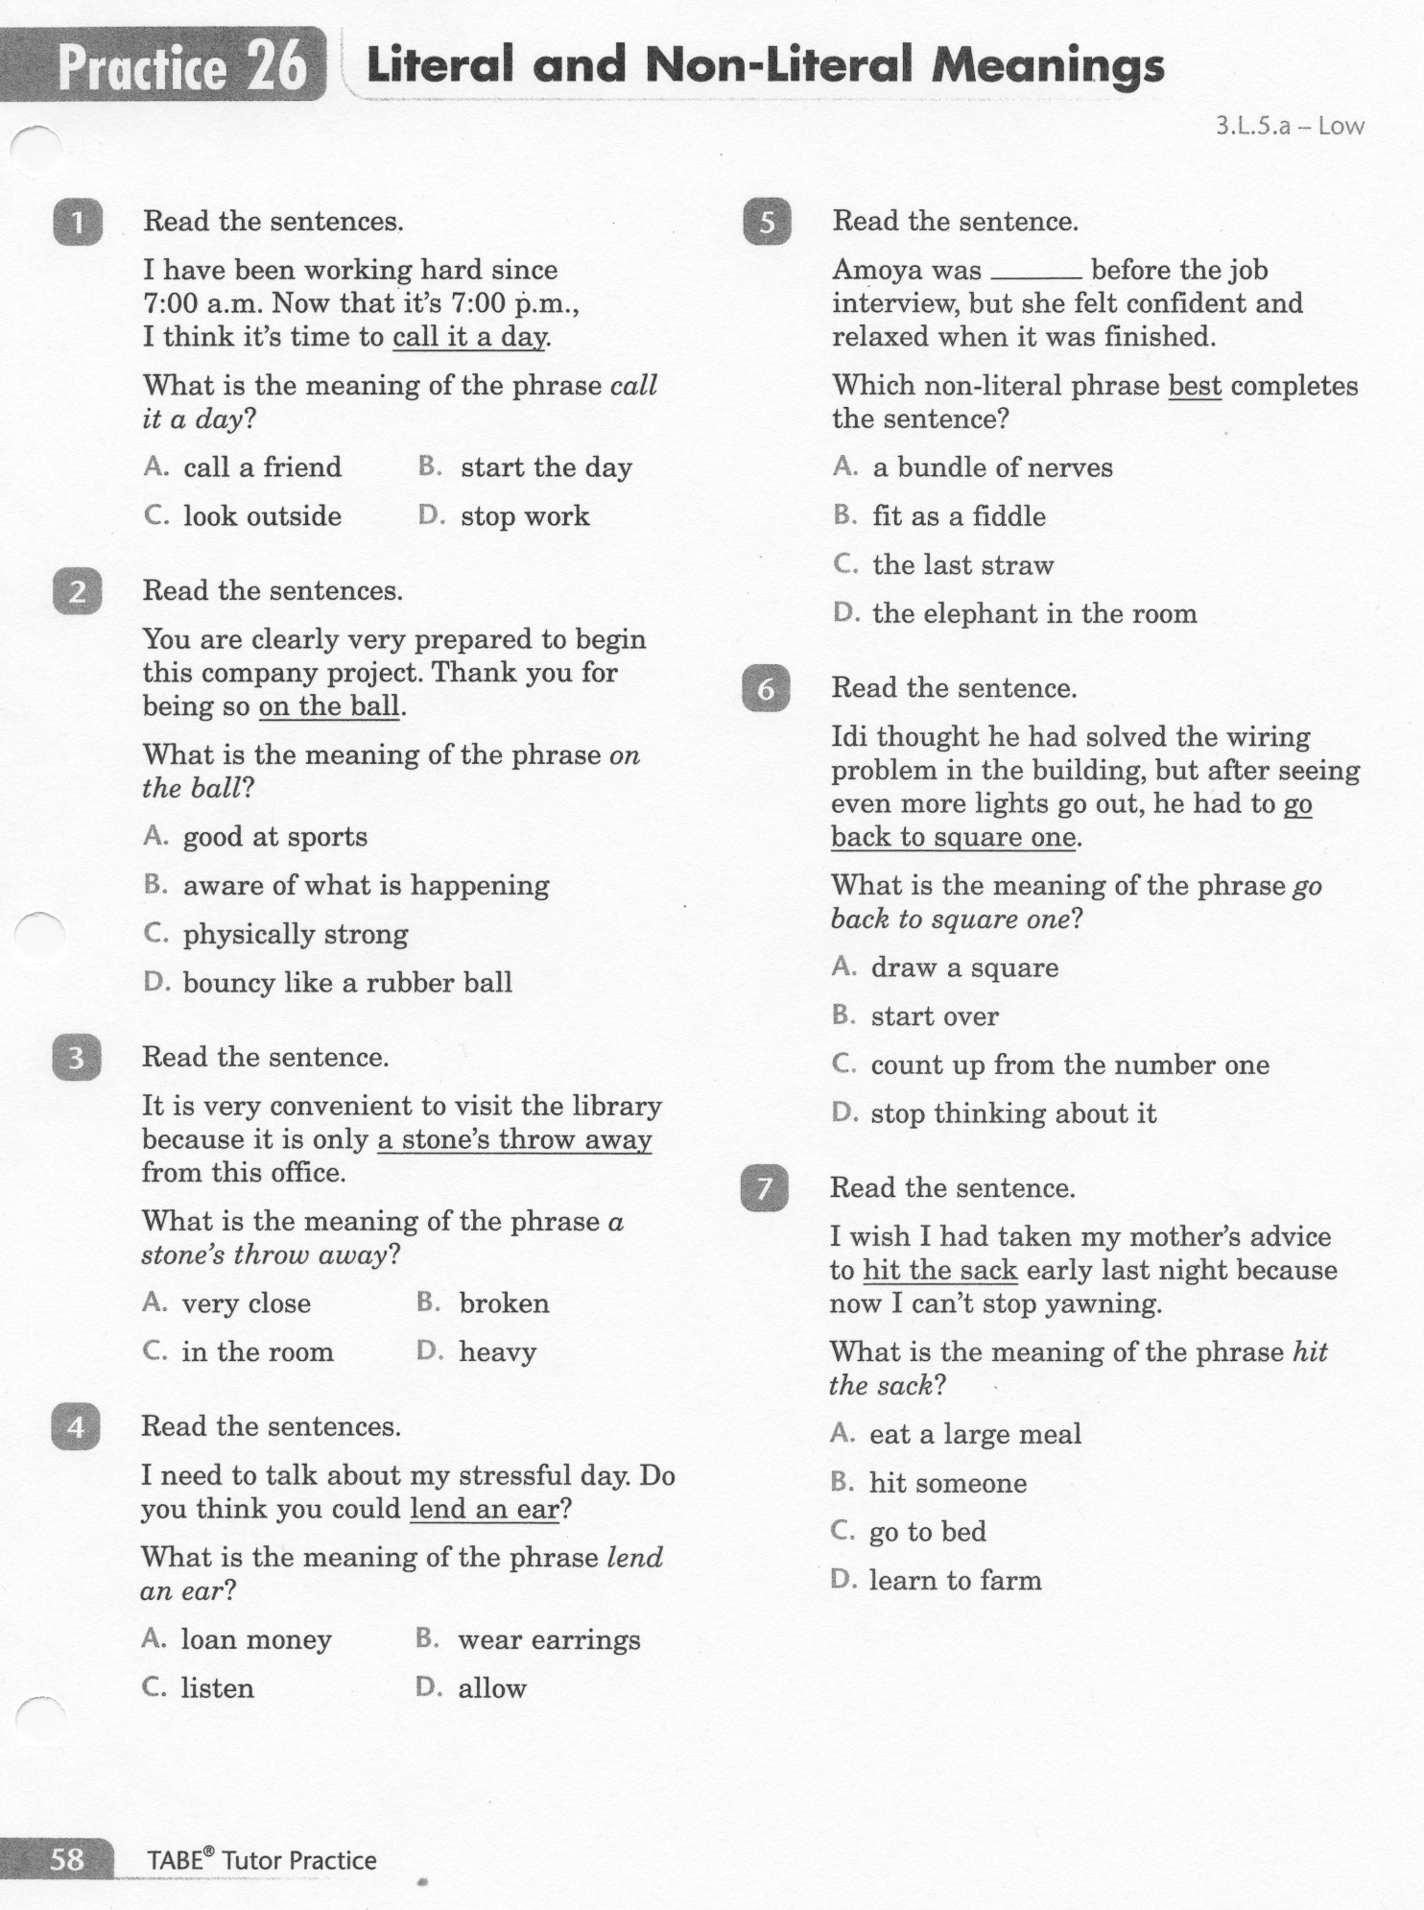
ELA-E-26 Literal and Non-literal

Slide 5
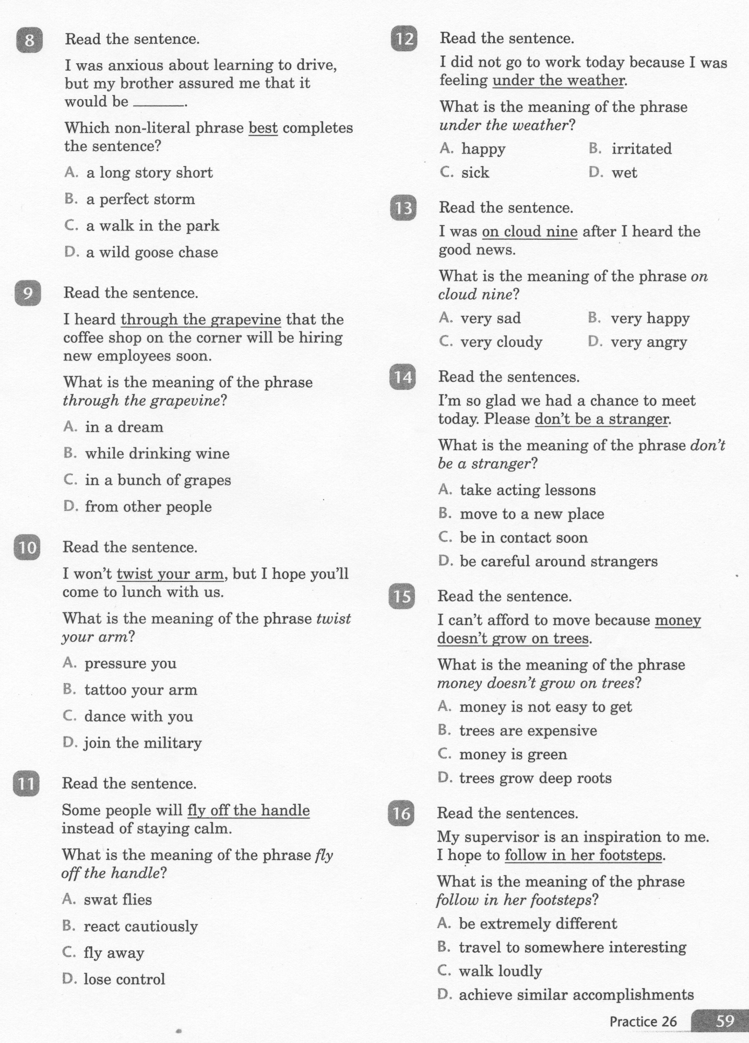
ELA-E-26 Literal and Non-literal

Slide 6
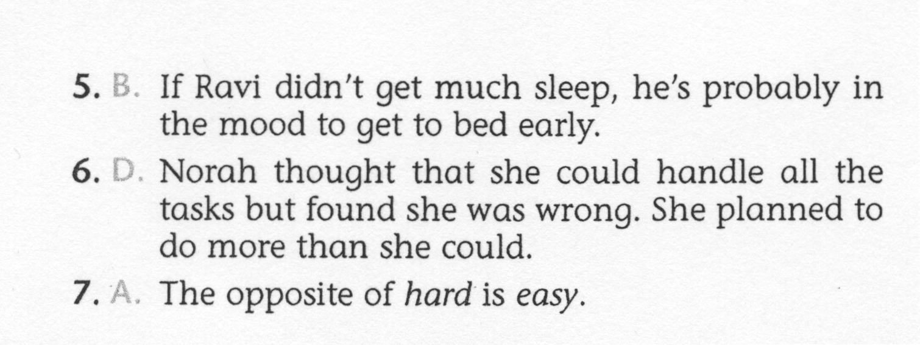
ELA-E-26 Literal and Non-literal

Slide 7
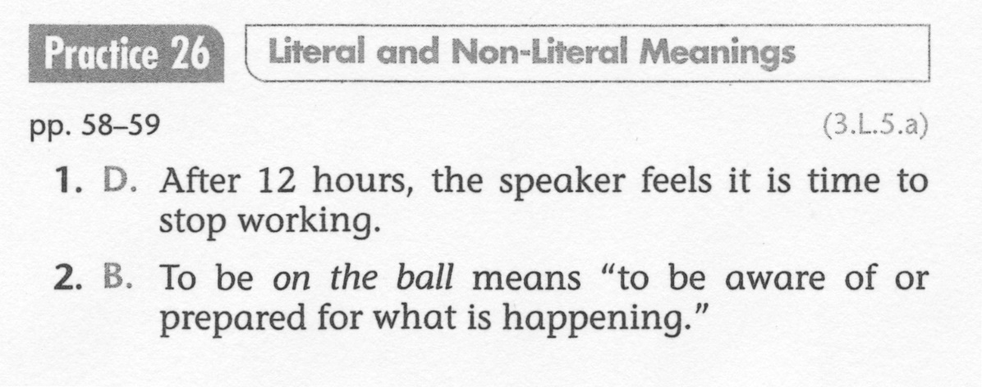
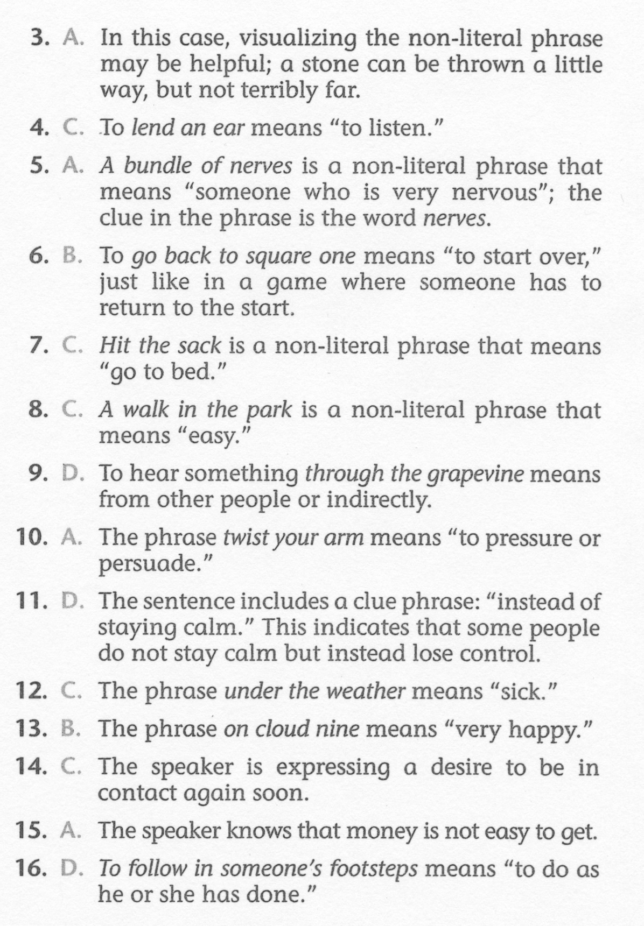
ELA-E-26 Literal and Non-literal

