Slide 1
TABE ELA-E PAXEN Unit-3 SENTENCES Lesson-21 Combine sentences with Subordinating Conjunctions
Some graphics may not have copied well during the Scan Process

Slide 2
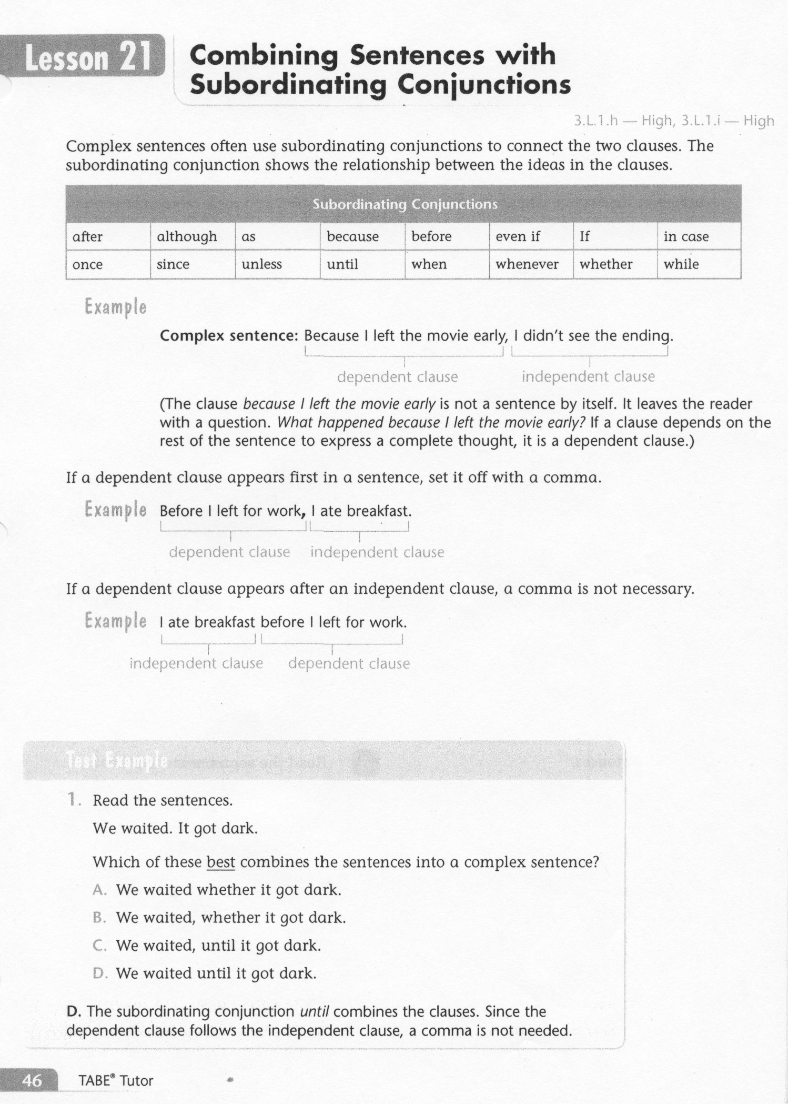
ELA-E-21 Subordinating Conjunctions

Slide 3
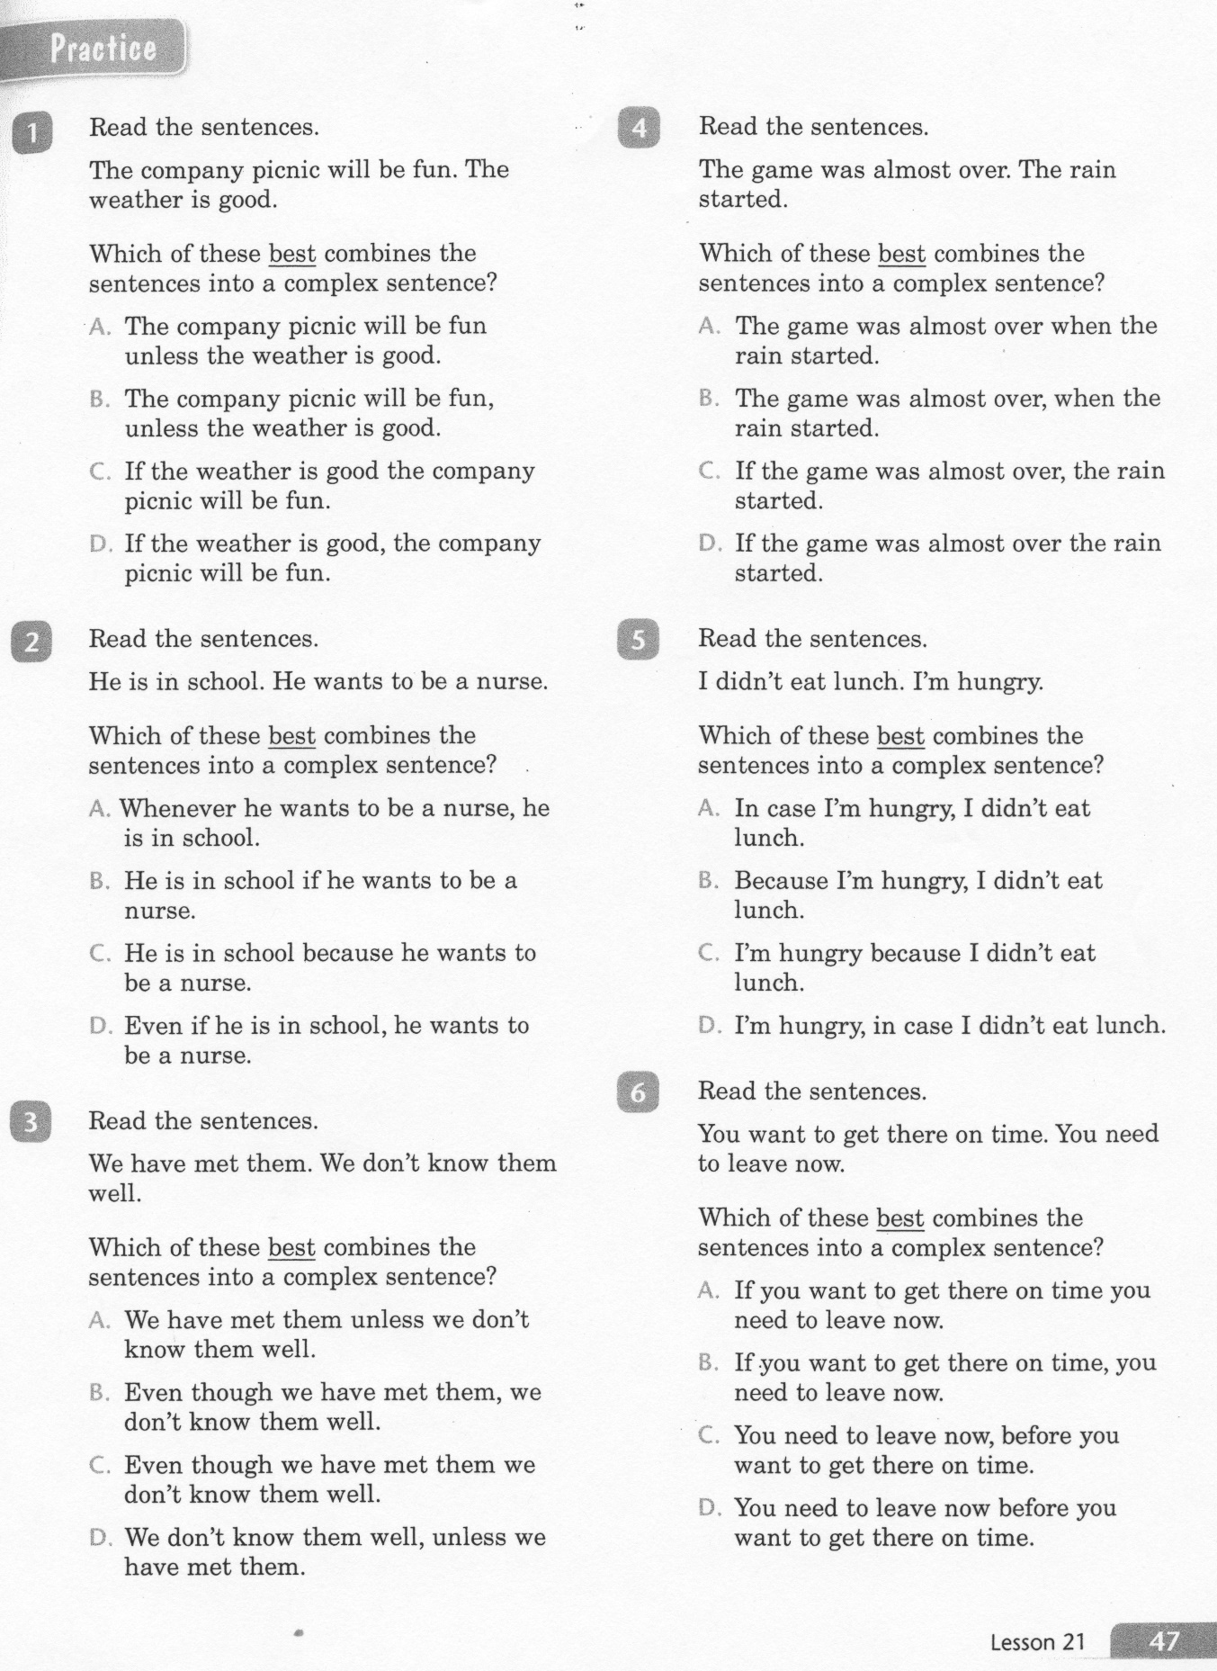
ELA-E-21 Subordinating Conjunctions

Slide 4
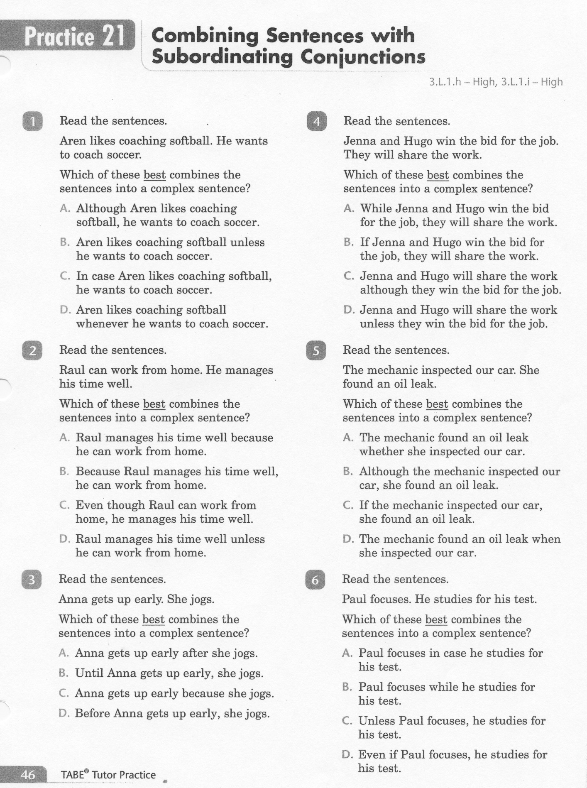
ELA-E-21 Subordinating Conjunctions

Slide 5
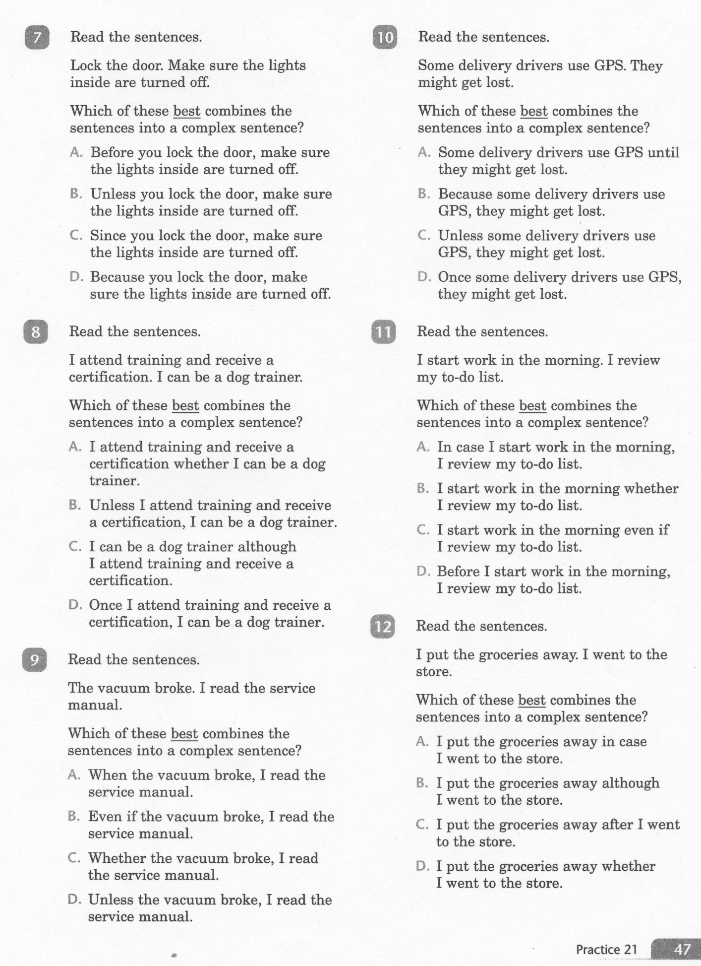
ELA-E-21 Subordinating Conjunctions

Slide 6
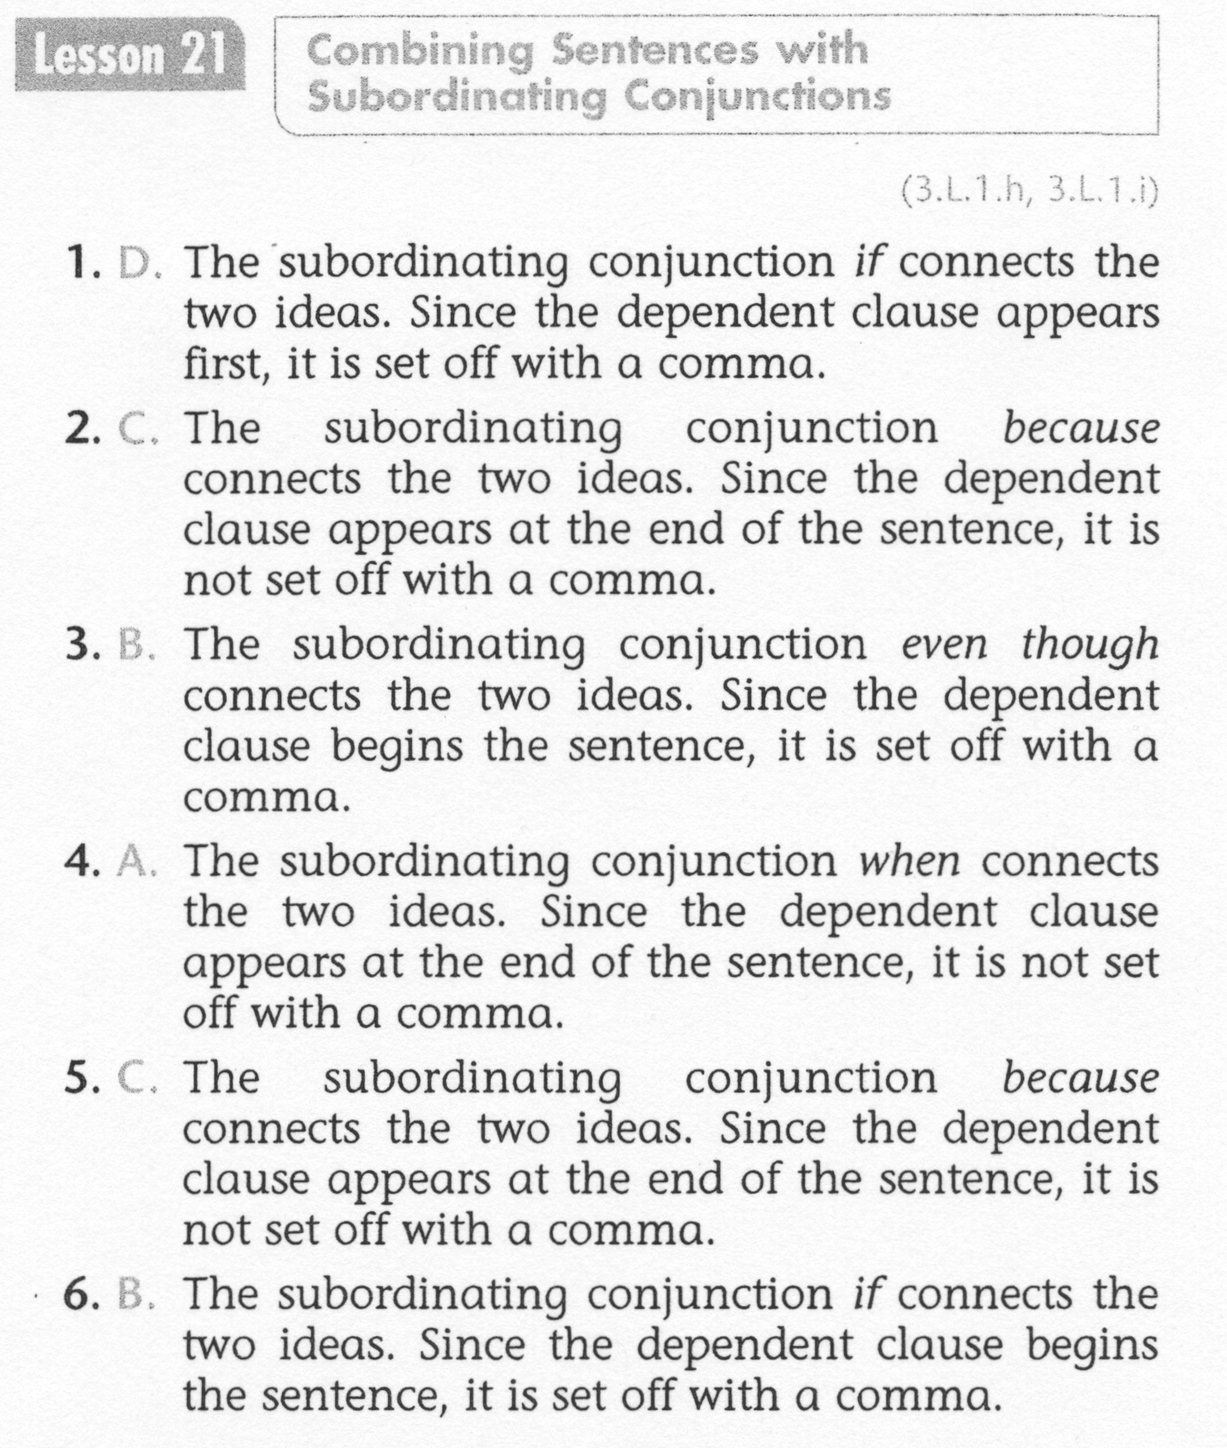
ELA-E-21 Subordinating Conjunctions

Slide 7
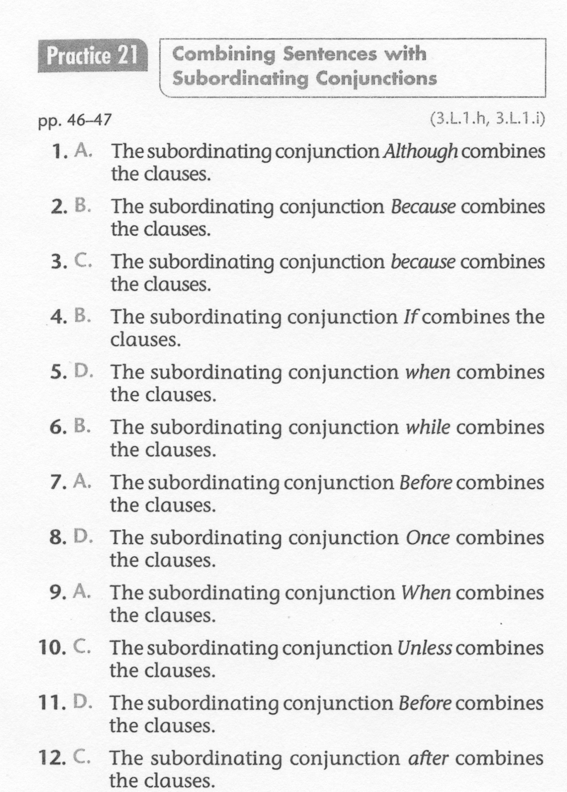
ELA-E-21 Subordinating Conjunctions

