Slide 1
TABE ELA-E PAXEN Unit-3 SENTENCES Lesson-19 Complex Sentences
Some graphics may not have copied well during the Scan Process

Slide 2
ELA-E-19 Complex Sentences

Slide 3
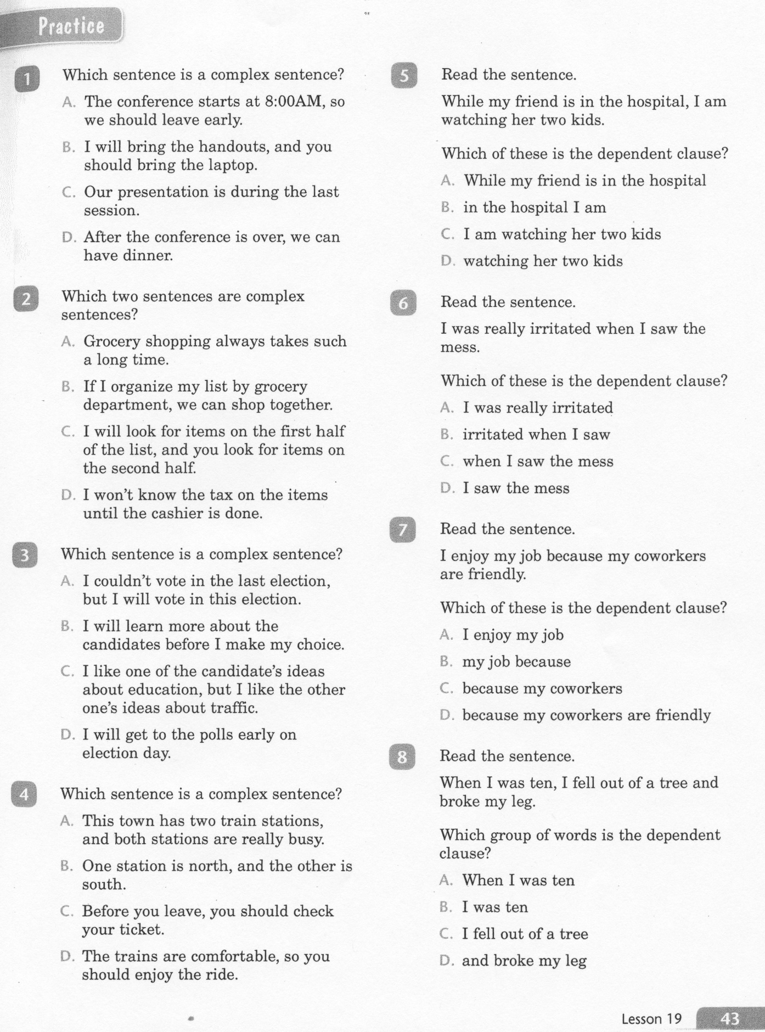
ELA-E-19 Complex Sentences

Slide 4
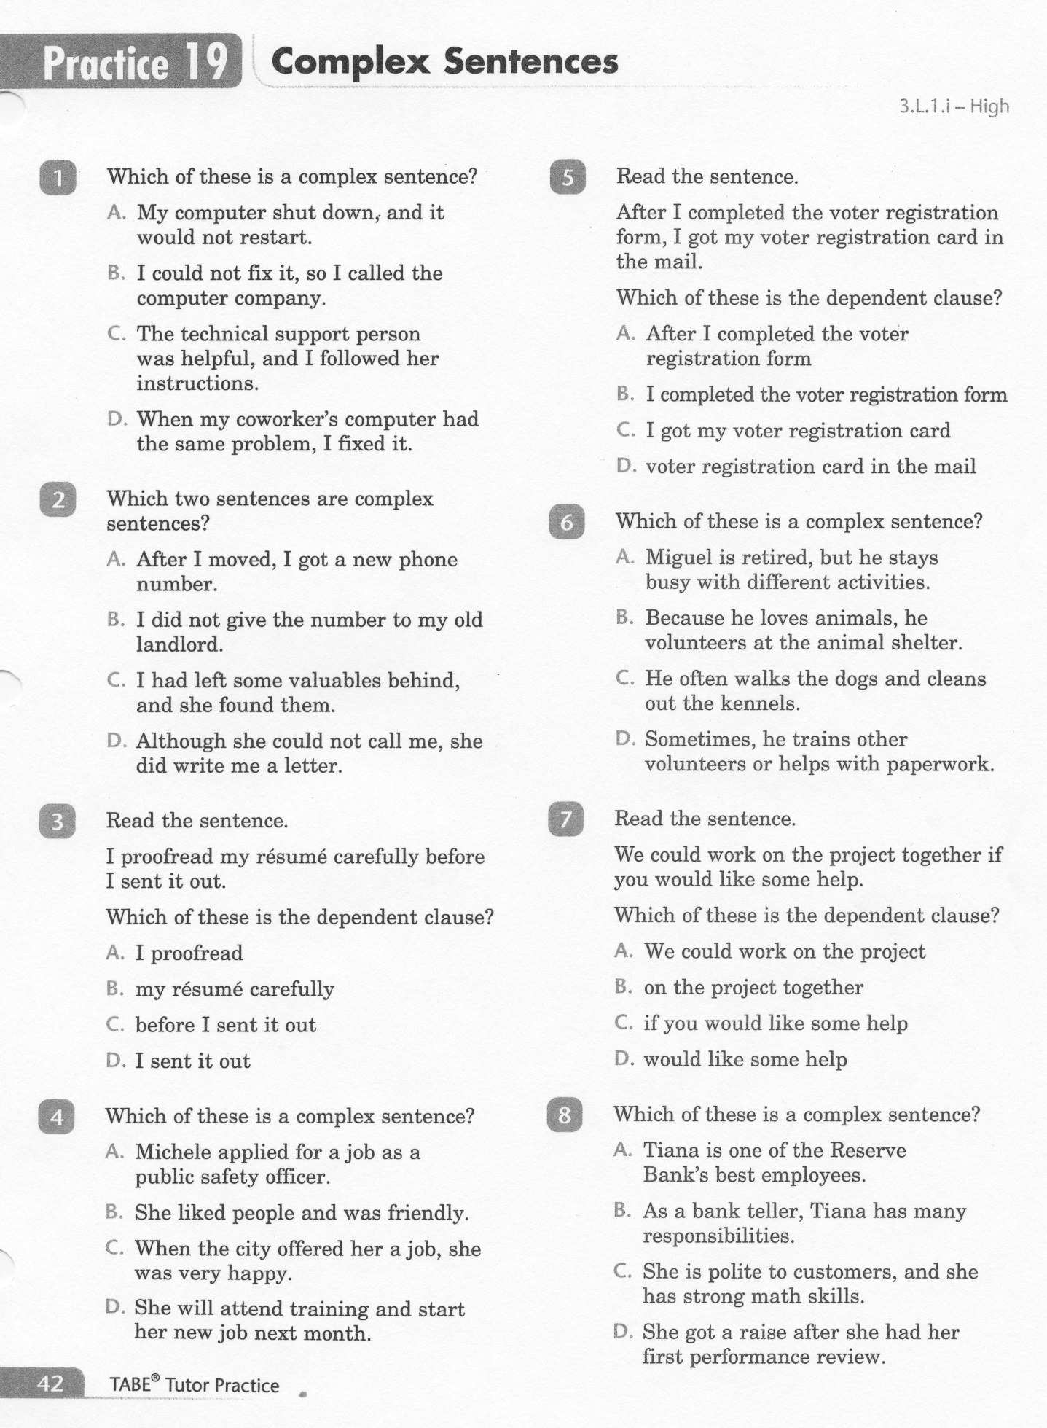
ELA-E-19 Complex Sentences

Slide 5
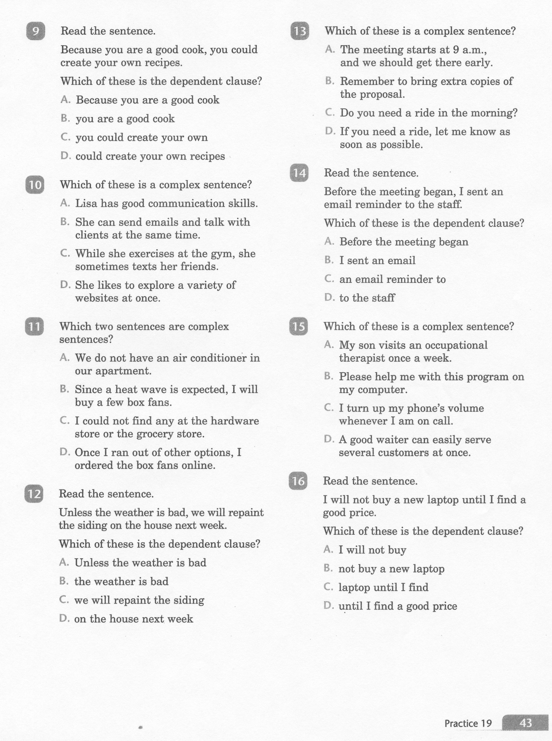
ELA-E-19 Complex Sentences

Slide 6
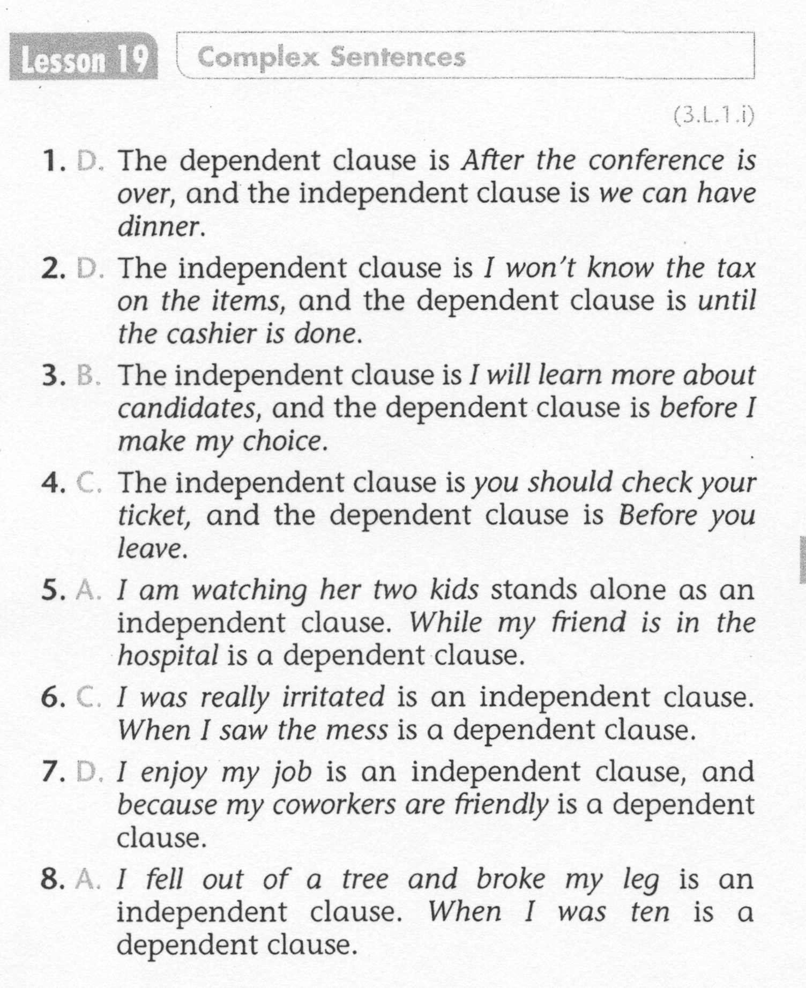
ELA-E-19 Complex Sentences

Slide 7
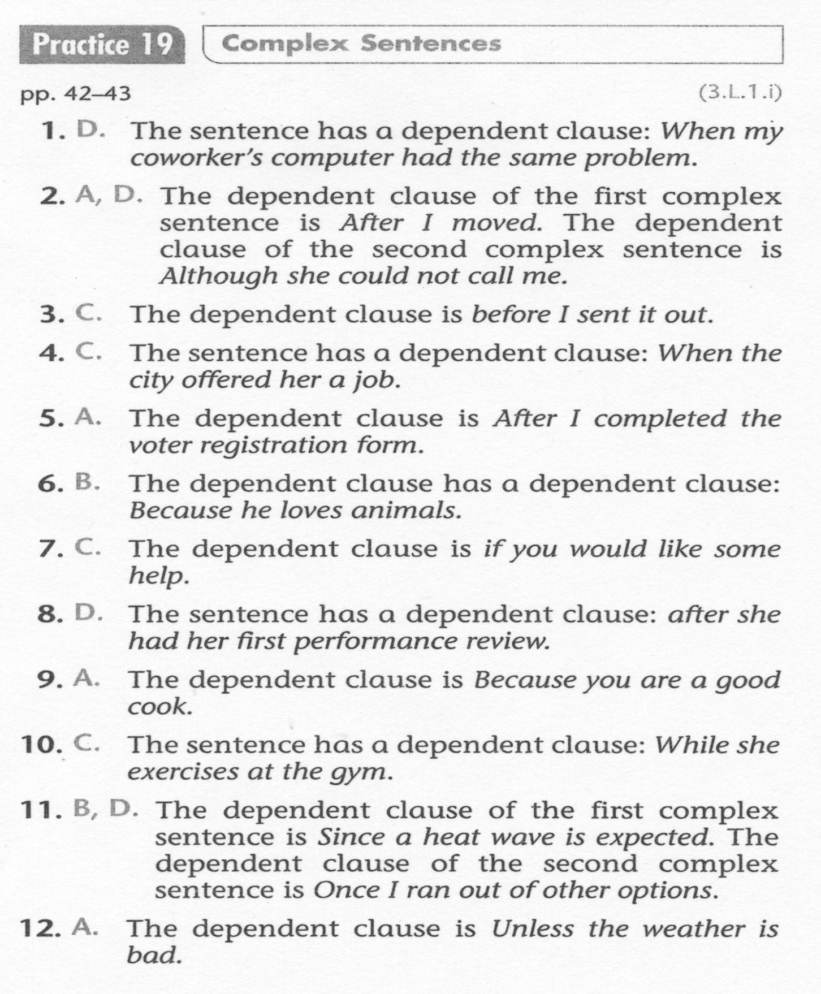
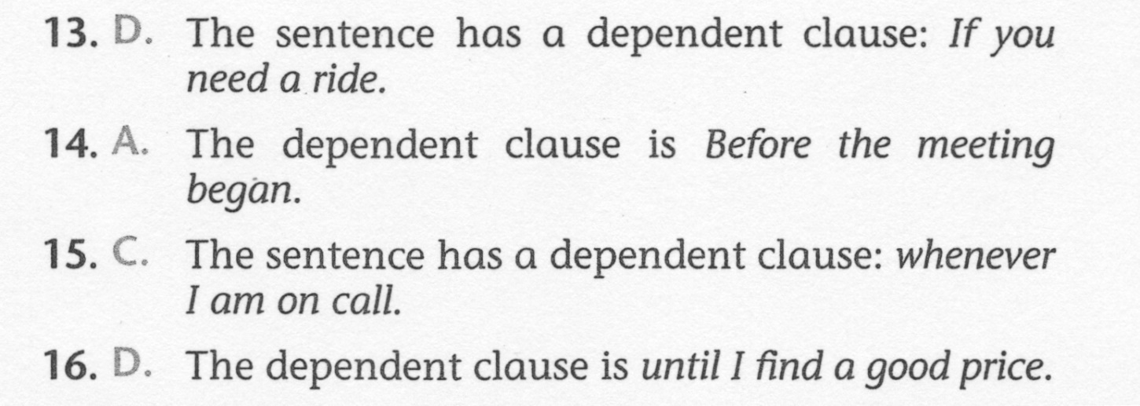
ELA-E-19 Complex Sentences

