Slide 1
TABE ELA-E PAXEN Unit-2 Punctuation, Capitalization, and Spelling Lesson-14 Commas
Some graphics may not have copied well during the Scan Process

Slide 2
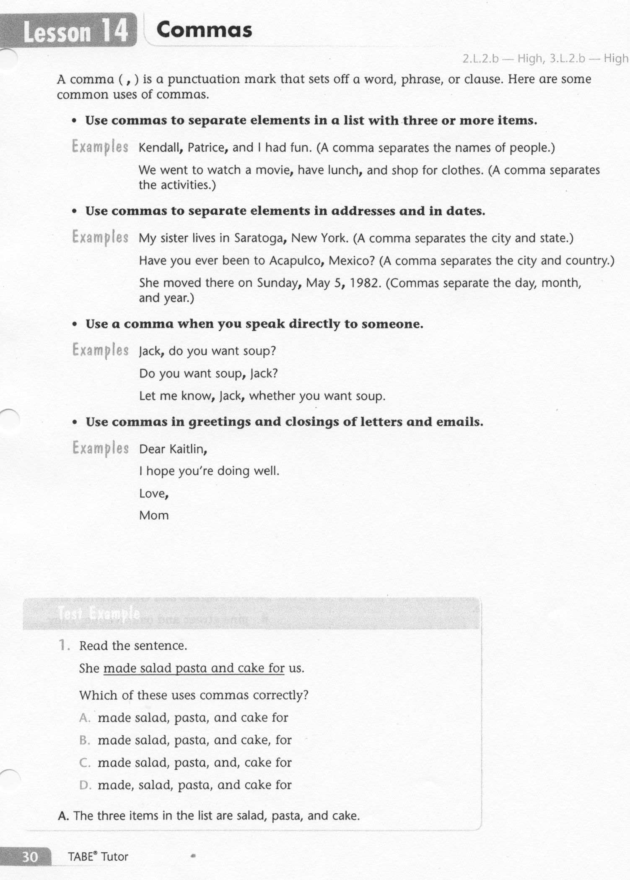
ELA-E-14 Commas

Slide 3
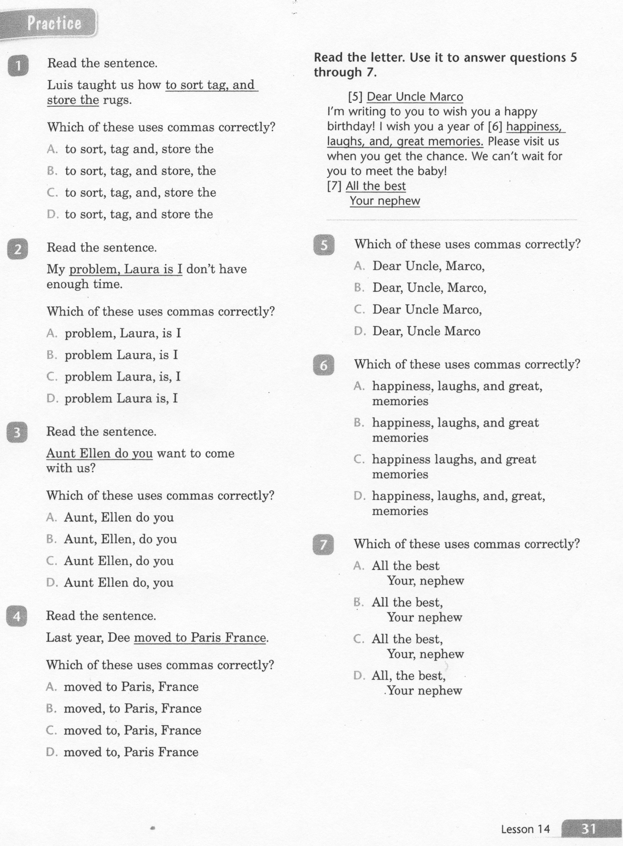
ELA-E-14 Commas

Slide 4
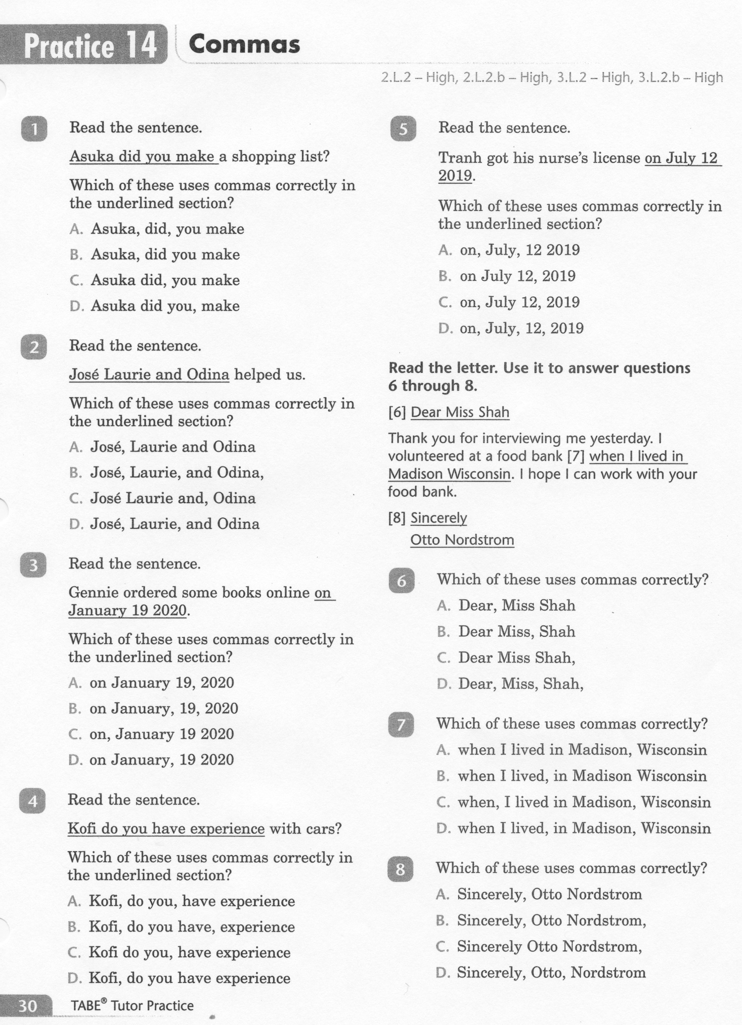
ELA-E-14 Commas

Slide 5
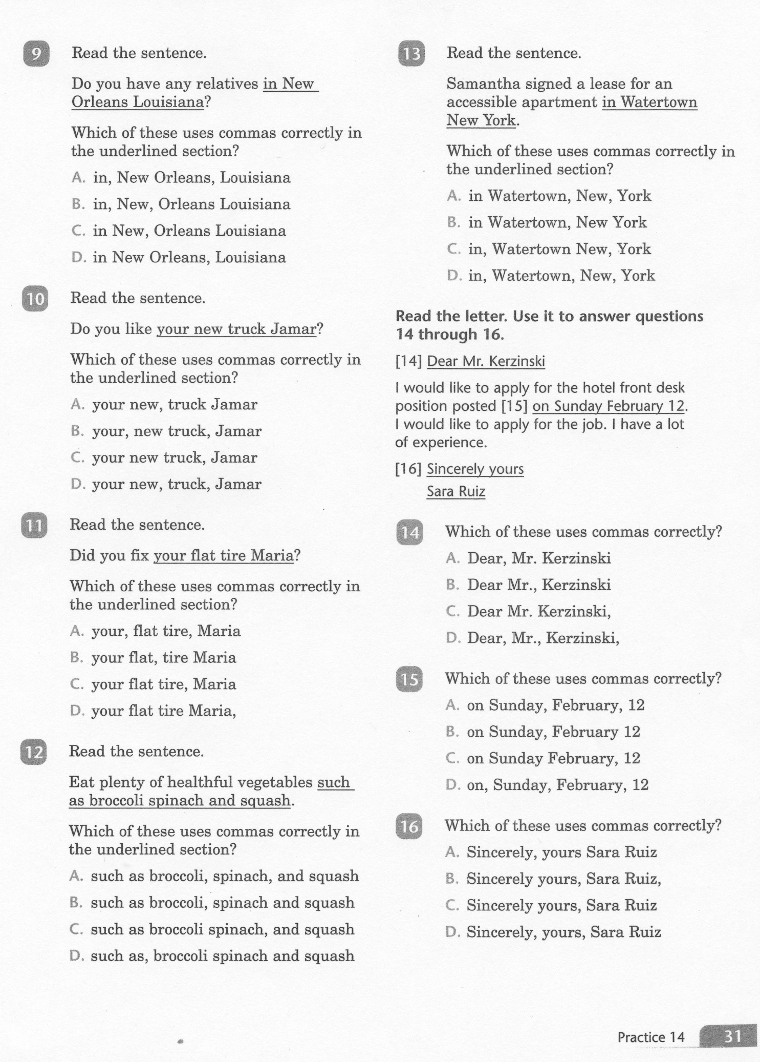
ELA-E-14 Commas

Slide 6
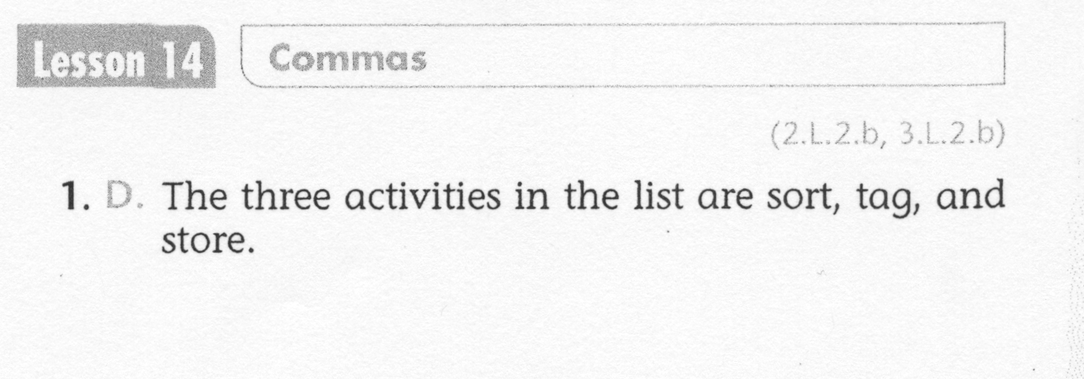
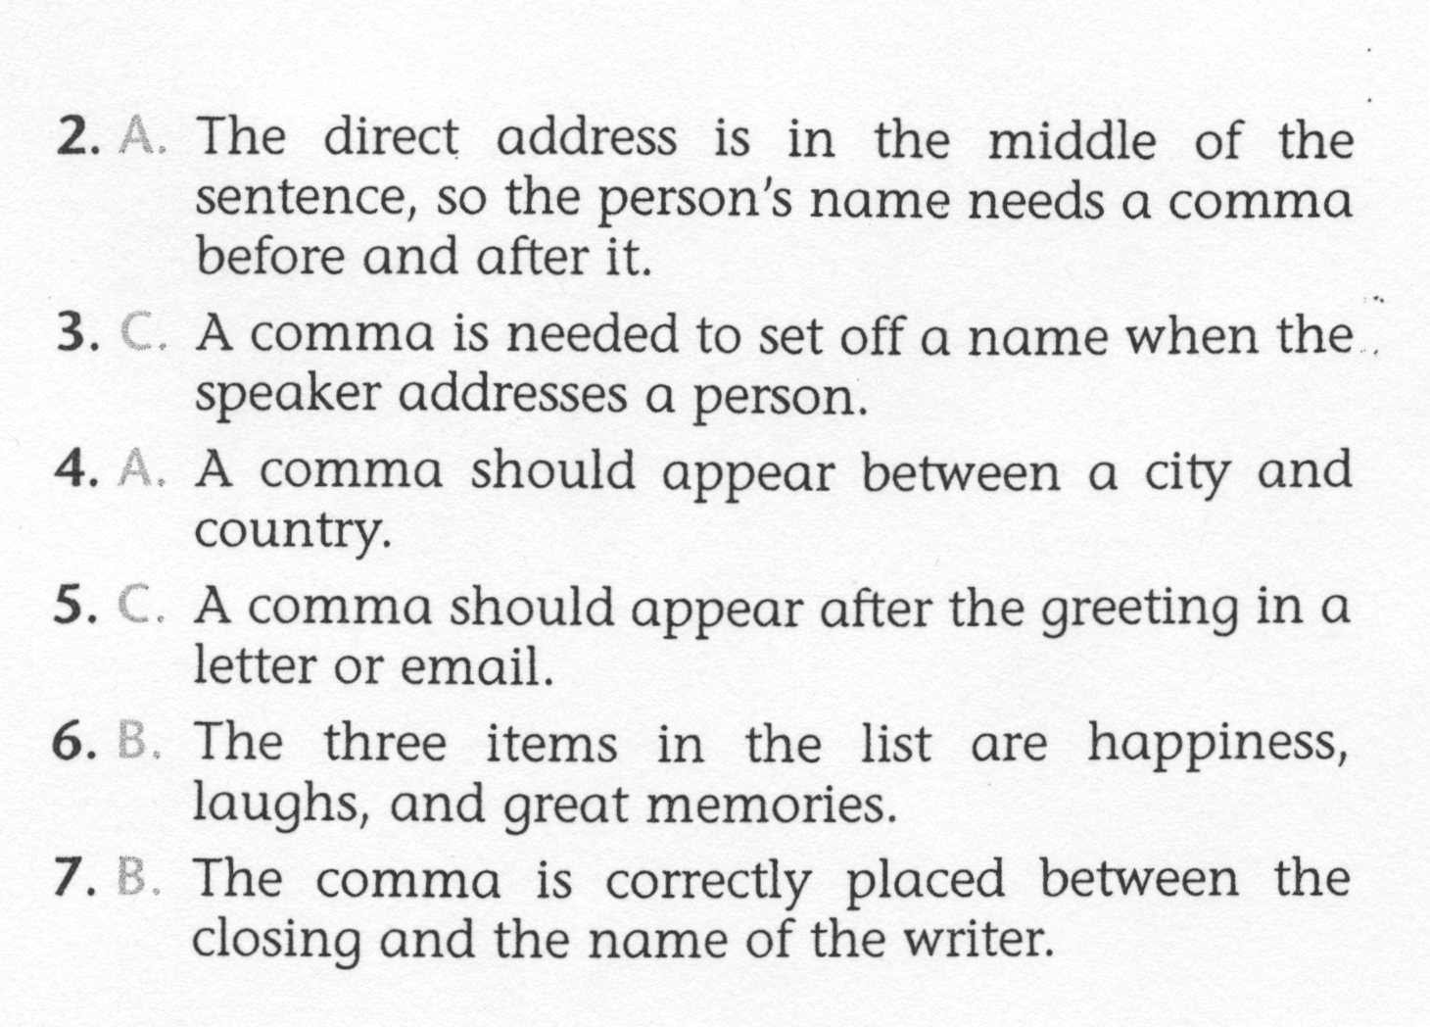
ELA-E-14 Commas

Slide 7
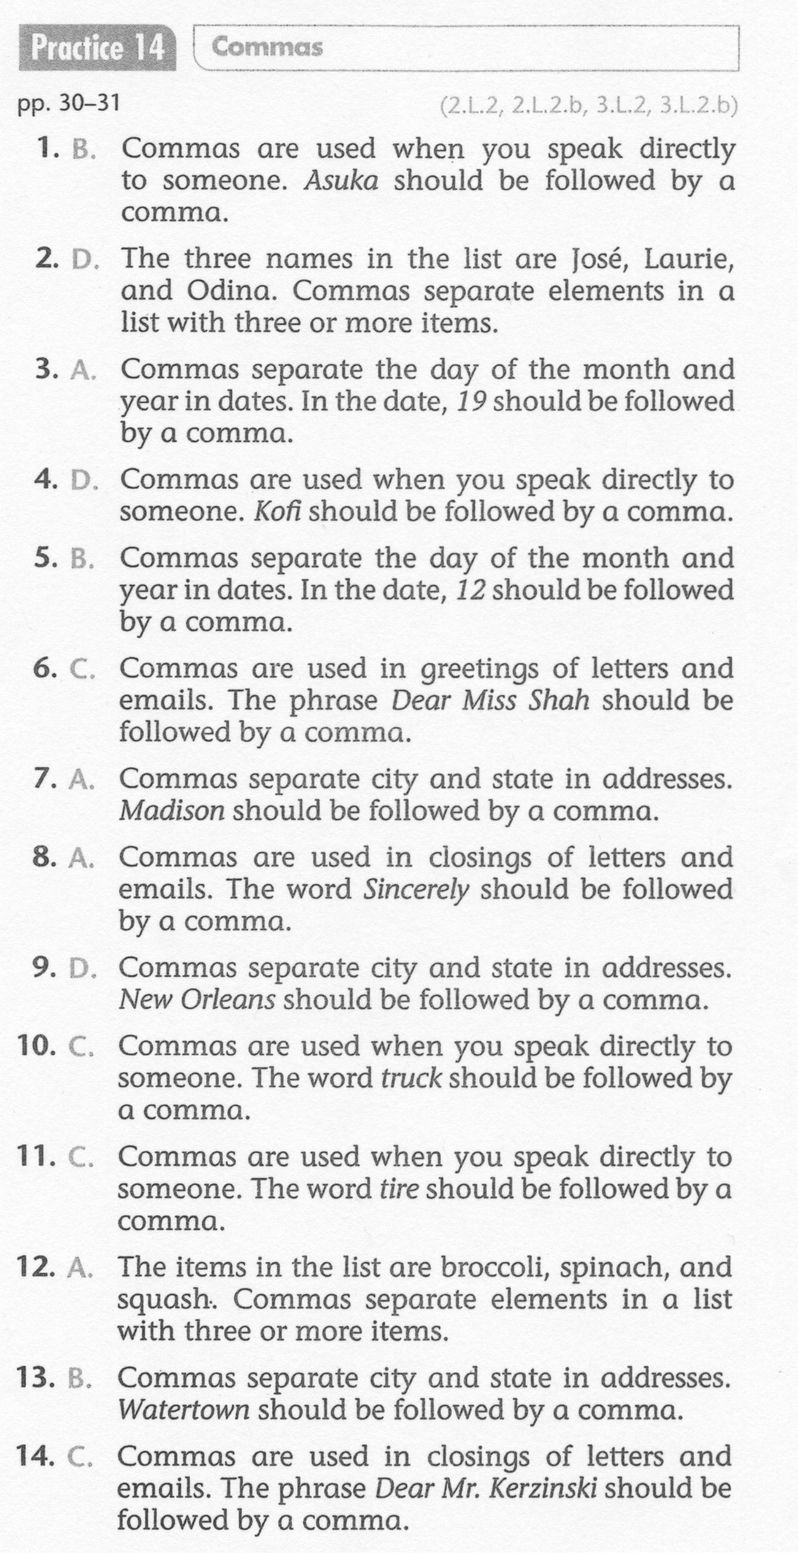
ELA-E-14 Commas

