Slide 1
TABE ELA-E PAXEN Unit-1 Usage Lesson-01 Nouns, Pronouns, Adjectives
Some graphics may not have copied well during the Scan Process

Slide 2
ELA-E-01_Nouns and Pronouns

Slide 3
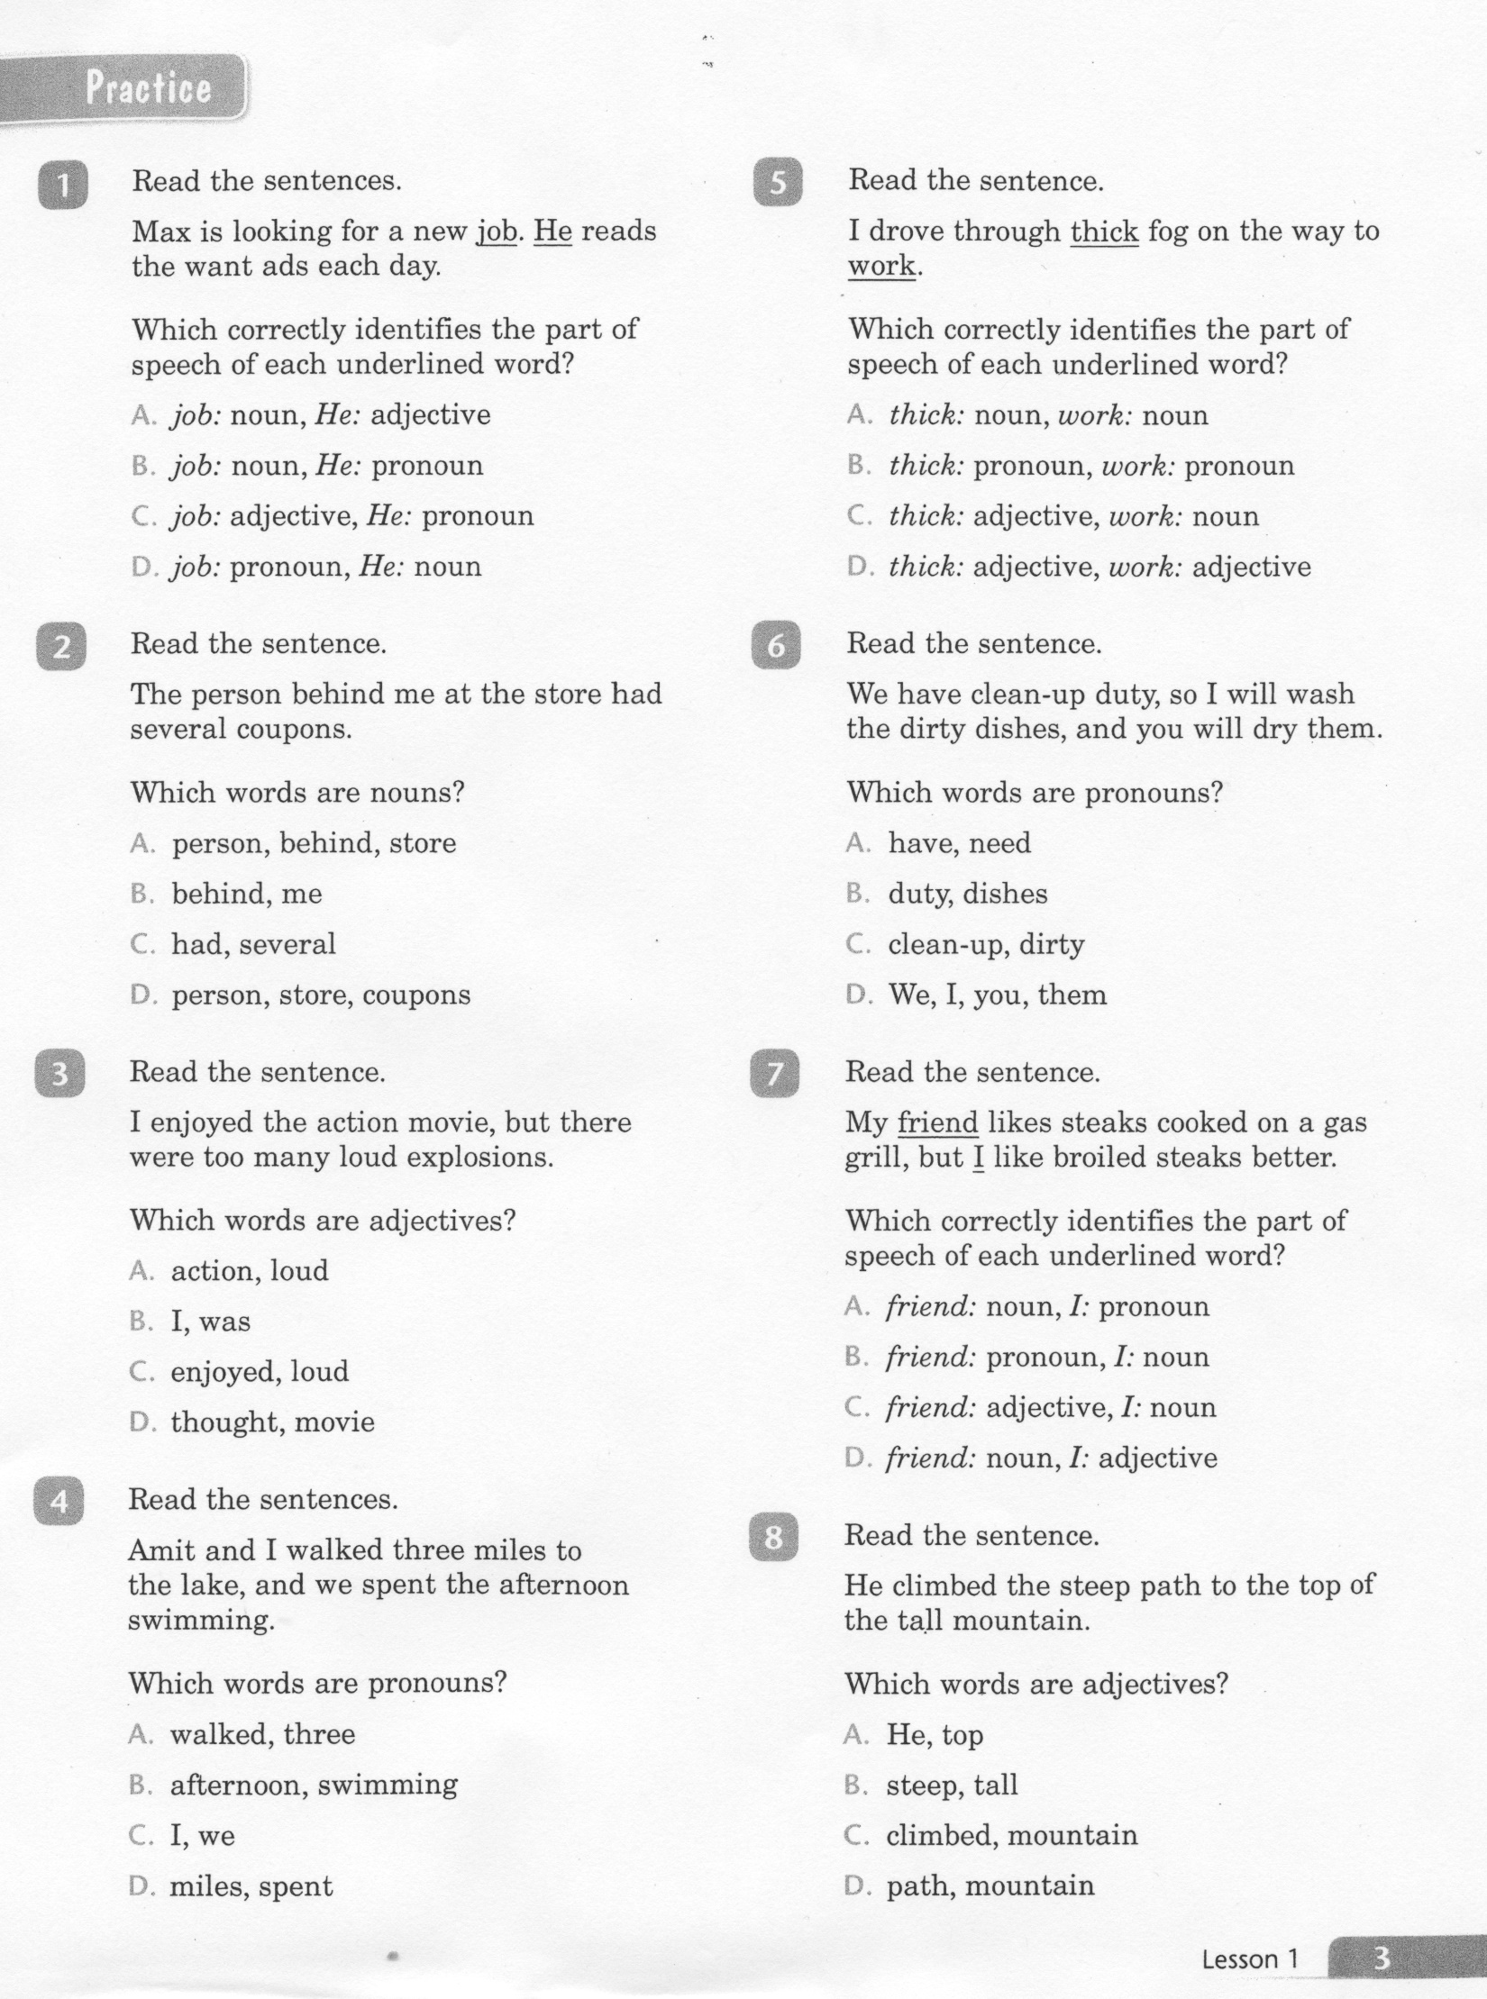
ELA-E-01_Nouns and Pronouns

Slide 4
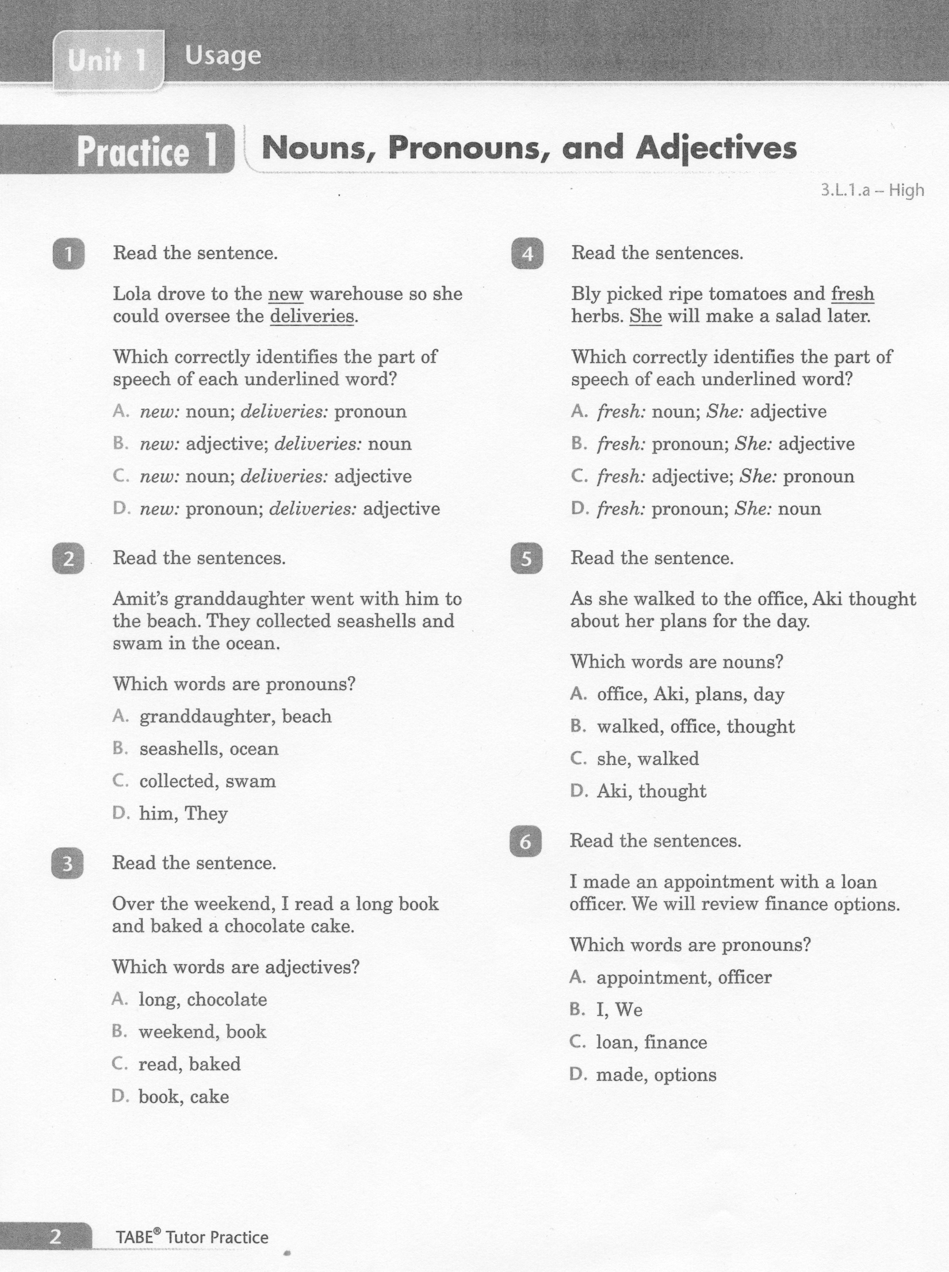
ELA-E-01_Nouns and Pronouns

Slide 5
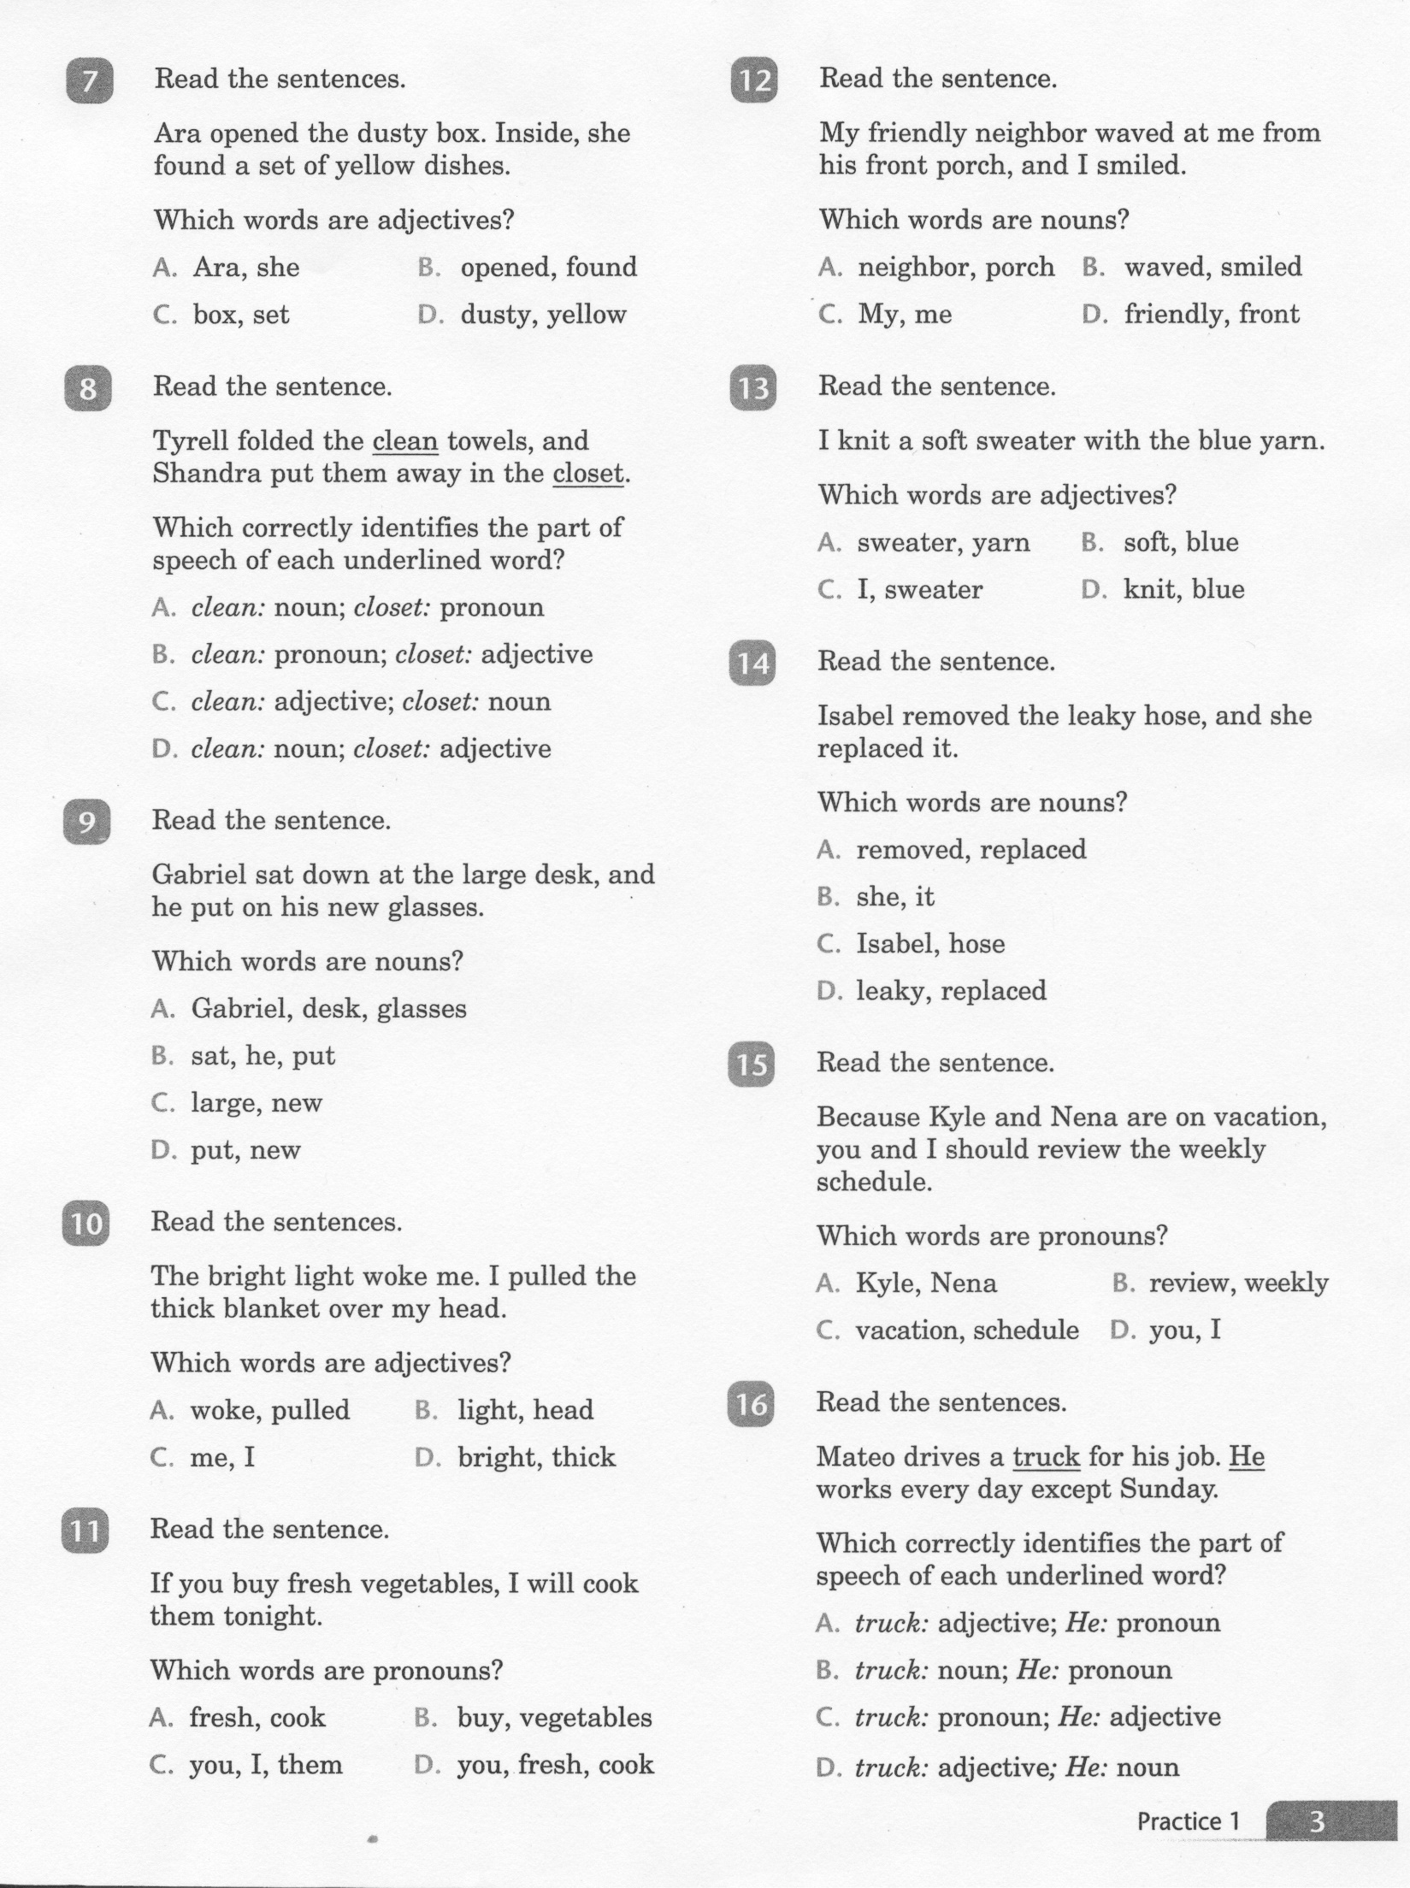
ELA-E-01_Nouns and Pronouns

Slide 6
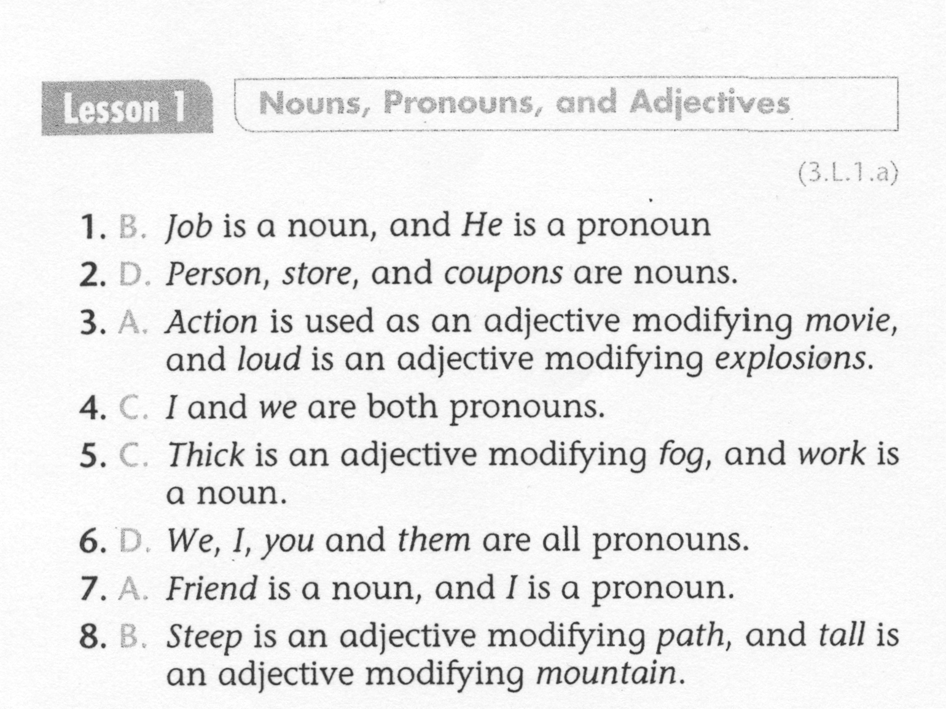
ELA-E-01_Nouns and Pronouns

Slide 7
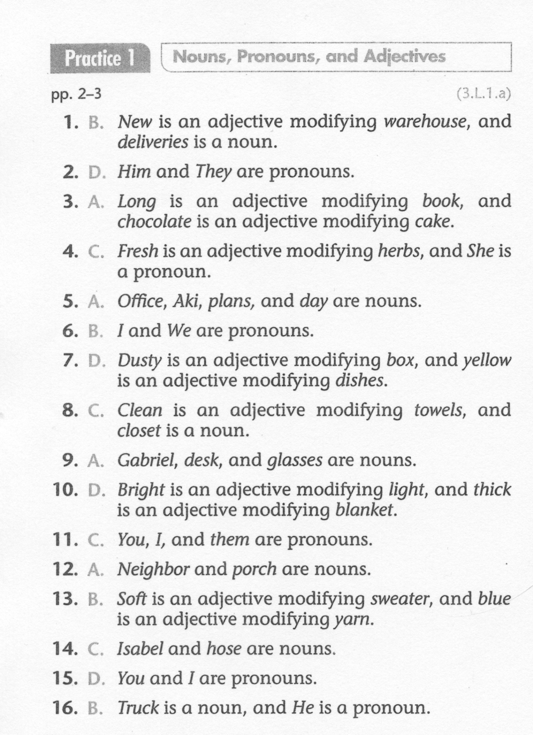
ELA-E-01_Nouns and Pronouns

