Slide 1
Charts and Graphs <F11>
Nolan Tomboulian
Tomboulian@yahoo.com
Tomboulian.Wikispaces.com

Slide 2
Charts and Graphs
Charts and Graphs are a simple way to help make information easier to analyze
Often helps people make better sense of numerical data
Show the relationship between a part and a whole
Show how numbers change over time
Show how values are distributed across a data set

Slide 3
Selecting a Data Source
The data source is the range that contains the data you want to display in the chart
Series name
Series values
Category values

Slide 4
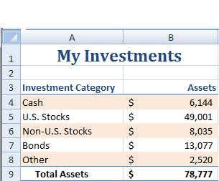
Selecting a Data Source
Series Name
Category Values
Series Values

Slide 5
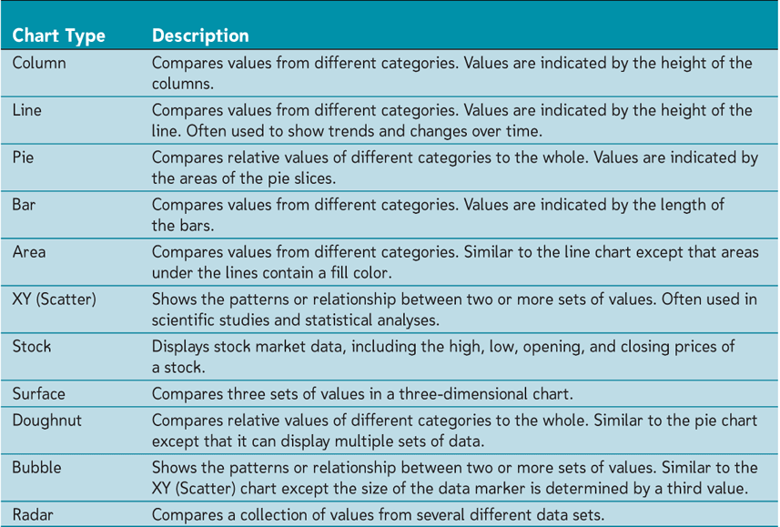
Selecting a Chart Type

Slide 6
Selecting a Chart Type
Click the [Insert]tab on the Ribbon
In the Charts group, click on the button of the type of chart you want to create

Slide 7
Moving and Resizing Charts
By default, a chart is inserted as an embedded chart, which means the chart is placed in a worksheet next to the data source
You can also place a chart in a “chart sheet”
To move a chart, go to the
Chart Tools
Design tab
Location group and click the Move Chart button

Slide 8
Chart Elements
Chart Area – contains the chart and all of the different chart elements
Plot Area – the are where the chart is drawn
Data Marker – represents each data value of a data series
Legend – area that labels the marker or symbols used in the chart

Slide 9
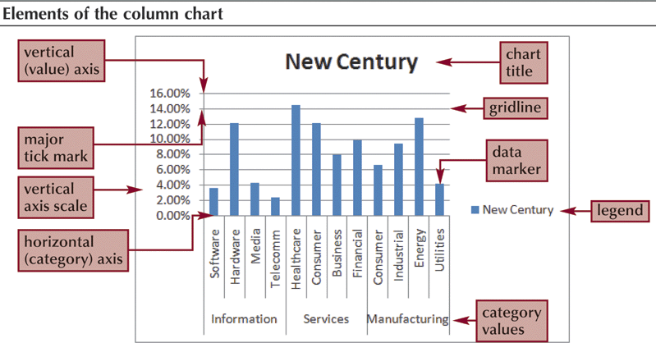
Chart Elements

Slide 10
Formatting Chart Elements
Click the Chart Tools Layout tab
Groups and buttons to access the different chart elements
Labels: Legend, Chart Title, etc
Axis: depends on the chart type
Background

Slide 11
Formatting the Chart Axis
Along with modifying axis text and labels, also control the scale of the axes
Modifying the chart axis usually changes the way data is displayed in the chart
Axis are not used in charts such as pie or doughnut

Slide 12
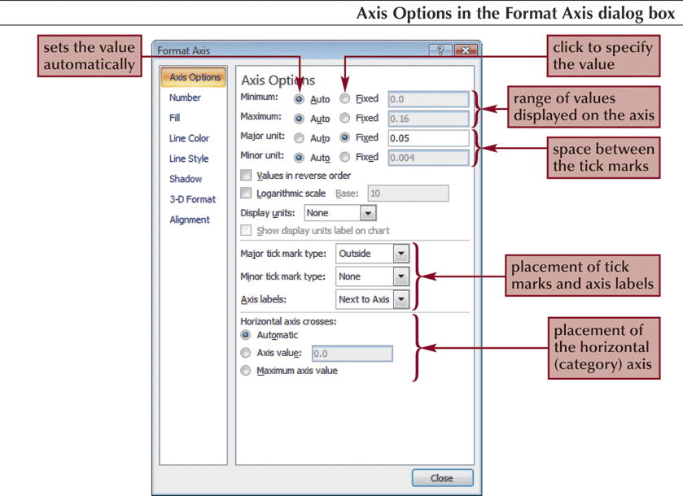
Formatting the Chart Axis

Slide 13
Editing Axis Range
Go to the Chart Tools Layout tab - Axis group then click the Axis button
Select the axis you want to edit
Click More… Options
Make the changes to the axis range are needed

Slide 14
Setting Label Units
Go to the [Chart Tools Layout] tab –
{Axes group} then click the Axis button
Select the axis you want to edit
Click More… Options
Click the Display units arrow and then make your selection

Slide 15
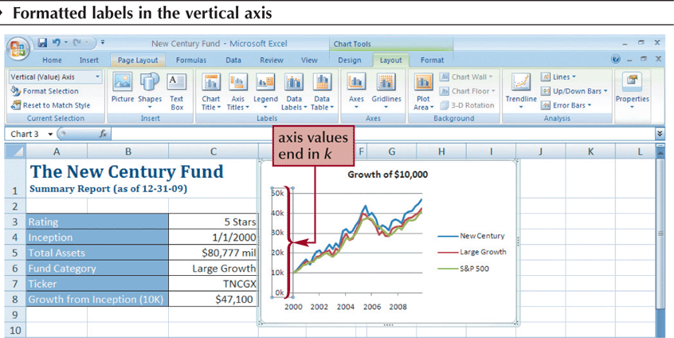
Setting Label Units

Slide 16
Formatting Data Series
Click on one of the markers for the series you want to modify
Go to the Chart Tools Layout tab - Current Selection group and then click Format Selection
Can also right-click on any data series and select Format Data Series from the Shortcut Menu

Slide 17
Modifying the Legend
Go to the [Chart Tools Layout] tab
{Labels group}, then click the Legend button, and then click the option you want.
To overlay the legend over the chart, click on the More Legend Options and then click the Show the legend without overlapping the chart check box to remove the check mark

Slide 18
End of Section
CHARTING
And
Graphs

Slide 19
Blank for Duplex Printing

Slide 20
Blank for Duplex Printing

