Slide 1
Nolan Tomboulian
Tomboulian@yahoo.com
Tomboulian.Wikispaces.com
Relative
and
Absolute
Cell Reference
And More
FUNCTION SYNTAX

Slide 2
References
Linking back to a cell from another is called a cell reference
Knowing how to use Relative and Absolute references is an critical skill for using functions and formulas
Excel adjusts references when functions and formulas are Moved and/or Copied

Slide 3
References
Absolute references can be identified by dollar signs in front of the column and row designation
Ex. $A$1
Relative references have just the column and row designations (NO $)
Ex. A1
Can also use Mixed References
$A1 : Column A stays fixed but the row will change
A$1 : Column will change but the row will stay as 1
Use the <F4> key to toggle between the: $x$#, $x#, x$# and x#

Slide 4
Relative References
Usually Excel interprets cell references in a formula in relation to the cell’s location
Ex. Entering =A1 in cell A3
Excel interprets that as using the cell two rows above and zero columns over
Copying the formula in another cell would result in a different reference
Ex. Copying the formula in cell A3 to cell A10 would result in the formula being changed to: =A8.
( ie: copy the cell that is two rows above)

Slide 5
Absolute References
Makes the reference to the specified cell
Ex. Entering =$A$1 in cell A3
Excel does not interpret the relative difference in cell location
Copying the formula in another cell would not change the cell reference
Ex. Copying the formula into cell A10 would result in the formula remaining =$A$1

Slide 6
Mixed References
Mixed references are cell references where only one portion is fixed
When a formula using mixed references is copied, one portion shifts and one portion stays fixed
This is useful when you are copying a formula down the rows or across the columns and you want part of the address to remain constant

Slide 7
Entering Relative, Absolute, and Mixed References
Relative reference – No dollar signs (C12)
Absolute reference – Dollar signs in front of each portion ($C$12)
Mixed reference – Dollar sign in front of the portion you want “locked”
$C12 - The Column C does not change
or C$12 - The Row does not change
Or
Press the <F4> key to cycle the reference from relative to absolute to mixed and then back to relative

Slide 8
Understanding Function Syntax
All functions have Arguments or Parameters, which are the data (values, cell references, other functions) that are needed by the function to calculate the value
Some functions have [optional] arguments
Optional arguments are not necessary for the function to calculate a value, but can provide more control over the value or format being returned.

Slide 9
Understanding Function Syntax
Standard function syntax
=Function name(argument 1 [, argument 2])
Argument 1: required argument
Argument 2: optional argument and its default value
Arguments are separated by a Comma
All optional arguments have a default value
Good programming style should require a value for all arguments so it is “Clear” what the intended operation should be

Slide 10
Understanding Function Syntax
Excel provides help with understanding function syntax
Optional arguments are enclosed in brackets [ ] when typing in a function
Required arguments are listed in bold text on the Insert Function Dialog Box
When typing a function, Excel also highlights where you are in the function using a Screen Tip

Slide 11
Common Functions
Function | Category | Description
SUM(number1 [, number2,…]) | Math & Trig | Adds a collection of numbers, where number1, number2, etc are either numbers or cell references
ROUND(number, num_digits) | Math & Trig | Rounds a number to a specified number of digits where number is the number to be rounded and num_digits specifies how many digits to round the number to.
AVERAGE(number1, [number2,…]) | Statistical | Calculates the average of a collection of numbers, where number1, number2, etc are either numbers or cell references.
COUNT(value1 [, value2…]) | Statistical | Counts how many cells in a range contain data, where value1, value2, etc are text, numbers, or cell references.
MAX(number1 [, number2,…]) | Statistical | Calculates the maximum value of a collection of numbers, where number1, number2, etc are either numbers or cell references.
MEDIAN(number1 [, number2,…]) | Statistical | Calculates the median, or middle, value of a collection of numbers where number1, number2, etc are either numbers or cell values.
MIN(number1 [, number2,…]) | Statistical | Calculates the minimum value of a collection of numbers, where number1, number2, etc are either numbers or cell references.

Slide 12
Date Functions
Function | Category | Description
DATE(year, month, day) | Date & Time | Creates a date value for the date represented by the year, month, and day arguments.
DAY(date) | Date & Time | Extracts the day of the month from the date value.
MONTH(date) | Date & Time | Extracts the month number from the date value.
YEAR(date) | Date & Time | Extracts the year number from the date value.
WEEKDAY(date, [return_type]) | Date & Time | Calculates the day of the week number from the date value. Return_type changes how Excel numbers the days.
NOW() | Date & Time | Displays the current date and time.
TODAY() | Date & Time | Displays the current date.

Slide 13
Inserting a Function
There are two ways to insert a function into a worksheet
Use the Insert Function button
Type the function directly into a cell
If you are new to using functions, or are working with an unfamiliar function, it is usually best to use the Insert Function button
Excel provides the Function Arguments dialog box, tailored to the specific function you are using

Slide 14
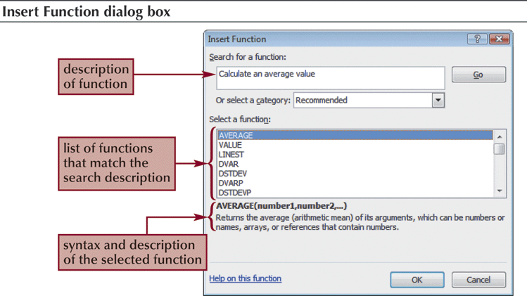
Inserting a Function

Slide 15
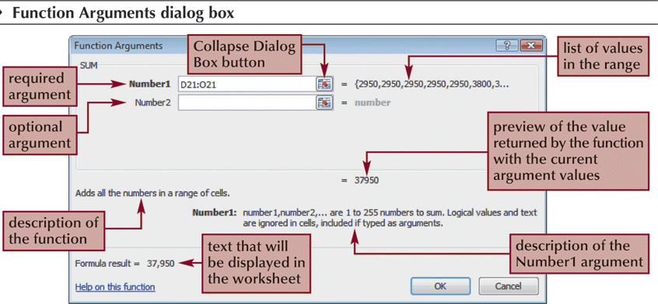
Inserting a Function

Slide 16
Inserting a Function
Typing in functions is another way to insert them
To start entering a function, type =
As you begin to type a function name within a formula, a list of functions that begin with the letters you typed appears

Slide 17
Inserting a Function

Slide 18
END OF SECTION Absolute and Relative Cells and FUNCTIONS

Slide 19
Blank for Duplex Printing

Slide 20
Blank for Duplex Printing

