Slide 1
Unit 4-2 Managing Microsoft Windows ™
A. Identify the parts of the Windows 10 interface (desktop, taskbar, etc.).
B. Demonstrate knowledge of the Windows Start Menu, including Get Help.
C. Use the search bar to locate a file, program, or document.
D. Start and exit programs.

Slide 2
Unit 4-2 Manage Microsoft Windows
4-2 Learning Objective Standards
2. Identify the parts of the Windows 10 interface (desktop, taskbar, Start Menu, etc.).
4. Use the search bar to locate a file, program, or document.
6. Start and Exit (Close) programs.
7. Minimize and Maximize windows.
8. Open, close and switch between windows.
4-2 Vocabulary
maximize minimize
restore down taskbar
window Files
Folders Sub-Folders
Directories Organization
Full Screen
Active Window
Full Screen
● In this lesson, learners need to be able to click and hold to drag and Drop files.​
Basic Computer Skills,
Lesson 2: Mouse Skills
​
.

Slide 3
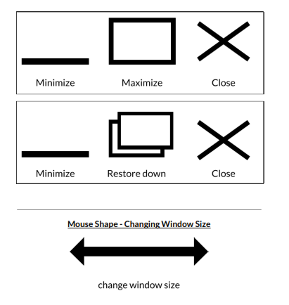
4-2-A Reference Windows

Slide 4
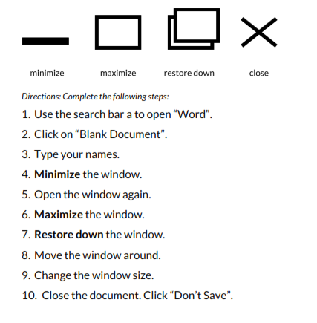
4-2-B Reference Pair Share Activity

Slide 5
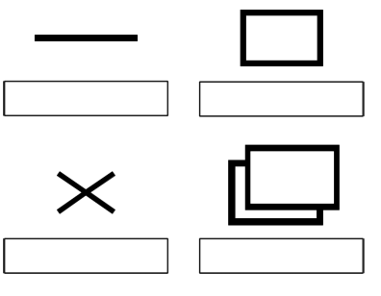
4-2-A Handout Manage Windows
Minimize
Maximize
Close
Restore Down

