Slide 1
Internet Basics Unit: 2 – 4 Search Terms

Slide 2
Warm-up: Thumbs Up / Thumbs Down
QUESTIONS I HAVE?.......

Slide 3
Unit 2-4 Internet Basic Skills Search Terms
12. Perform internet search using clear parameters (terms and filters).
Practice changing questions into search terms by including content words and excluding irrelevant grammatical words.
In Google Chrome, and most other browsers, the address bar (where you type web addresses URL) can also function as a search bar.

Slide 4
Unit 2-4 Search Terms Vocabulary
address bar
Images (pictures)
Hyperlinks
search bar
search engine Google, Bing, Yahoo
search terms
Search results
Filters (ALL, Images, Shopping, Videos, etc.

Slide 5
Unit 2-4: Search Engines and Search Bars
◆ Sometimes, when you use the internet you need to ﬁnd information, but don’t know where to ﬁnd the information you need.
For example, if you need to apply for a driver’s license, but don’t know the web address (URL) where you can apply, you can use Google (or another search engine) to ﬁnd it.”
◆ “A search engine helps you to ﬁnd websites. Google is a popular search engine.
There are many others. https://blog.hubspot.com/marketing/top-search-engines
You can type the important words in the search engine to help you ﬁnd what you are looking for.
◆ Open Google.com (or Bing.com)
◆ Write ‘apply driver’s license [your state or city]’ in the search bar.
◆ Open the corresponding website.
◆ “There are two places where you can write words to help you ﬁnd information.”

Slide 6
Handout 2-4-A Search Terms
Questions Search Terms:
1: What is the time in Mogadishu? _______________________________
2: What is the weather in Bangkok today? _______________________________
3: How much sugar is in a can of Coke? _______________________________
4: What is the capital of Uruguay? _______________________________
5: ______________________________ _______________________________
6: ______________________________ _______________________________

Slide 7
Handout 2-4-B Country Research
What country are you researching? ___________________________________________________________
1) What is the capital of the country? __________________________________________________________
2) What is the population? __________________________________________________________________
3) What language (or languages) do they speak? _________________________________________________
4) What are some popular foods in the country? _________________________________________________
5) Who is the president or prime minister? ______________________________________________________
6) Who is a popular singer in that country? ______________________________________________________
7) Area: __________________________________________________________________________________

Slide 8
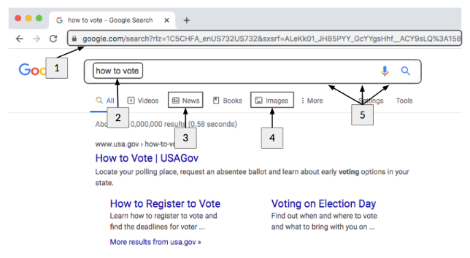
Handout 2-4-C Search Vocabulary

