Slide 1
Basic Computer Skills Unit: 1 – 8 Customization and Settings

Slide 2
Warm-up:
Apple
◆ What is Customization?
Custom Made Clothes
Customized Car
Android

Slide 3
Basic Hardware Skills and Objectives
1. Distinguish between different types of devices (tablets, desktop and laptop computers).
2. Identify specific computer hardware (system unit, monitor, printer, keyboard, mouse or touchpad, ports, touchscreen).
3. Log on to and shut down a computer.
Demonstrate knowledge of keys on keyboard
(Enter / Return, Shift, Control / CTRL, Backspace, Delete, Arrow Keys, Tab, Caps Lock, Number Lock, ESC, Windows, Function, ALT, Space Bar ).
Identify types of mice: mouse and touchpad.
6. Identify mouse pointer shapes and the functions they represent
[spinning wheel (loading), I-Beam (text), arrow (basic clicking), hand pointer (clickable links)]
7. Demonstrate knowledge and appropriate use of mouse clicks (right-click, left-click, and double click).
8. Drag and drop.
9. Utilize common controls for screen interaction (selecting check boxes, using drop-down menus, scrolling).
10. Access and control audio output features (volume, mute, speakers and headphones).
11. Identify icons on desktop.
Demonstrate ability to trash and retrieve items using the trash or recycle bin.
Demonstrate understanding that it is possible to customize a computer for increased accessibility
(customizing a mouse for left-handed use and sensitivity, and changing screen resolution on a monitor).
14. Demonstrate understanding that software programs are upgraded periodically to fix bugs and increase utility,
and that different versions may be installed on different computers.
15. Identify mechanisms for storing files (flash drives, hard drives, cloud-based storage).
16. Identify whether or not a computer is connected to the internet.
17. Identify and locate camera and mic on laptops, tablets.
18. Turn computer and monitor on and off.

Slide 4
Unit 1-8 Customization Vocabulary
Background : the main area of a screen behind icons and open programs, also known as the desktop
Customize: to change something to make it personal for an individual
Settings (Windows) (Application): programs used on a computer or device an where you can customize the device to be specific for your use
Software (APP) to get a newer version
Update: A newer version of a program (Fix ‘bugs’)
Restore Factory Settings
Version or Release:
Default: The original settings or settings you set (Preferences)

Slide 5
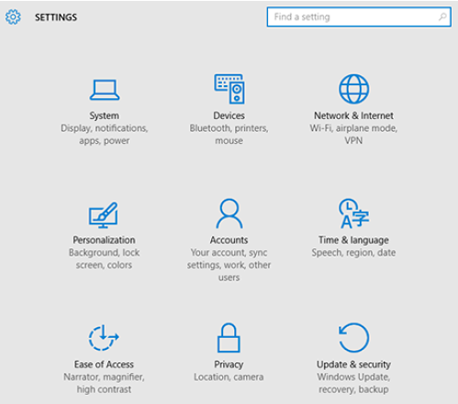

Slide 6
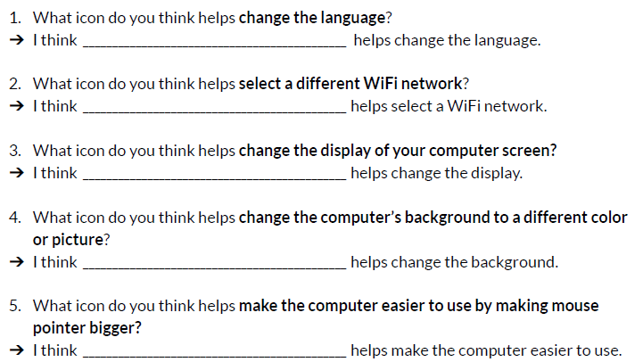
Time & Language
Network & Internet
System
Personalization
Ease of Access

Slide 7
Windows Settings

