Slide 1
Basic Computer Skills Unit: 1 – 5 Keyboard Keys

Slide 2
Warm-up: Thumbs Up / Thumbs Down
I know how to use special keys
I have used a computer keyboard
I am excited to be here.
I am ready to learn.
QUESTIONS I HAVE….

Slide 3
Basic Hardware Skills and Objectives
1. Distinguish between different types of devices (tablets, desktop and laptop computers).
2. Identify specific computer hardware (system unit, monitor, printer, keyboard, mouse or touchpad, ports, touchscreen).
3. Log on to and shut down a computer.
Demonstrate knowledge of keys on keyboard
(Enter / Return, Shift, Control / CTRL, Backspace, Delete, Arrow Keys, Tab, Caps Lock, Number Lock, ESC, Windows, Function, ALT, Space Bar ).
Identify types of mice: mouse and touchpad.
6. Identify mouse pointer shapes and the functions they represent
[spinning wheel (loading), I-Beam (text), arrow (basic clicking), hand pointer (clickable links)]
7. Demonstrate knowledge and appropriate use of mouse clicks (right-click, left-click, and double click).
8. Drag and drop.
9. Utilize common controls for screen interaction (selecting check boxes, using drop-down menus, scrolling). 1
10. Access and control audio output features (volume, mute, speakers and headphones).
11. Identify icons on desktop.
Demonstrate ability to trash and retrieve items using the trash or recycle bin.
Demonstrate understanding that it is possible to customize a computer for increased accessibility
(customizing a mouse for left-handed use and sensitivity, and changing screen resolution on a monitor).
14. Demonstrate understanding that software programs are upgraded periodically to fix bugs and increase utility,
and that different versions may be installed on different computers.
15. Identify mechanisms for storing files (flash drives, hard drives, cloud-based storage).
16. Identify whether or not a computer is connected to the internet.
17. Identify and locate camera and mic on laptops, tablets.
18. Turn computer and monitor on and off.

Slide 4
Unit 1-5 : Keyboard Keys
4. Demonstrate knowledge of keys on keyboard:
Enter or Return
Space Bar
Shift
Control [CTRL]
Backspace
Delete [DEL]
Arrow Keys
Tab
Caps Lock
Number Lock
WINDOWS
Function: [FN]
ALT
Hot Keys
Home
End

Slide 5
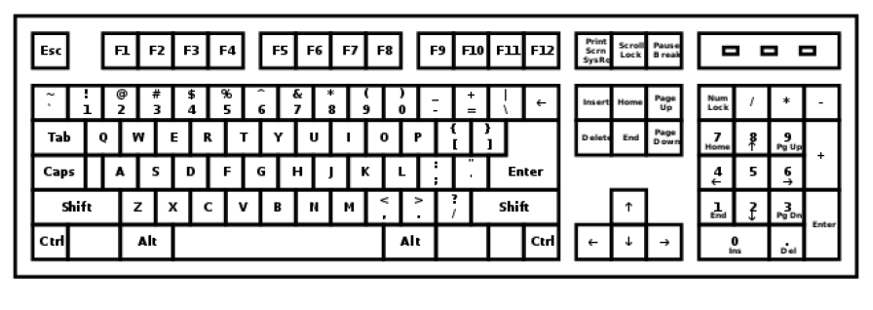
Typical QWERTY Keyboard (Know your hardware!)
HOME KEYS
Left Hand: A S D F
Right Hand: J K L ;
Some Keys l(Like Delete) are in multiple places

Slide 6
Unit 1-5: Keyboard Keys – Learning Objectives
Learners will practice recognizing important keys on the keyboard and when to use them appropriately.
Use the keyboard to write and edit text with support from an instructor.
learners should be able to use Shift and Caps Lock to make capital letters. (Caps Lock does not do Special Characters)
Learners should also be able to highlight, copy, and paste text using the mouse and the Control/Command keys.
Move the cursor with the mouse and Arrow Keys.
Backspace to delete letters to the ← LEFT of the CURSOR
DELETE to delete letters to the → RIGHT of the CURSOR
Home Shift+Home CTRL+Home END Shift+End CTRL+End
Use of the [ALT] Key for Hot Keys / Shortcuts
● Demonstrate how text will automatically move to a new line as you type.
Pressing Enter at the end of every line is not necessary. (WORD WRAP)
Adjust Line Spacing (Not using Enter)
● Encourage learners to use both the mouse, Arrow Keys, and Commands to move the cursor.

Slide 7
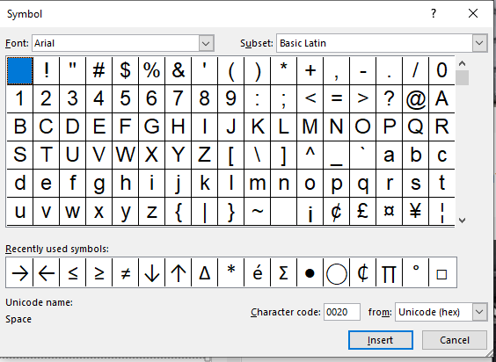
Insert Special Characters and Fonts

Slide 8
Typing Activity - We will learn to:
This activity uses Microsoft WORD. (Guided)
While you do not know all the features of the program, you can start to experiment how tying on a computer is different than typing on a type-writer.
Select Text (Highlight Shift+arrows, Mouse, CTRL, for Text Attributes)
Make CAPITAL letters and Symbols with Shift.
Special Symbols. (and INSERT SYMBOLS)
Use Enter to make new lines.
Edit text and fix mistakes using the:
mouse, Arrow Keys, DELETE, and Backspace.
Use Special Control / Hot Keys:
CTRL+C CTRL+V CTRL+X CTRL+Z
Copy Paste Cut UNDO

Slide 9
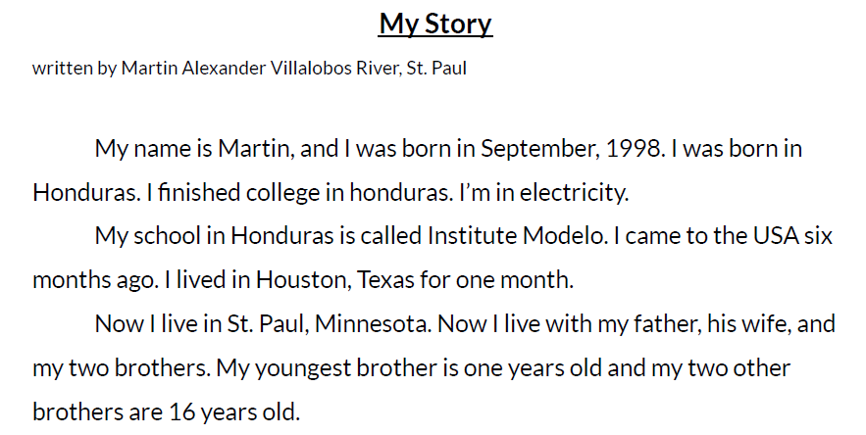
Reference - A Task: Typing Practice, Story 1
Directions: Type this story. Try to fix your mistakes when you are done.
Story from “ Journeys an Anthology of Student Writing, 2017” published by Literacy Minnesota.

Slide 10
Reference B - Practice Typing
Directions: Complete the following steps.
1. Type these sentences:
The Golden Gate Bridge is in San Francisco.
DO NOT TOUCH! WET PAINT!
2. Highlight one sentence. (Arrows, Mouse, Special Keys)
3. Try copying and pasting.
4. Move the sentences to the next tab stop with [Tab].

Slide 11
Handout A - Practice Typing - Part-1
Directions: Type these sentences.
1) The was started in 1868.
2) The was finished in 1883.
3) The was started in 1930.
4) The was opened in 1931.
5) Brooklyn Bridge
6) Empire State Building

Slide 12
Handout A - Practice Typing - Part-2
Directions: Now, use copy (Ctrl+C) and paste (Ctrl+V)
to make these sentences.
1) The Brooklyn Bridge was started in 1868.
2) The Brooklyn Bridge was finished in 1883.
3) The Empire State building was started in 1930.
4) The Empire State building was opened in 1931.

Slide 13
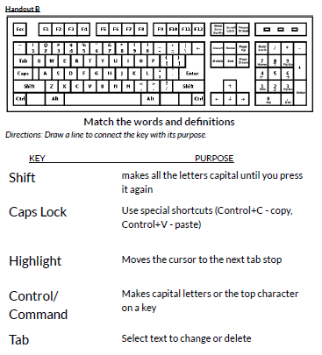

Slide 14
Unit 1-5 Summary
Answers:
➔ Shift: makes capital letters or the top character on a key
➔ Caps Lock: makes all the letters capital letters until you press it again.
➔ Tab: moves the cursor to the next tab stop.
➔ Highlight: Select text to change or delete.
➔ Command/Control: Use special shortcuts
Control + C = copy Control + V = paste
Look at these two sentences:
1. Taste of Napoli Italian Restaurant.
2. CLOSED FOR REMODELING.
➔ Read each question below aloud, have learners turn and talk and then share out:
1. “Which key should be used to make capital letters in sentence 1?”
2. “Which key should be used to make capital letters in sentence 2?”

