Slide 1
Basic Computer Skills Unit: 1 – 4 Fixing Typos

Slide 2
Warm-up: Thumbs Up / Thumbs Down
I know how to Type
I have used a computer keyboard.
I am excited to be here.
I am ready to learn.
Questions I have…..

Slide 3
Basic Hardware Skills and Objectives
1. Distinguish between different types of devices (tablets, desktop and laptop computers).
2. Identify specific computer hardware (system unit, monitor, printer, keyboard, mouse or touchpad, ports, touchscreen).
3. Log on to and shut down a computer.
Demonstrate knowledge of keys on keyboard
(Enter, Shift, Control, Backspace, Delete, Arrow Keys, Tab, Caps Lock, Number Lock, ESC, Windows, Function, ALT, Space Bar ).
Identify types of mice: mouse and touchpad.
6. Identify mouse pointer shapes and the functions they represent
[spinning wheel (loading), I-Beam (text), arrow (basic clicking), hand pointer (clickable links)]
7. Demonstrate knowledge and appropriate use of mouse clicks (right-click, left-click, and double click).
8. Drag and drop.
9. Utilize common controls for screen interaction (selecting check boxes, using drop-down menus, scrolling). 1
10. Access and control audio output features (volume, mute, speakers and headphones).
11. Identify icons on desktop.
Demonstrate ability to trash and retrieve items using the trash or recycle bin.
Demonstrate understanding that it is possible to customize a computer for increased accessibility
(customizing a mouse for left-handed use and sensitivity, and changing screen resolution on a monitor).
14. Demonstrate understanding that software programs are upgraded periodically to fix bugs and increase utility,
and that different versions may be installed on different computers.
15. Identify mechanisms for storing files (flash drives, hard drives, cloud-based storage).
16. Identify whether or not a computer is connected to the internet.
17. Identify and locate camera and mic on laptops, tablets.
18. Turn computer and monitor on and off.

Slide 4
Unit 1-4 Edit Typing Mistakes
4. Demonstrate knowledge of keys on the keyboard:
Enter or Return
Space Bar
Shift
Backspace
Delete [DEL]
Arrow Keys
Caps Lock
Number Lock
ALT
[FN] Function
COMMAND Key
Windows
Microsoft
MAC
Apple

Slide 5
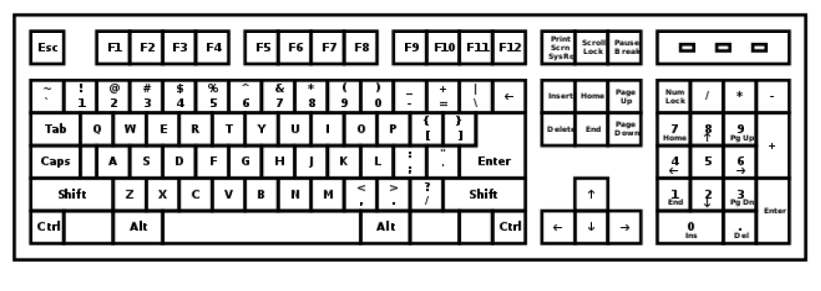
Typical QWERTY Keyboard
HOME KEYS
Left Hand: A S D F
Right Hand: J K L ;

Slide 6
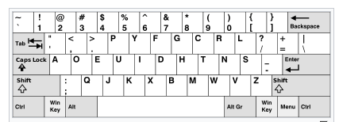
DVORAK Keyboard
A keyboard layout for English patented in 1936 by August Dvorak and his brother-in-law, William Dealey, as a faster and more ergonomic alternative to the QWERTY layout (the de facto standard keyboard layout).

Slide 7
Special Keys: Think, Pair, Share
➔ Directions: Give two minutes to think about questions below, then discuss in pairs for two minutes,
The Statue of Liberty is in New York City.
Tickets @ the Statue of Liberty are $25.50 (or $16 for children!)
and finally share together as a class.
◆ What symbols do you notice in these sentences?
◆ How many capital letters do you see?
◆ What special keyboard keys would you need to type these sentences?

Slide 8
DO IT TOGETHER
The Statue of Liberty is in New York City.
Tickets @ the Statue of Liberty are $25.50 (or $16 for children!)
EXPLORE
➔ Directions: You try it!
Type some equations using numbers and symbols.
For example, 1+1=2 5^2=25
◆ Use Enter key (return) to make a new line.
◆ Type your address.
◆ Move the cursor using only the Arrow Keys .

Slide 9
Unit 1-4 Fixing Typos – Learning Objectives
Learners will practice recognizing important keys on the keyboard and when to use them appropriately.
Use the keyboard to write and edit text with support from an instructor.
Move the cursor with the mouse and Arrow Keys.
Backspace to delete letters to the LEFT of the CURSOR
DELETE to delete letters to the RIGHT of the CURSOR
● If you notice learners use two hands to press Shift and a number key to make a symbol, show them how to use their pinky finger to press Shift to better facilitate typing. (CAPS LOCK does not get the symbols).
● If learners find it challenging to identify extra spaces or spelling mistakes, use the magnifying lens tool to zoom in on the screen. Windows: hold start menu key and press plus sign key (+) | Mac: Command Option 8
● Demonstrate how text will automatically move to a new line as you type.
Pressing Enter at the end of every line is not necessary. (WORD WRAP)
● Encourage learners to use both the mouse, Arrow Keys, and Commands to move the cursor.

Slide 10
Typing Activity - We will learn to:
This activity uses Microsoft WORD. (Guided)
While you do not know all the features of the program, you can start to experiment how tying on a computer is different than typing on a type-writer.
Select Text (Mouse and Shift+Arrows for Attributes)
Make capital letters and Symbols with Shift.
Use Enter to make new lines.
Edit text and fix your mistakes using the
mouse, Arrow Keys, DELETE, and Backspace.

Slide 11
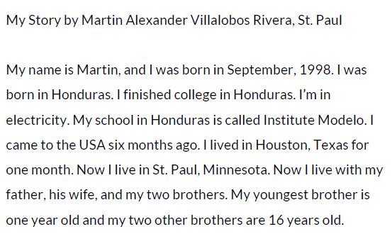
Handout A.1
Task: Typing Practice, Story 1
Directions: Type this story.
Try to fix your mistakes when you are done.
Story from “ Journeys an Anthology of Student Writing, 2017” published by Literacy Minnesota.

Slide 12
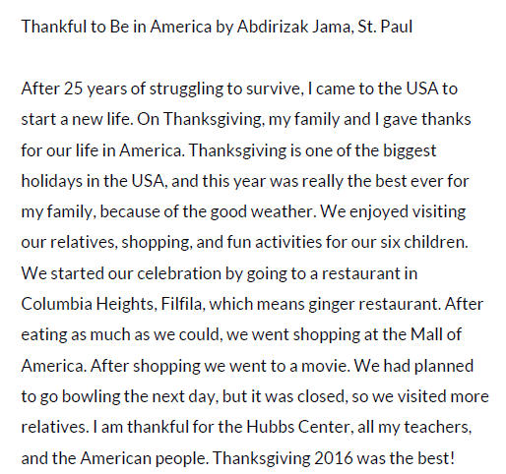
Handout A.2
Task: Typing Practice, Story 2
Directions: Type this story.
Try to fix your mistakes when you are done.
Story from “ Journeys an Anthology of Student Writing, 2017” published by Literacy Minnesota.

