Slide 1
Basic Computer Skills Unit: 1 – 1 Overview Devices and Computer Log On

Slide 2
Craven Community College Lab Procedures
1) Find the ‘Power” Button (on the screen)
2) Login (Sign on) and wait for the system to load
3) Respect School Property
4) Be Kind to Others
5) Ask Questions
6) Try Your Best

Slide 3
Warm-up: Thumbs Up / Thumbs Down
◆ I have ……
used a Mobil (Cell) Phone
used a Desktop Computer
used a Laptop
used a Tablet
◆ I am excited to be here
◆ I am ready to learn
QUESTIONS I HAVE?.......

Slide 4
Unit 1 - Basic Hardware Skills and Objectives
1. Distinguish between different types of devices (tablets, desktop and laptop computers).
2. Identify specific computer hardware (system unit, monitor, printer, keyboard, mouse or touchpad, ports, touchscreen).
3. Log on to and shut down a computer.
4. Demonstrate knowledge of keys on keyboard (Enter, Shift, Control, Backspace, Delete, Arrow Keys, Tab, Caps Lock, Number Lock).
5. Identify types of mice: mouse and touchpad.
6. Identify mouse pointer shapes and the functions they represent (spinning wheel (loading), I-Beam (text), arrow (basic clicking), hand pointer (clickable links)).
7. Demonstrate knowledge and appropriate use of mouse clicks (right-click, left-click, and double click).
8. Drag and drop.
9. Utilize common controls for screen interaction (selecting check boxes, using drop-down menus, scrolling). 1
10. Access and control audio output features (volume, mute, speakers and headphones).
11. Identify icons on desktop.
12. Demonstrate ability to trash and retrieve items using the trash or recycle bin.
13. Demonstrate understanding that it is possible to customize a computer for increased accessibility
(customizing a mouse for left-handed use, sensitivity, and changing screen resolution on a monitor).
14. Demonstrate understanding that software programs are upgraded periodically to fix bugs and increase utility,
and that different versions may be installed on different computers.
15. Identify mechanisms for storing files (flash drives, hard drives, cloud-based storage).
16. Identify whether or not a computer is connected to the internet.
17. Identify and locate camera and mic on laptops, tablets.
18. Turn computer and monitor on and off.

Slide 5
Unit 1 -1 Basic Hardware Vocabulary
Desktop computer (Tower (CPU) / Keyboard / Monitor)
Laptop (Notbook)
Monitor / Screen / Display / CRT
Mouse (wheel, Left button, Right button) Mouse Pad
System Unit (CPU / Central Processing Unit)
Tablet (big smart phone)
ADDITIONAL Terms
Notebook
Hard Drive (Floppy Disk)
Peripherals (Things outside the computer)
Camera
Speakers / Microphone
Printers
Bluetooth

Slide 6
Unit 1-1 - Hardware Standards
1. Distinguish between different types of devices.
2. Identify specific computer hardware.
3. Log on to and shut down a computer.
5. Identify types of mice: mouse and touchpad.
18. Turn computer monitor on and off.

Slide 7
Power Off / Power Down
Shutting Down / Reboot
Power Off
Restart
Sleep

Slide 8
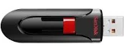
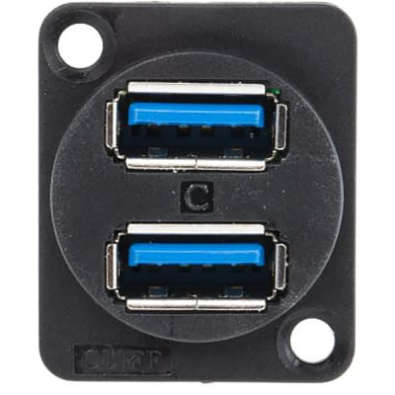
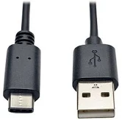
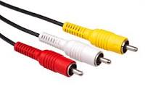
Reference “A”
Monitor / Screen / Display
USB (2.0, 3.0)
Flash Drive
THUMB Drive
A Tower (BOX) is almost obsolete today
TOWER
CPU
Central
Processing
Unit
Male
Female
Power
Disk Drives
Keyboard
PORTS (USB) 2.0, 3.0
FLASH Drive
Universal Serial Bus
Cursor
Movement
Numeric
Keypad
QWERTY Keyboard
HDMI
RCA Plugs
USB-C
USB-A

Slide 9
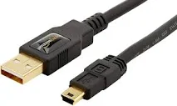
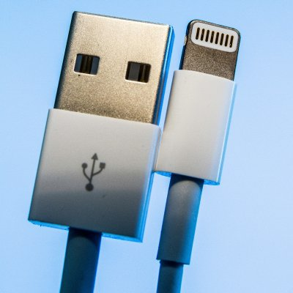
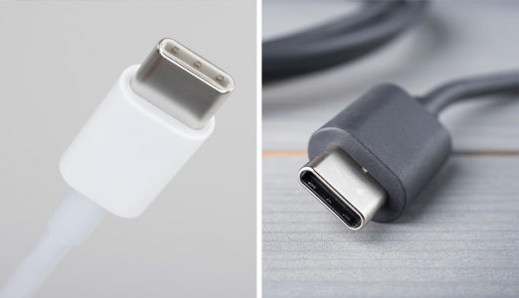
Micro-B Vs. Type-C Lighting Cable
USB-A
Micro USB-B
Older Apple
2020: EUROPE Standard USB Type ‘C’

Slide 10
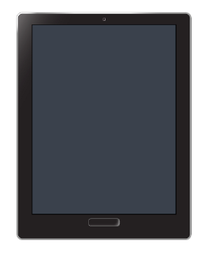
Laptop
Tablet
Camera
Screen
Older technology image with POWER / Home at the bottom or side
Touch Screen
Mouse Pad / Trackpad
Virtual or Pop-Up Keyboard

Slide 11
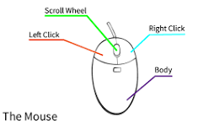
MOUSE (Apple ‘bought’/modified Invention) Point and Click Drag and Drop Left Click (select / highlight) Right Click (Menu options) Double Right Click (Open) Scroll Wheel (rapidly move up or down) Wired or Wireless
https://edu.gcfglobal.org/en/mousetutorial/mouse-tutorial/1/
https://www.youtube.com/watch?v=KNKgBBn_Fsg
History:
https://en.wikipedia.org/wiki/Apple_pointing_devices

Slide 12
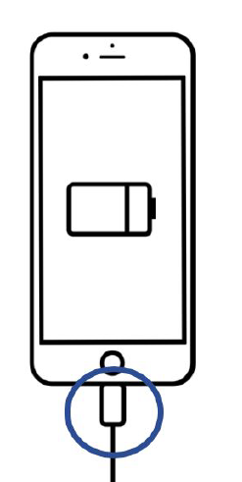
Tablets / Touch Screens
Technology Changes. This is older technology.
Tablets today may have the power or HOME buttons on the side
HOME
Touch Screen
Charging Port

Slide 13
Desktop Hardware Identification Worksheet
Computer Parts and Definition
a) keyboard a place to type on a computer
b) monitor shows information from the computer
c) mouse moves the cursor
d) power button turns on a device
e) system unit (CPU) the brain of the computer
f) monitor power button turns on and off the monitor / Screen / Display

Slide 14
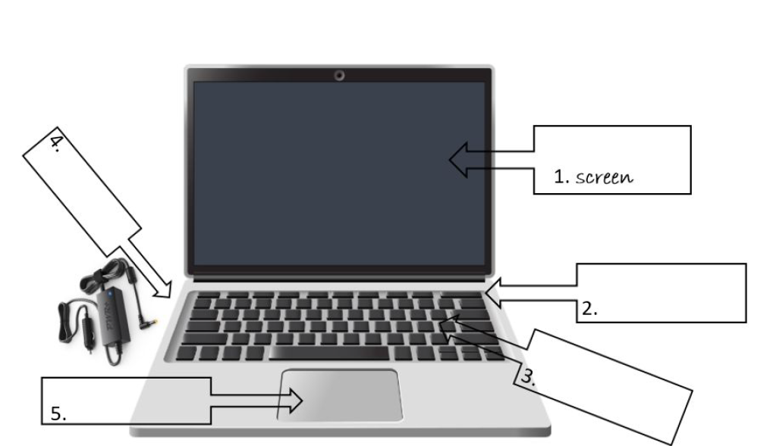
Laptop Hardware Identification Worksheet
Laptop Computer Parts and Definition
a) screen shows information from the computer
b) keyboard a place to type on a computer
c) touchpad a place to move the cursor (trackpad)
d) power button turns on a computer
e) charging port a place to plug in the computer to charge the battery

Slide 15
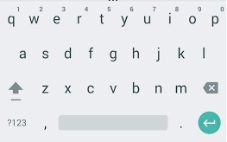
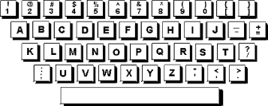
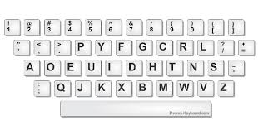
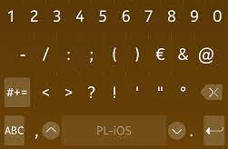
Virtual Keyboard and Alternate Keyboards

Slide 16
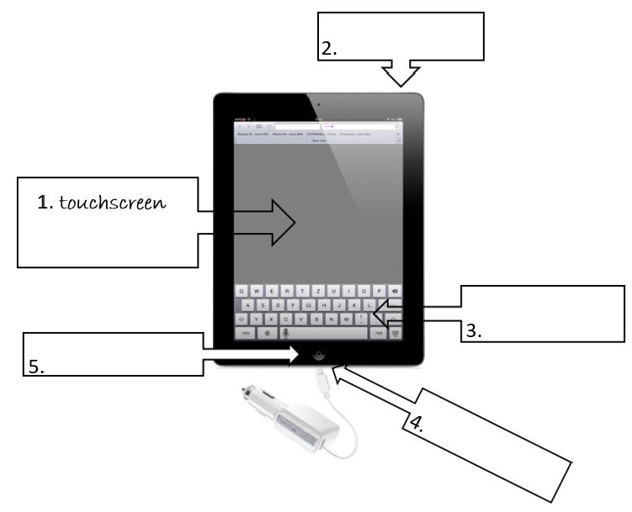
Tablet Hardware Identification Worksheet
a) touchscreen a place to see and click
b) keyboard a place to type on a computer (Virtual Pop-Up Keyboard / Alternate Keyboard)
c) home button goes to ‘home’ screen (Older Apple / Tablet or cell phone Function)
d) power button turns on a tablet or a phone
e) charging port a place to plug in the charger

Slide 17
Unit 1-1 – Hardware Matching Quiz

Slide 18
Handout - A

