Slide 1
TABE Math-E Unit-3 Multiply and Divide Whole Numbers REVIEW
Revised: October 16, 2023
Nolan Tomboulian
Some graphics may not have copied well during the scan process.

Slide 2
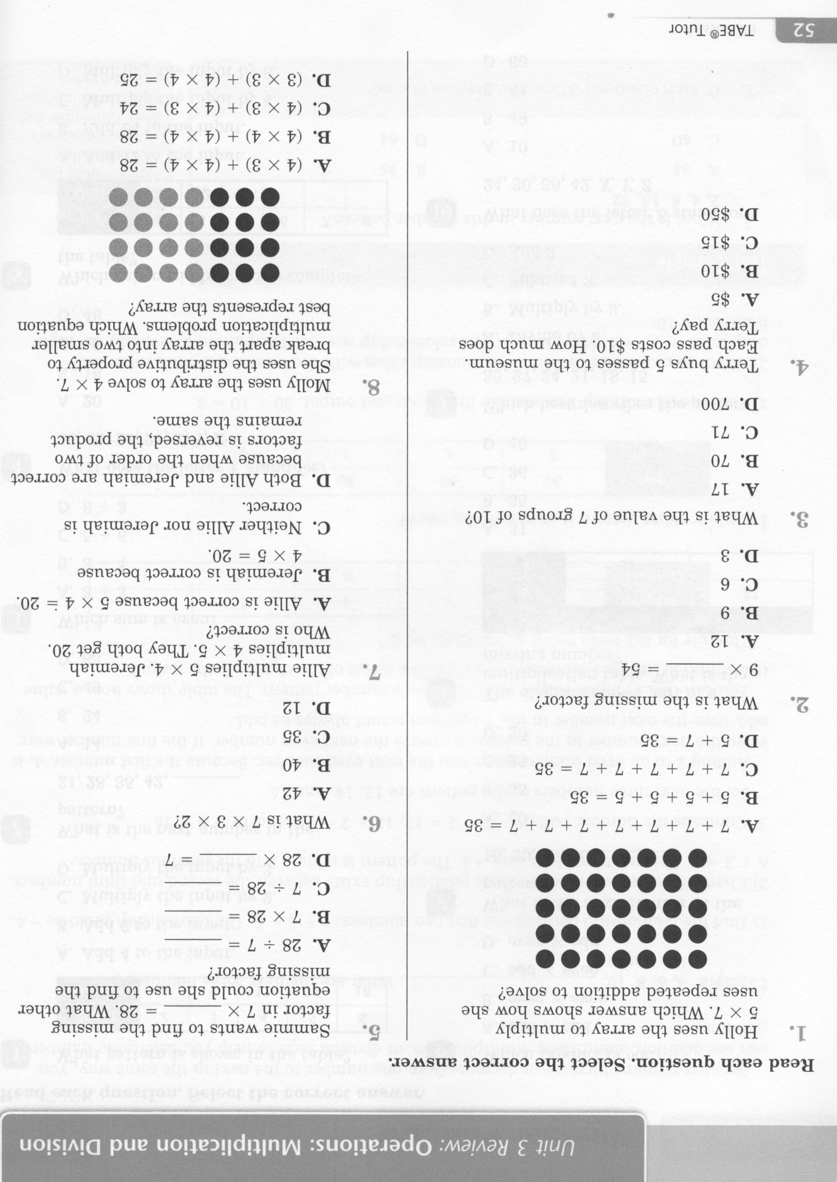
Math-E - Unit 3 - Review

Slide 3
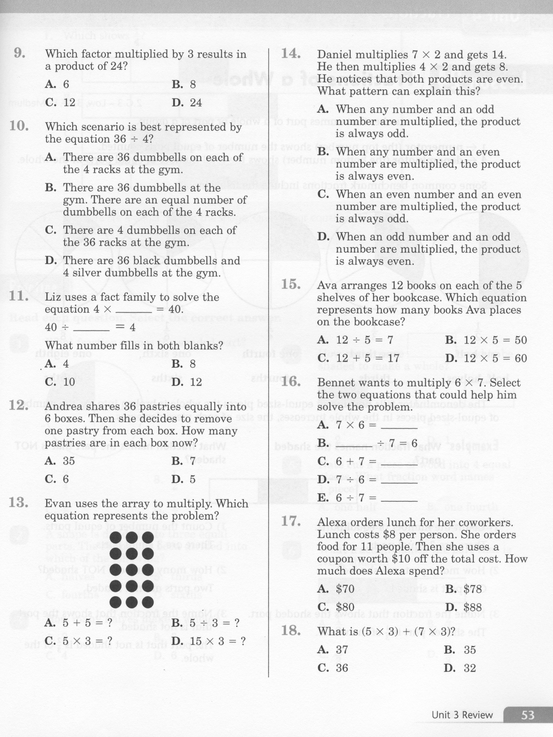
Math-E - Unit 3 - Review

Slide 4
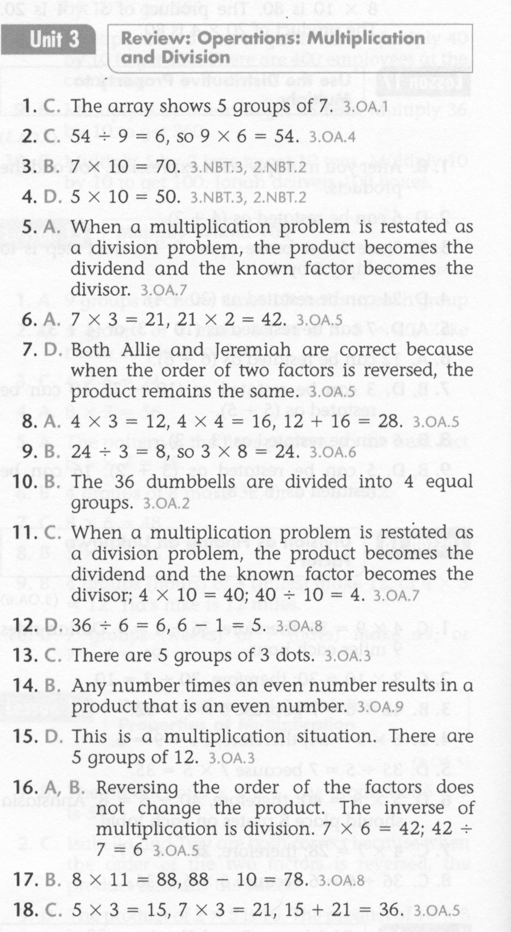
Math-E - Unit 3 - Review

Slide 5
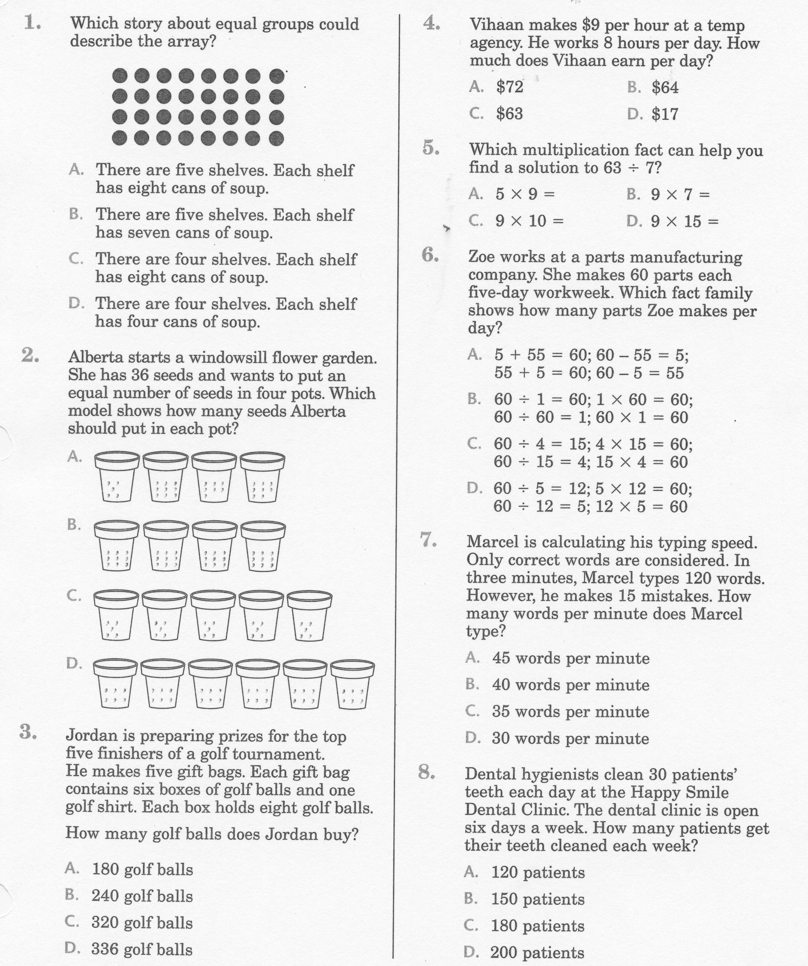
Math-E - Practice Unit-3 Review

Slide 6
Math-E - Practice - Unit-3 Review

Slide 7
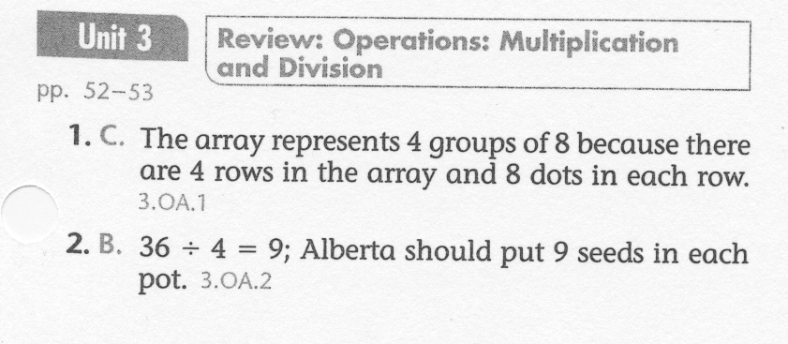
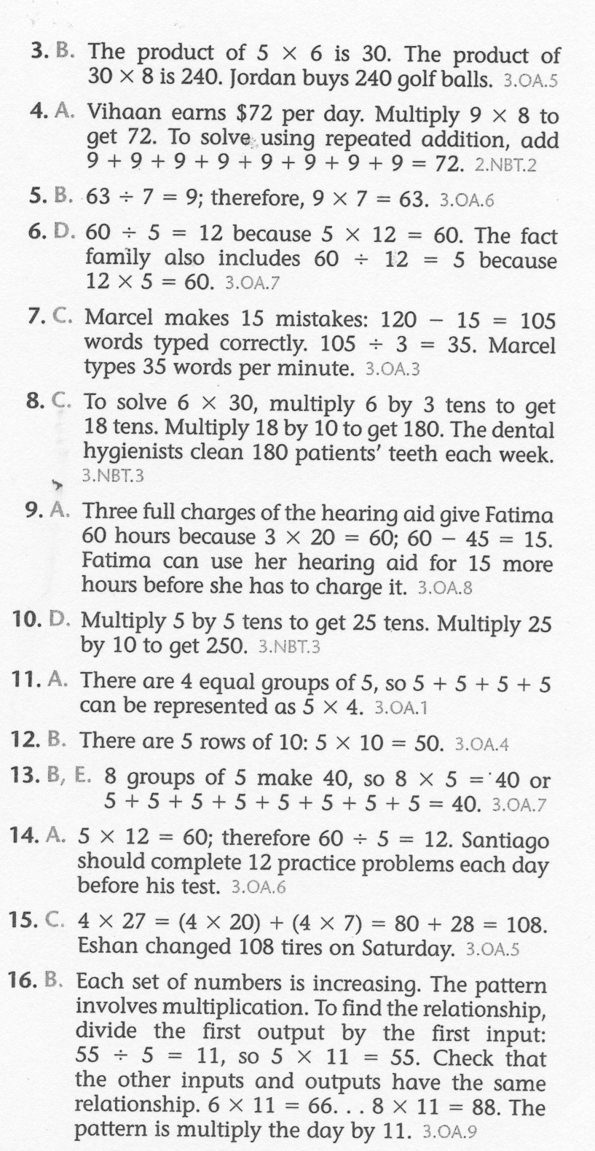
Math-E - Practice - Unit-3 Review

