Slide 1
TABE Math-E PAXEN Unit-3 Multiply and Divide Whole Numbers Lesson 19 DIVISION (as Equal Sharing)
Revised: October 16, 2023
Nolan Tomboulian
Some graphics may not have copied well during the scan process.

Slide 2
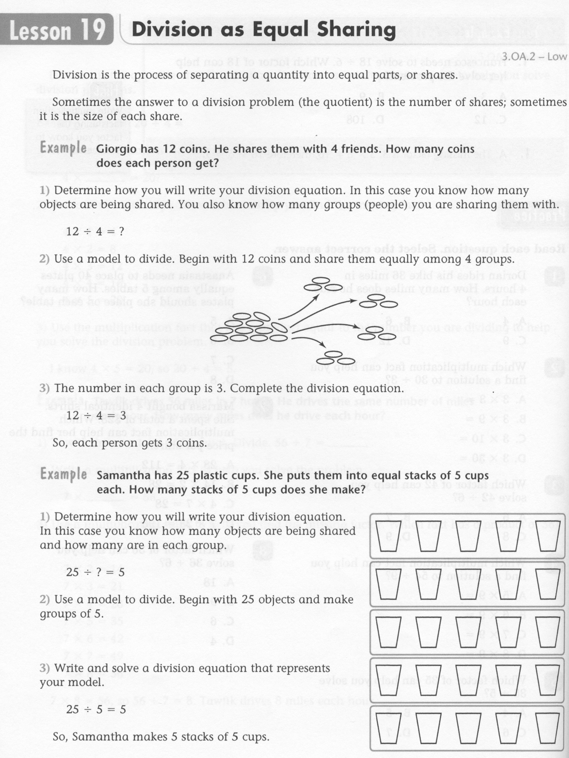
Math-E - Lesson 19 – Division

Slide 3
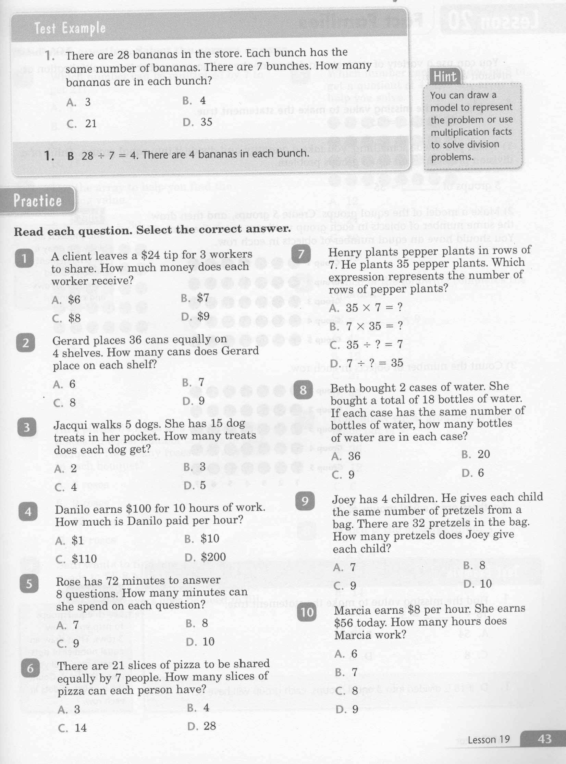
Math-E - Lesson 19 – Division

Slide 4
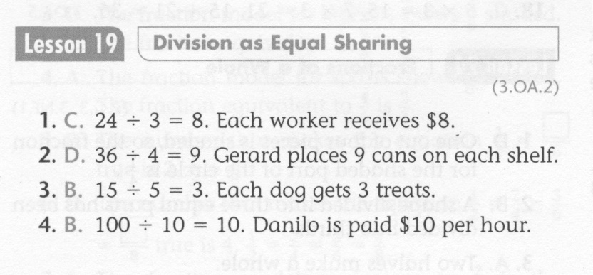
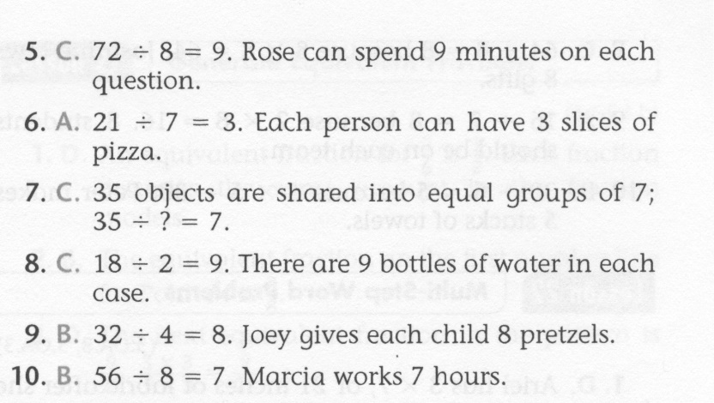
Math-E - Lesson 19 – Division

Slide 5
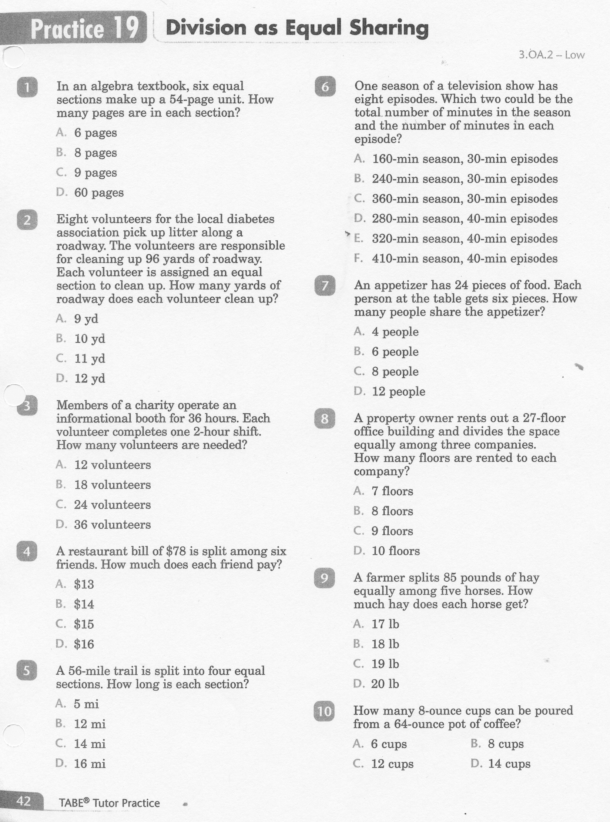
Math-E - Practice 19 – Division

Slide 6
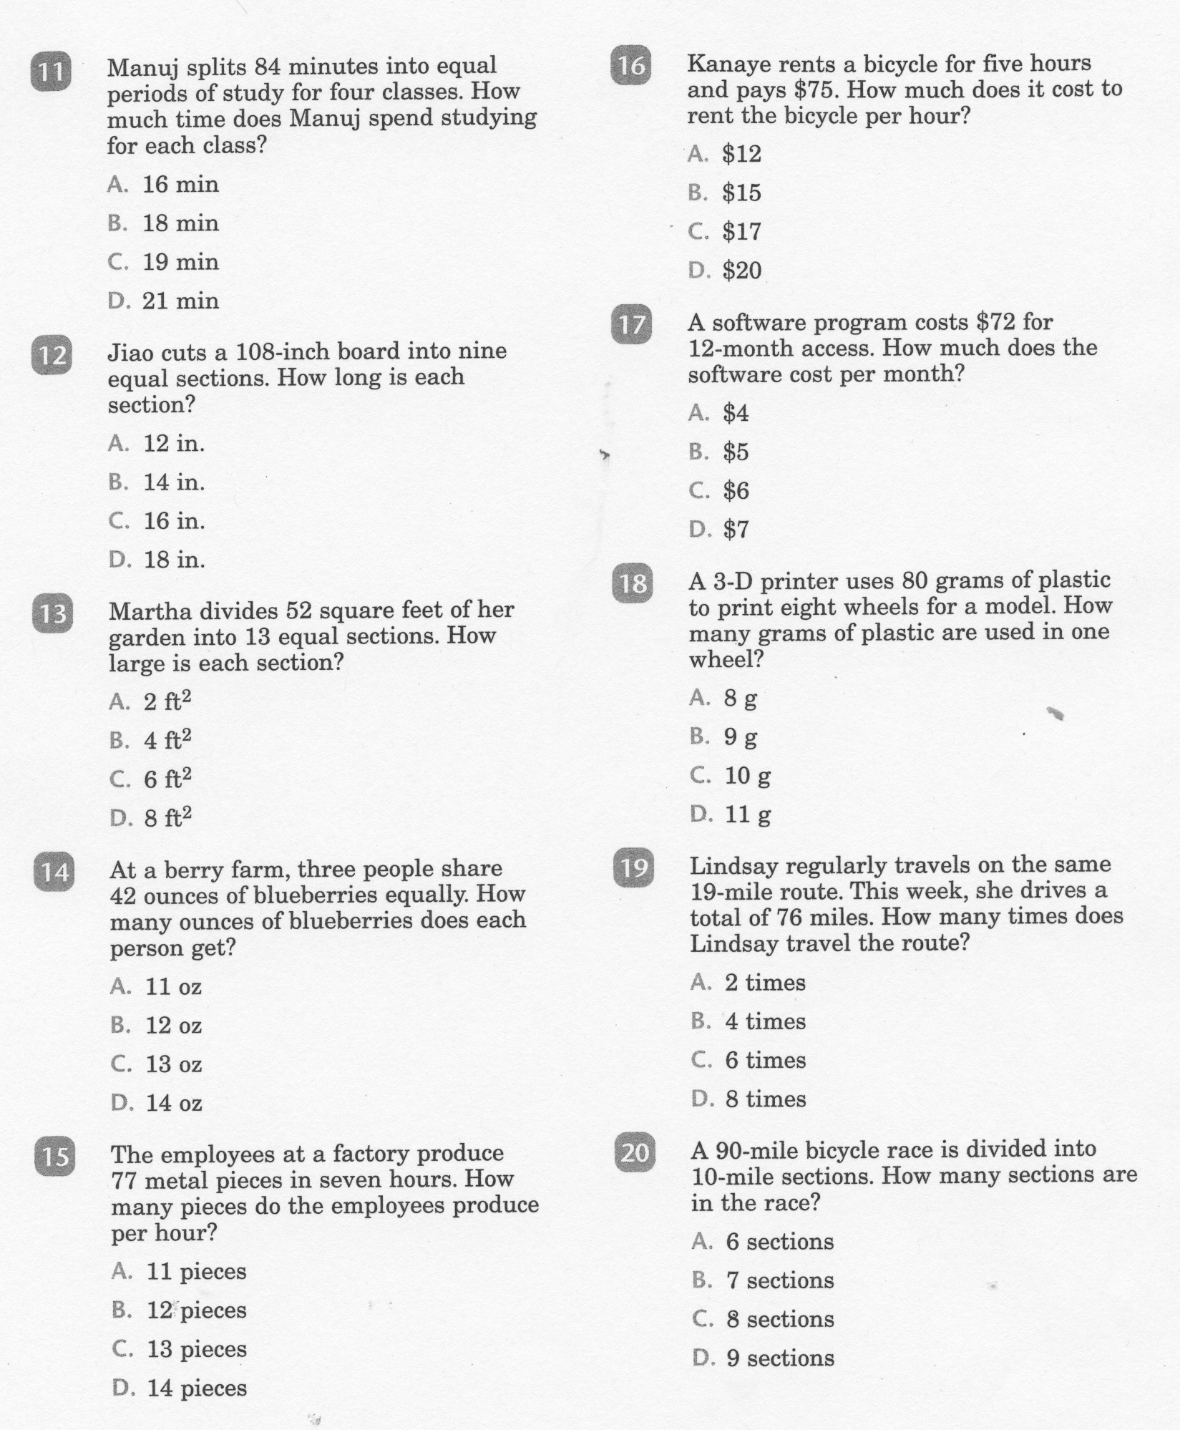
Math-E - Practice 19 - Division

Slide 7
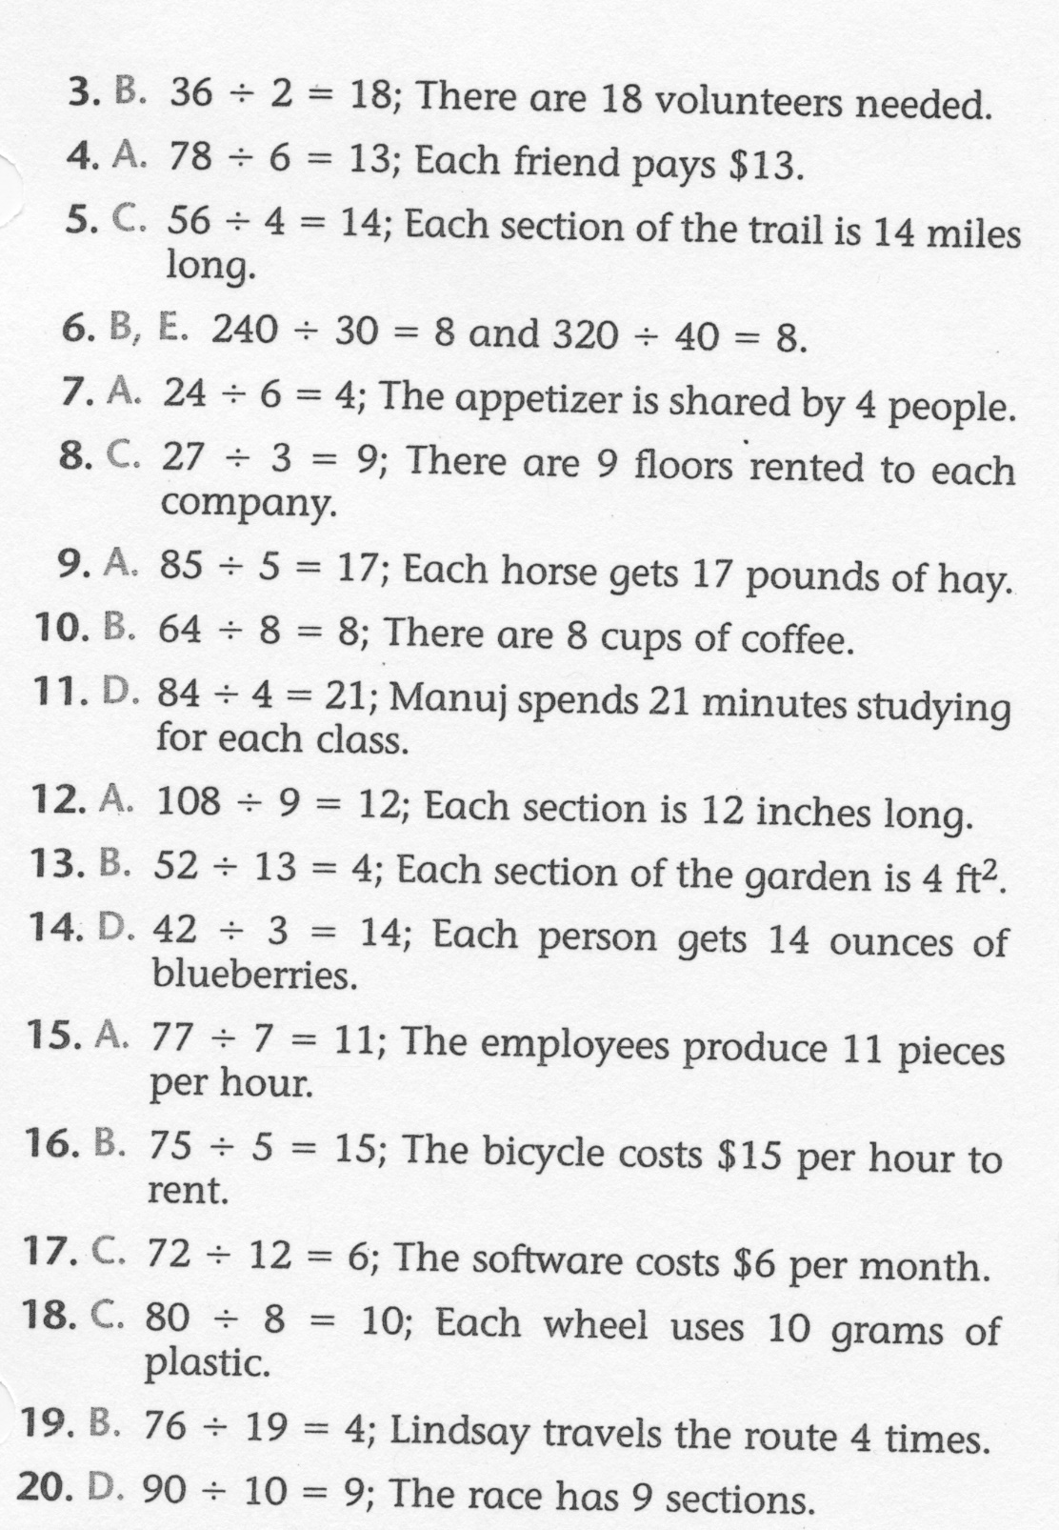
Math-E - Practice 19 – Division

