Slide 1
TABE ELA-E PAXEN Unit-5 Text Types and Purposes Lesson-37 Conclusion
Some graphics may not have copied well during the Scan Process

Slide 2
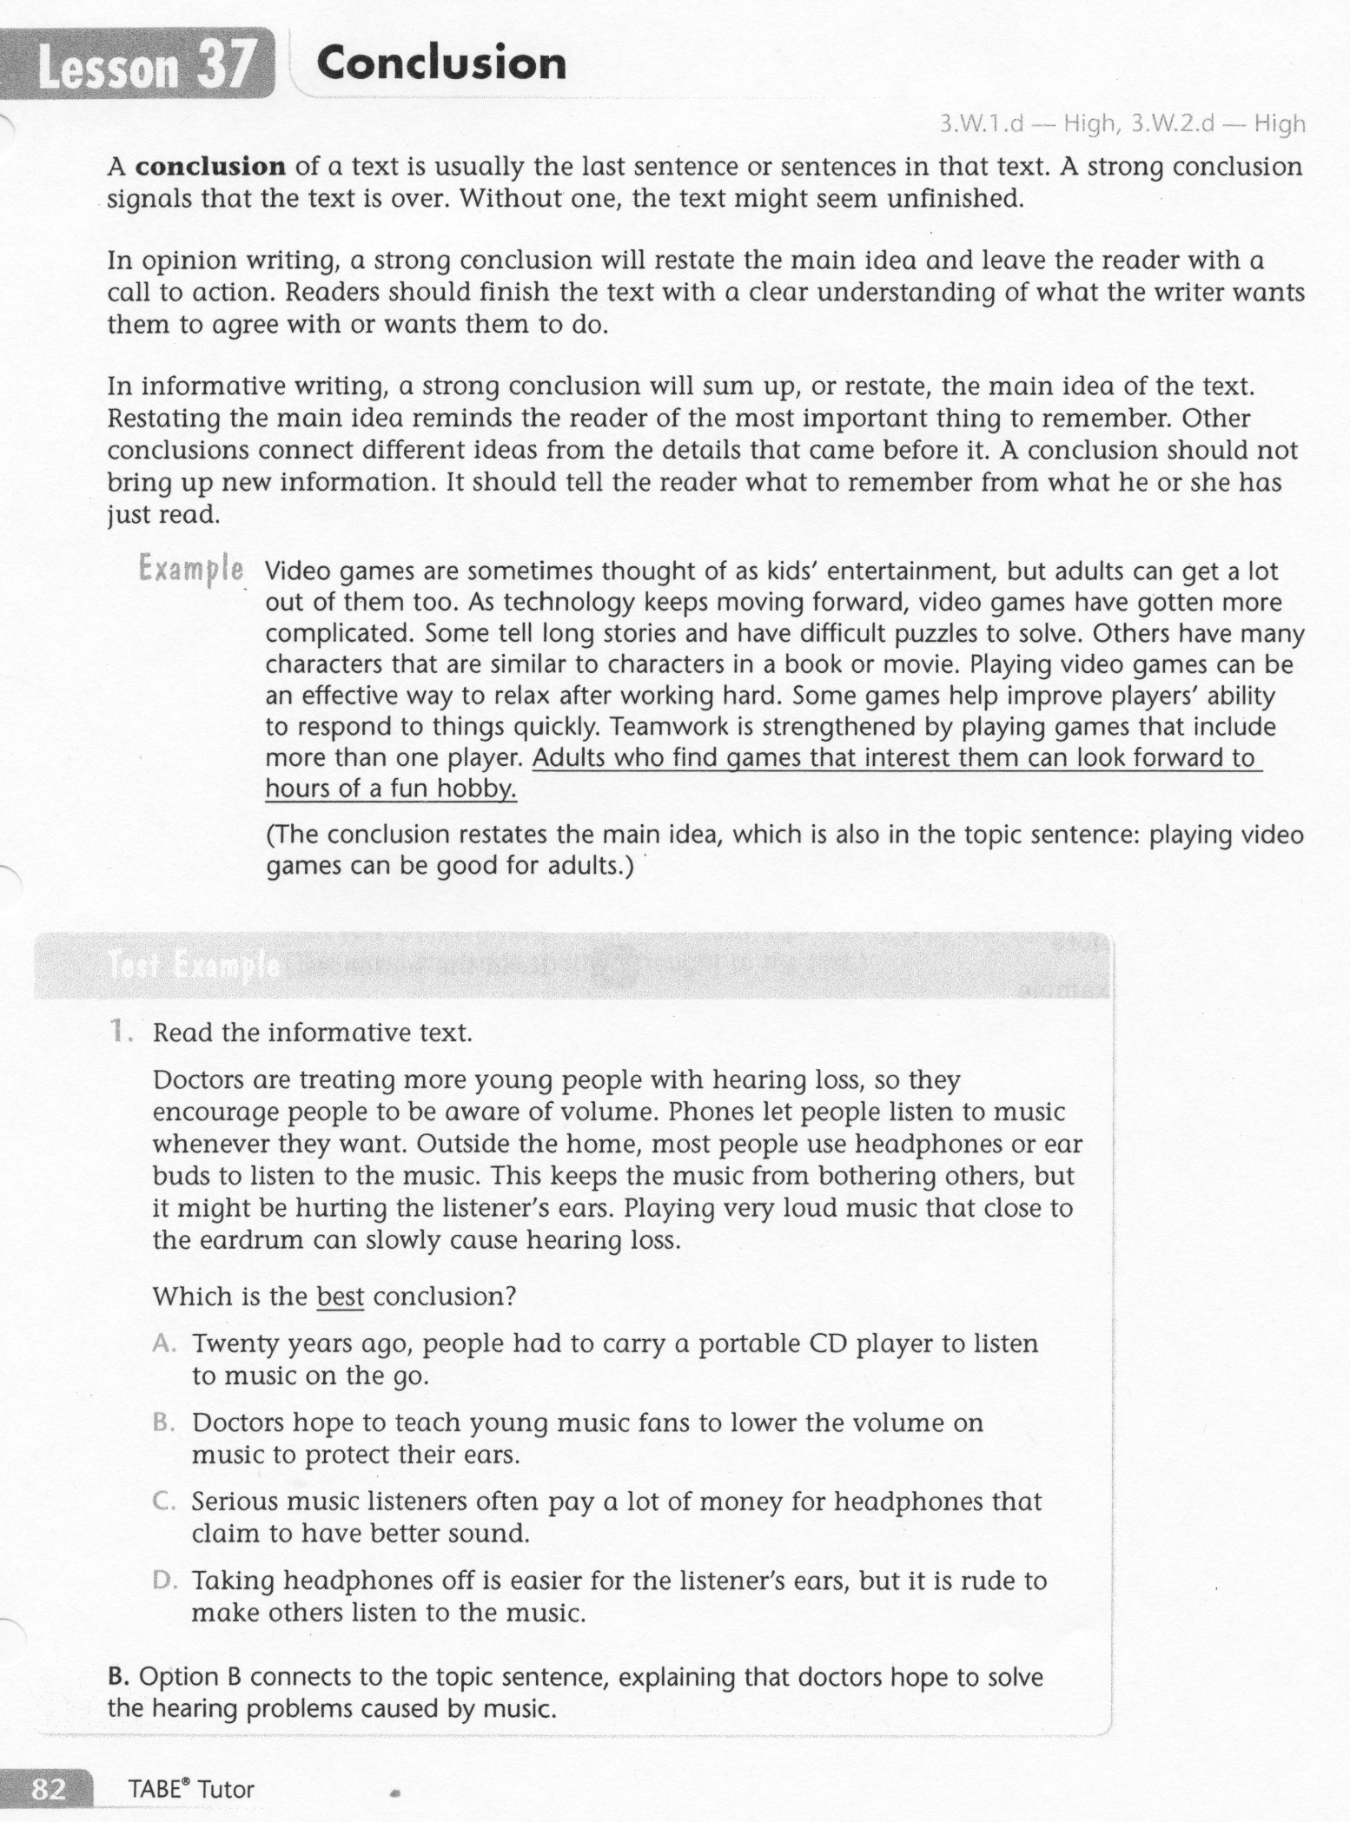
ELA-E-37 Conclusion

Slide 3
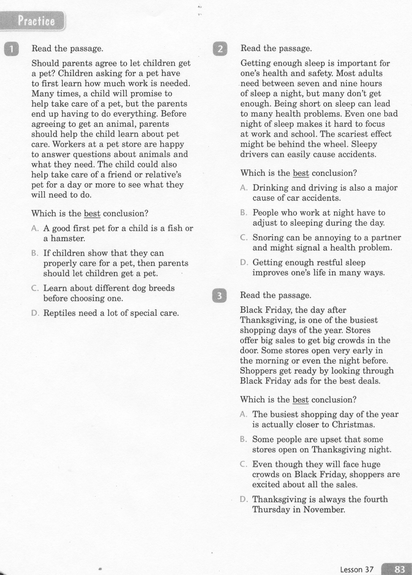
ELA-E-37 Conclusion

Slide 4
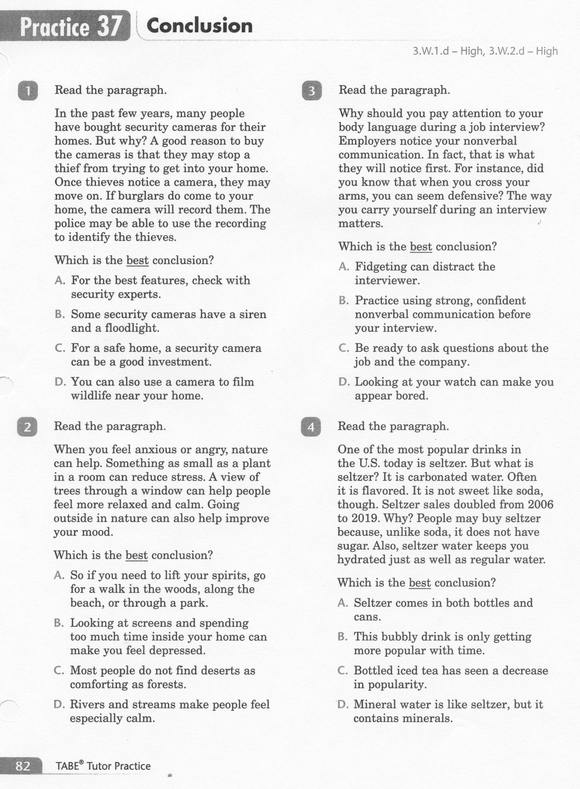
ELA-E-37 Conclusion

Slide 5
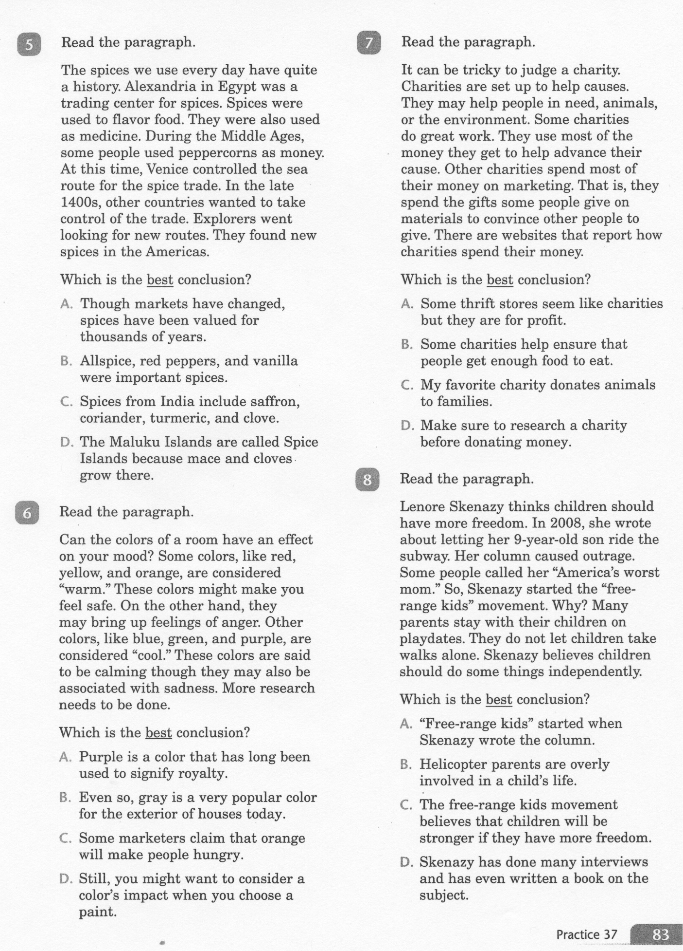
ELA-E-37 Conclusion

Slide 6
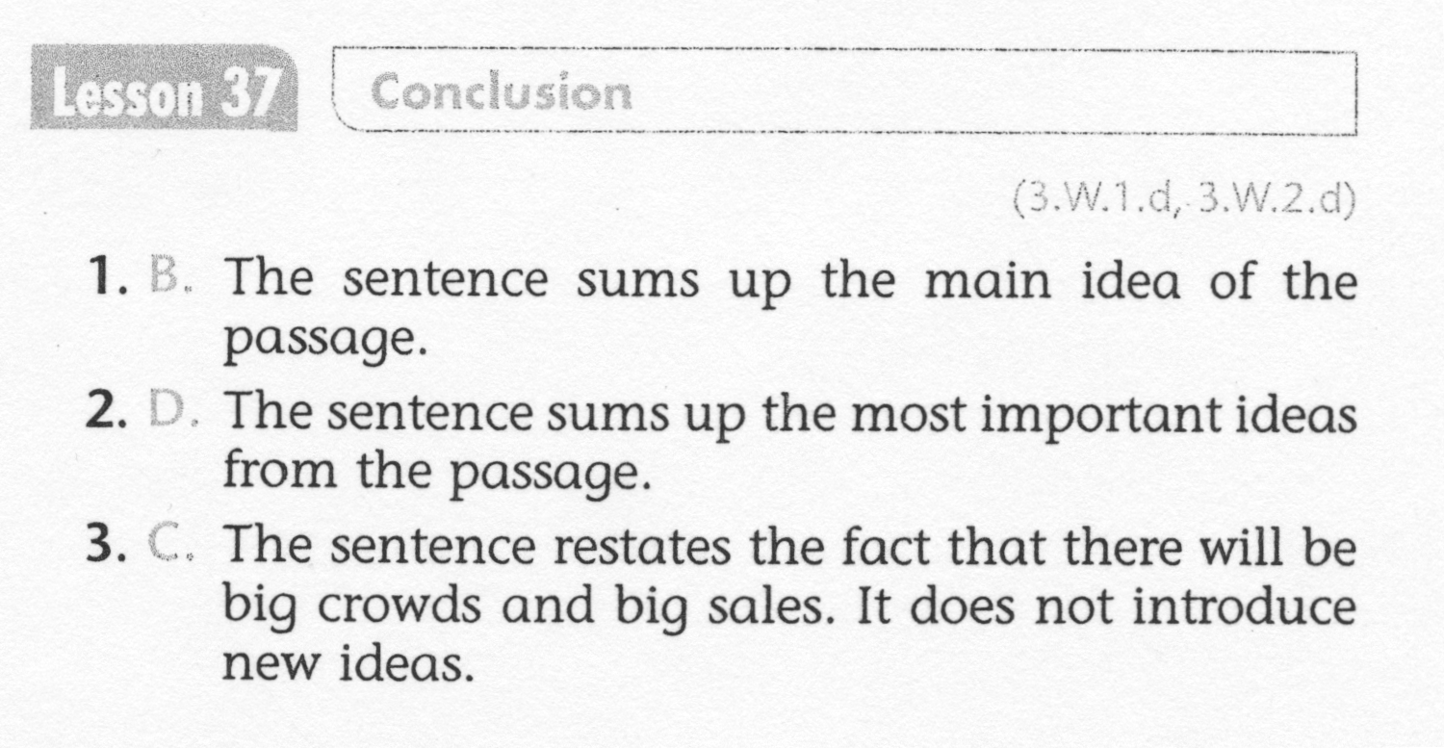
ELA-E-37 Conclusion

Slide 7
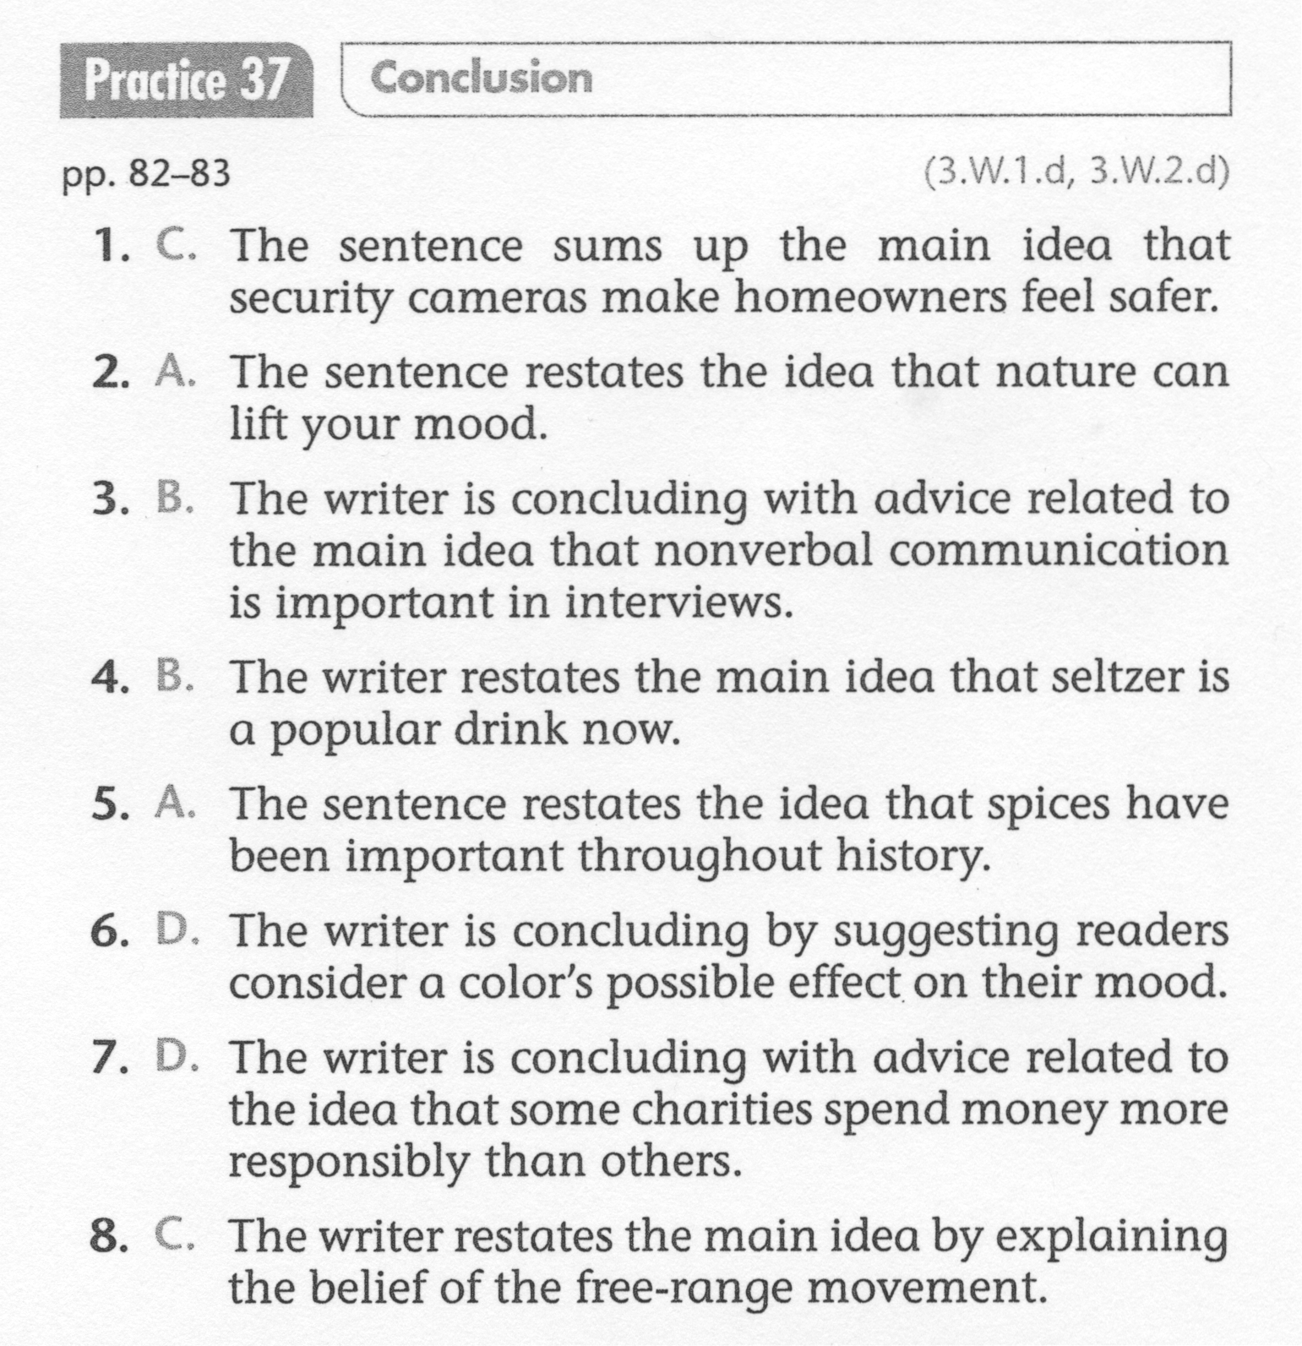
ELA-E-37 Conclusion

