Slide 1
Nolan Tomboulian
Tomboulian@yahoo.com
Tomboulian.wikispaces.com
Entering Data

Slide 2
Entering Data in Cells
Excel data usually takes one of four basic TYPES:
Text : combination of letters, numbers, and symbols (Left Align) (sometimes called Labels)
Numbers : general, integer, decimals, currency, accounting, fractions, percent, others (Right Align)
Date/Time : dates, parts of dates, times, parts of times (multiple standard and Custom Formats)
Formulas or Functions:
All start with =
Math order of operations: ( ), ^, *, /,+, -, Sum, Average, Count, Min, Max, and many others (under the [FORMULAS] Tabor with the f_{x}Caculatioo perform. Always start with an = Equal sign.

Slide 3
Entering Numbers in Cells
Just like text. Put your cursor in a desired cell and begin typing.
Cells containing numeric data should not include any other data, except for related symbols (currency, percentage, negative)
Sometimes it is better to Format the cell rather than enter the symbols for $ or %
Depending on the cell format, the number may seem to display incorrectly or in an undesired way!

Slide 4
Entering Dates
Dates can be entered in any standard format
mm/dd/yyyy, MON-DD-YYYY
Excel calculates dates mathematically. This allows for date and time calculations to be made quickly (January 1st 1900 is DAY 1)
Excel uses default date formats when it detects a date, but other formats can be applied.

Slide 5
Working with Cells and Ranges

Slide 6
Working with Cells and Cell Ranges
A group of cells is called a cell range or range
An adjacent range is a single rectangular block of cells
A nonadjacent range consists of two or more distinct cell or range references
A range reference indicates the location and size of a cell range
The colon (:) between two cells identifies a RANGE
Range references indicate the top-left and bottom-right corners of the cell range
Adjacent: A1:G5 A15:A30 C15:G15
The Semicolon (;) links multiple ranges in NonAdjacent Ranges
Nonadjacent: A1:A5;F1:G5
<Ctrl><A> may be used to select a contiguous Range of cells

Slide 7
Selecting Adjacent Cell Ranges
Left Click the cell in the upper-left corner of the adjacent range to be selected
Drag the mouse to the lower-right corner
Release the mouse button
Or
Left Click the cell in the upper-left corner of the adjacent range
Press and hold the Shift key and click the cell in the lower-right corner of the adjacent range, and then release the Shift key
Or
Left Click on the 1st Cell, press and hold the <Shift> key and use the arrows (↑ ← → ↓) to select a range
Or
Select a cell within the desired contiguous range and press <Ctrl><A>

Slide 8
Selecting Nonadjacent Cell Ranges
Select the first Range
Press the <Ctrl> key as you select additional ranges
Release the <Ctrl> key
(It is easier with a mouse than with the Keyboard)
To select ALL the cells in a worksheet:
Click the Select All button located at the intersection of the row and column selectors
But why would you need to do that?!
(This can be difficult to do with a laptop Mouse Pad)

Slide 9
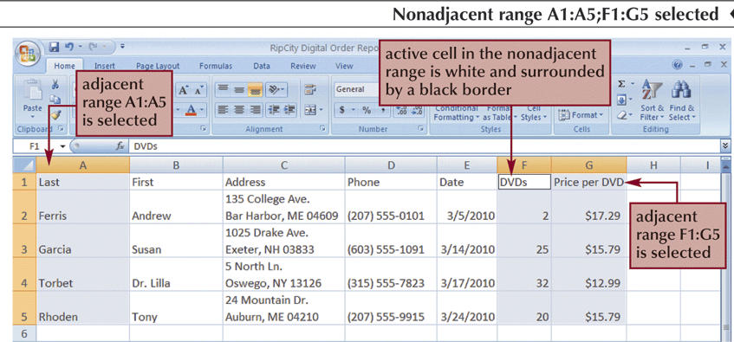
Nonadjacent Range

Slide 10
Moving or Copying a Cell or Range (with the Mouse)
Select the cell (or range) to move or copy
Move the mouse pointer over the border of the selection until the pointer changes shape (Cross-Hair)
To move the range, <left click> the border and drag the selection to a new location
To copy the range, press and hold down the <Ctrl> key and then press the <left click> and drag the selection to a new location
(This can be hard to do using a laptop Mouse Pad)

Slide 11
Moving or Copying a Cell or Range (With Ribbon Cut and Paste Icons)
Select the cell or range you want to move or copy
Go to the [Home] tab - Clipboard group and click the Cut button or the Copy button
Or <right-click> the selection, and then press
Cut <Ctrl X> or Copy <Ctrl C> on the shortcut menu
Select the cell or upper-left cell of the range where you want to move or copy the content
In the Clipboard group, click the Paste button (or <right-click> the selection, and then click Paste on the shortcut menu <Ctrl V>)
PASTE can overwrite existing Cell Data without warning! - BE CARFUL!

Slide 12
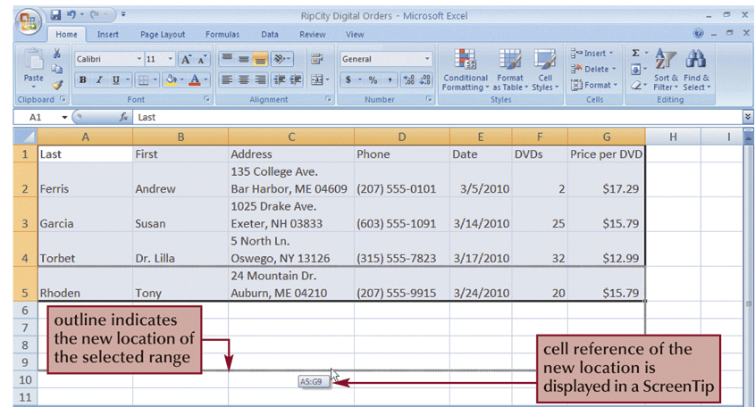
Dragging a Range

