Slide 1
Excel Worksheet Basics Terminology Navigation The Ribbon
Nolan Tomboulian
Tomboulian@yahoo.com
Tomboulian.wikispaces.com

Slide 2
Introducing Excel
Microsoft Office Excel 2010 (Excel) is a computer application used primarily to enter, analyze, and present quantitative data (but has many other uses: ie: Database for Mail Merge)
It is best for historic data that won’t be changing or need “real-time” updates.
Desktop Icon
or
Start / All Programs / Microsoft Office
(Right Click and copy the program to the desktop for quick access if it is not there!)
A spreadsheet is usually a collection of text and numbers laid out in a rectangular grid. (Columns and Rows)
Often used for budgeting, inventory management, and decision making
Think of Excel as a big table or chart to fill in with data
Today, every cell is customizable and you are not restricted to set Rows or Columns for Formatting.
There are 1,048,578 Rows and 16,384 Columns = 17,179,869,184 cells
Other objects such as: pictures, WordArt, SmartArt, drawings/shapes and even other OBJECTS (files) can be inserted into the workbook.

Slide 3
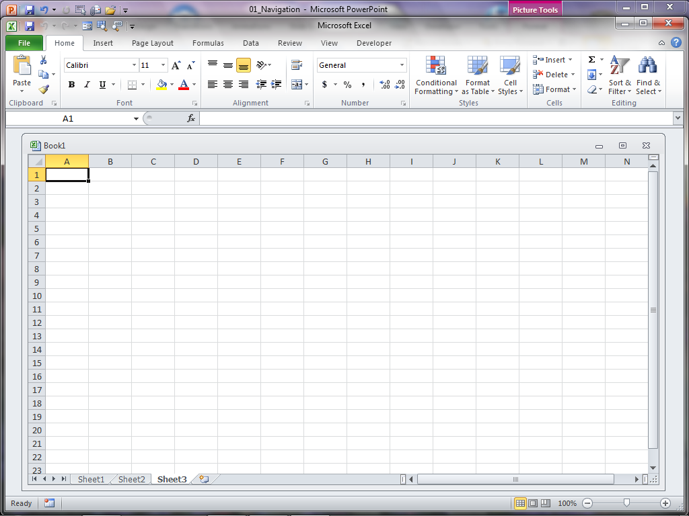
Does your screen look something like this?
You may need to change the SCREEN Resolution
START
Control Panel
Display
Or the size of the Excel Window?
Program and Workbook View
Your Ribbon and QAT may have been modified by prior users or the options changed (IE: the [DEVELOPER] tab or other add-ins)

Slide 4
The Ribbon
Depending on the resolution of your screen monitor
and the size of the Excel Window, the Ribbon will change appearance
You CAN change the design or layout of the Ribbon
You CAN minimize the Ribbon (<CTRL F1> Ribbon, Button)
You CAN move and modify the Quick Access Toolbar

Slide 5
Basic Workspace Vocabulary
Workbook
Worksheet
Title Bar
Ribbon
Tabs
Groups
Commands
Dialog Boxes
Quick Access Toolbar
Status Bar
Name Box
Range (uses the colon :)
Formula Function (insert)
Formula Bar
Select ALL
Column Headings
Row Headings
Cell
Vertical Scroll Bar
Horizontal Scroll Bar
Zoom Control
View Modes
Screen Splitter
Sheet Tabs
Sheet Tabs Scrolling Bar

Slide 6
Excel Workspace 2007

Slide 7
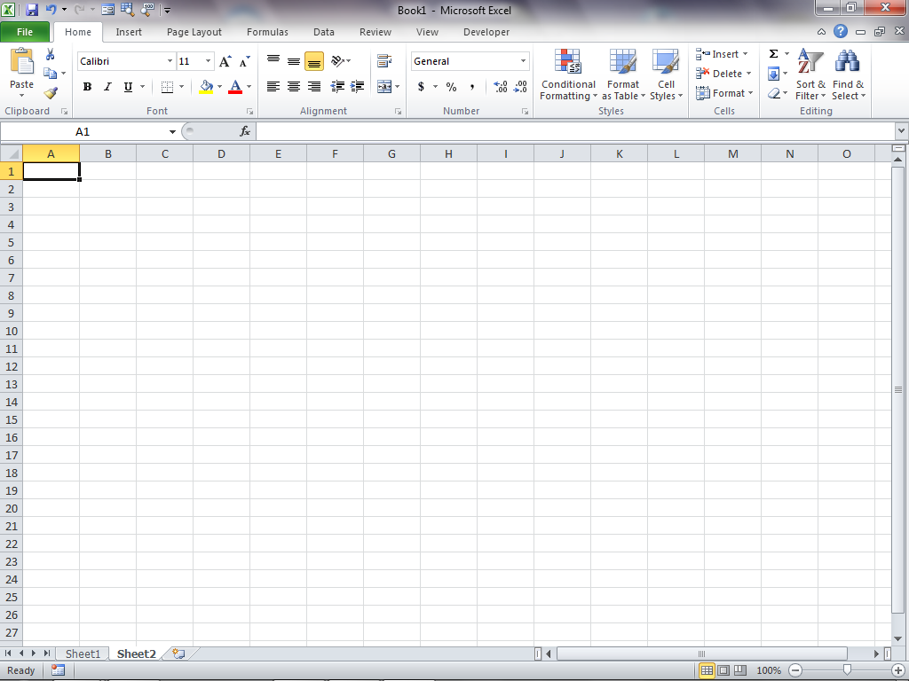

Slide 8
Basic Parts of Excel
Ribbon - Area above workbook window where [Tabs], groups, and Commands are located. (Menu Functions)
[Home] [Insert] [Page Layout] [Formulas] [Data] [Review] [View] [Developer]
Each Ribbon Tab has a sub-menu Group of tasks, commands and options
There are other [TABS] that are Context Based and appear when the selected object is active: Tables, SmartArt, WordArt, Drawings, Pictures, Charts
Workbook – collection of one or more worksheets (An Excel file is a workbook)
Worksheet – collection of cells that hold data or other objects.
Range – Multiple cells (adjacent or non-contiguous) for action to be applied
(Formatting, Moving, Copying, Sort, Filter, Apply Formula)
Cell – formed at the intersection of a column and row (the cell reference or address: ColumnLetterRowNumber) Cell Address, Cell Reference. Cell Name

Slide 9
Navigating Excel
Worksheet Tabs – click to move between worksheets (can move, rename, and color code)
Columns Headings – Letters above each column that identify the column (cannot change)
Row Headings – Number next to each row that identify each row
Cell Reference – unique combination of column letter and row number intersection point (cell address or Cell Name)

Slide 10
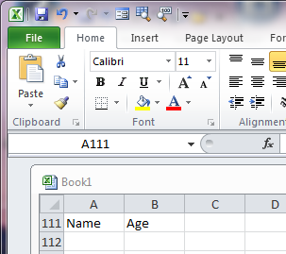
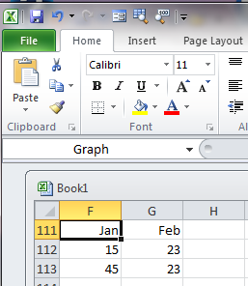
Other Parts of Excel
Formula Bar – Toolbar (usually between the Ribbon and Workbook window) where cell contents are displayed and functions can be inserted in a cell (may be turned off or expanded to view long formulas )
Name Box – Displays the cell reference of the active cell or (Range Name or object). May also be used as a GOTO <F5> address.
View Options – Displays the spreadsheet in the Normal, Page Layout, Page Break and ZOOM mode.
F_{x} Insert Function Dialog Help

Slide 11
Basic Navigating in a Worksheet
<Right Click> Possible Options to do on the item (Dialog Box)
↑ ↓ → ← Up, Down, Left, Right
<Shift> {Arrows} Used to select a “Range” of data
{enter} Down one Row <Shift> {enter} Up one Row
<Tab> Right one Column <Shift><Tab> Left one Column
{Home} Column A of the current Row
<Ctrl> {Home} Cell A1
<Shift>{Home} Highlight cells from current cell to Column A
<Ctrl> {End} Last cell of data in spreadsheet
{PageUp}, {PageDown} move up or down 1 screen of data
<Ctrl> {PageUp} <Ctrl> {PageDown} change SHEETS
<Ctrl>{~} Toggle between Formula View and Calculated View
<F2> Edit
<F3> Name Manger
<F4> Absolute Cell Reference
<F5> Go to Dialog Box
<F8> allows you to select the Lower Right corner of a range
<F1> Help
<F10> Turn on/off <ALT> Ribbon Short-cut Key Tips (HotKeys)
<F11> Chart
<Ctrl> A Select a Range <Ctrl> Z Undo

Slide 12
Links to more shortcut tips
http://office.microsoft.com/en-us/excel-help/excel-shortcut-and-function-keys-HP010073848.aspx
http://www.ddmcomputing.com/excel/keys/excel_fkeys.htm
http://www.ddmcomputing.com/excel/

Slide 13
Key Tips
Key Tips are shortcuts to [Tab] and other options on the Ribbon.
Press the <Alt> key to show the Key Tips, then press the corresponding letter (or number) on the keyboard to activate the option.
KeyTips go off when you finish the command.
Pressing <F10> also turns on KeyTips

Slide 14
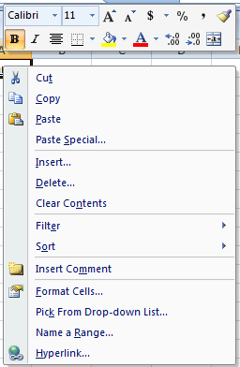
<Ctrl> Commands and <Right Click> (You don’t always have to use the Ribbon!)
<Right Click> Options
What about the old keyboard shortcuts?
Shortcuts that begin with <CTRL> are still intact, and you can use them like you always have.
Ctrl C Copy
Ctrl V Paste
Ctrl B Bold
Ctrl U Underline
Ctrl I Italic
Ctrl X Cut
Ctrl Z Undo
others…..

Slide 15
Planning a Workbook
Before you begin to enter data into a workbook, you should develop a plan!
Failing to plan is a plan to fail!
What problem do you want to solve?
Define the workbook’s purpose
What data is needed?
Define the types of data to collect and source
What calculations are required?
Define what formulas or functions to use
What form will the solution take?
Define appearance of the workbook content. Formatting
Who is the User?
Define Edits, Controls, Data Validation, Color Codes
Passwords and Security?

Slide 16
EXCEL
WORKBOOK Terminology
& NAVIGATION

