Slide 1
Unit 4-4 Microsoft Application Programs
MICROSOFT is a company that makes APPLICATION SOFTWARE for computers.
MICROSOFT is the ‘Industry Standard’
APPLE and GOOGLE also have a SUITE of products

Slide 2
Unit 4-4 Microsoft Application Programs
4-4 Learning Objective Standards
5. Identify icons, functions, and any file extensions related to basic Microsoft Office software (Word, PowerPoint, and Excel) and
default Windows programs (Microsoft Edge, Windows Defender, Paint, Snip, Etc.)
4-4 Vocabulary
default
Excel spreadsheet (xlsx)
Edge internet browser
file extension (jpg, png, pdf, mp4, mp3, mov, avi, exe, txt, gif, tif, zip, wav)
Microsoft
PowerPoint slideshow (pptx, ppts)
Word document (docx)

Slide 3
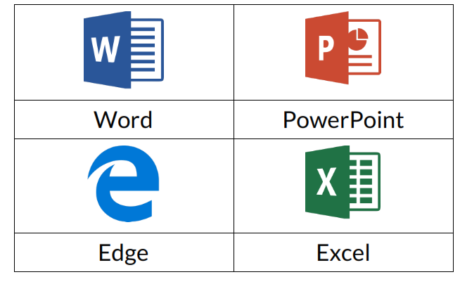
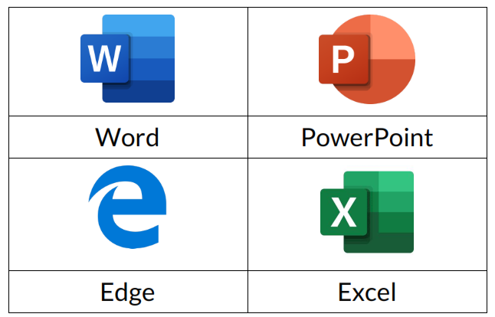
Unit 4-4-A Reference Microsoft Icons
2013
2018

Slide 4
Unit 4-4-B Reference Extensions
SOME OTHER EXTENSIONS: pdf, mp4, vid, avi, txt, png, gif, zip, exe, html, wav, tif
https://it.nmu.edu/docs/common-windows-file-extensions
https://www.indeed.com/career-advice/career-development/types-of-files
https://www.filecenter.com/blog/the-giant-list-of-document-file-types-and-extensions/
https://support.microsoft.com/en-us/windows/common-file-name-extensions-in-windows-da4a4430-8e76-89c5-59f7-1cdbbc75cb01

Slide 5
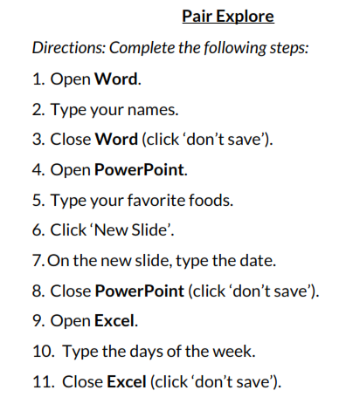
Unit 4-4-C Reference (Pair Explore)

Slide 6
Unit 4-4-A Handout QUIZ-1 (Microsoft Programs)

Slide 7
Unit 4-4-A Handout QUIZ-2 (Microsoft Programs)

