Slide 1
Unit-3-3 Email Etiquette
Learners will be skilled at…
In this lesson, learners will begin to understand the basics of professional email
Etiquette.
​
They will practice writing emails that include a clear Subject, polite Heading, a concise Body and a proper Closing.
Learners will type and send emails using prompts based on common situations, such as emailing a teacher about an absence.
Teaching Tips:
Many of the elements of email etiquette discussed in this lesson are necessary in a professional setting.
Consider discussing other situations where rules of etiquette may have changed!

Slide 2
Unit 3-3 Email Etiquette
Learning Goals:
5. Create and send an email, including recipient address, subject, and message.
11. Understand basics of email etiquette
using salutations and closings
avoiding all caps
making use of the subject line
understanding when it's ok to forward messages
Knowing who to cc: or bcc:
Unit 3-3 Vocabulary:
body greeting
closing message
email address subject
etiquette
To

Slide 3
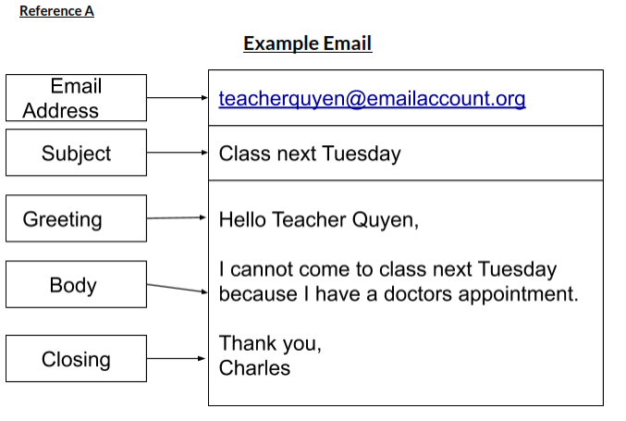
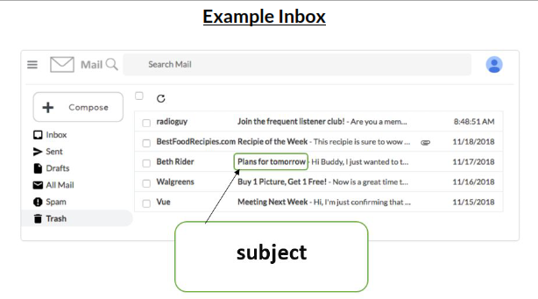
3-3 Reference A

Slide 4
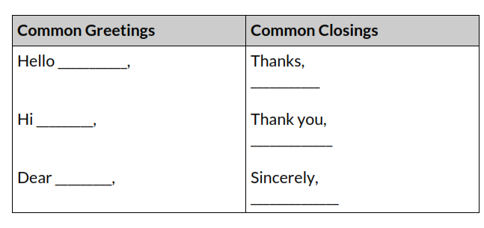
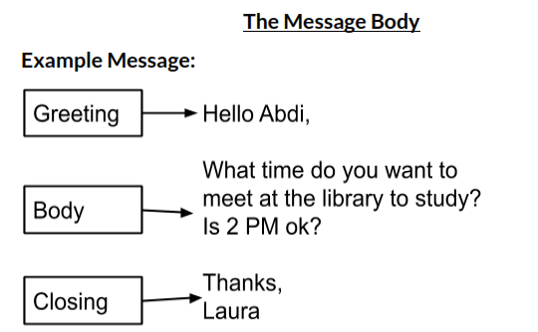
3-3 Reference B
* Be careful with the word DEAR.
This used to be the Formal Greeting used in letters, but times are changing and may not be appropriate!
Greetings
Blessings
Looking forward to your response,
In Peace,

Slide 5
Unprofessional Emails
3-3 Reference C

Slide 6
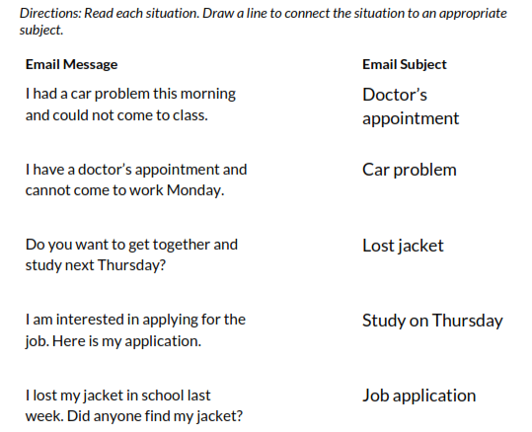
Email Subject Lines
3-3 Handout A

Slide 7
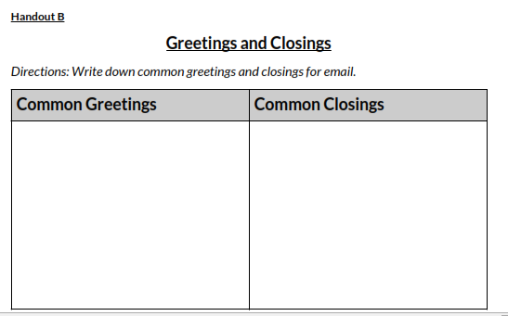
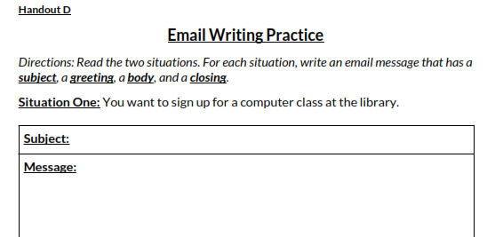
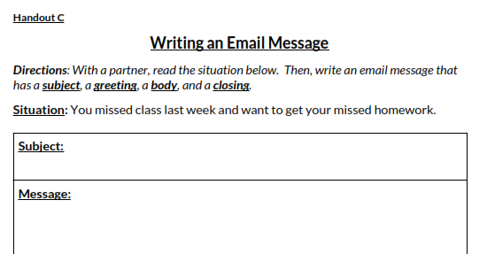
Practice Writing Emails
3-3 Handout
B, C, D
The Book uses “Paper Forms” for this activity.

Slide 8
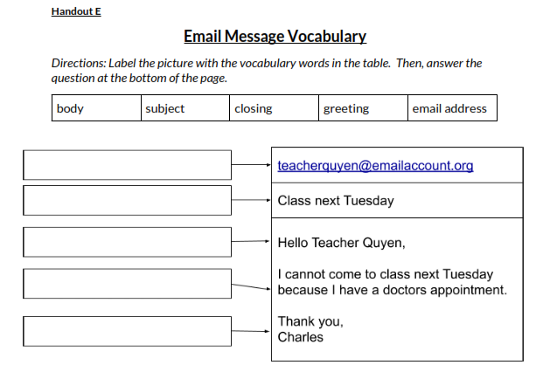
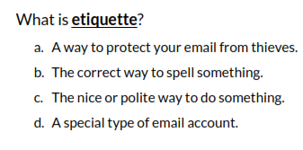
3-3 Handout E
QUIZ

