Slide 1
Unit-3-2 Email Addresses vs URLS
Learners will be skilled at…
In this lesson, learners will identify the important parts of an Email Address.
They will practice differentiating between email addresses and Website addresses
​as well as identifying and fixing common errors made when typing email addresses
​
Finally, they will practice sending and receiving emails
​

Slide 2
Unit 3-2 Email Addresses (Username)
Learning Goals:
1. Define email and identify common email providers.
2. Tell the difference between a URL and an email address.
5. Create and send an email, including recipient address, subject, and message.
Unit 3-2 Vocabulary:
compose
email
email address
email provider
web address
username
open
respond

Slide 3
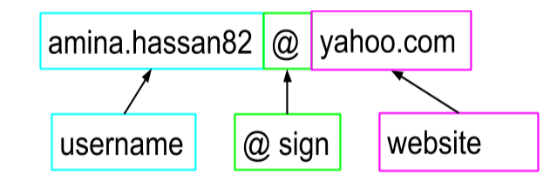
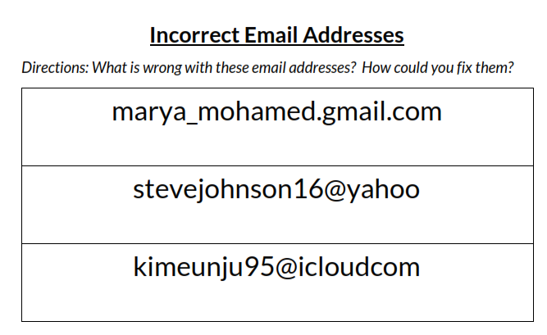
Email User Address
3-2 Reference A

Slide 4
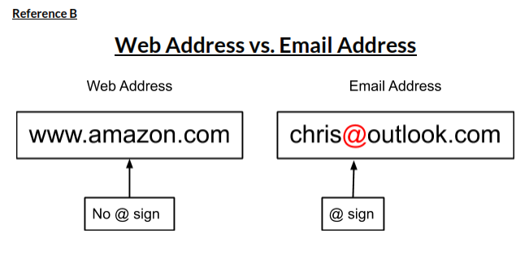
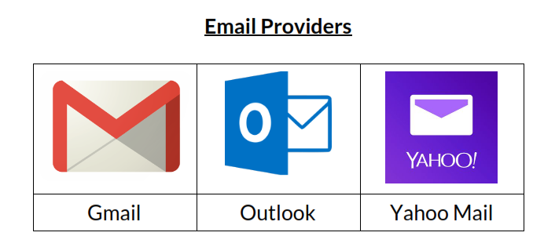
3-2 Reference B

Slide 5
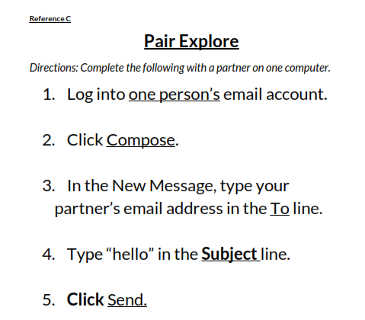
3-2 Reference C

Slide 6
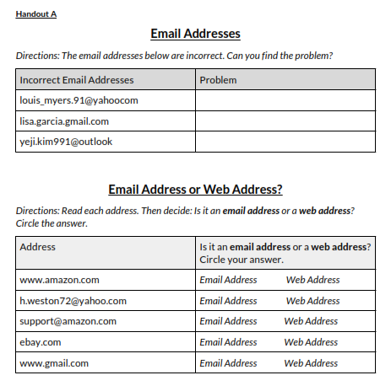
3-2 Handout A
Web Addresses vs. Email Addresses
◆ Websites like Amazon, Facebook, and eBay
also have addresses.
They are called URLS or web site Addresses.
​
The look similar. They both often end in .com.
◆ The difference is that a Web addresses
​ never have an @ sign.
◆ email addresses always have an @ sign and
​web addresses
​
◆ Web Addressed go a a Page on the internet.
Email addresses to send electronic
mail and documents to a person or business.

Slide 7
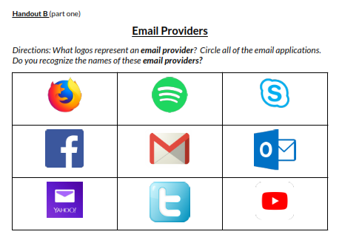
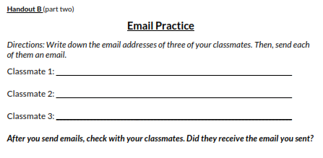
3-2 Handout B

Slide 8
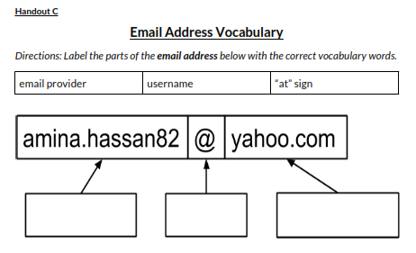
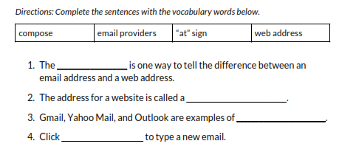
3-2 Handout C

