Slide 1
GED MATH BASICS: TI-30XS
Start Here
Decimal / Fraction / Percent
Converting Fractions
By L. Koenig

Slide 2
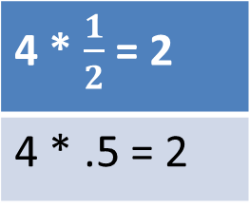
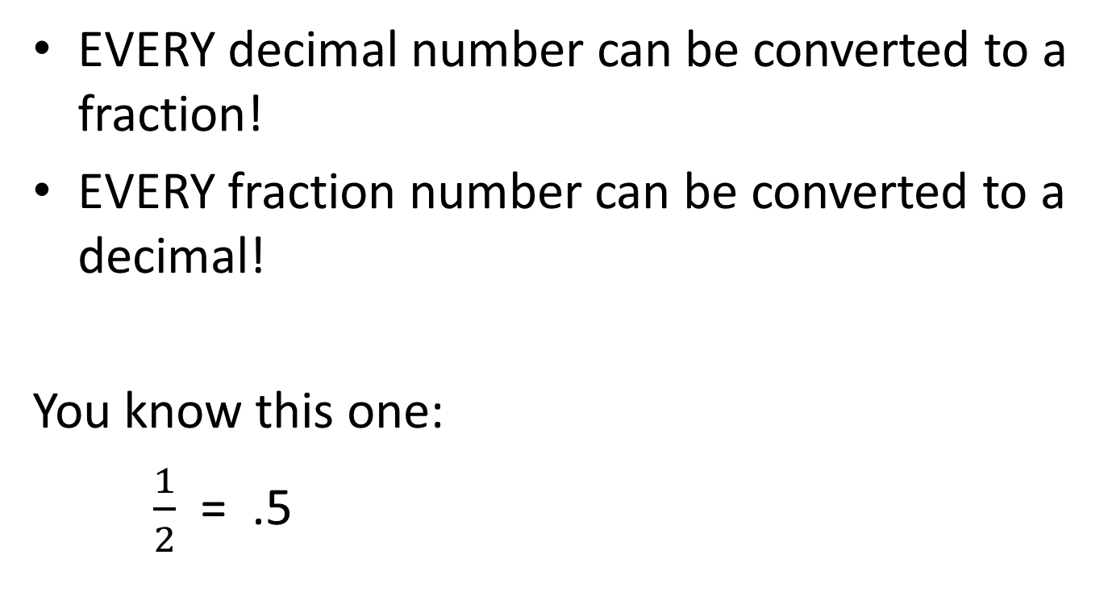
Number Format
EVERY decimal number can be converted to a fraction!
EVERY fraction number can be converted to a decimal!
You know this one:
$\frac{1}{2}$ = .5
4 * $\frac{1}{2}$ = 2
4 * .5 = 2

Slide 3
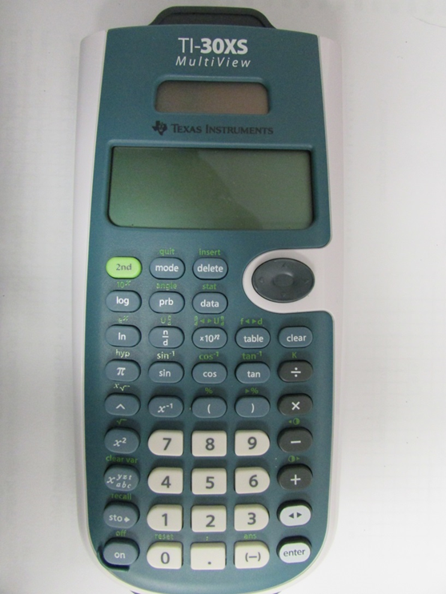
Decimal Point
Separates the whole number values from the tenTHS, hundreTHS, and even smaller numbers.
Review Place Value or watch the
Math Antics video on it to learn more!

Slide 4
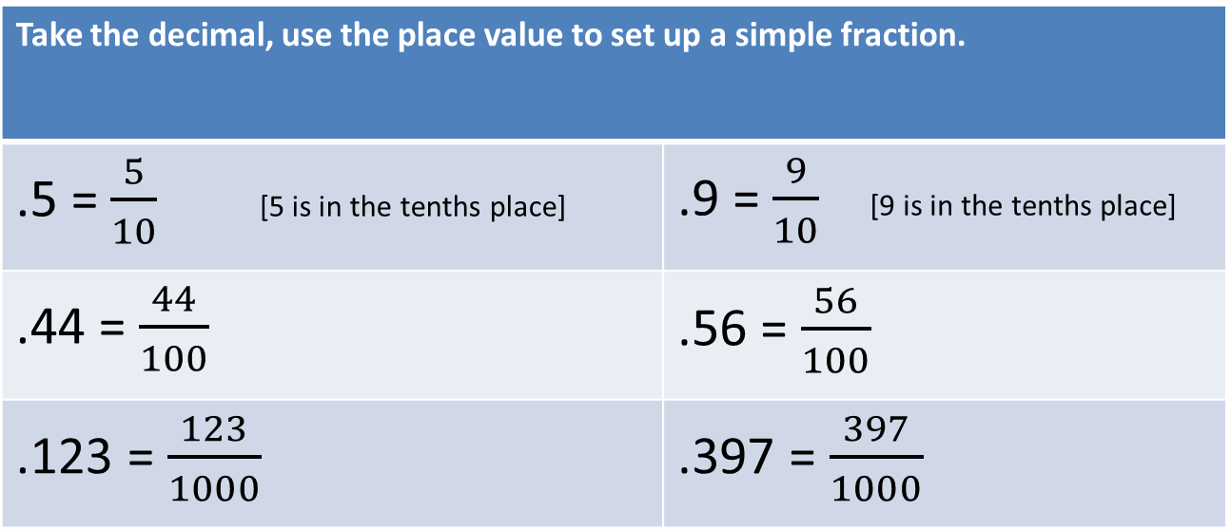
Decimal to Fraction:
Know your Place Value!
4, | 5 | 6 | 7, | 8 | 9 | 1 | . | 2 | 3 | 4
millions | hundred-thousands | ten-thousands | thousands | hundreds | tens | ones | (decimal point) | tenths | hundredths | thousandths
Take the decimal, use the place value to set up a simple fraction.
.5 = $\frac{5}{10}$ [5 is in the tenths place] | .9 = $\frac{9}{10}$ [9 is in the tenths place]
.44 = $\frac{44}{100}$ | .56 = $\frac{56}{100}$
.123 = $\frac{123}{1000}$ | .397 = $\frac{397}{1000}$

Slide 5
Use the Calculator to convert Decimal to Fraction!
Type in the decimal
Hit the double arrow key
Hit enter
You Try:
.877
.91
.3

Slide 6
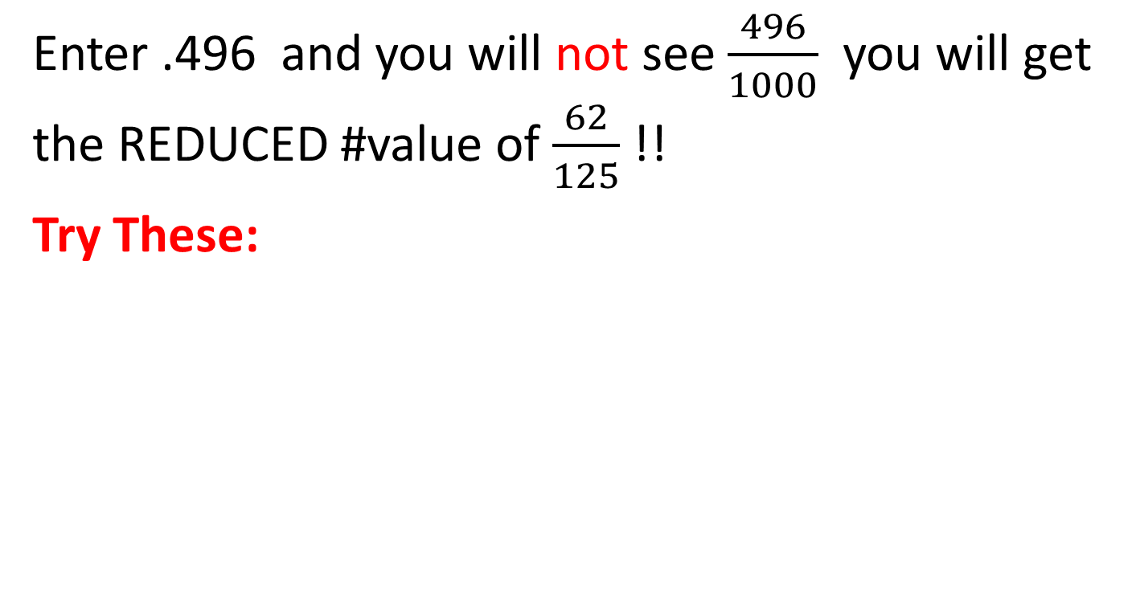
Reducing of Fractions is AUTOMATIC with the TI-30XS!!
Enter .496 and you will not see $\frac{496}{1000}$ you will get the REDUCED #value of $\frac{62}{125}$ !!
Try These:
.48 = | .12=
.22 = | .248 =
.755 = | .465 =
.292 = | .688 =
[With the Calculator: Insert decimal/ double arrow key/ enter]

Slide 7
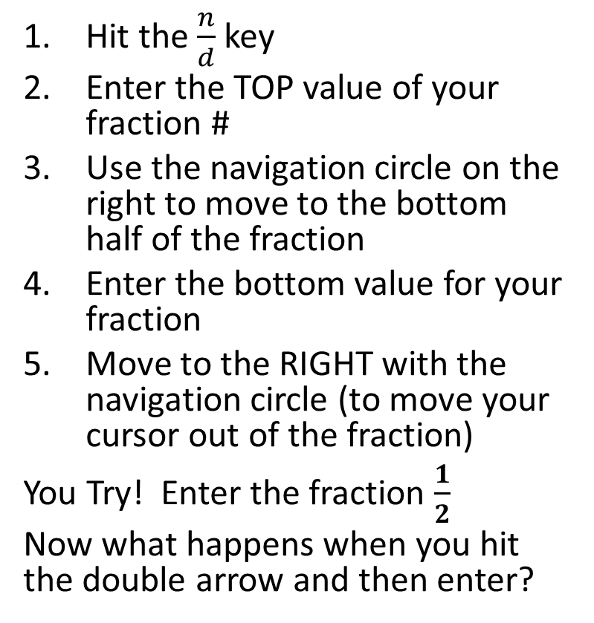
Entering Fractions on the TI-30XS
Hit the $\frac{n}{d}$ key
Enter the TOP value of your fraction #
Use the navigation circle on the right to move to the bottom half of the fraction
Enter the bottom value for your fraction
Move to the RIGHT with the navigation circle (to move your cursor out of the fraction)
You Try! Enter the fraction $\frac{1}{2}$
Now what happens when you hit the double arrow and then enter?

Slide 8

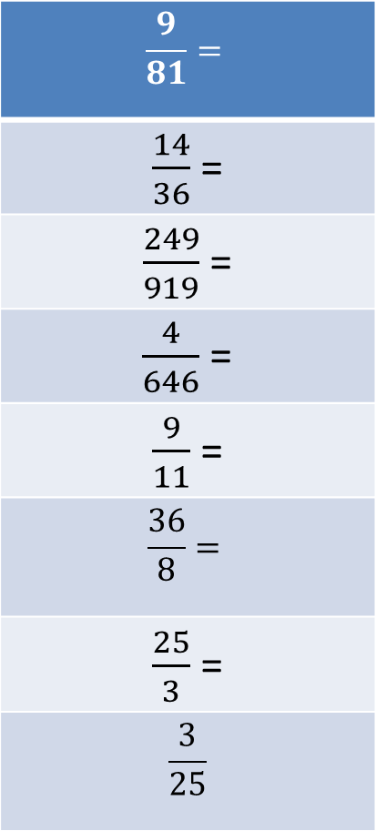
Practice! Convert these fractions to decimals:
$$\frac{9}{81}=$$
$\frac{14}{36}$ =
$\frac{249}{919}$ =
$\frac{4}{646}$ =
$\frac{9}{11}$ =
$$\frac{36}{8}=$$
$\frac{25}{3}$ =
$$\frac{3}{25}$$
Improper fractions will convert to decimals too!
$\frac{112}{58}$ = 2.54545454
? What happens if you hit the double arrow key another time?

Slide 9

Numerator / Denominator
$\frac{n}{d}$ = $\frac{numerator}{denominator}$ = $\frac{top value in the fraction}{bottom value in the fraction}$
www.mathantics.com
Math Antics has several great videos to help you understand these math concepts.
Watch their videos on fractions!

Slide 10
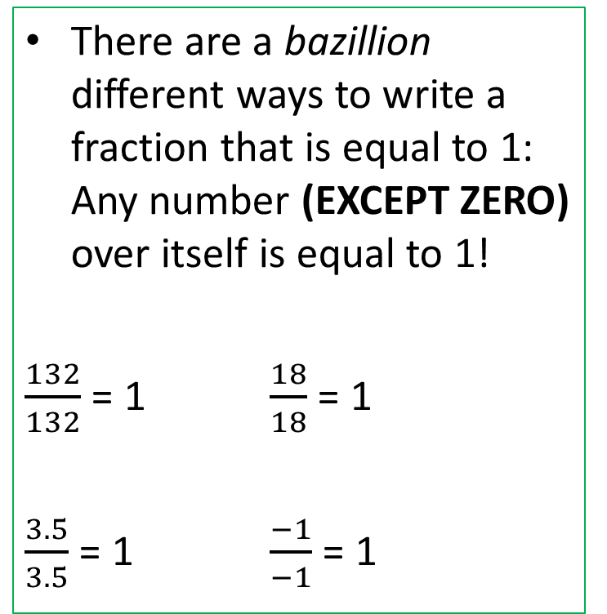
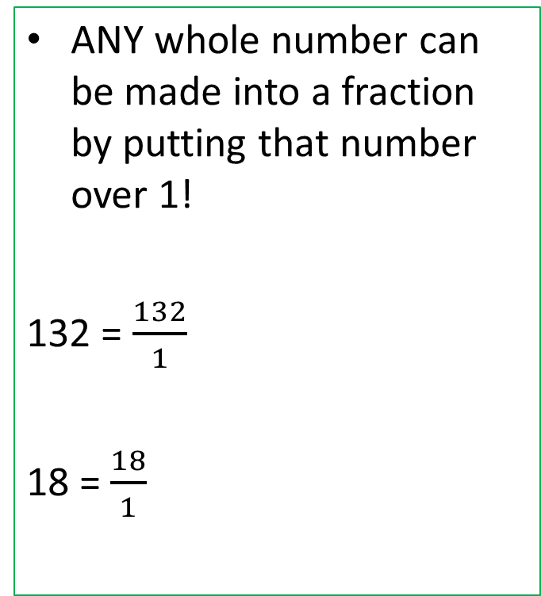
FRACTION of a Number/
Fractions Equal to 1
ANY whole number can be made into a fraction by putting that number over 1!
132 = $\frac{132}{1}$
18 = $\frac{18}{1}$
There are a bazillion different ways to write a fraction that is equal to 1: Any number (EXCEPT ZERO) over itself is equal to 1!
$\frac{132}{132}$ = 1 $\frac{18}{18}$ = 1
$\frac{3.5}{3.5}$ = 1 $\frac{−1}{−1}$ = 1

Slide 11
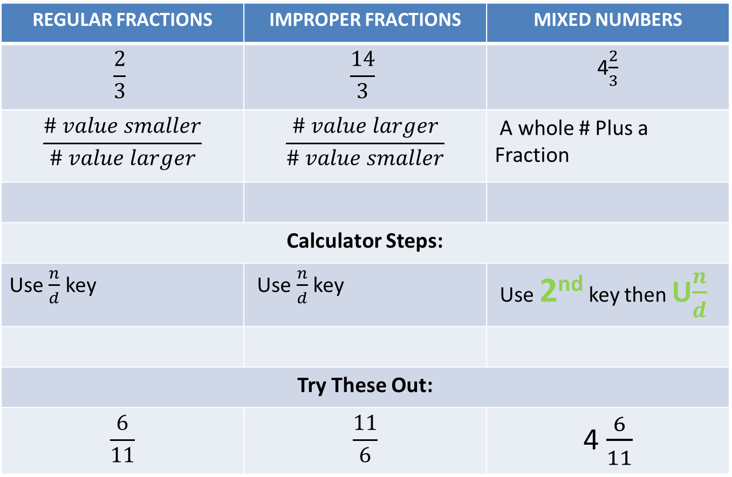
All About Fractions
REGULAR FRACTIONS | IMPROPER FRACTIONS | MIXED NUMBERS
$$\frac{2}{3}$$ | $$\frac{14}{3}$$ | 4$\frac{2}{3}$
$$\frac{\# value smaller}{\# value larger}$$ | $$\frac{\# value larger}{\# value smaller}$$ | A whole # Plus a Fraction
Calculator Steps:
Use $\frac{n}{d}$ key | Use $\frac{n}{d}$ key | Use 2nd key then U$\frac{n}{d}$
Try These Out:
$$\frac{6}{11}$$ | $$\frac{11}{6}$$ | 4 $\frac{6}{11}$

Slide 12
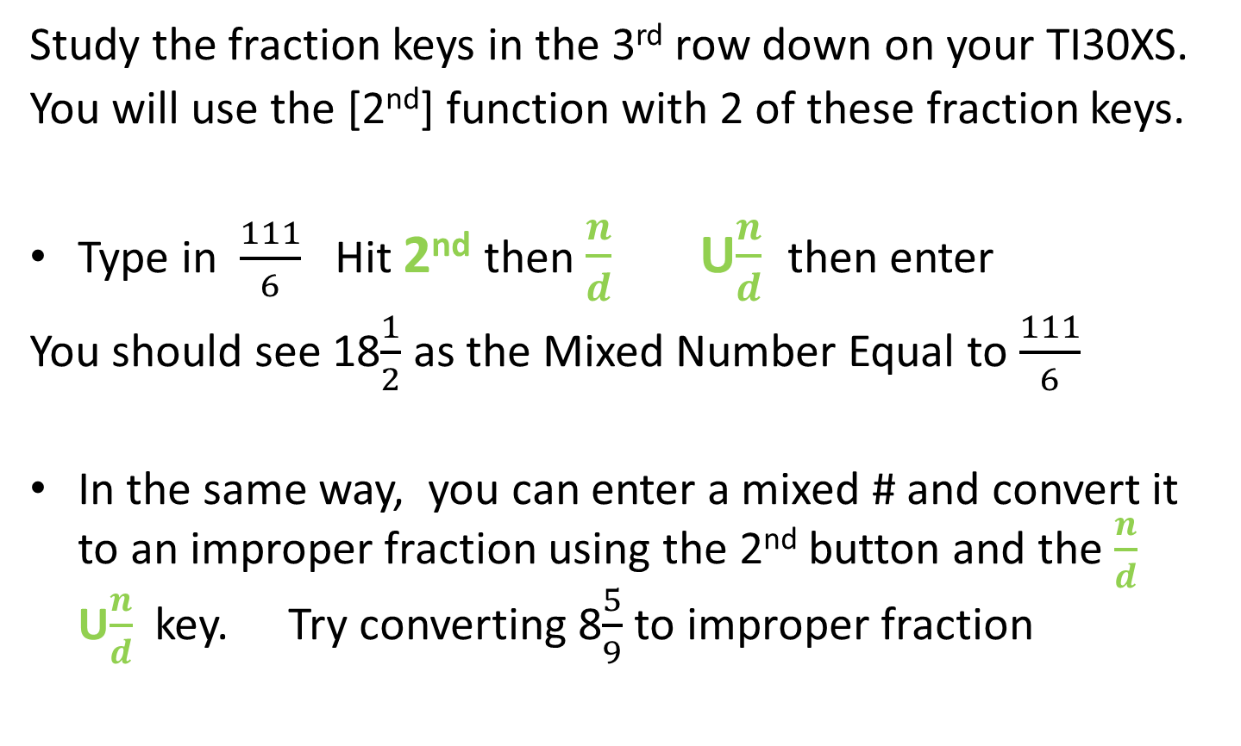
Improper Fraction Mixed Number
Study the fraction keys in the 3rd row down on your TI30XS.
You will use the [2nd] function with 2 of these fraction keys.
Type in $\frac{111}{6}$ Hit 2nd then $\frac{n}{d}$ U$\frac{n}{d}$ then enter
You should see 18$\frac{1}{2}$ as the Mixed Number Equal to $\frac{111}{6}$
In the same way, you can enter a mixed # and convert it to an improper fraction using the 2nd button and the $\frac{n}{d}$ U$\frac{n}{d}$ key. Try converting 8$\frac{5}{9}$ to improper fraction

Slide 13

Try a couple of problems
5 $\frac{2}{5}$ + 11 $\frac{1}{3}$ =
25 $\frac{1}{10}$ - 4 $\frac{2}{5}$
2 $\frac{4}{9}$ * 1 $\frac{3}{4}$
8 $\frac{2}{7}$ ÷ 3 $\frac{1}{9}$

Slide 14
PERCENT Explained with Examples…
Watch the MATH ANTICS videos on percent!
A percent is a portion of something out of 100 parts.
  Of the people in America who are struck by lightning each year, 9% will die. This means: out of every 100 people who are hit by lightning, 9 of them will die and 91 will NOT.
  A COACH purse is now on sale, 20% off with a regular price of $100.00.
  The full price of the purse = $100 = 100%
  The discount price off the purse is $100 x 20% = $20
  The payment price for the purse is $100 x 80% = $80

Slide 15
Percent Keys…
2nd
%
˃ %

Slide 16
Percent Keys… % and ˃%
If you are working 5% in your math problem, key in the 5, then hit 2nd, and then the % key.
You try: 412 x 8% =
If your problem asks for a percent as your answer, take your value, then hit 2nd, and then the ˃% key, and enter.
You try: 4.56 is what as a percent?

Slide 17
Take it Step by Step…
Percent problems can be very difficult to figure out- you need good problem solving skills and a little knowledge of Algebra doesn’t hurt.
Work through the Math Antics videos on percent.
Try these:
88 × 22% = 157 × 1.75% =
903 x 2% = 43 x 17% =

