Slide 1
Techy Tips & Tricks for ABE Teachers
Lori Koenig
Presented at the WI CEA Conference in 2016

Slide 2
Why Use Video/ Technology?
“Technologies open the door to a multitude of possibilities… Teachers need to consider how they select and use technology within the traditional tools that are available. And they need to evaluate strategies in their effectiveness. Teachers need to know how to use old and new technology within the classroom.”
Teaching in the Digital Age… by Brian Puerling, Carol Copple

Slide 3
We Remember…
10% of what we read
20% of what we hear
30% of what we see
50% of what we see and hear
70% of what we discuss with others
80% of what we personally experience
95% or what we teach others
- Edgar Dale

Slide 4
Presentation Outline….
Who I am & What I’ve Done
What I have to share today:
Video Sources for Teaching ABE/ GED Students
Smart Searching for worksheets, curriculum and other teaching aids.
Microsoft Word tips for making your own worksheets.
Smart Notebook lessons from PPT.

Slide 5
Math Antics Videos
Videos: www.mathantics.com
Worksheets: www.mathworksheets4kids.com
DIY Worksheets in Microsoft Word: 2010 & 2007 versions have an Insert Equation feature. This makes it much easier to create worksheets with complex fractions and algebra equations.
A strong majority of my math students agreed that the videos helped them to better understand the math concepts presented.
Notes:
View triangle/ angle video

Slide 6
Math Antics: Student Comments
He does walk you through the steps well
If I keep seen this videos every day I probably learn even more
Helps you get a better understanding for Math concepts your not familiar with
Its very easy to learn this way
I do understand and I’m proud of it
I never knew that math even had a rules, Thanks Ms Koening and Math Antics

Slide 7
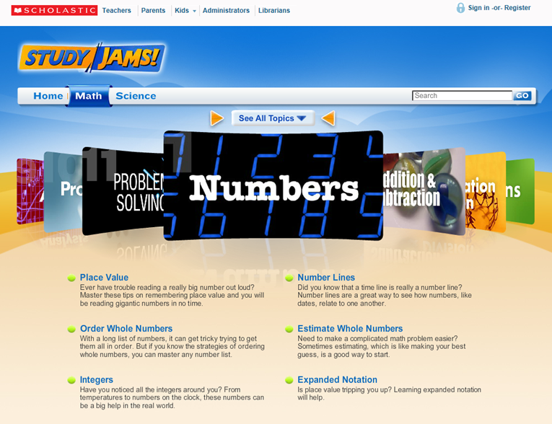
Study Jams by Scholastic (Google)
Math & Science videos: Similar to Math Antics
Notes:
Bring Web page up to show search tools

Slide 8
Connect Ed Studios: Real World Connections
Notes:
Play one of the videos

Slide 9
Connect Ed: What I like about these Videos
Videos show real world jobs that my students have no knowledge of.
They show workplace applications of the scientific method, mathematical calculations, problem solving, writing, and many more scholastic uses.
I can take some creative freedom and think up math questions that align with these careers for my students to apply a variety of mathmatical processes.

Slide 10
Connect Ed: Worksheet Creation
I type a variety of questions within Microsoft Word.
I brainstorm math applications that I think would fit the job. Then add in numbers that my students have the skill to manipulate.
Google Images
I look for related pictures to copy and paste into my worksheet
If you add the word “chart” to your search term, related bar graphs may appear that can be used to teach.
NOTE: WRAP TEXT feature… In order for your words to flow next to your image, you will need to right click on it; choose WRAP TEXT; and then select TIGHT
*I created the worksheet, copied it into my tutors computer account and asked him to put together a related PPT.

Slide 11
Interactive Sites for Education
Interactivesites.weebly.com
Notes:
English/ Vocabulary/ Slang Game

Slide 12
ShareAmerica.Gov
ShareAmerica is the U.S. Department of State’s platform for sharing compelling stories and images that spark discussion and debate on important topics like democracy, freedom of expression, innovation, entrepreneurship, education, and the role of civil society.

Slide 13
Newton’s Laws of Motion & Sports
You Tube Videos: The Science of NFL Football by the National Science Foundation
Newton's First Law of Motion
Newton's Second Law of Motion
Newton's Third Law of Motion
Related: Science of Golf: Kinetic & Potential Energy by United States Golf Association

Slide 14
WTCS Educational Tools
https://www.wisc-online.com/
Notes:
Search cells & taste buds

Slide 15
Interactive Checkbook Lesson
WHAT I HAVE TO SHARE:
Informative PowerPoint, including basic activity (simple, short video links included)
PowerPoint converted to Smart Notebook
PDF file from the lesson plan online that I modified
Word document showing images of sample debit card receipts you can edit for use
Lesson Observations: many students were interested, even tutors. Many have never had their own checking account or it had been many years.

Slide 16
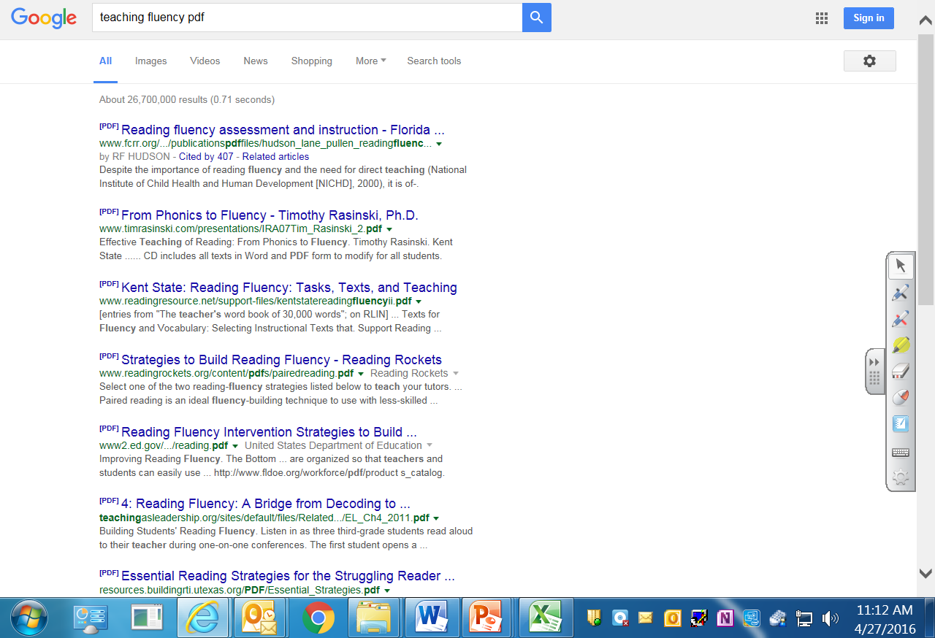
Smart Searching
PDF searches often bring up print-ready documents (Worksheets, curriculum, books)

Slide 17
A search with the letters PPT can bring up another teacher’s PowerPoint on a particular topic.

Slide 18
Worksheets can be viewed by image with google. Learn which ones you need to register/ login/ pay and avoid those. [Hover your mouse over the top of the page it shows the source.
Click for a bigger view, then visit page.
Notes:
Favorite source math: worksheets4kids.com

Slide 19
Microsoft Word: Creating Worksheets
Open a new blank presentation
Look over the Ribbon that holds your tools
Insert / Header to put a NAME_______ section in.

Slide 20
Word Worksheet Ideas…
A TEMPLATE (pattern) can be saved and then used and re-used to create worksheets for one particular class.
Type out your questions…
Go back then highlight all at once and then click the number button in the paragraph tab
When numbers appear goofy… tinker, backspace, enter, etc… [Try not to tinker with margins, tabs, this can throw numbering off.]
Notes:
When you get stuck: google your question

Slide 21
Adding Charts & Diagrams
Images can be found online with a google search then a click on images.
Images can be copied and pasted onto your worksheets.
Add text/images/content then SAVE SMART
Avoid generic terms like “math worksheet”
Use specifics like “Fraction Word Problems”
Create folders for each class to keep content together

Slide 22
Forget where you saved it?
B. Use the search box for one of those key words
A. My Documents Button
Notes:
71 Folders: 509/ MOS/ MATH/
Click and drag to reorganize or copy, paste.

Slide 23
THE END

