Slide 1
TABE Math-E PAXEN Unit-3 Multiply and Divide Whole Numbers Lesson 15 Multiplication Within 100
Revised: October 16, 2023
Nolan Tomboulian
Some graphics may not have copied well during the scan process.

Slide 2
Math-E - Lesson 15 – Multiplication

Slide 3
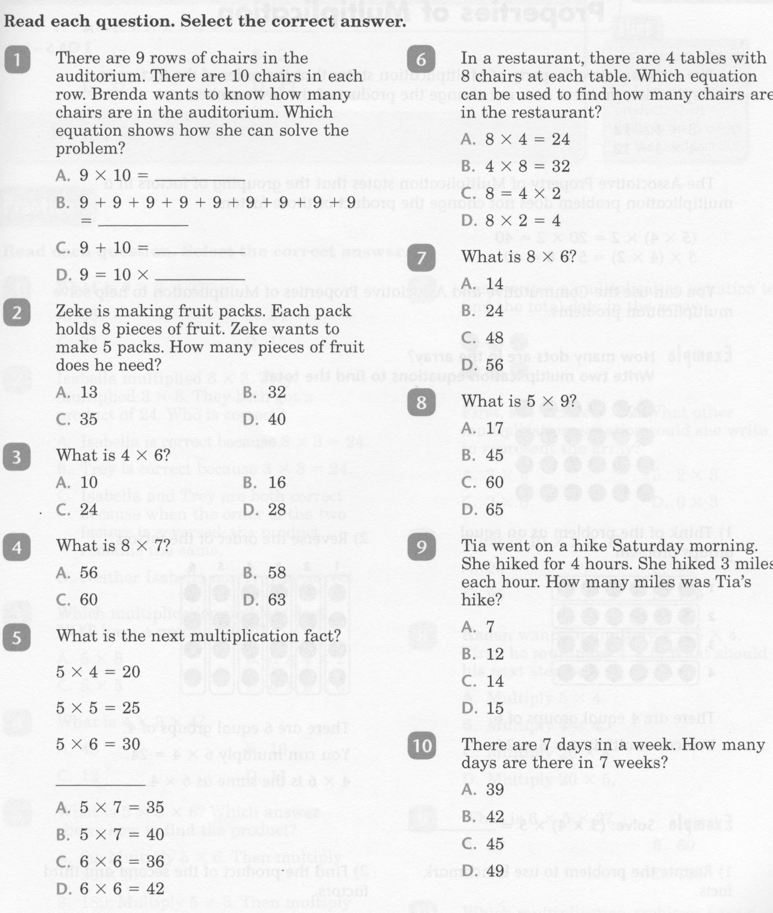
Math-E - Lesson 15 – Multiplication

Slide 4
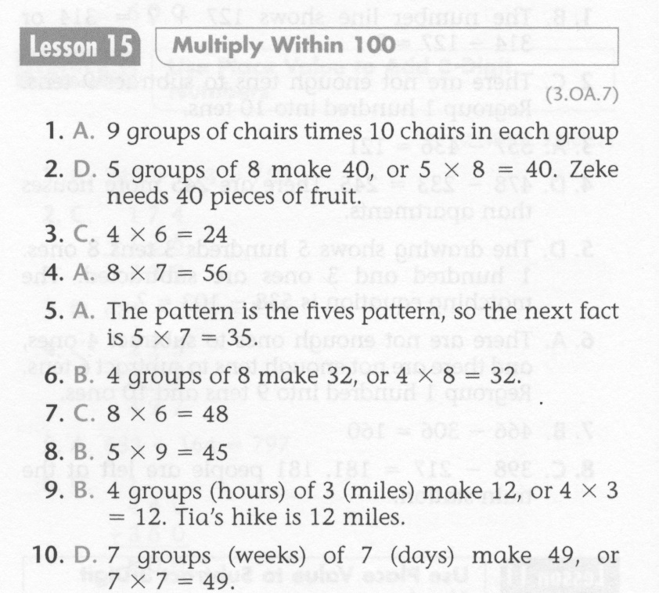
Math-E - Lesson 15 – Multiplication

Slide 5
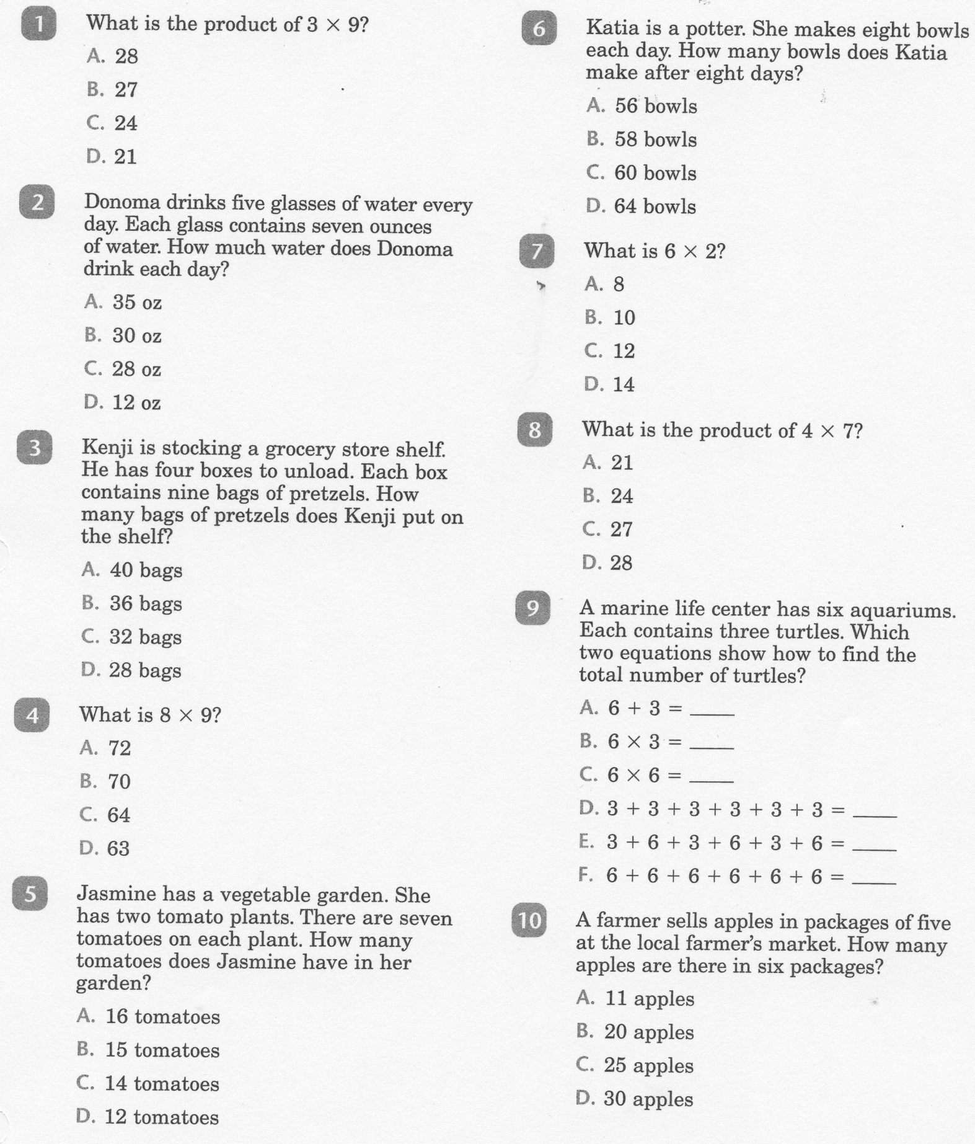
Math-E - Practice 15 - Multiplication

Slide 6
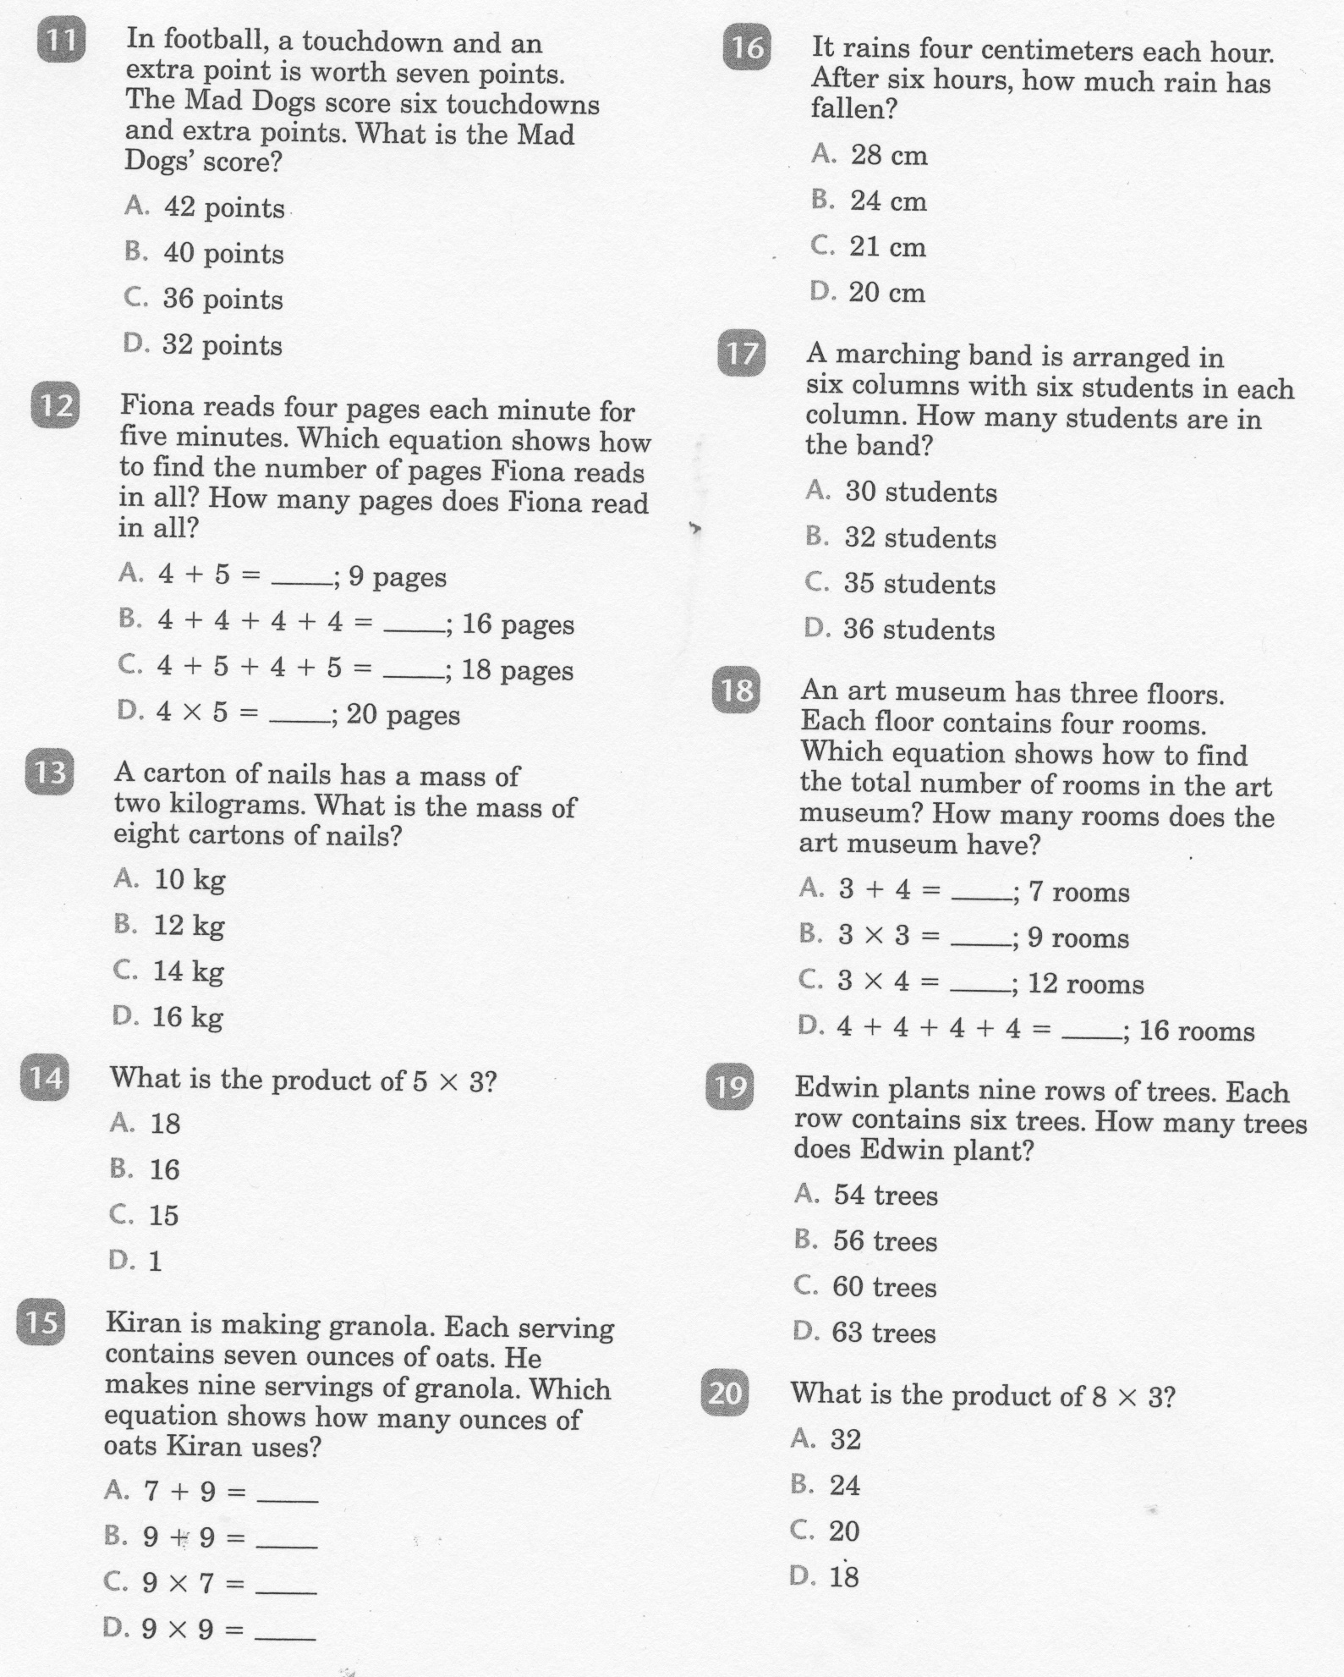
Math-E - Practice 15 Multiplication

Slide 7
Math-E - Practice 15 – Multiplication

