Slide 1
TABE Math-E PAXEN Unit-3 Multiply and Divide Whole Numbers Lesson 14 Multiplication N x 10
Revised: October 16, 2023
Nolan Tomboulian
Some graphics may not have copied well during the scan process.

Slide 2
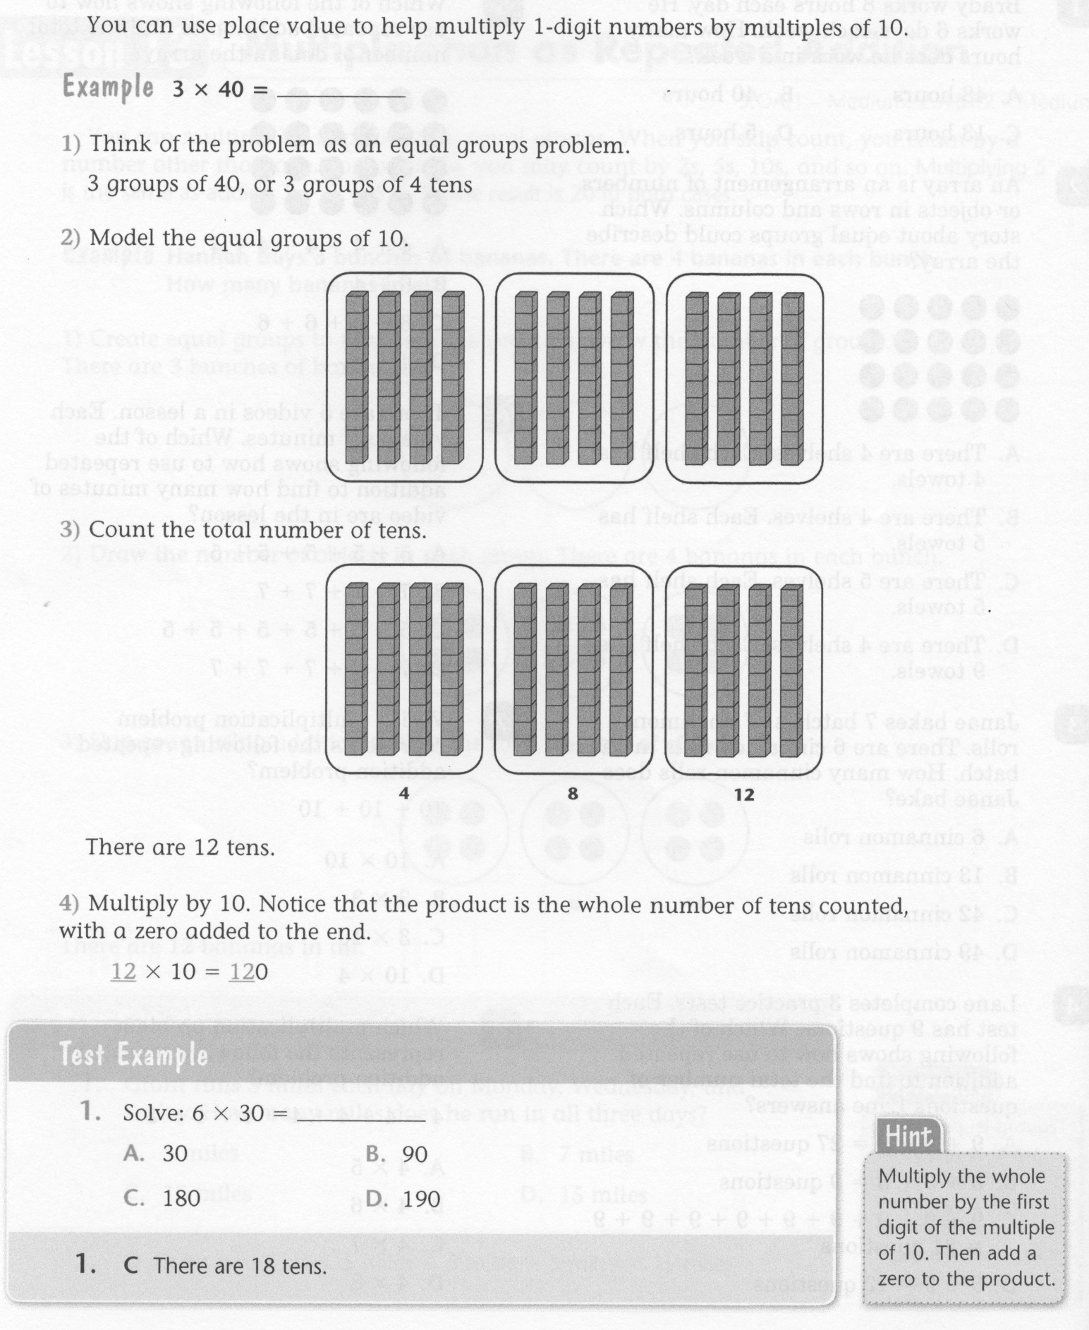
Math-E - Lesson 14 – Multiplication

Slide 3
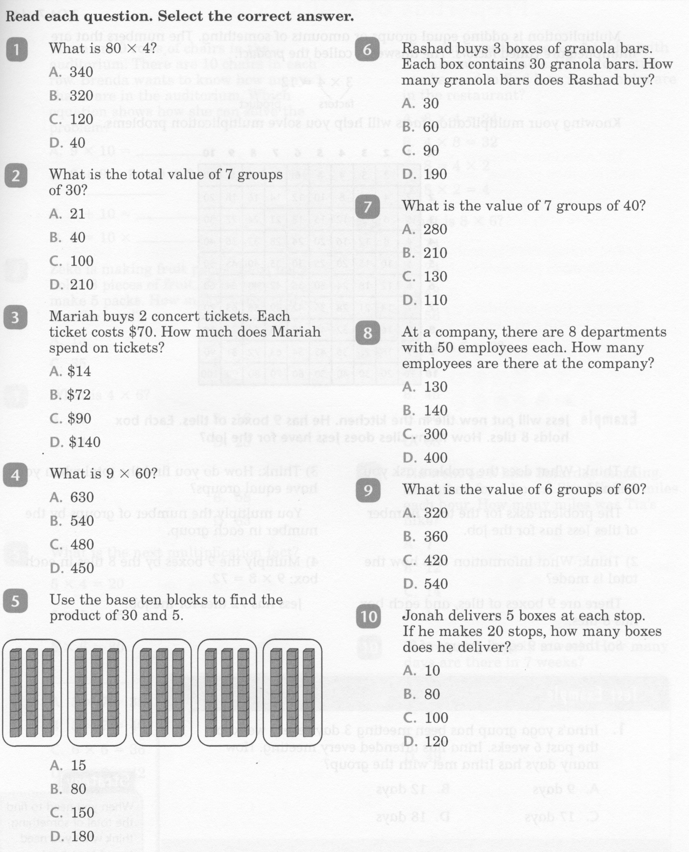
Math-E - Lesson 14 – Multiplication

Slide 4
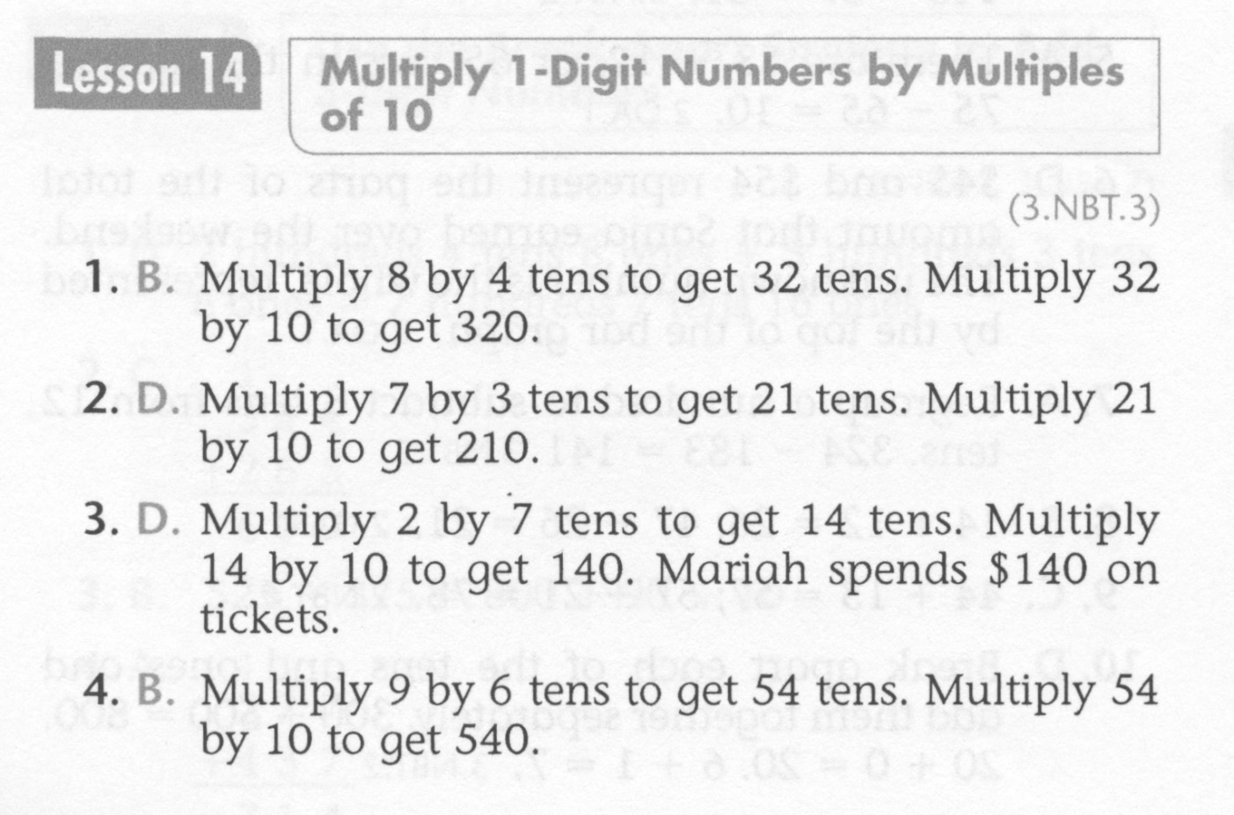
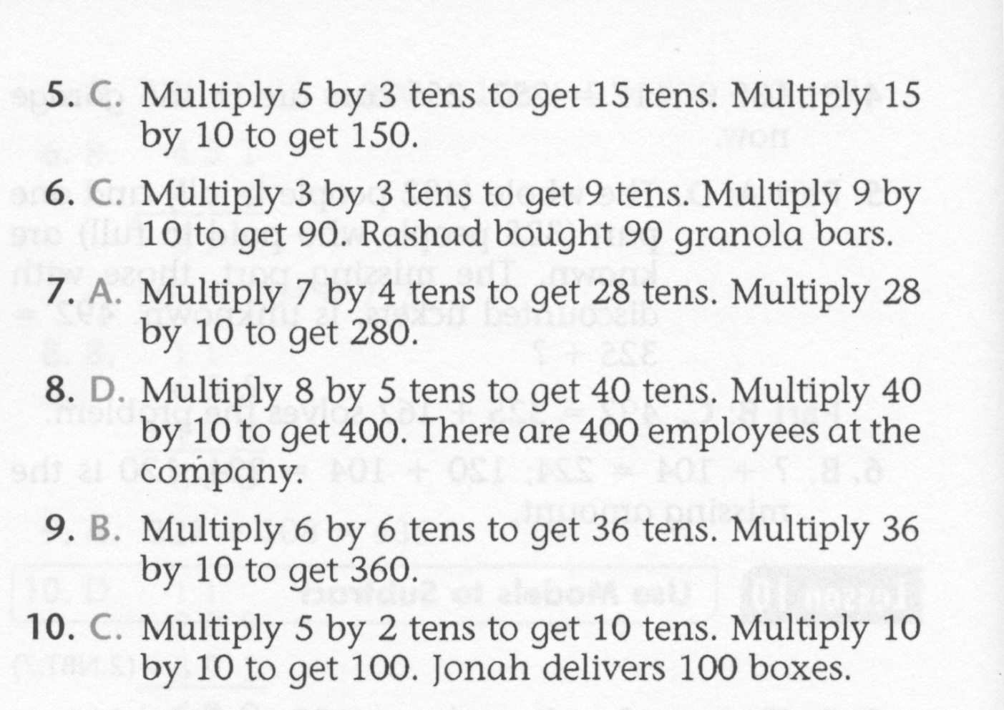
Math-E - Lesson 14 – Multiplication

Slide 5
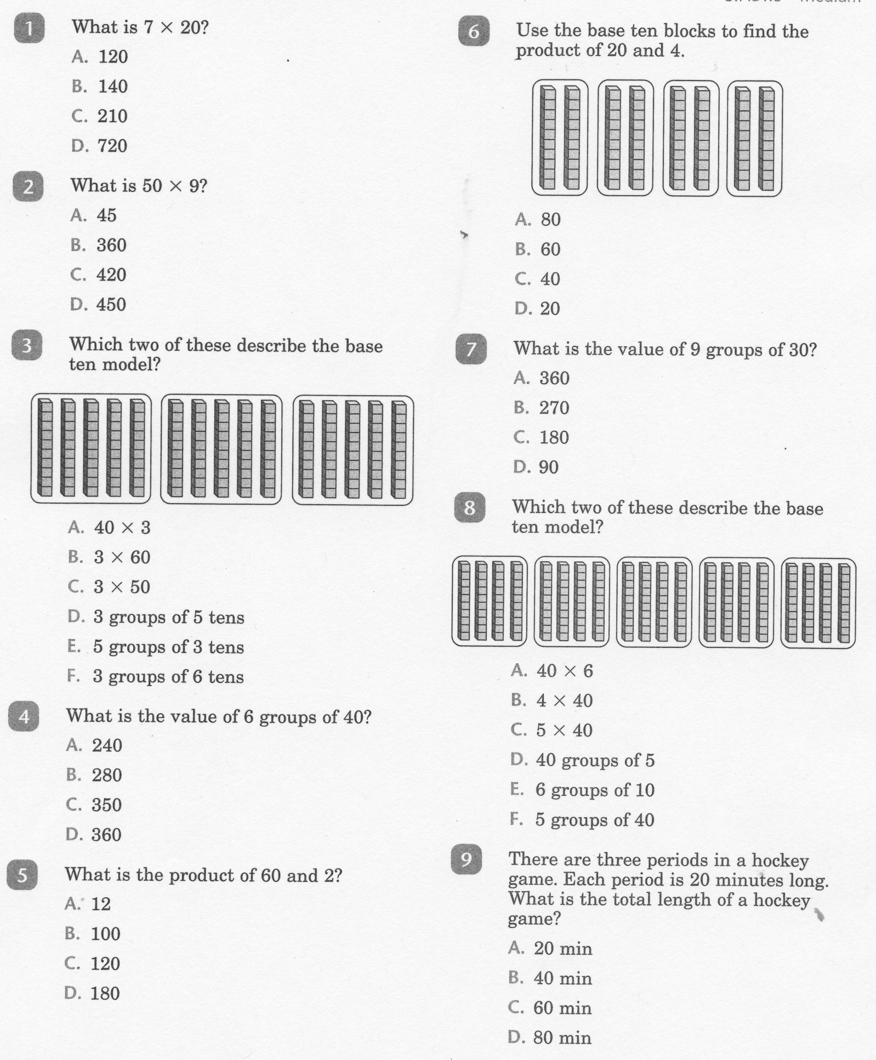
Math-E - Practice 14 - Multiplication

Slide 6
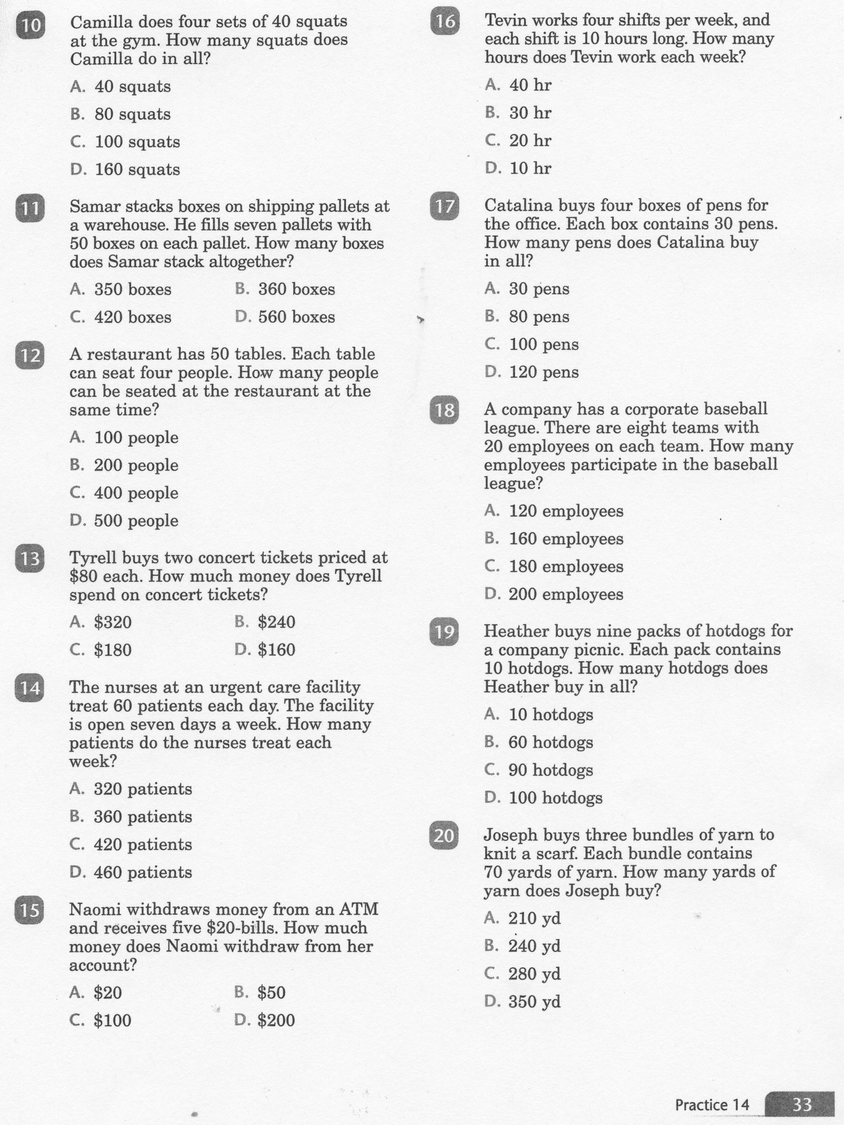
Math-E - Practice 14 Multiplication

Slide 7
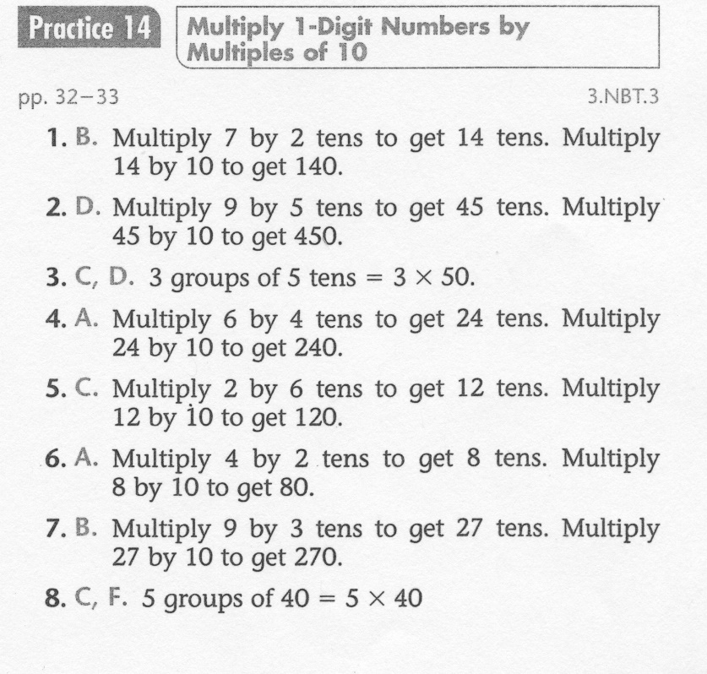
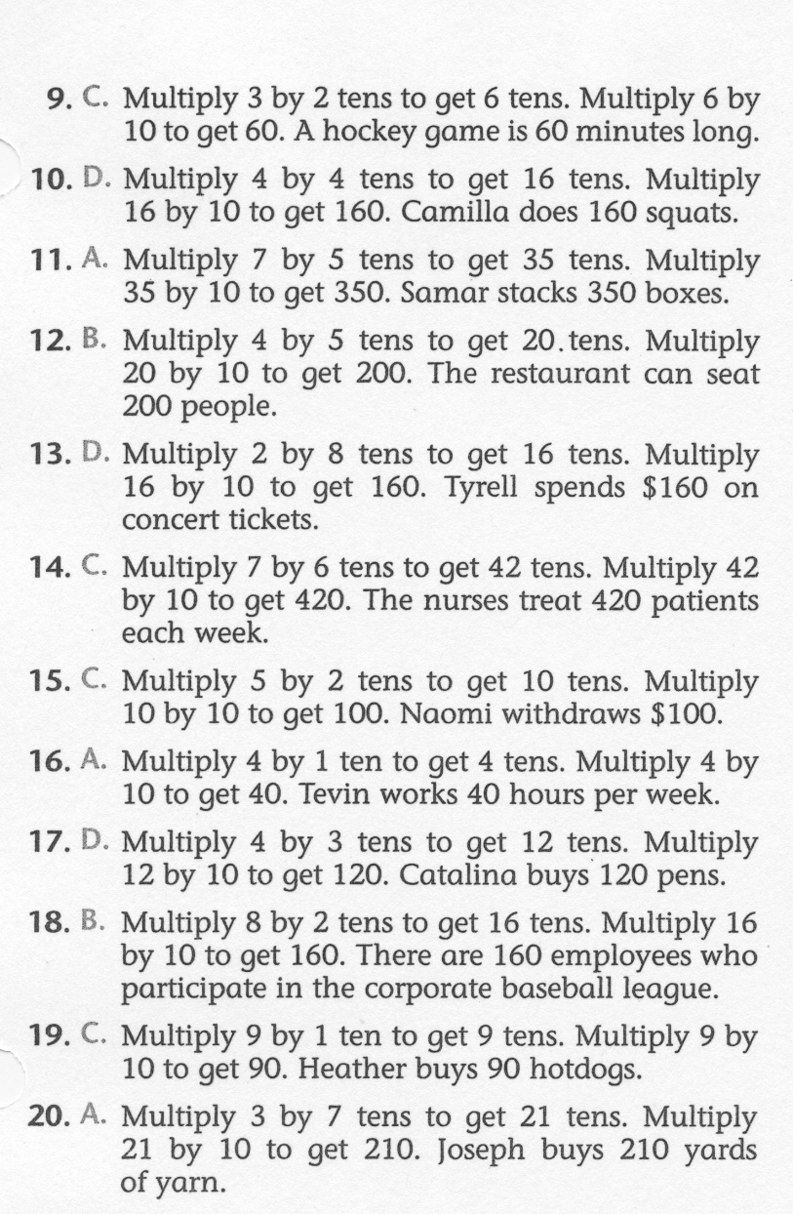
Math-E - Practice 14 – Multiplication

