Slide 1
TABE MATH - D
Unit - 1
Lessons 1 - 10
Review Numbers
Revised: March 10, 2024
Nolan Tomboulian

Slide 2
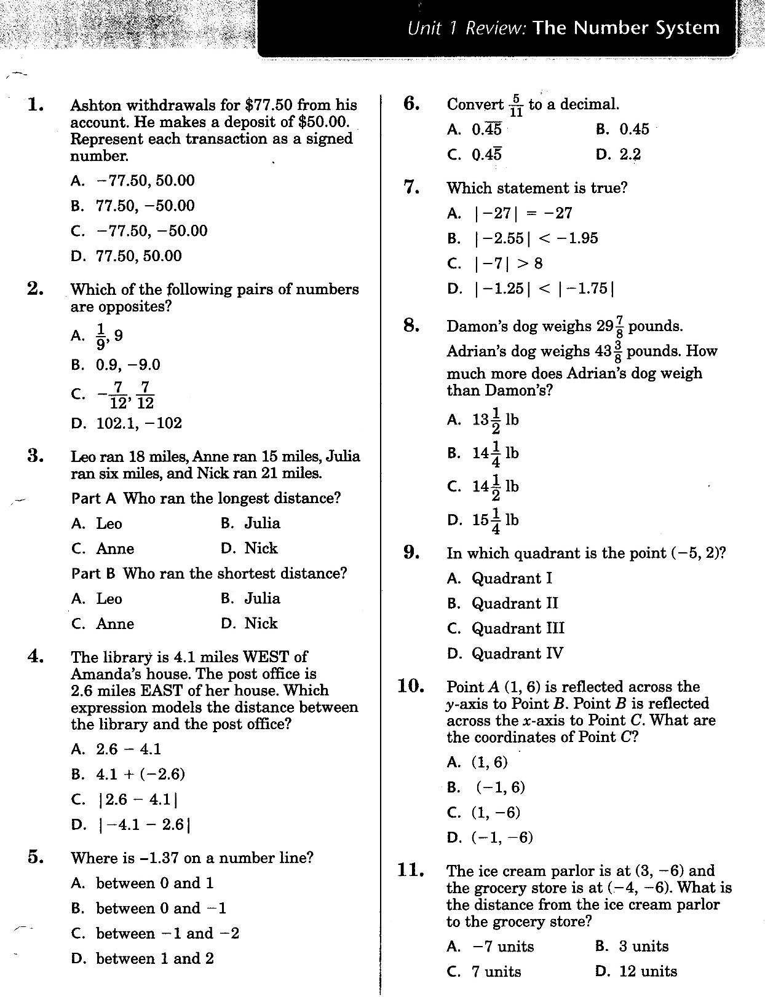

Slide 3
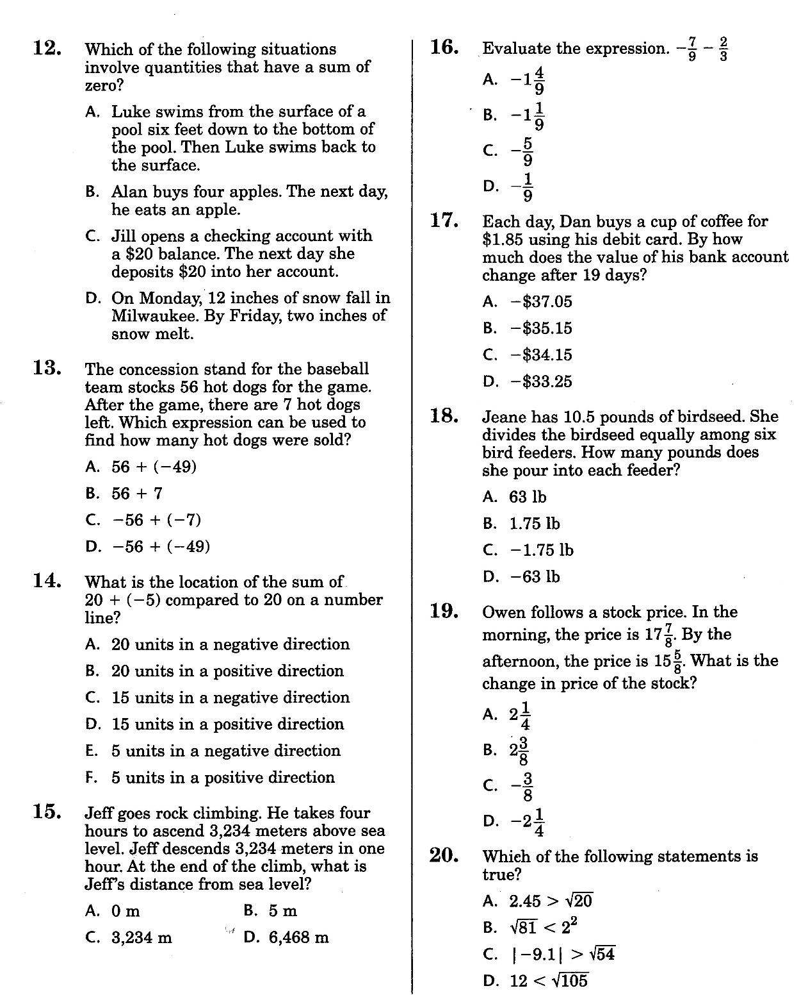

Slide 4
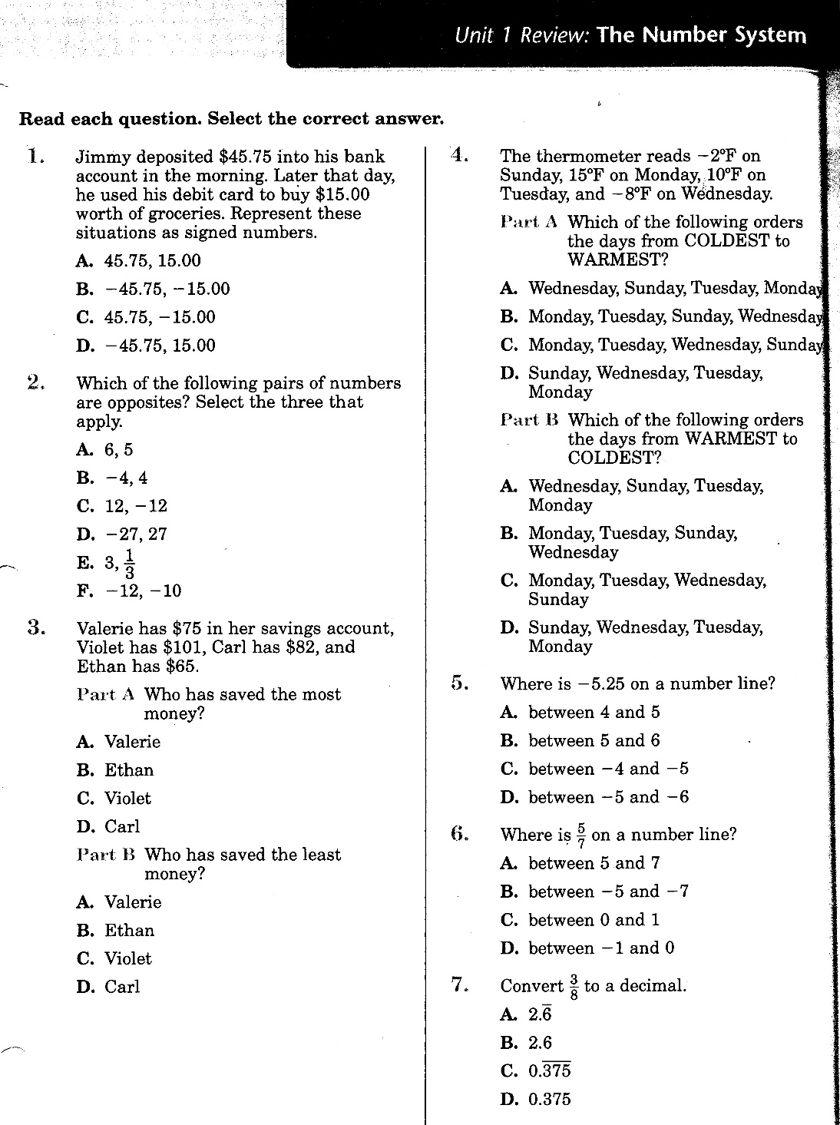

Slide 5
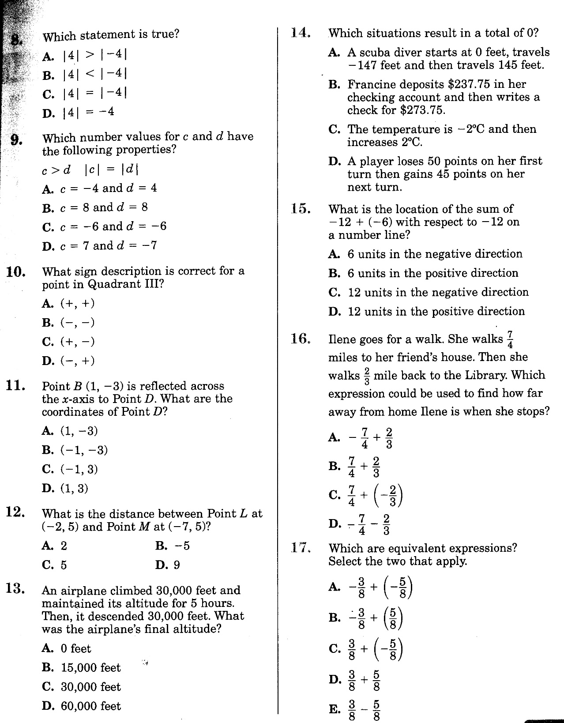

Slide 6
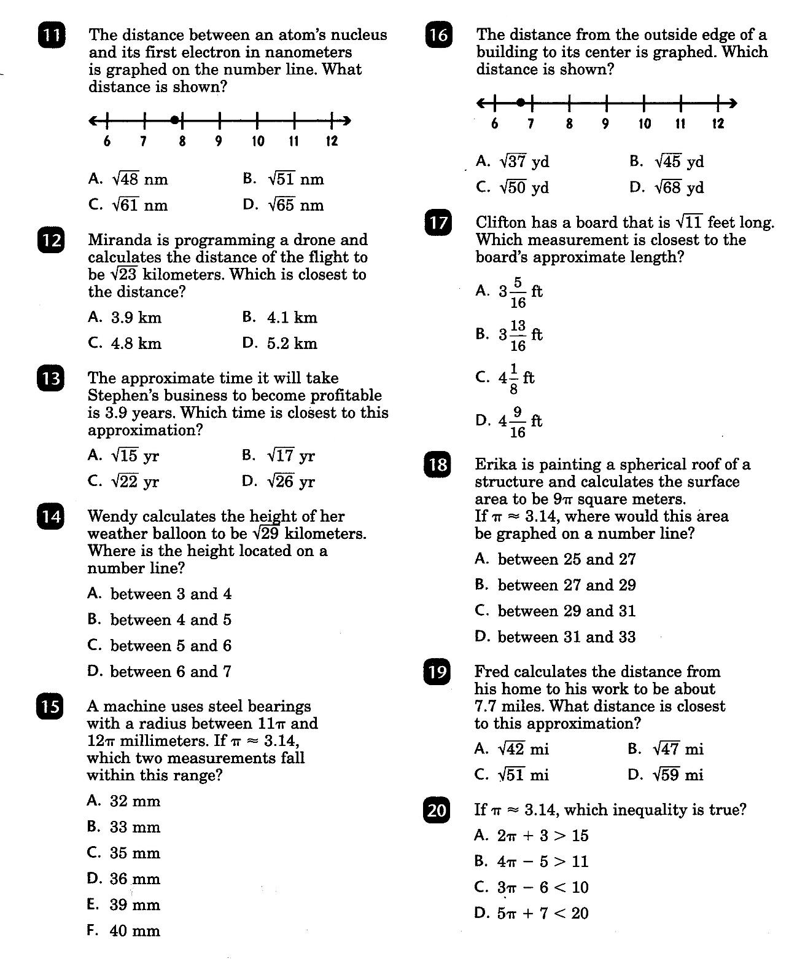

Slide 7
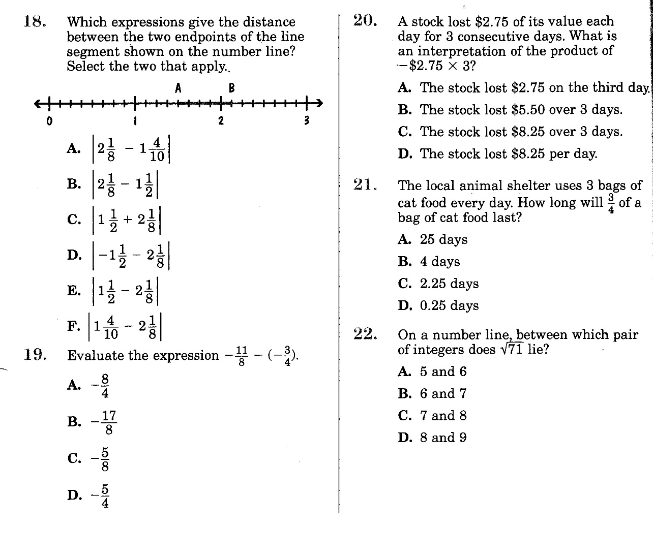

Slide 8
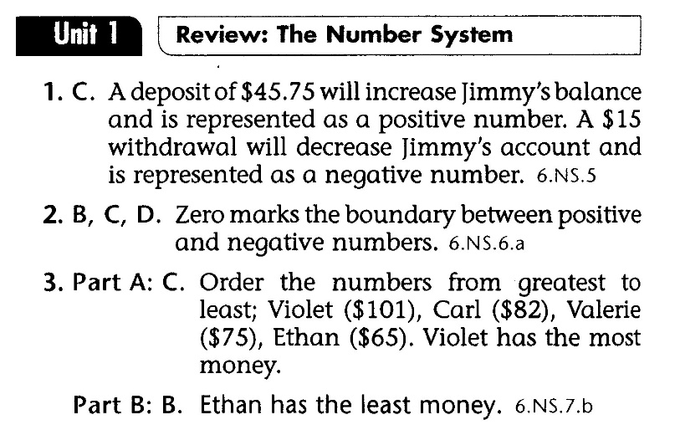
Math-D UNIT-1 Lesson Key

Slide 9
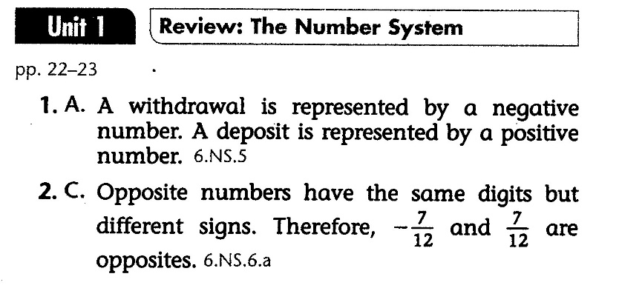
Math-D UNIT-1 Practice Key

