Slide 1
TABE MATH - D
Unit - 1
Lesson - 9
Rational Numbers
Multiply and Divide
Revised: March 10, 2024
Nolan Tomboulian

Slide 3
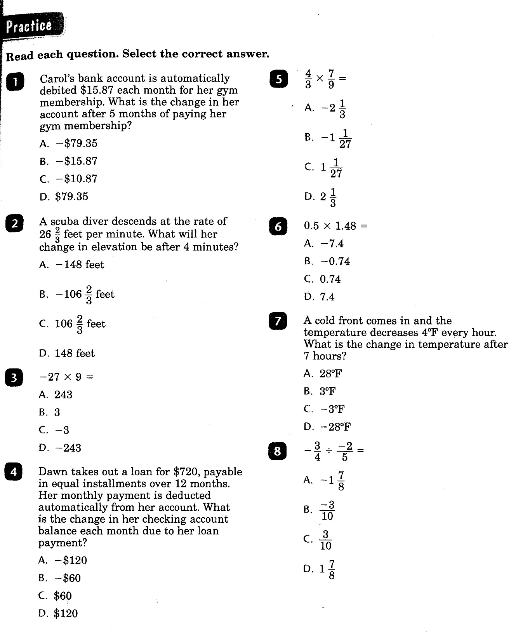

Slide 4
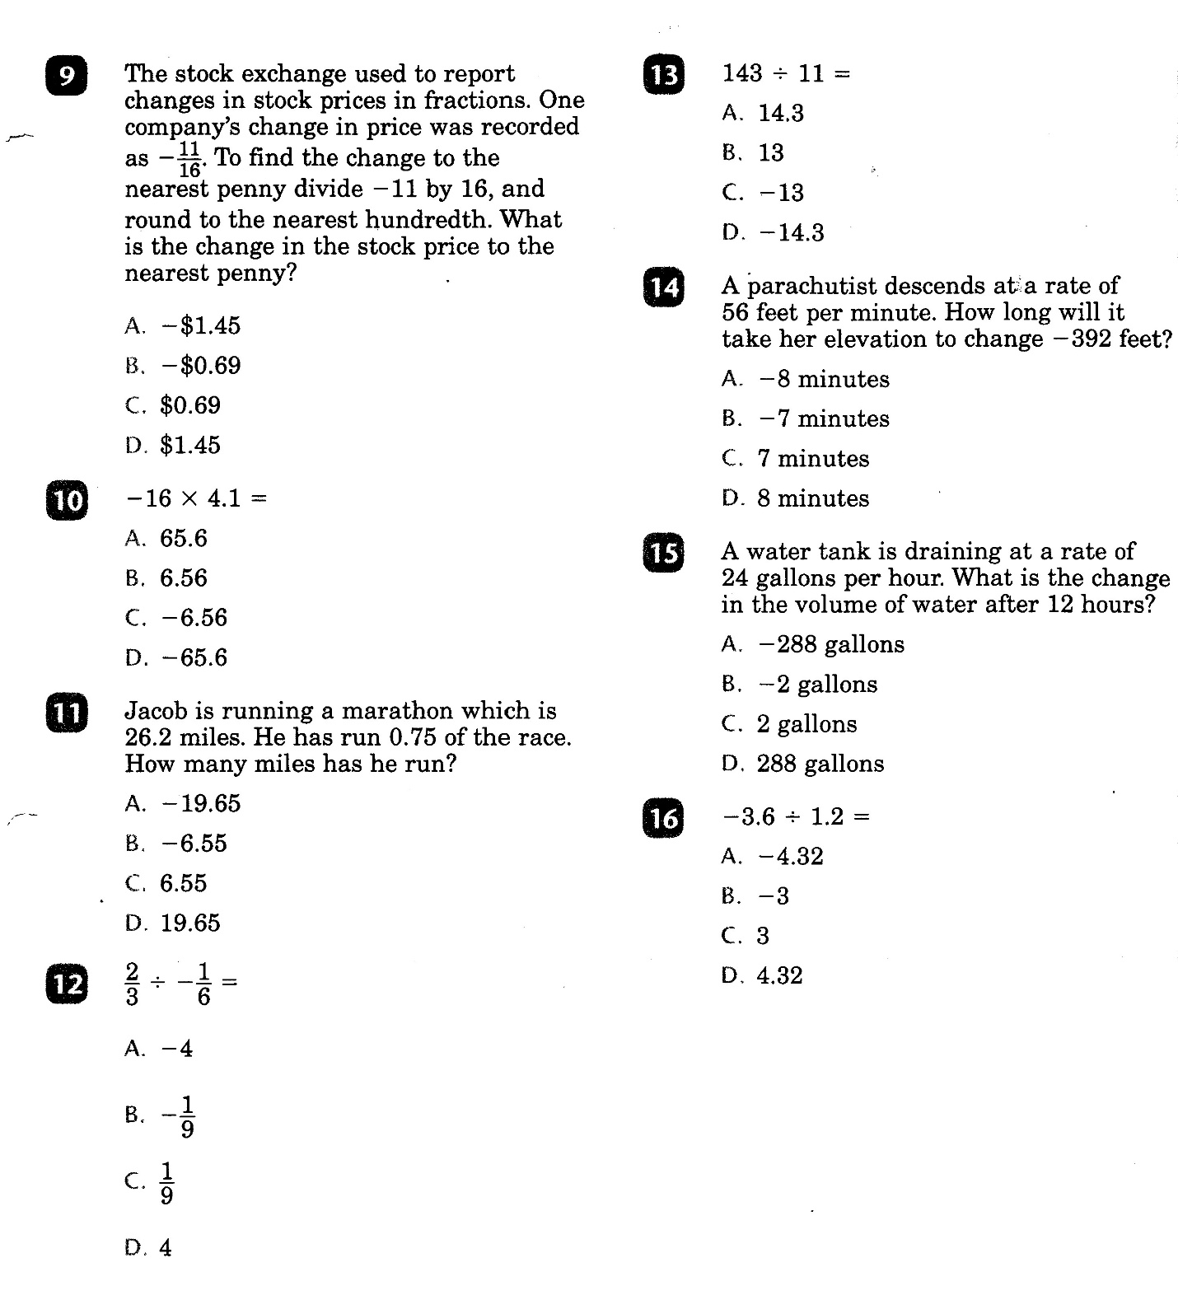

Slide 5
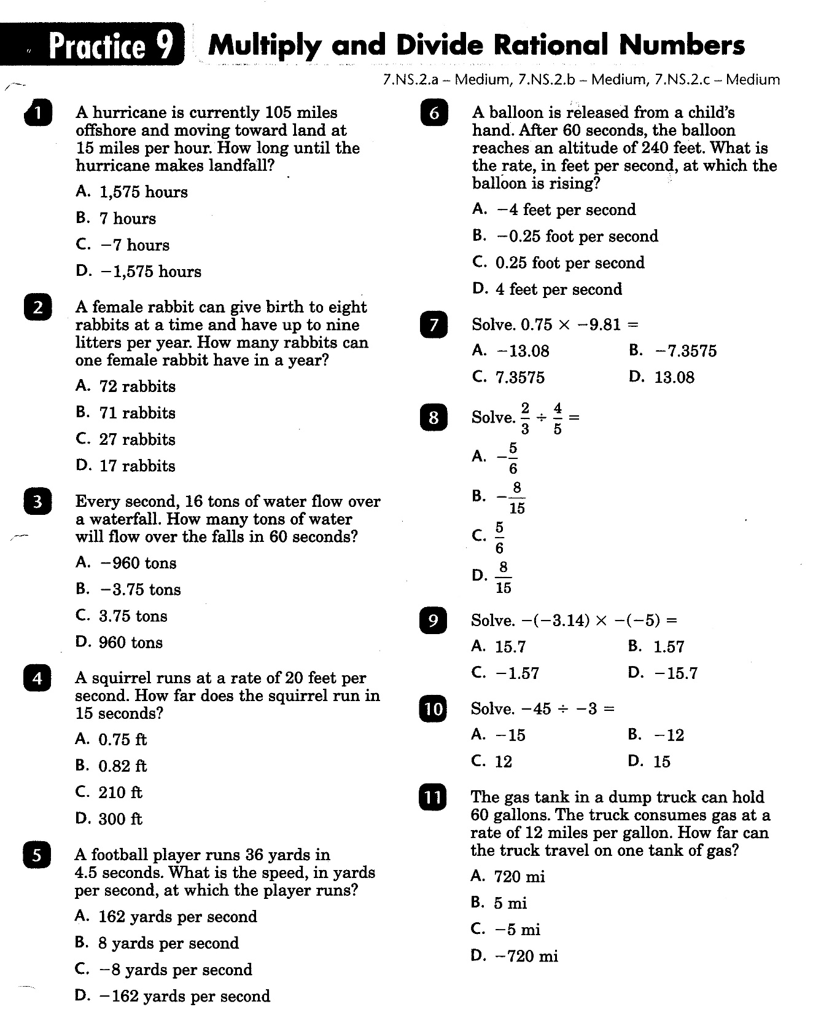

Slide 6
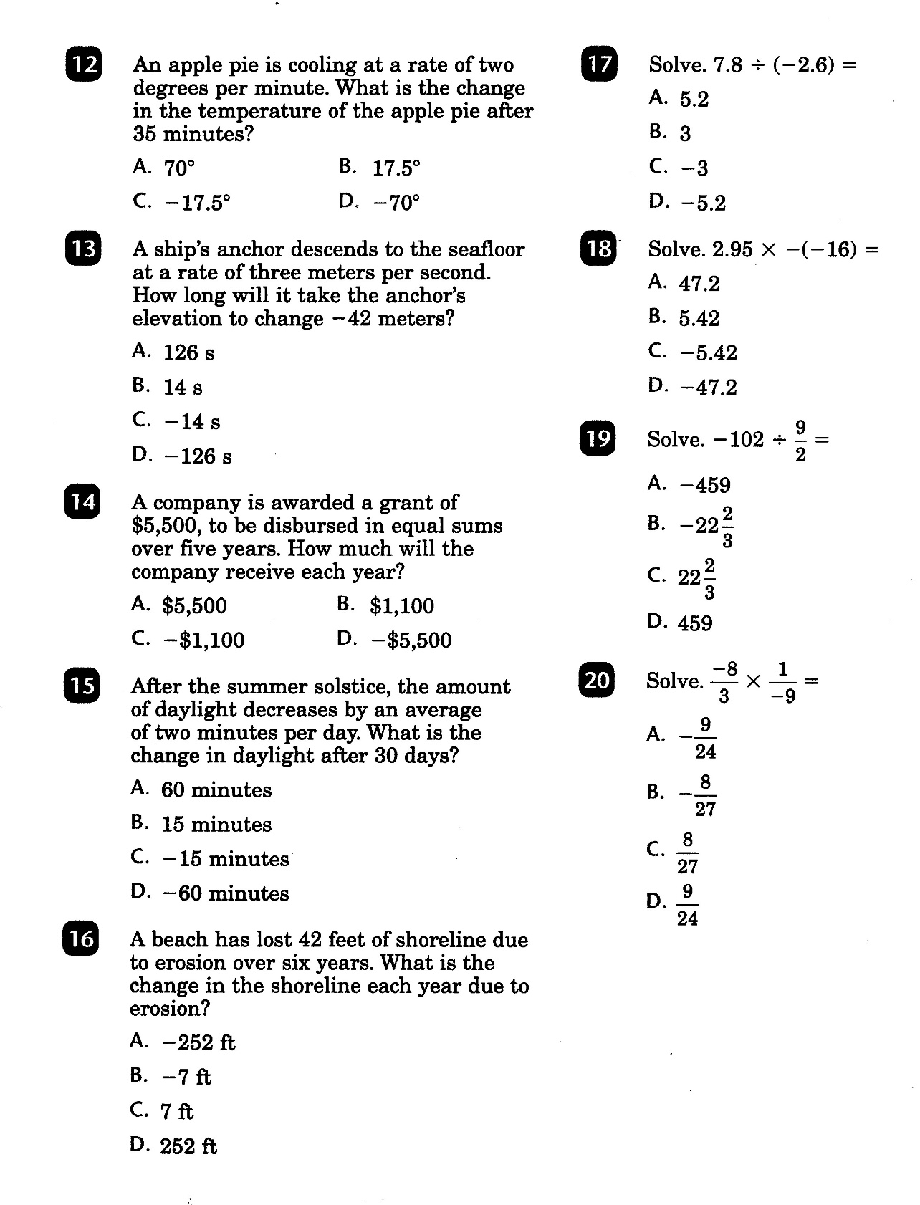

Slide 7
Math-D Lesson-9 Key

Slide 8
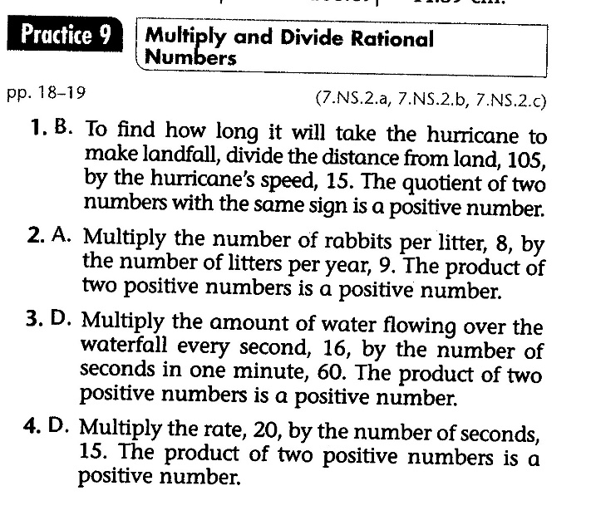
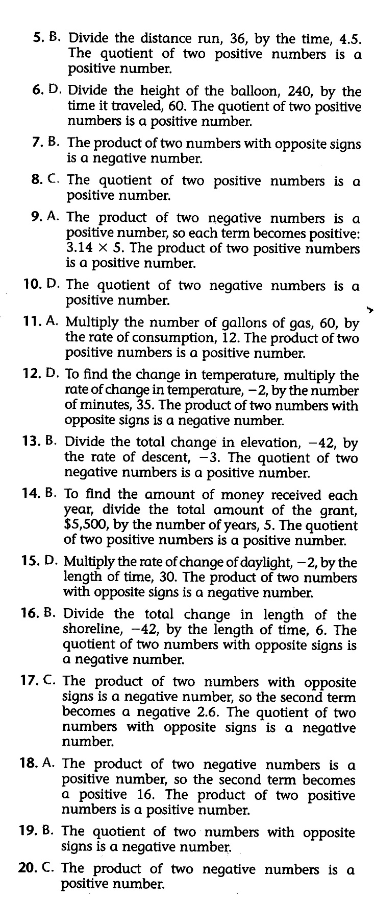
Math-D Practice-9 Key

