Slide 1
TABE MATH - D
Unit - 1
Lesson - 3
COMPARE
Fractions and Decimals
< = >
Revised: March 10, 2024
Nolan Tomboulian

Slide 3
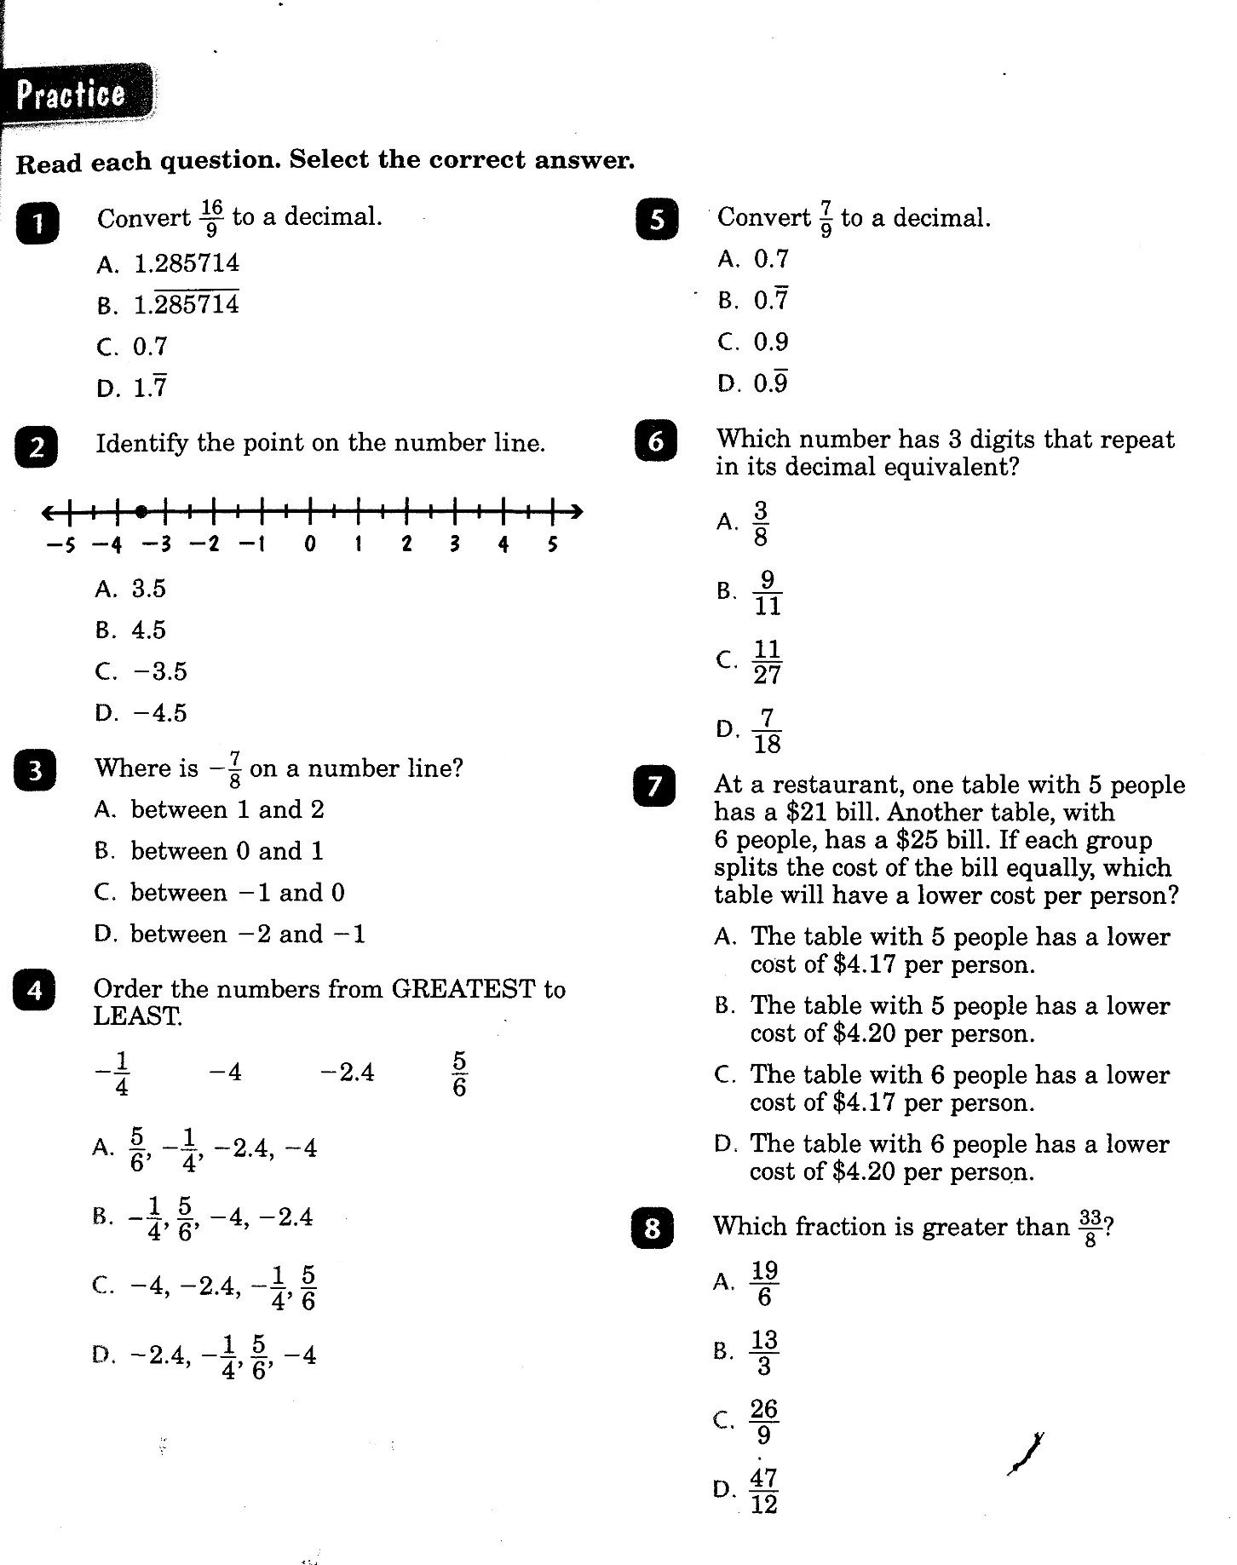

Slide 4
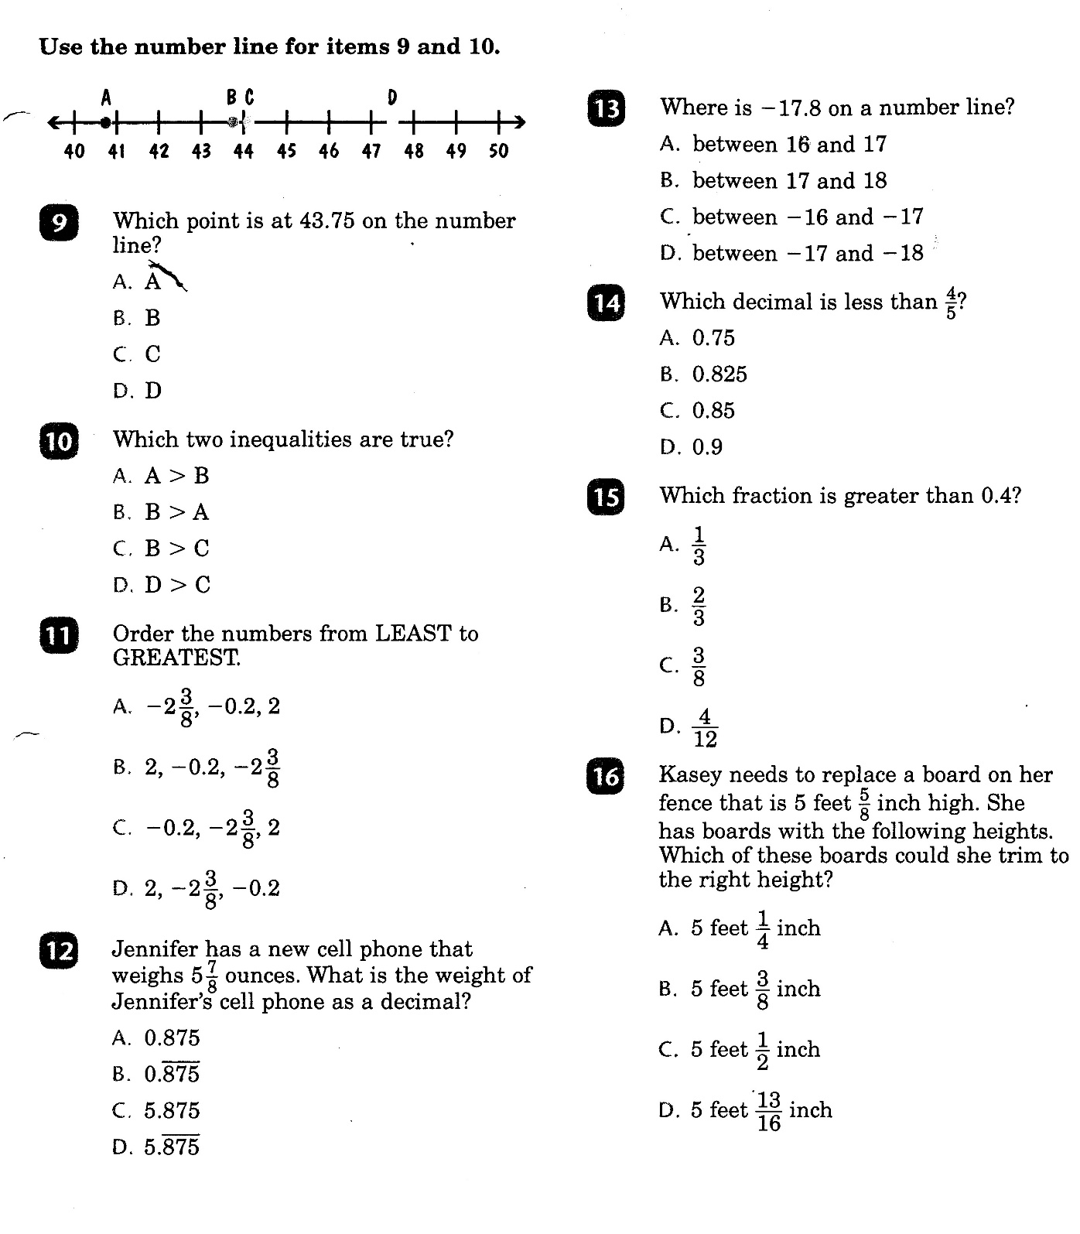

Slide 5
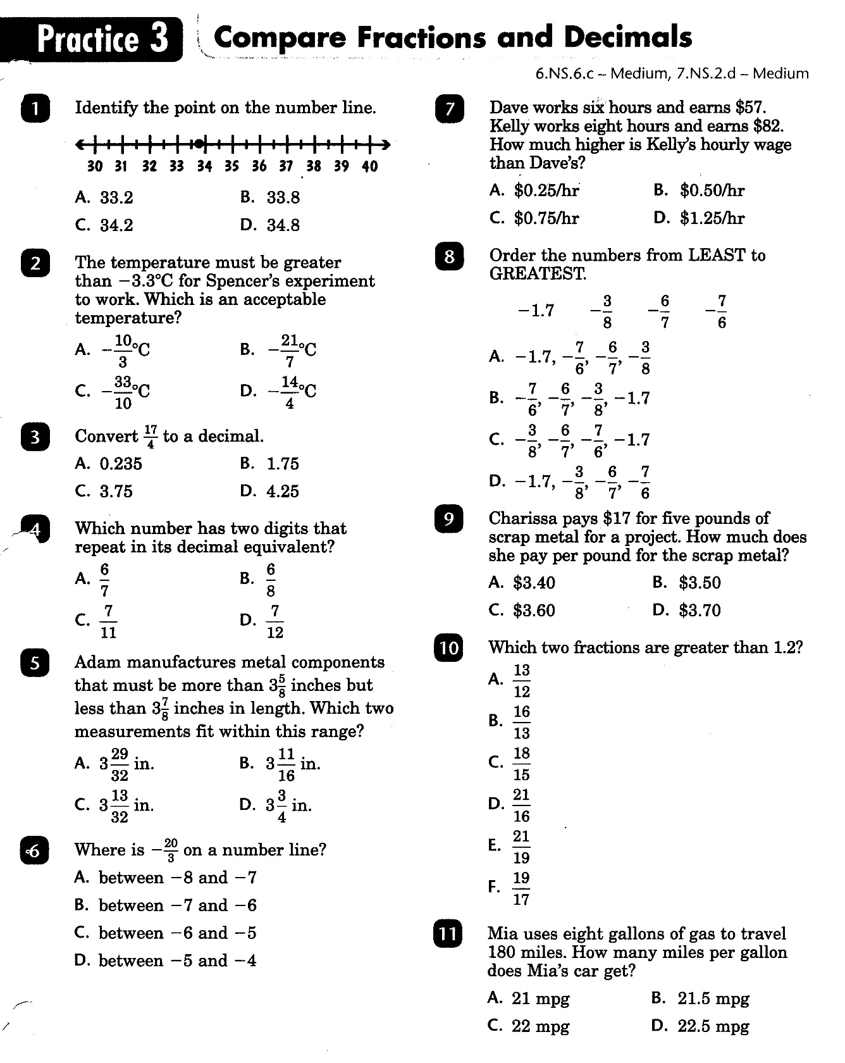

Slide 6
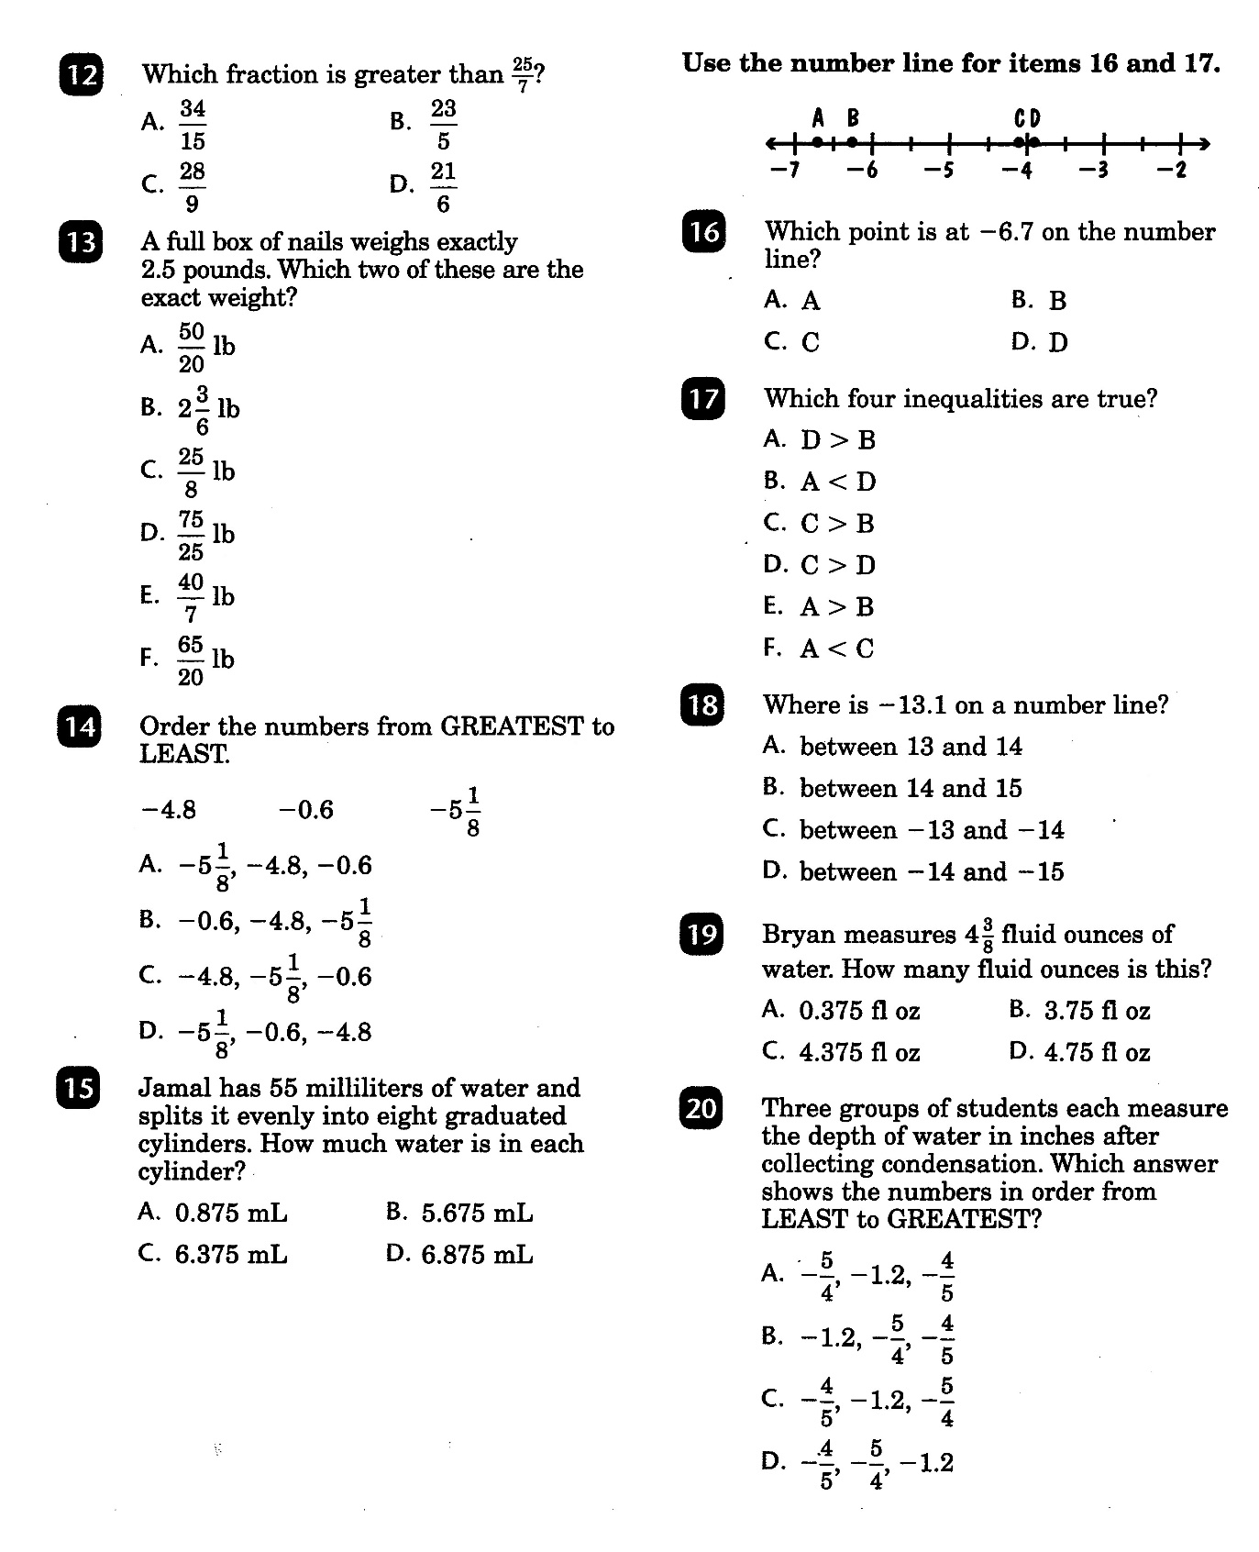

Slide 7
Math-D Lesson-3 Key

Slide 8
Math-D Practice-3 Key

