Slide 1
TABE MATH-D Unit 1 NUMBERS
Answer Keys
Lessons: 1-10
Revised: October 24, 2023

Slide 2
Math-D - Lesson-1 page-1 Positive and Negative Numbers

Slide 3
Math-D Lesson-1 page-2

Slide 4
Math-D - Lesson-2 page-1 Compare and order Whole Numbers

Slide 5
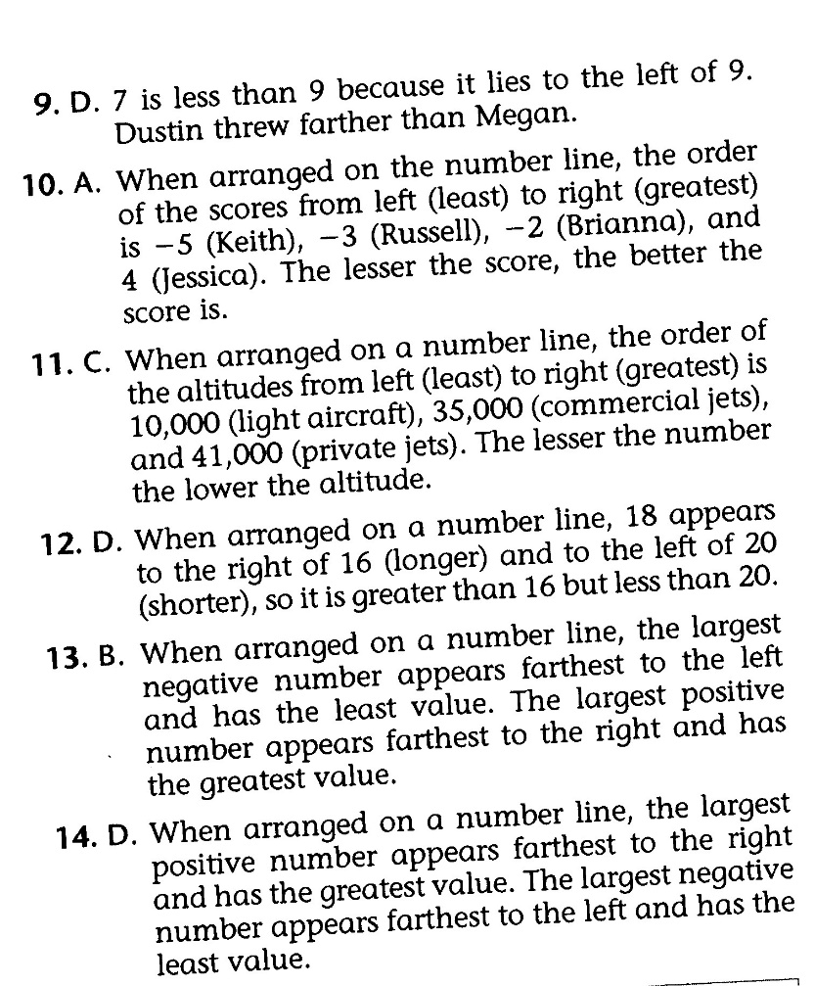
Math-D - Lesson-2 page-2

Slide 6
Math-D - Lesson-3 page-1 Compare Fractions and Decimals

Slide 7
Math-D - Lesson-3 page-2

Slide 8
Math-D - Lesson-4 page-1 Absolute Value

Slide 9
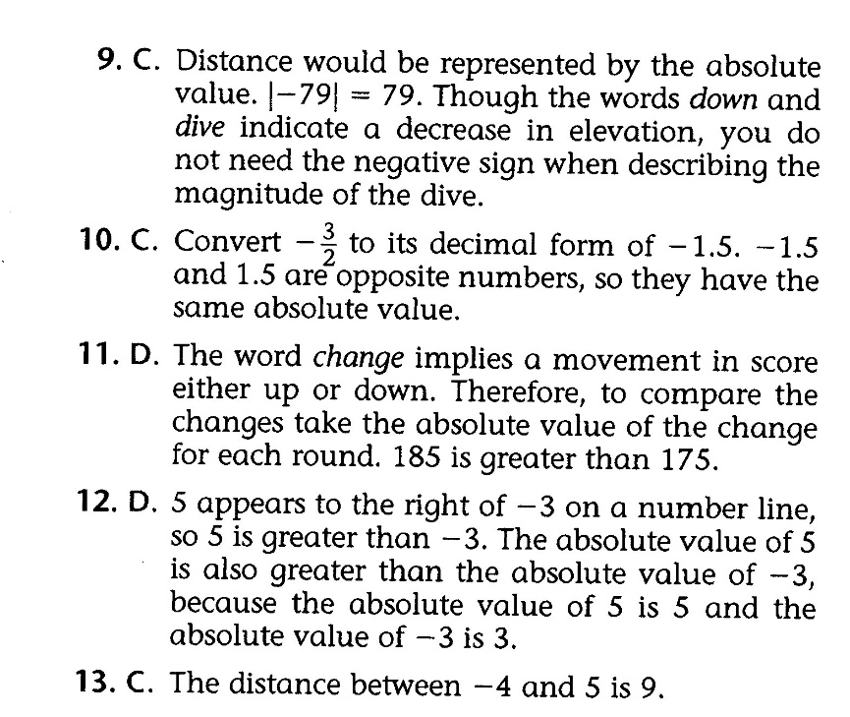
Math-D - Lesson-4 page-2

Slide 10
Math-D - Lesson-5 page-1 Ordered Pairs of Relationships (X, Y)

Slide 11
Math-D - Lesson-5 page-2

Slide 12
Math-D - Lesson-6 page-1 Absolute Value on the Coordinate Plane (Distance)

Slide 13
Math-D - Lesson-6 page-2

Slide 14
Math-D - Lesson-7 page-1 ADD Rational Numbers (Signed Numbers)

Slide 15
Math-D - Lesson-7 page-2

Slide 16
Math-D - Lesson-8 page-1 (Subtract Rational Numbers (Addition of the Opposite)

Slide 17
Math-D - Lesson-8 page-2

Slide 18
Math-D - Lesson-9 page-1 Multiply and Divide Rational Numbers (Like and Unlike Signs)

Slide 19
Math-D - Lesson-9 page-2

Slide 20
Math-D - Lesson-10 page-1 Estimate and Compare IRRATIONAL Numbers

Slide 21
Math-D - Lesson-10 page-2

Slide 22
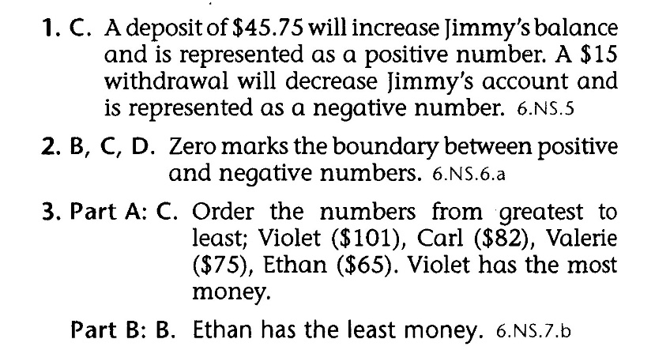
Math-D - Lesson-UNIT-1 page-1

Slide 23
Math-D - Lesson-UNIT-1 page-2

