Slide 1
TABE ELA-E PAXEN Unit-5 Text Types and Purposes Lesson-33 Organizational Structure
Some graphics may not have copied well during the Scan Process

Slide 2
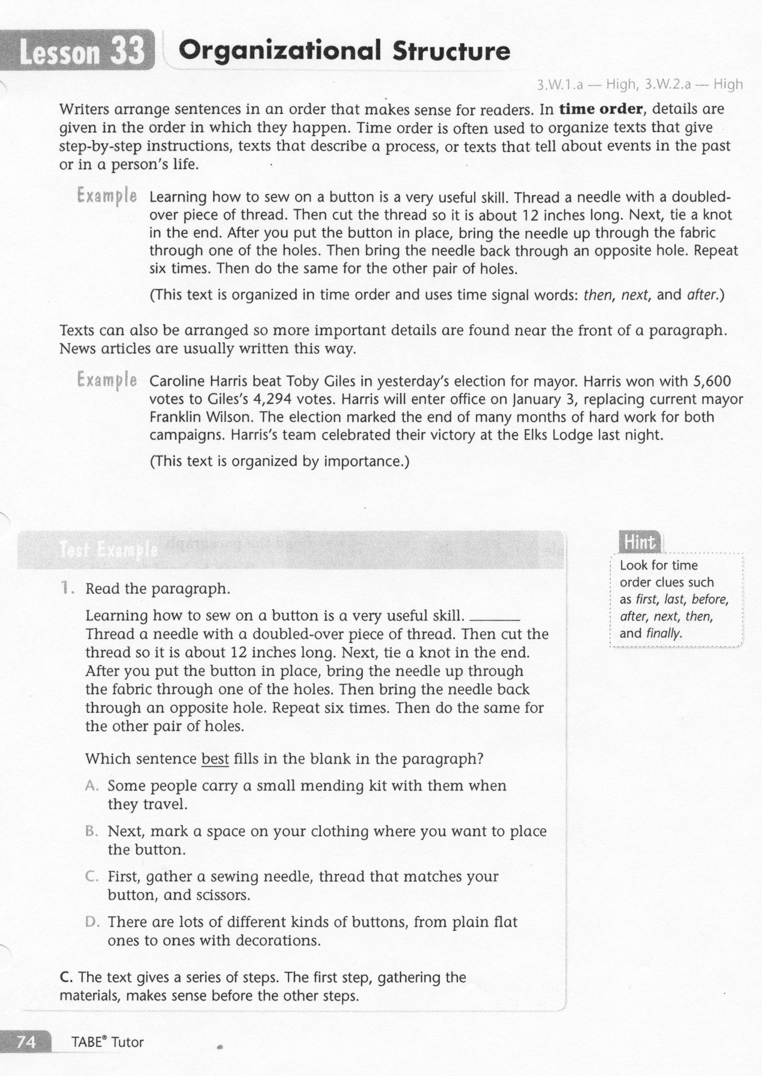
ELA-E-33 Organizational Structure

Slide 3
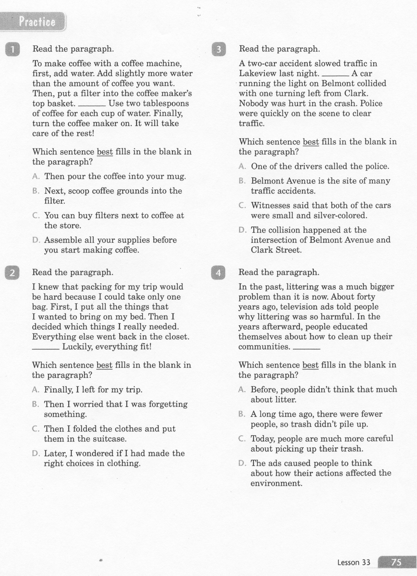
ELA-E-33 Organizational Structure

Slide 4
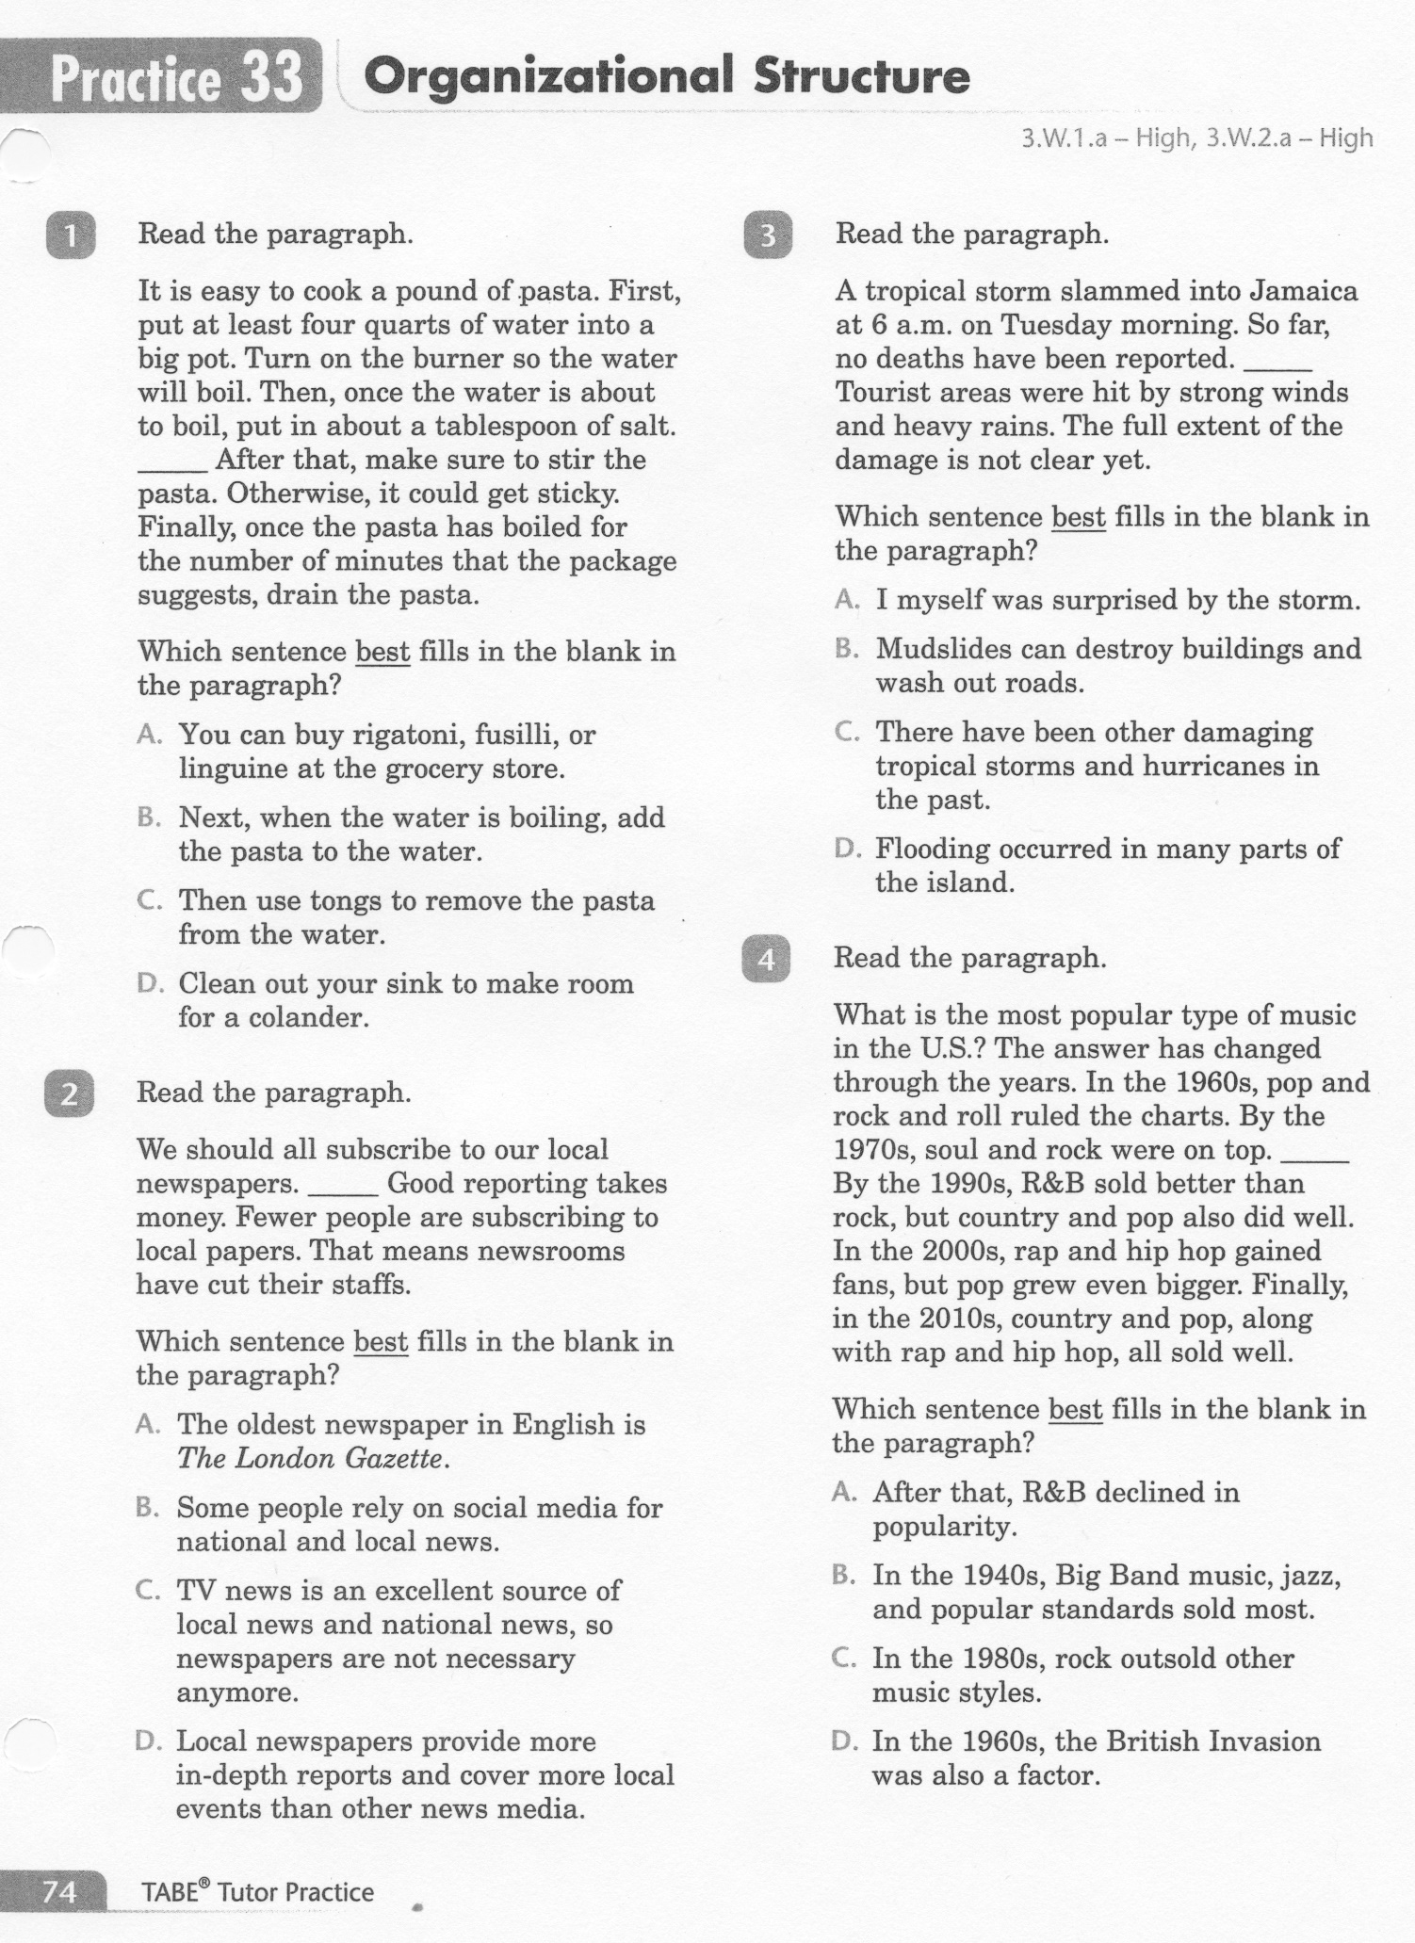
ELA-E-33 Organizational Structure

Slide 5
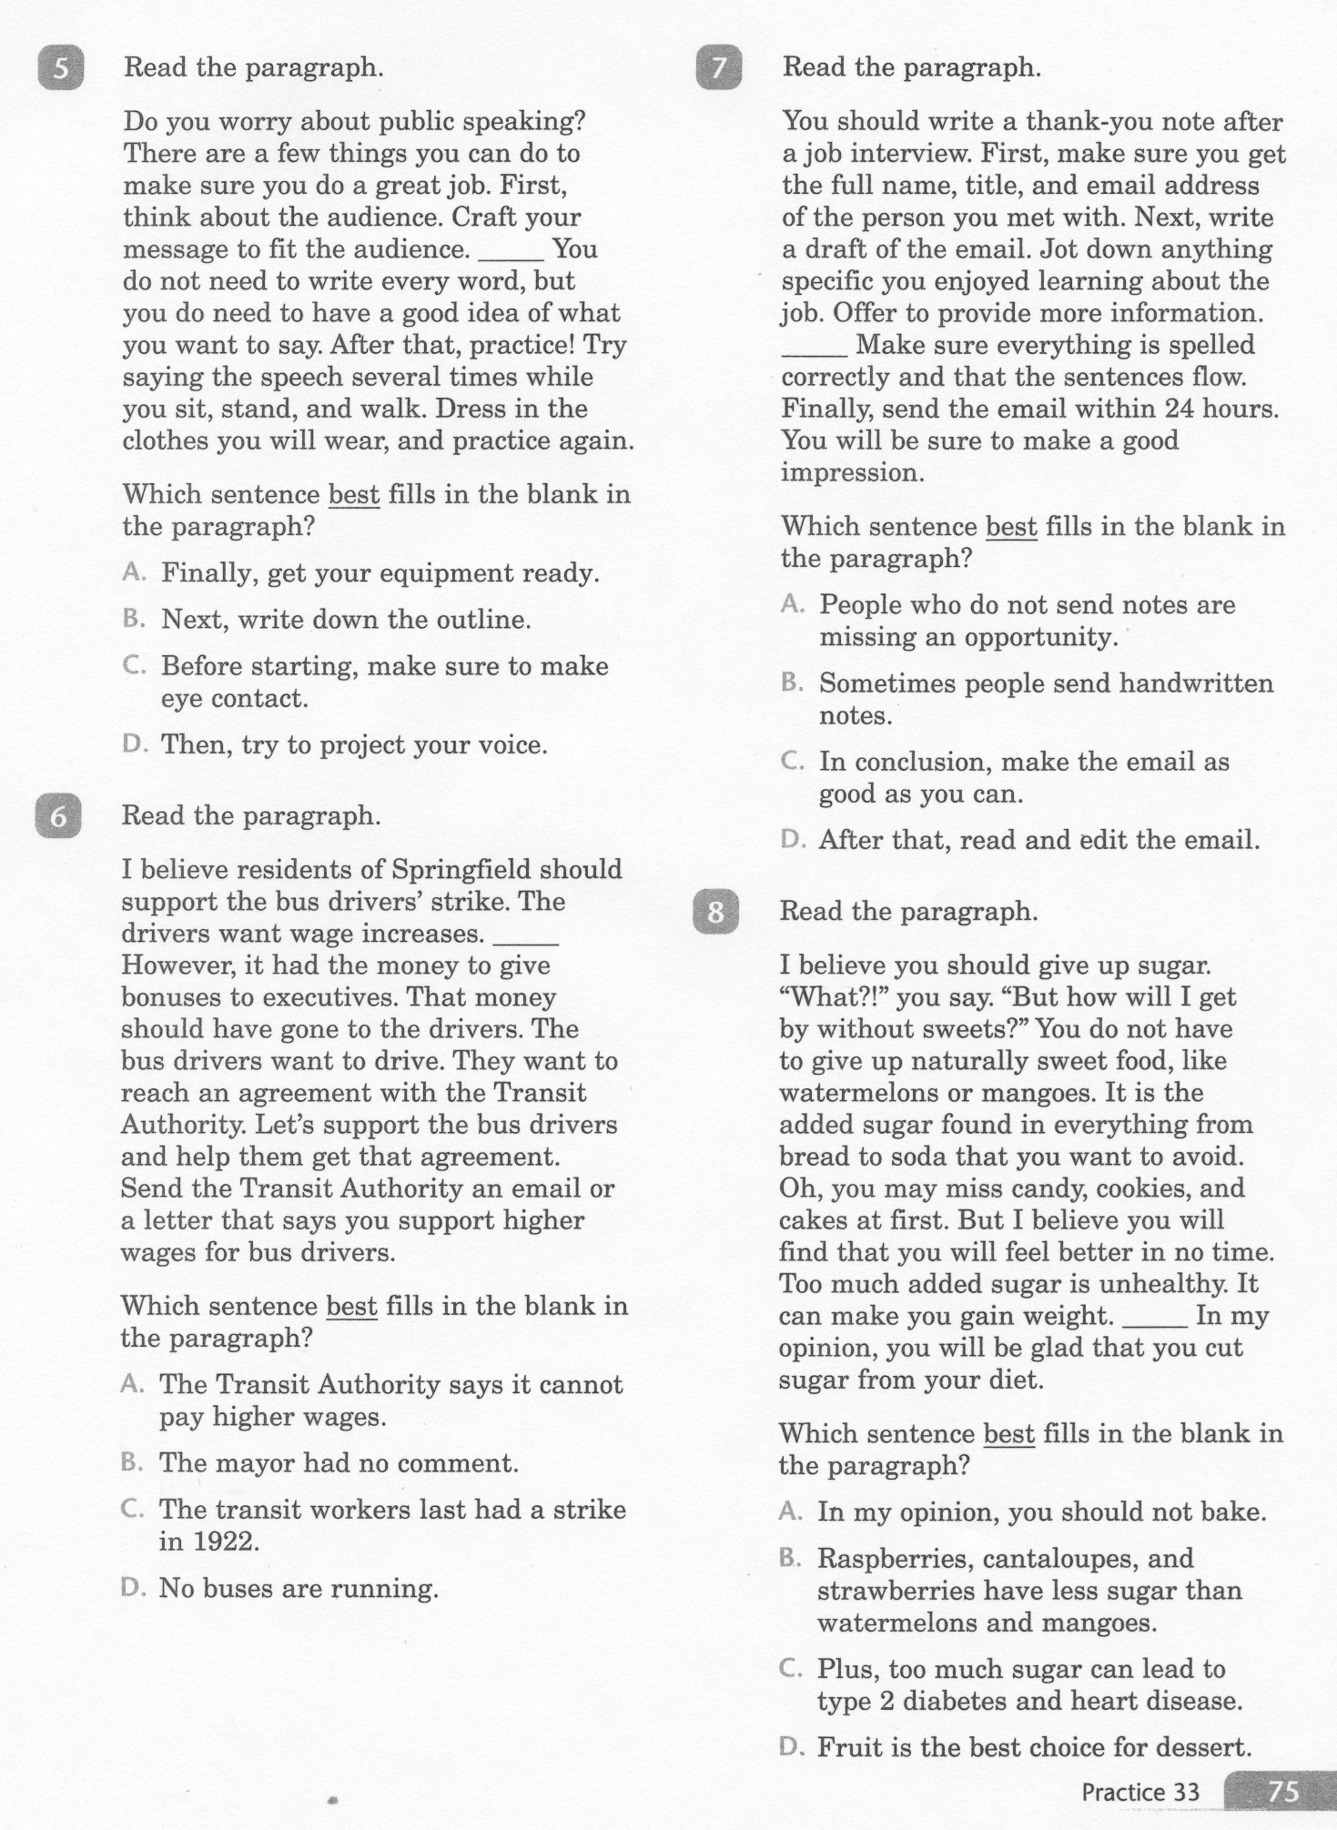
ELA-E-33 Organizational Structure

Slide 6
ELA-E-33 Organizational Structure

Slide 7
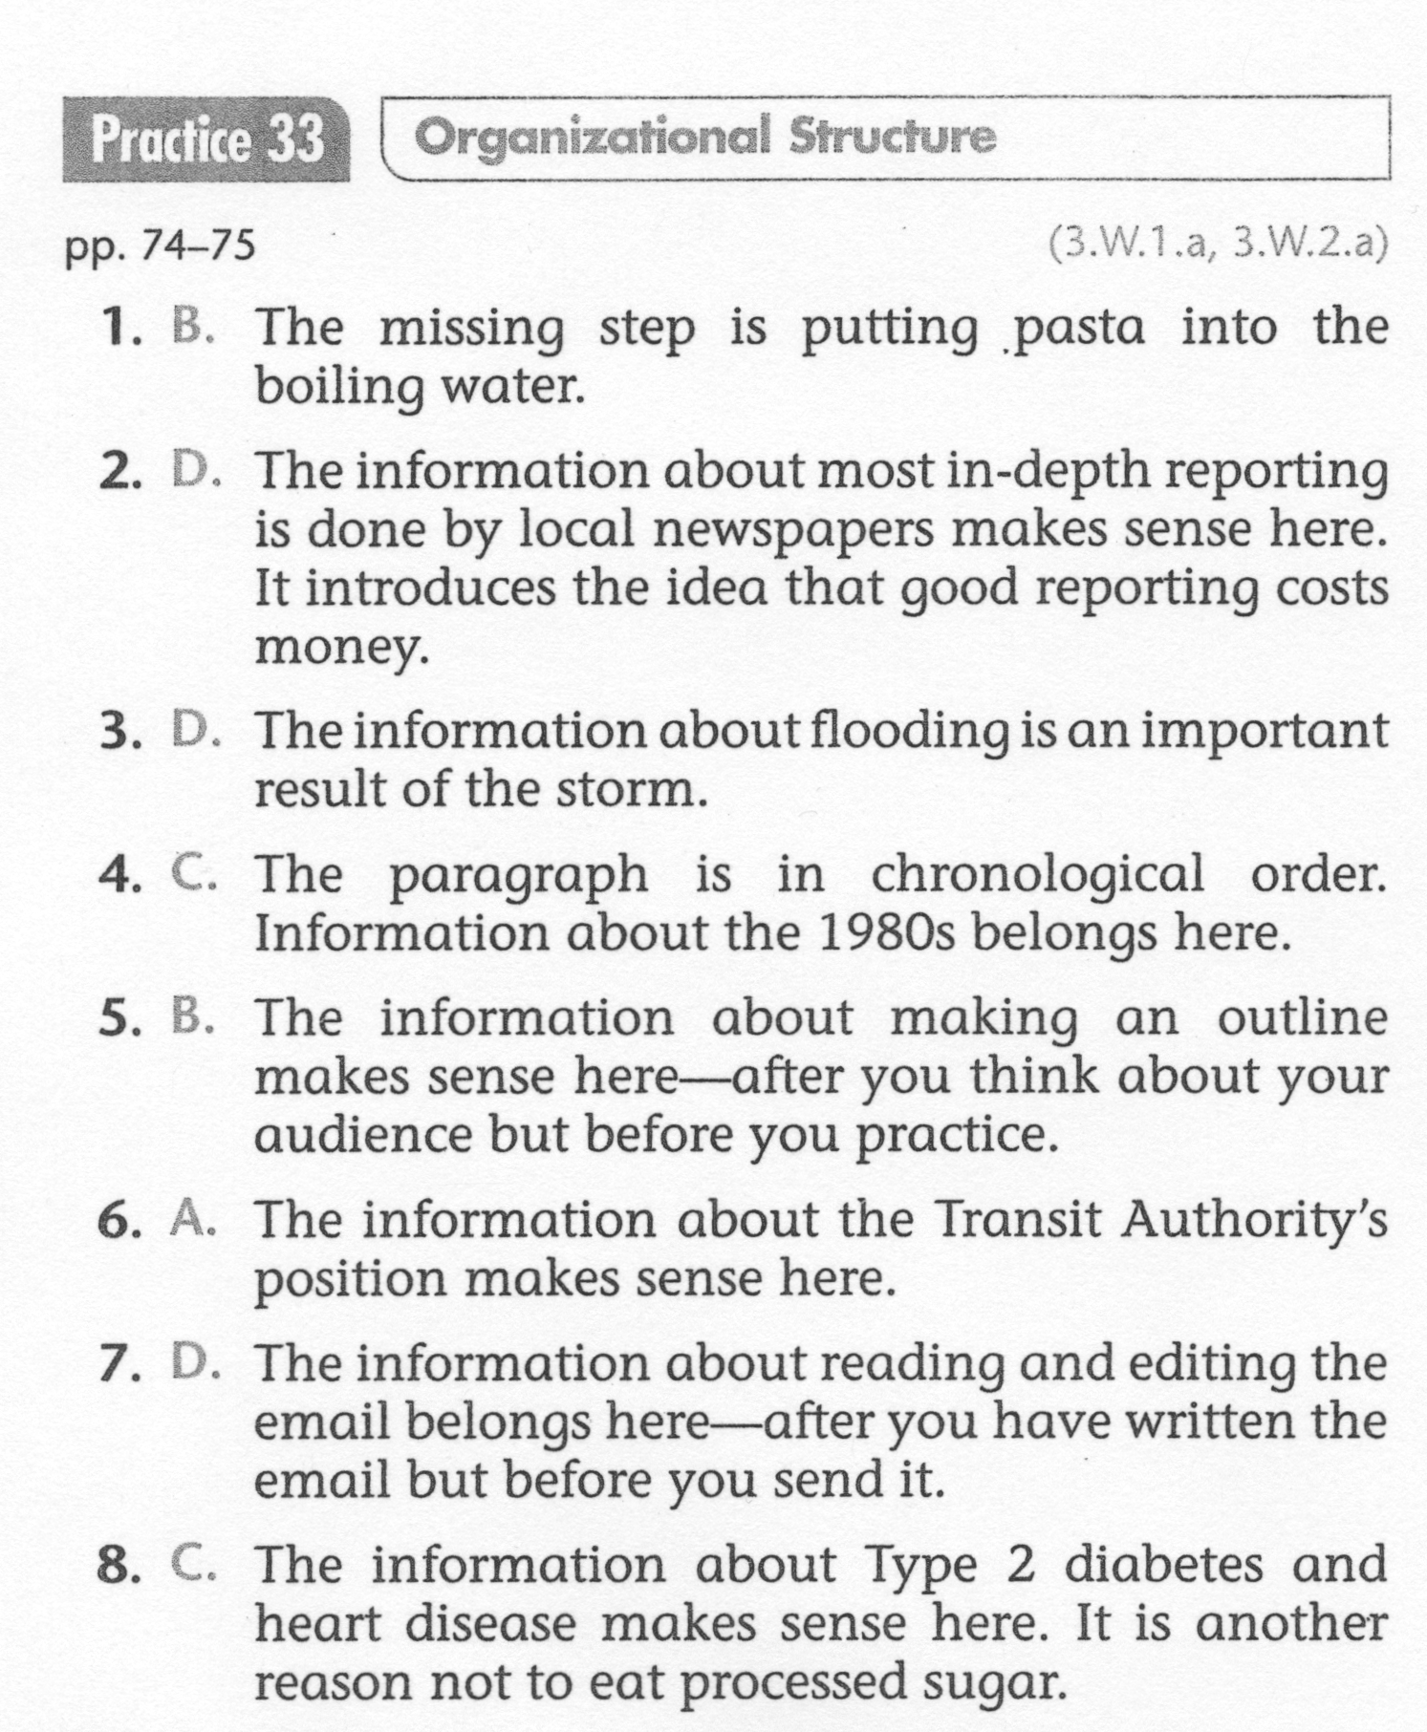
ELA-E-33 Organizational Structure

